Slide 1



INDONESIA’S EXPERIENCE REGARDS MANAGING PANDEMIC RISKS IN HEALTH FACILITIES POST COVID-19 AND BEYOND
UNDRR & WHO HQ Safe Hospital Webinar 4
Illustrations by Stories Freepik
PROF WIKU ADISASMITO
NATIONAL TASK FORCE OF COVID-19 MITIGATION

Slide 2




Update Daily COVID-19
14 April 2021
Active Cases
Daily New Cases
108.384
5.656
6,8%
Recovered Cases
Death Cases
1.431.892
42.906
Update Data: 14 April 2021
90,4%
2,7%
World: Active Cases 17,4% | Recovered Cases 80,4% | CFR 2,2%

Slide 3
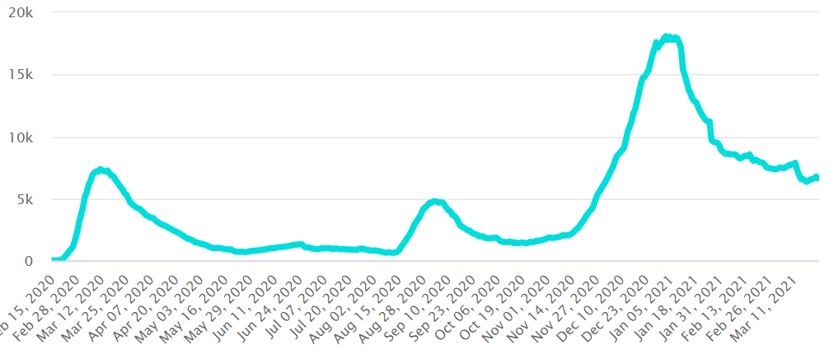
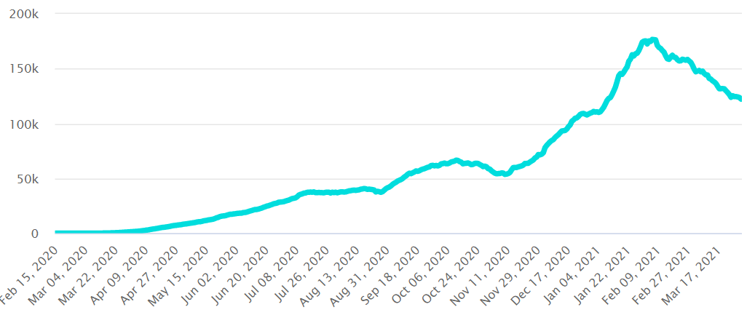

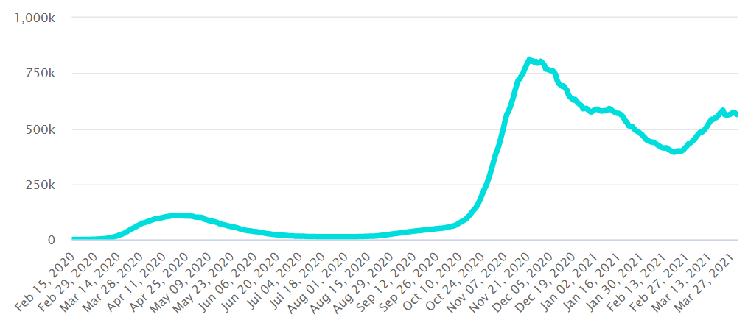


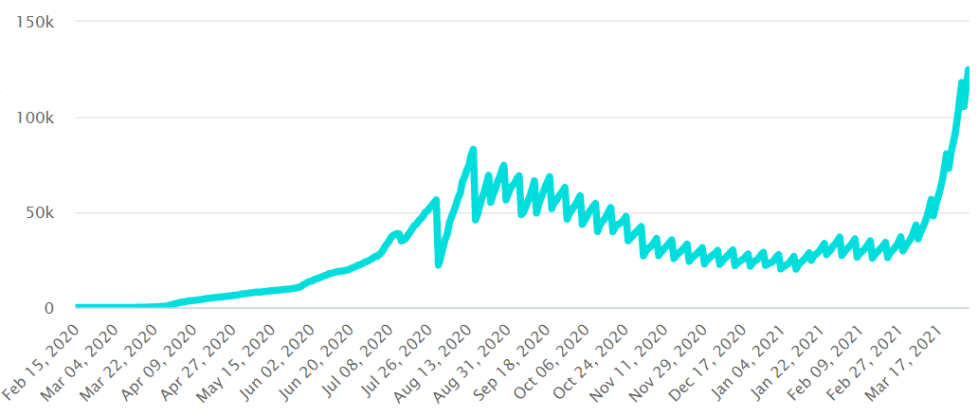
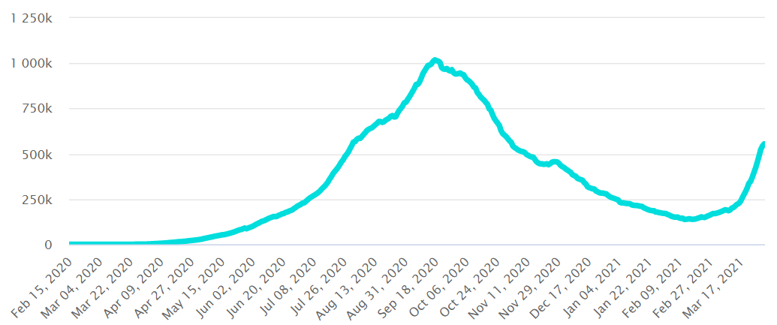


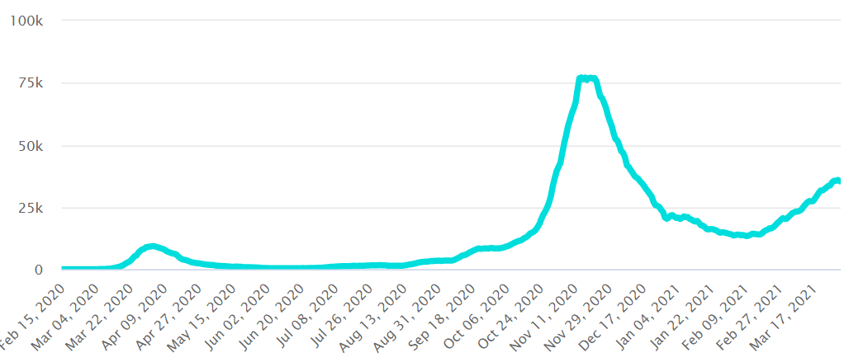
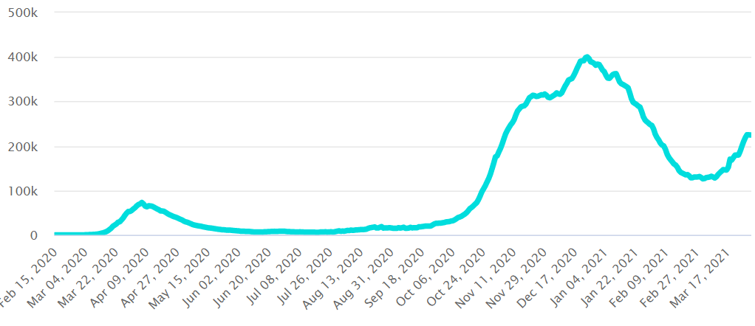


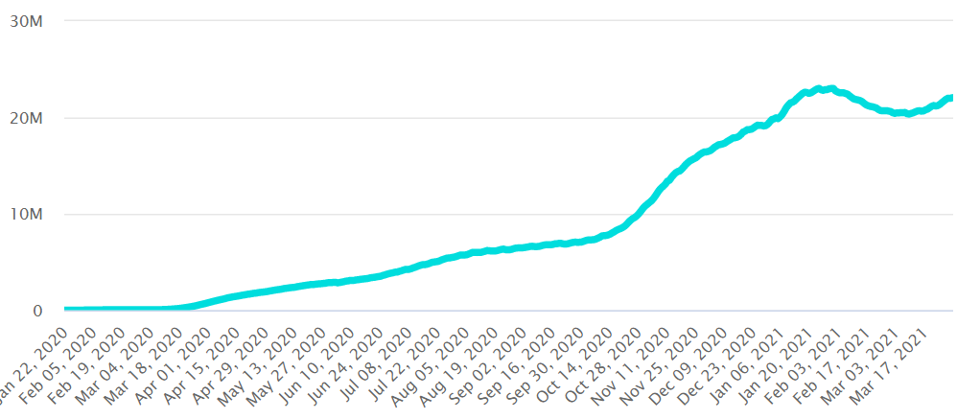

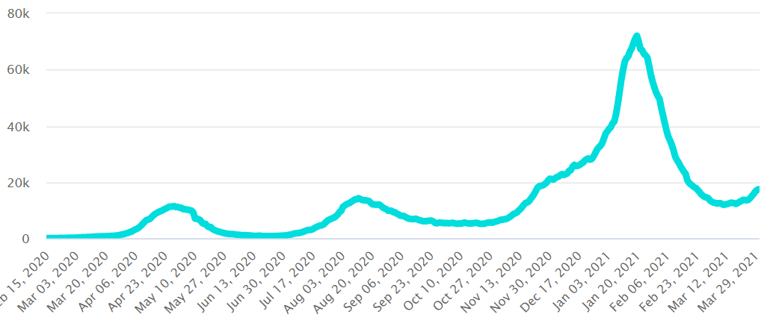
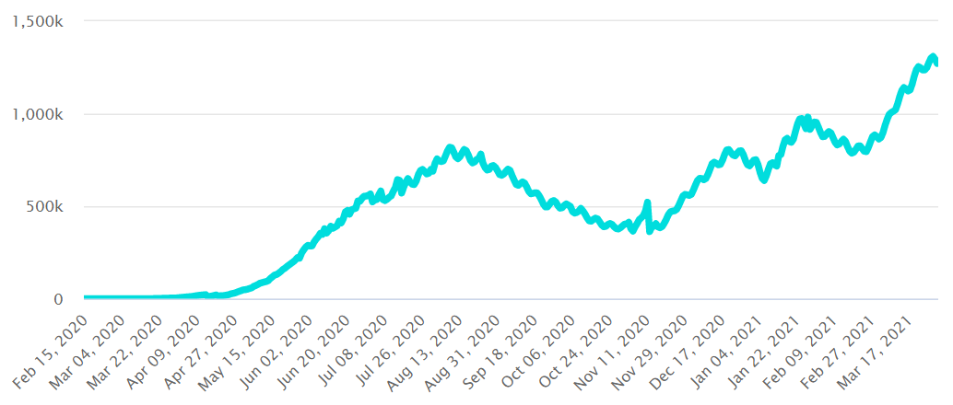


Comparation of Active Case
Indonesia and the World
KOREA SELATAN
6,9%
ITALIA
13,5%
INDONESIA 6,8%
FILIPINA
19,3%
INDIA
10,4%
AUSTRIA
5.03%
JERMAN
8,1%
DUNIA
17,4%
Update Data: 14 April 2021
JEPANG
6,1%
BRAZIL
8,3%

Slide 4
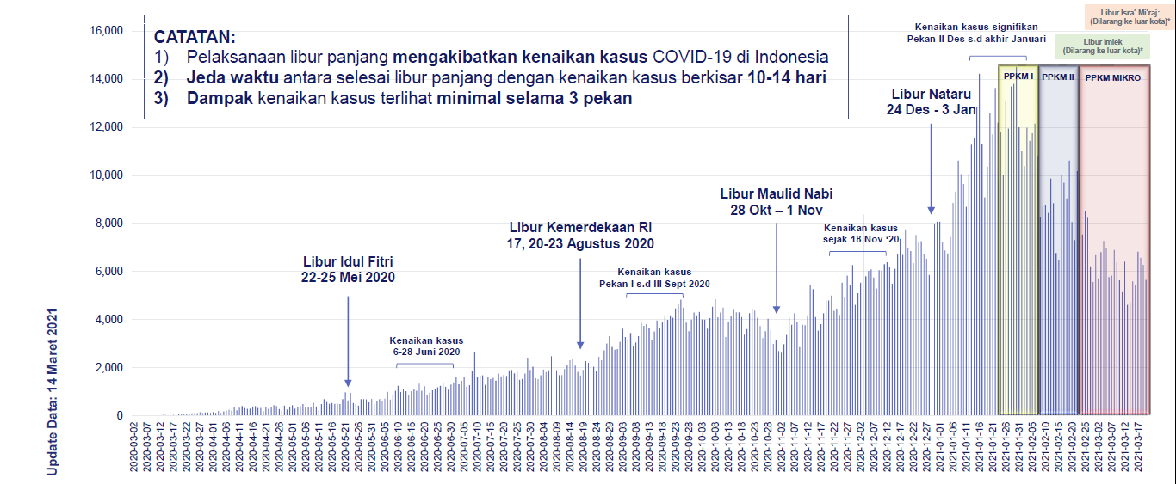
Lesson Learned: Trend after Long Holidays
Update Data: 19 Maret 2021
INDIKATOR
Kenaikan rerata jumlah kasus harian
Kenaikan %kematian mingguan
% Orang dalam Pemantauan Protkes
LIBUR IDUL FITRI
68 - 93%
28 - 66%
LIBUR AGUSTUS
58 - 119%
10 - 57%
LIBUR OKTOBER
37 - 95%
13 - 75%
Tempat Wisata: +92.02% Mall: +23.45% ||Resto : +39.66%
LIBUR NATARU
37 - 78%
6 - 46%
Tempat Wisata: +34.21 sd 161.7% Mall: -13.92% || Resto : -13.22%

Slide 5








INDONESIA’S COVID-19 MITIGATION FOCUS
CURATIVE
PREVENTION & PROMOTION
KURATIF
Health promotion through social media and mass media
Community-based health approach
Monitoring of behaviour change
Health Measures
764 COVID-19 Laboratory
920 COVID-19 Hospital
Emergency and Field Hospital Development
Funding
Central govt high allocation on social, industrial, and economy recovery
Local govt allocation (healthcare, economy impact, social safety net provider)
Allocation on health promotion
Rp.
Strategy
Active surveillance
Public health measures (Nutrition, environment, MCH, psychology)
Micro-scale COVID-19 control through COVID-19 Desa/Kelurahan Command Post
PPE, mask, diagnostic and screening kits, medicine (machinery and reagents)
Sumber:
https://kemenkeu.go.id/covid19
Economical, Effective, Efficient, Sustainable
Expensive, High-Tech, Fast
Catatan:
per tanggal 9 November 2020
@Tim PakarSatuanTugas

Slide 6






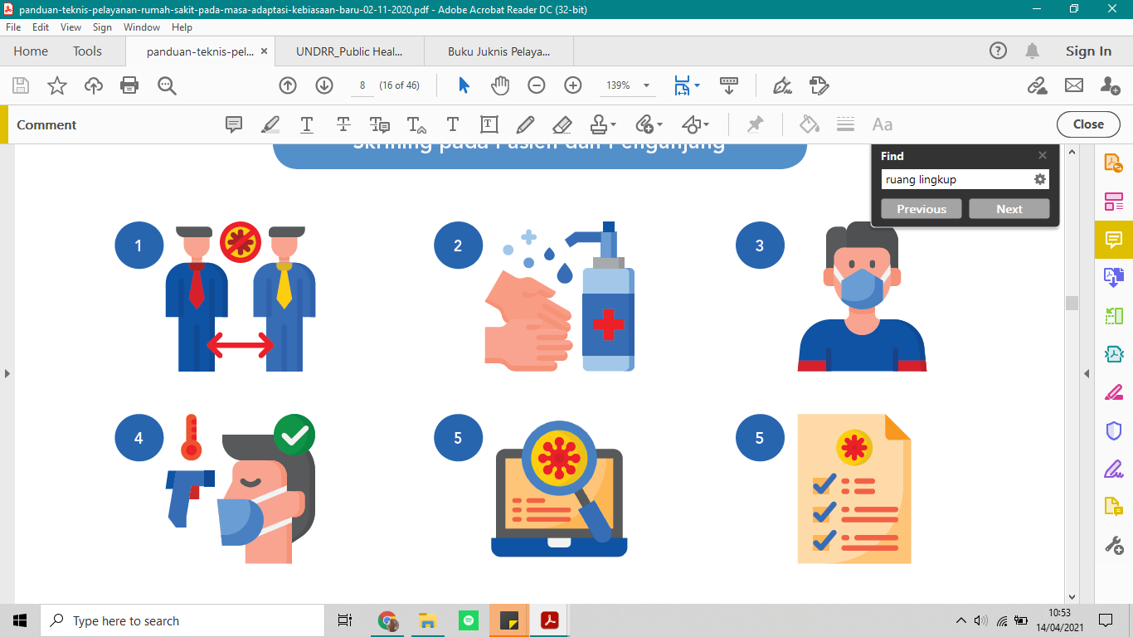
Indonesia’s MoH Technical Guidance on Hospital Services during New Normal:
Future of Hospital and Healthcare Facilities during Pandemic and Beyond
1
Improving Healthcare Service Flow
2
Innovation on Health Service System
Improving Patient Flow
Online Registration
Online Registration
Telemedicine
Electronic Meds Prescription
Meds Delivery
Patient Referral from Primary Level Healthcare Facilities (FKTP/FKRTL)
3
Screening
Zonation of COVID-19 Transmission Risk Area
S
C
R
E
E
N
I
N
G
Emergency Outpatient Area
COVID-19
Zone
COVID-19 Triage
Mortuary
Emergency Inpatient Area
COVID-19 quick assessment to define whether the patient is a COVID-19 suspect or not
Emergency Area
Donning/Doffing Area
Waste Management Area
Triage
Non-COVID-19 Triage
Operational Support Area
Identifying COVID-19 risk degree on a patient
Non COVID-19
Zone
Inpatient Area
Emergency Area
Healthofficer changing rooms
Administration & Management Area
Outpatient Area
Laundry
Notes:
Improving Healthcare Service Flow
Patient Flow → online registration, referral from primary level healthcare facilities
Screening → patients, visitors, health officers
Triage → patient’s COVID-19 risk degree indetification
Classification of COVID-19 Transmission Risk Zonation
COVID-19 zone
Non COVID-19 zone
Infection Prevention and Control
Enhancing 3M practices
Health Service System Innovation Development
Online registration
Telemedicine
E-medical prescription, meds delivery
Referral System Strengthening

Slide 7

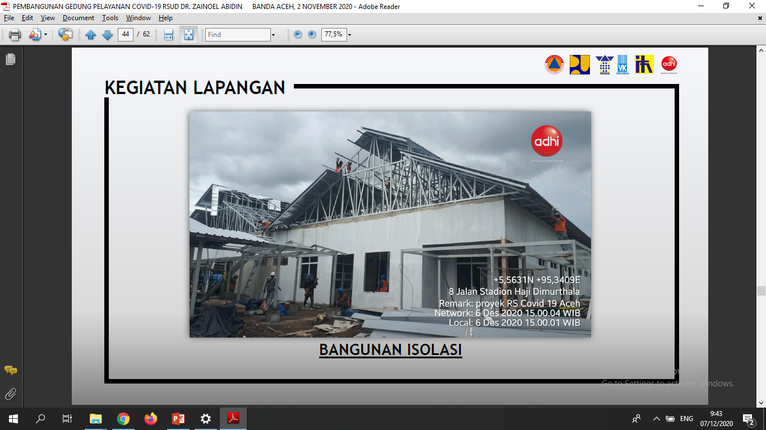
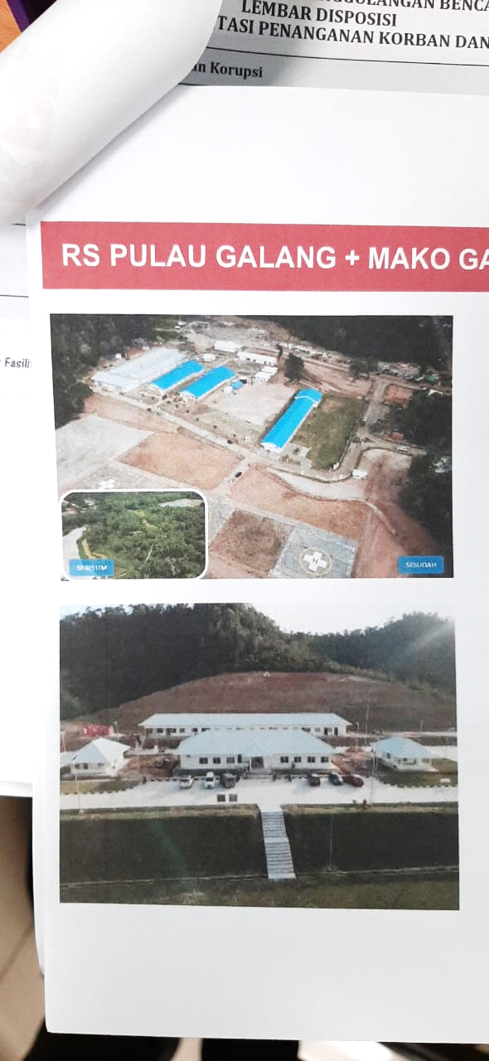
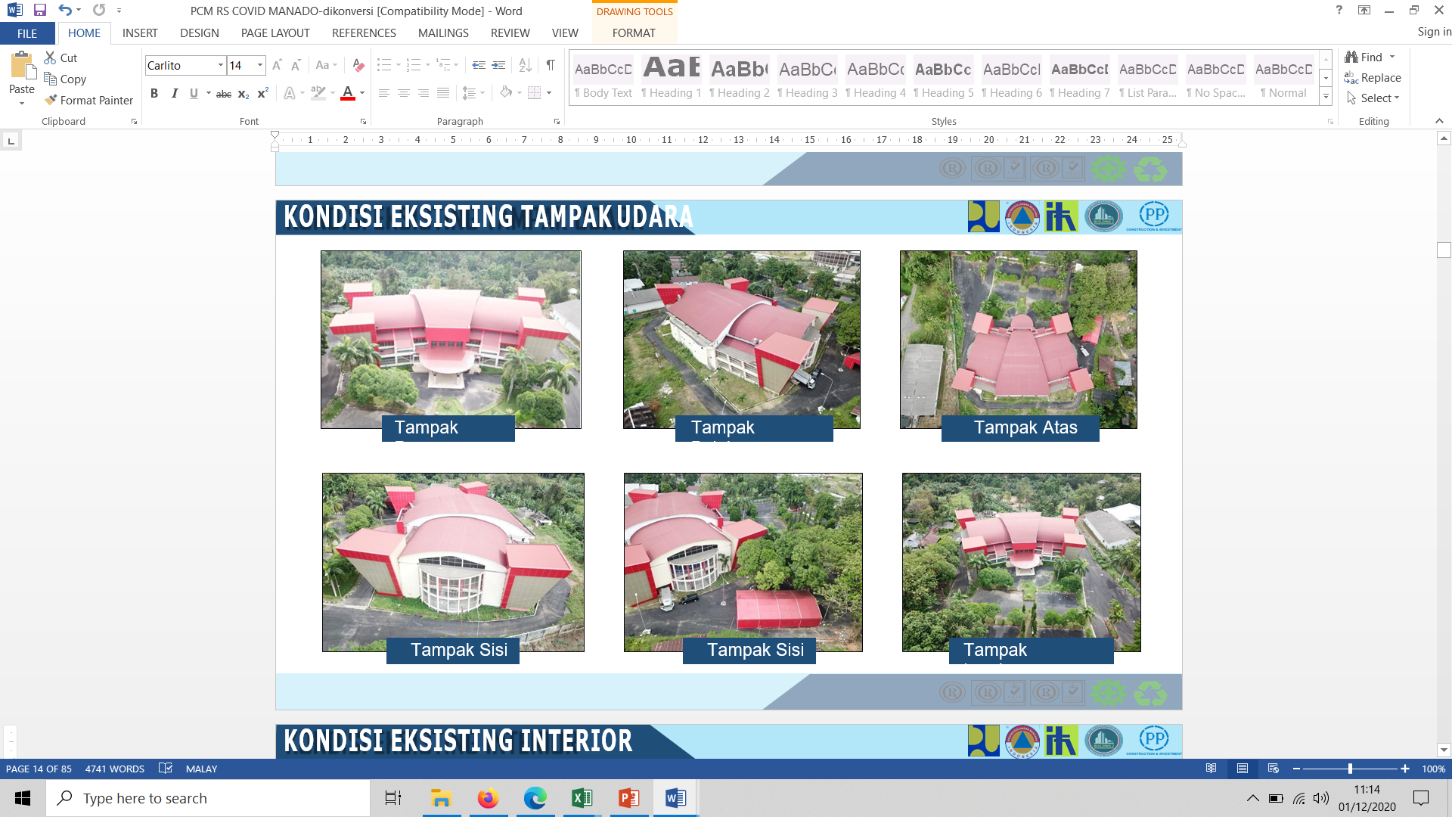

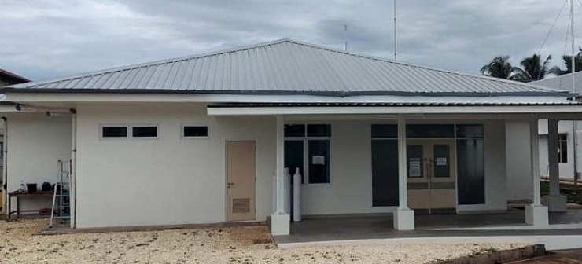
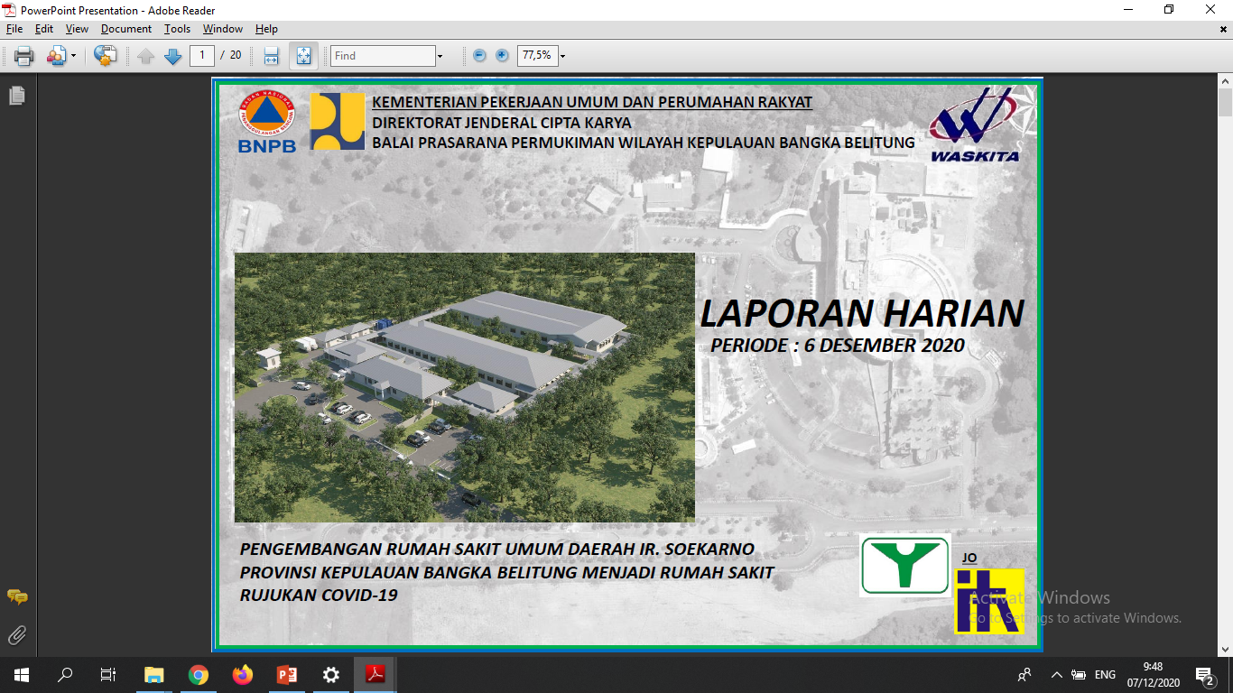
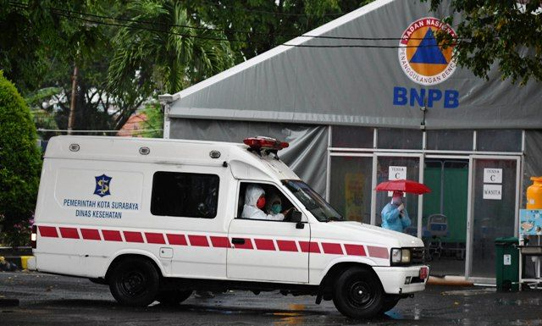
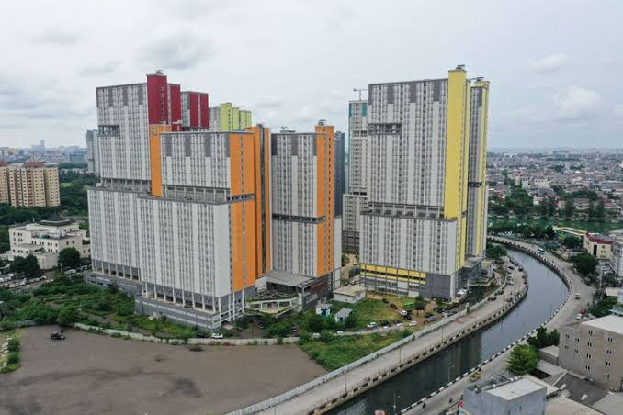
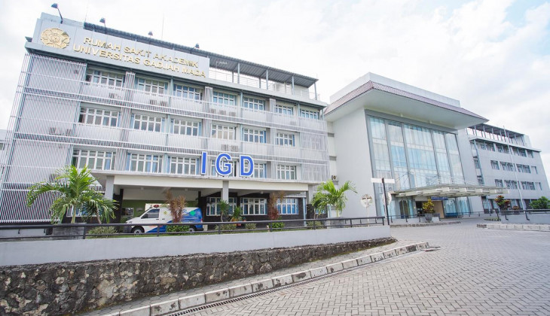

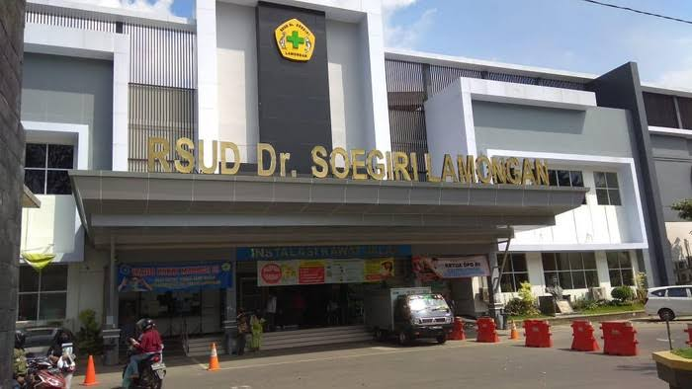
Referral Hospital, Field Hospital, and Regional Public Hospital Development
in Indonesia’s COVID-19 Mitigation Acceleration
4
Strengthening Referral System
ZAINOEL ABIDIN HOSPITAL
EMERGENCY HOSPITAL
GALANG ISLAND
EMERGENCY HOSPITAL
KITAWAYA MANADO
BIAK REGIONAL PUBLIC HOSPITAL
Ir. SOEKARNO HOSPITAL
INDRAPURA
FIELD HOSPITAL
WISMA ATLET KEMAYORAN
EMERGENCY HOSPITAL
GADJAH MADA UNIVERSITY ACADEMIC HOSPITAL
TOTAL
dr. SOEGIRI HOSPITAL
Note :
>12,250
ICU, HCU, and Isolation Beds
>10,964
Hotel Rooms for Isolation
Hospital Development into COVID-19 Referral Hospital

Slide 8
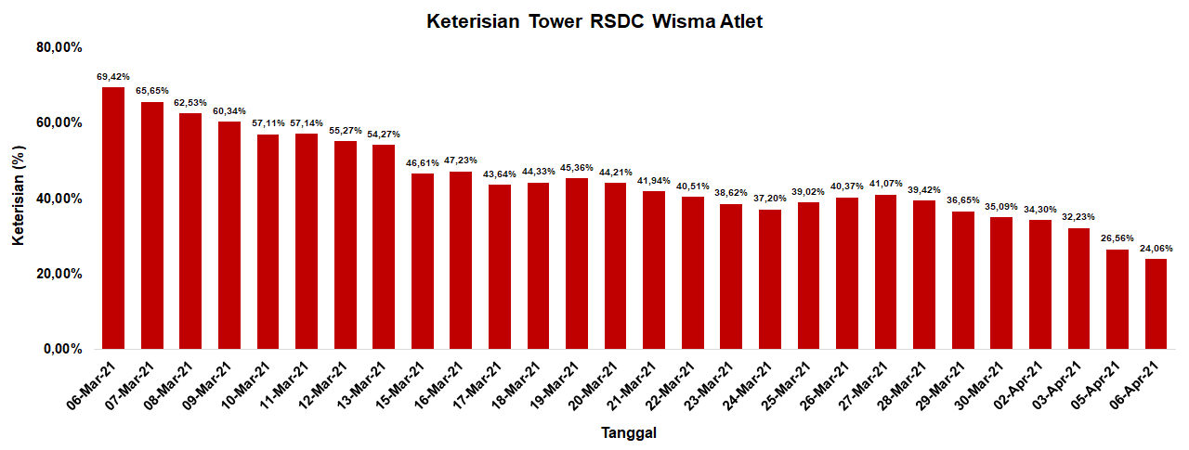
WISMA ATLET KEMAYORAN EMERGENCY HOSPITAL
BED OCCUPANCY RATIO UPDATE
6 March 2021
6 April 2021
69.42%
24.06%
BOR Difference
in the last 1 month
-45.36%
BOR (%)
Note : Data shown are BOR from Tower 4,5,6, and 7

Slide 9
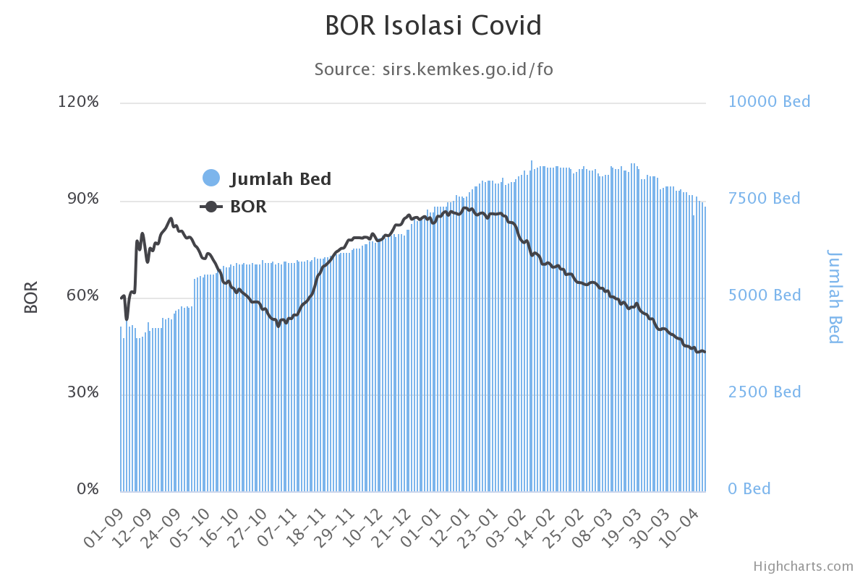
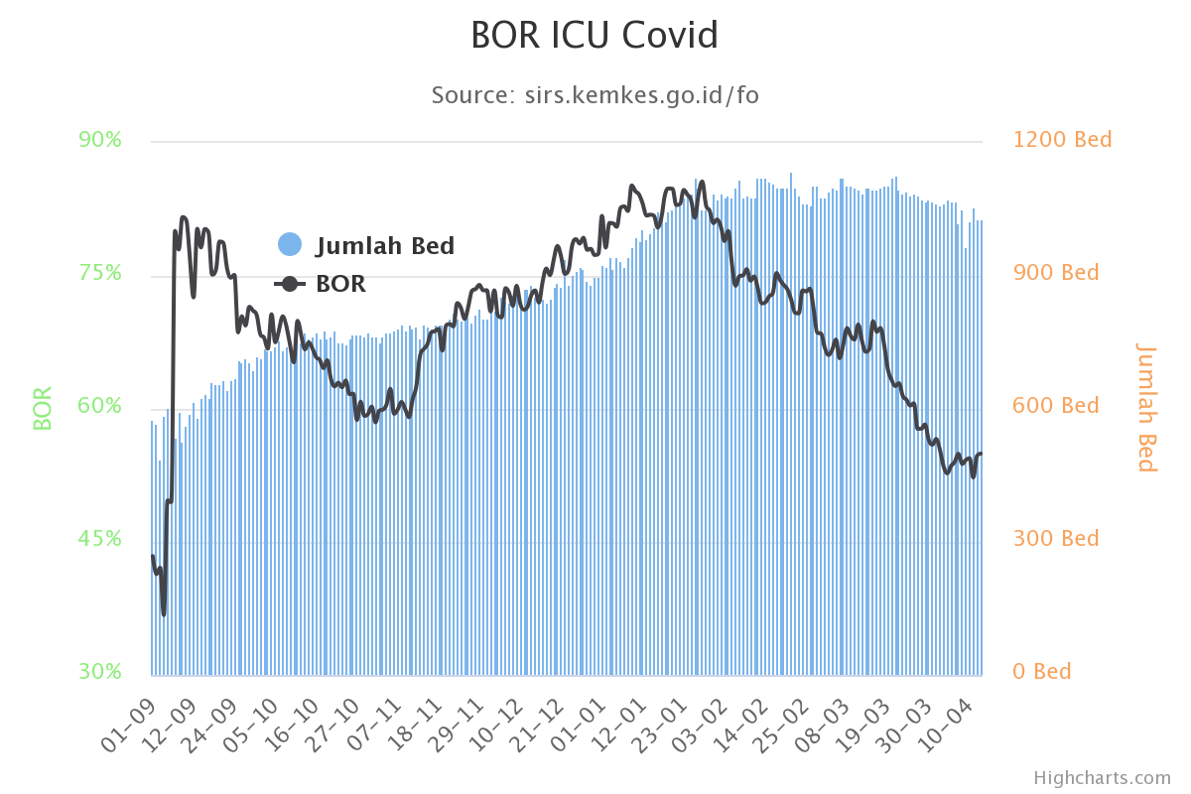
BED OCCUPANCY RATIO OF COVID-19 REFERRAL HOSPITAL
IN DKI JAKARTA
COVID-19 Isolation BOR
COVID-19 ICU BOR
Isolation BOR 13 April 2021
ICU BOR 13 April 2021
Availability : 7.398
Occupied : 3.197
Availability : 1.028
Occupied : 565
BOR: 43,21%
BOR: 54,96%

Slide 10
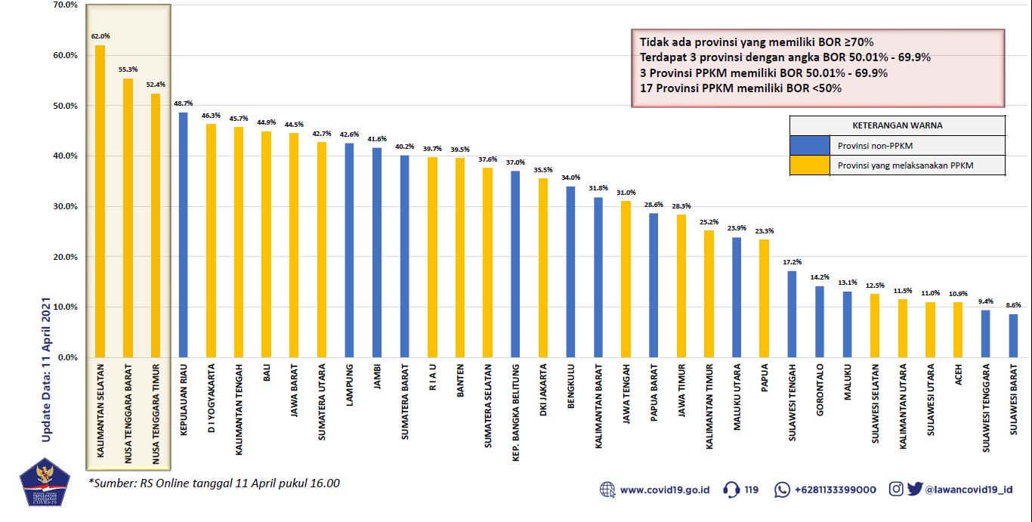
BED OCCUPANCY RATIO OF COVID-19 REFERRAL HOSPITAL
IN 34 PROVINCES
No Province with BOR >=70%
3 Provinces with BOR 50.0 - 69.9%
17 Provinces with BOR <50%
Non -PPKM
PPKM

Slide 11
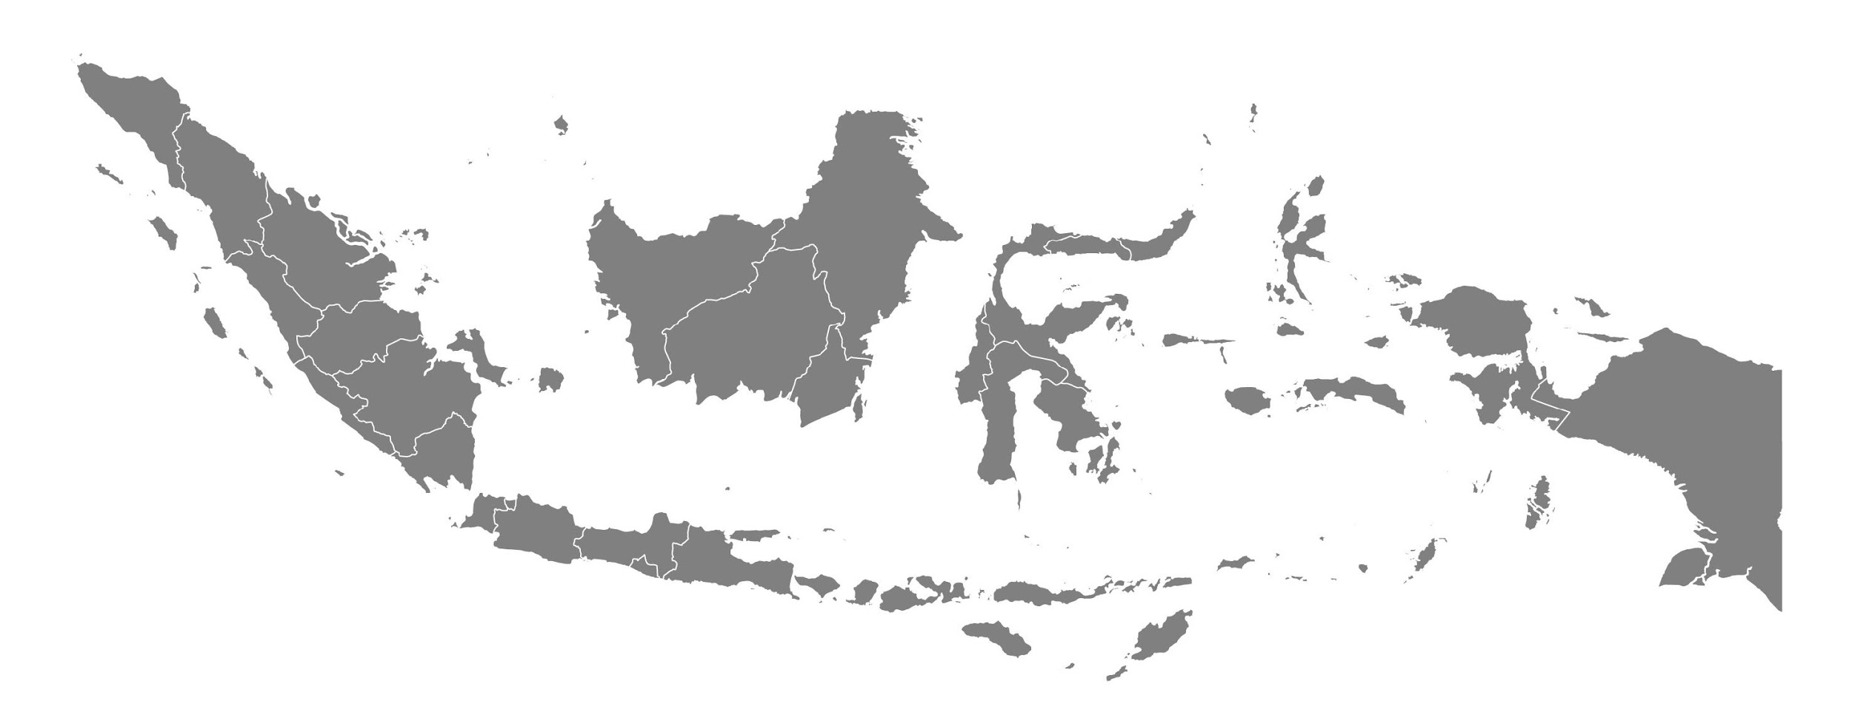
Development of Laboratory Network for COVID-19 in Indonesia
Mar ‘21
Apr ‘21
721
764
Jan ‘21
Feb ‘21
613
685
Nov ‘20
Dec ‘20
Sept ‘20
Oct ‘20
496
570
July ‘20
Aug ‘20
354
422
Across
May ‘20
June ‘20
278
322
34
Provinces
Mar ‘20
Apr ‘20
177
269
1
46
TOTAL SPECIMENS EXAMINED
TOTAL CASES EXAMINED
CUMMULATIVE POSITIVITY RATE
13,412,303
2,711,030
11,7%
HIGHEST DAILY SPECIMEN EXAMINATION
HIGHEST DAILY EXAMINATION
88,821
71,814
Source: Health Research and Development Body, Ministry of Health

Slide 12

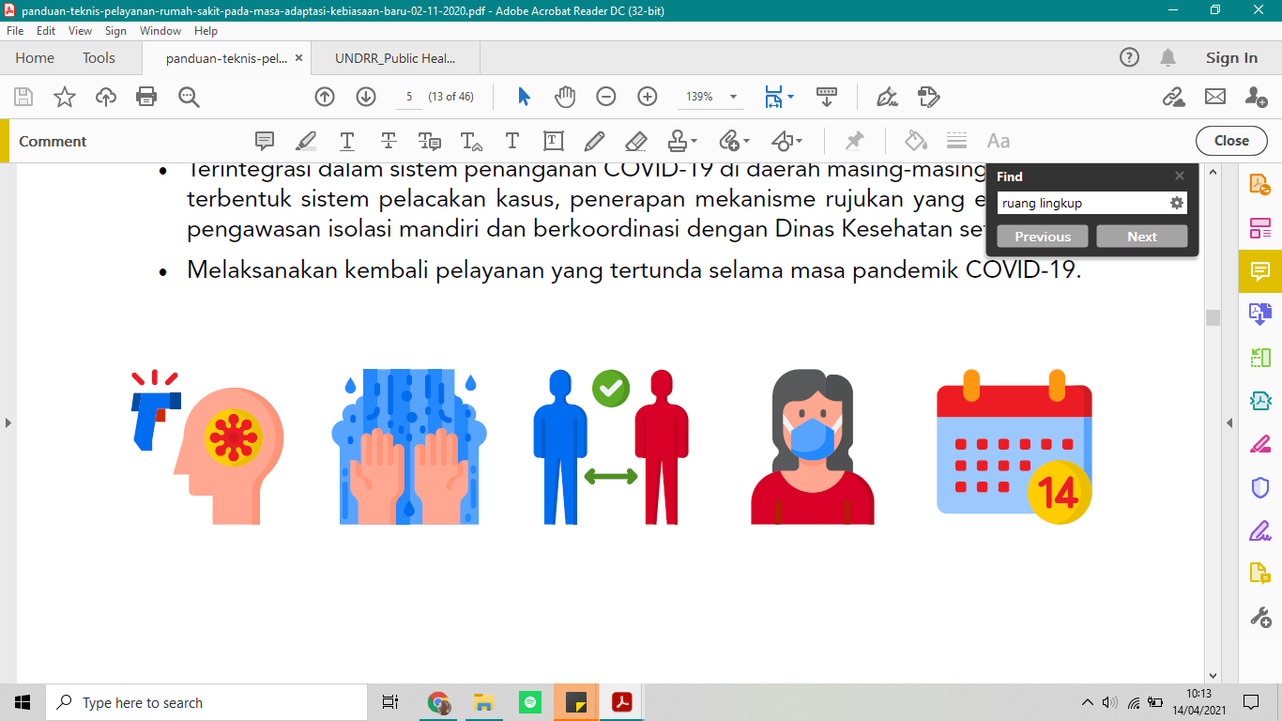
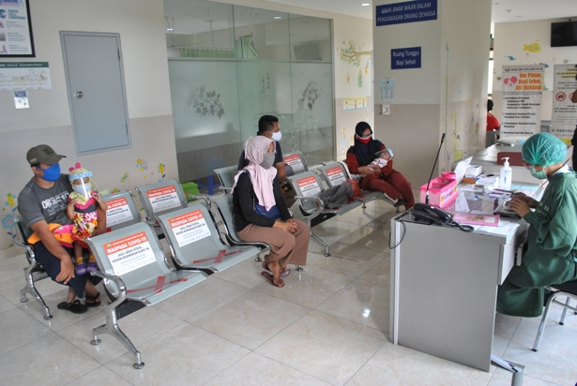
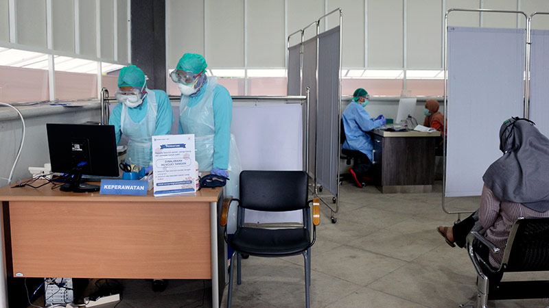
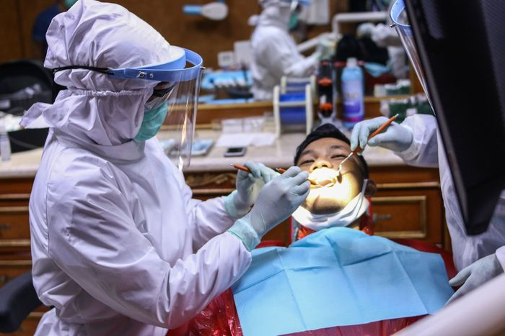
Future of Hospital and Healthcare Facilities during Pandemic and Beyond
Enhancing
Infection Prevention and Control
through
3M Practices in Healthcare Facilities
Wear Mask/ppe
physica l distancing
Wash hands often
“What does Indonesia’s Healthcare Facilities look like right now..?”

