Slide 1
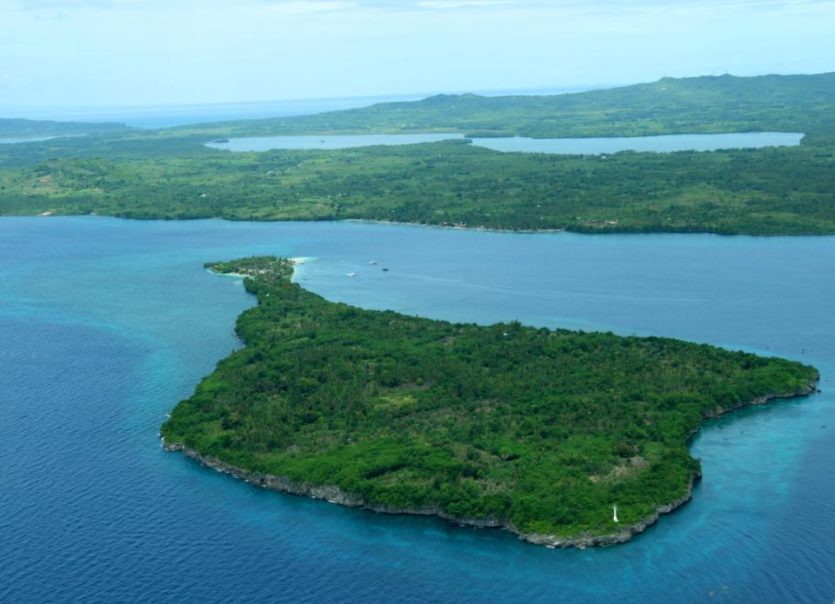
THINK BIG! STARTS SMALL
AN ISLAND’S SOLUTION IN REDUCING RISK
SANFRAN, CAMOTES, CEBU, PHILIPPINES
BY: VICE MAYOR ALFREDO A. ARQUILLANO, JR

Slide 2
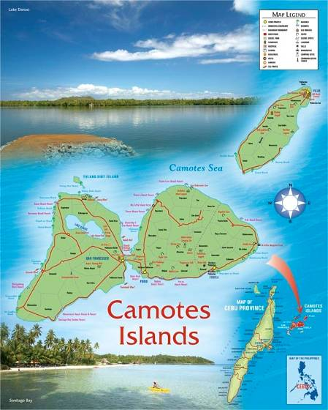
BRIEF PROFILE OF OUR MUNICIPALITY
3rd Class Municipality
LAND AREA
  10, 597 hectares
NO. OF BARANGAY
  15 – fully energized
  with 120 functional Puroks
POPULATION
  44, 588 – 2007 Census
AREA OF LAKE DANAO
  649 hectares
VAST WHITE SAND BEACHES
LIVELIHOOD
  Farming
  Fishing
  Cottage Industries
    Soli – Soli Weaving
    Bamboo Strips Weaving

Slide 3
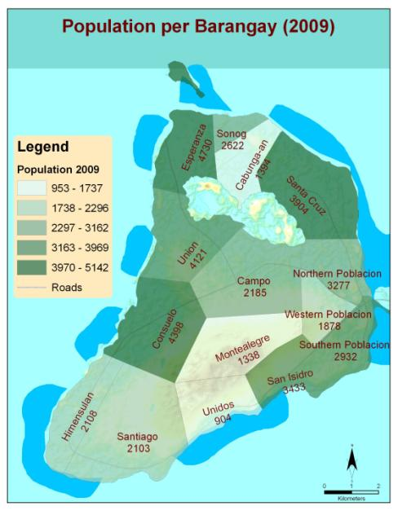
Sanfran Population

Slide 4
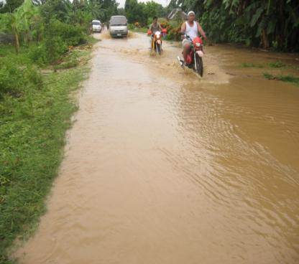
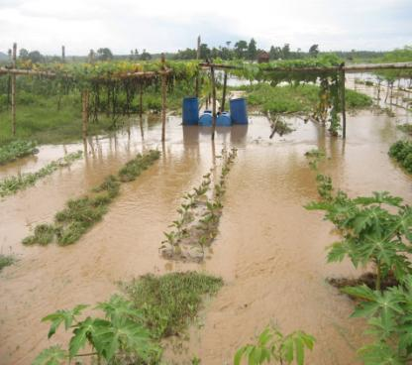
Municipal Hazards
FLOOD AT WESTERN POBLACION, SAN FRANCISCO, CEBU PHILIPPINES 8-11-2010

Slide 5
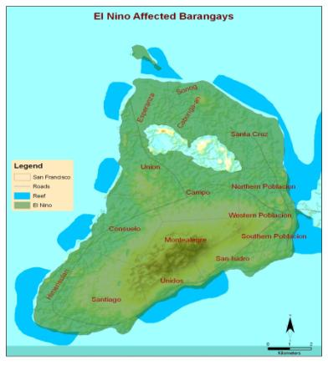
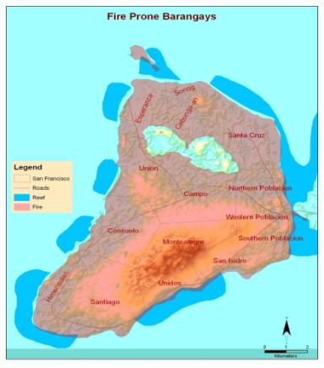
El Nino & Fire Affected Barangays

Slide 6
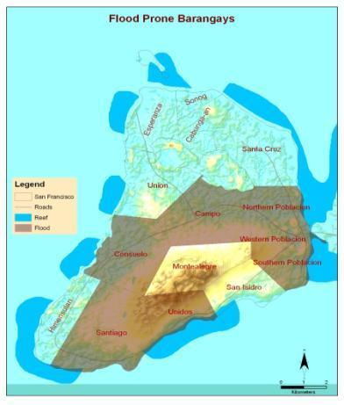
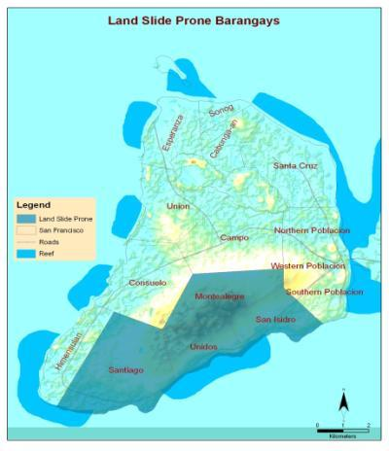
Flood & Land Slide Prone Barangays

Slide 7
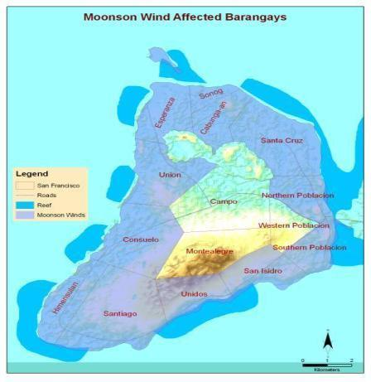
Monsoon Wind Affected Barangays

Slide 8
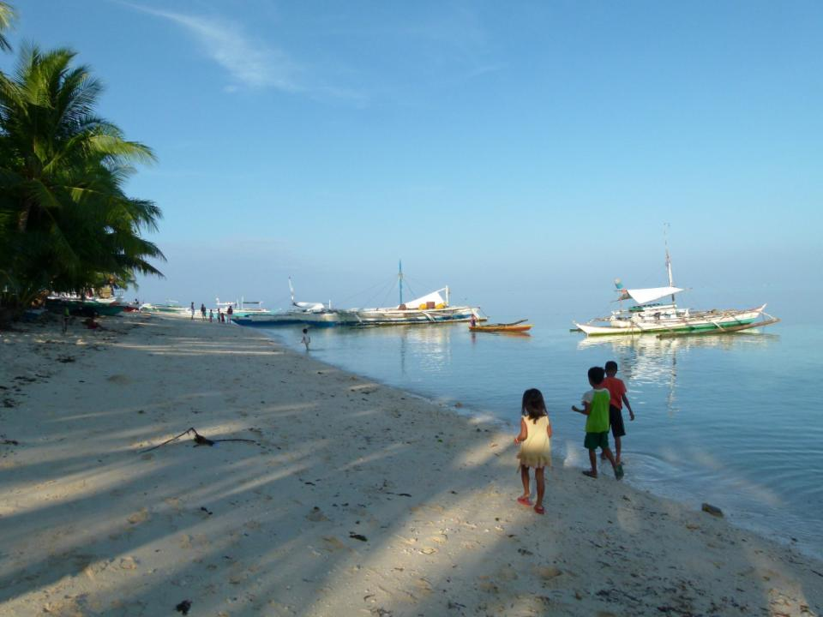
HOW SANFRAN PREPARE THE TOWN TO BECOME RESILIENT
HOW SANFRAN
PREPARE TO BECOME RESILIENT

Slide 9
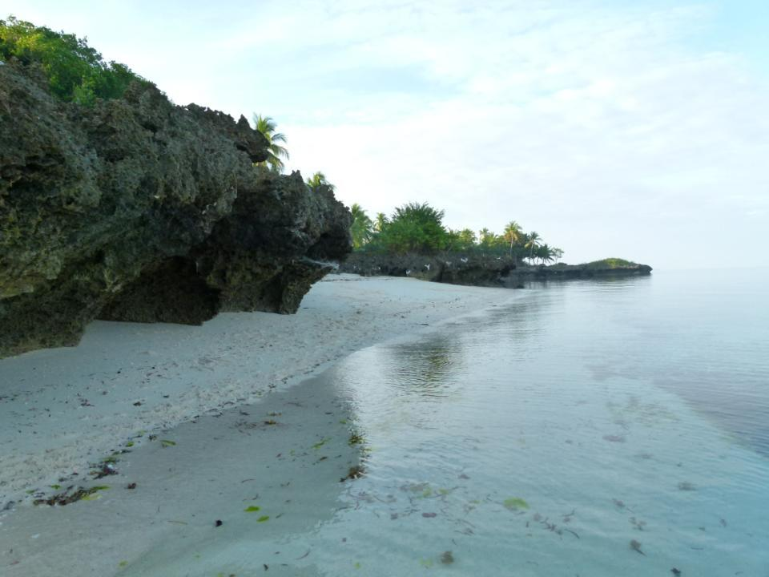
COMMUNITY ORGANIZING AND EMPOWERMENT
THRU PUROK SYSTEM APPROACH
(Essential 1)
COMMUNITY ORGANIZING & EMPOWERMENT THRU PUROK SYSTEM APPROACH

Slide 10
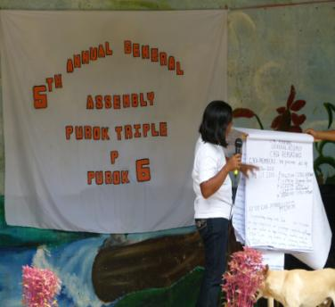
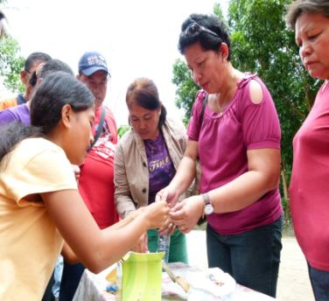
The Purok System
Resilience built by communities

Slide 11
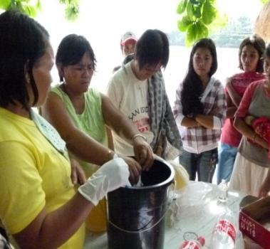
Why a Purok system?
In the Philippines, the smallest governing unit is called a barangay (village).
Each barangay consists of several puroks or sub-villages.
The purok system builds an existing indigenous social organization for mobilizing local resources in creating local and practical solutions to address community needs

Slide 12
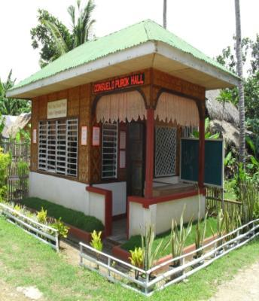
The Purok system: a unique innovation
A Purok System is a micro structure of the barangay unit bringing effective governance at the sub-village level, a one-of-a kind innovation seen only in San Francisco
The Purok System showcases its Capital Build Up (CBU) program that empowers communities at the purok level by allowing local initiatives to flourish.
The Bayanihan (community cooperation) is the backbone of the purok system

Slide 13
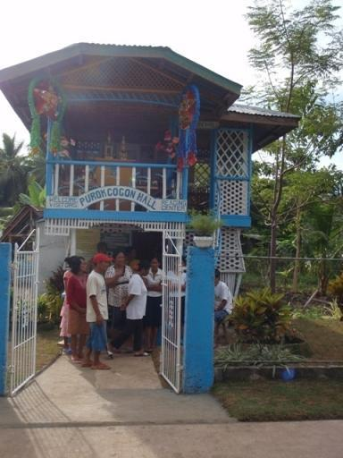
THE PUROK HALL: An Example
built by the Purokhanons through the CBU program.
constructed through the bayanihan spirit
For the maintenance, the barangay council counterpart P2,000 to the group to make sure that the purok hall will sustain

Slide 14
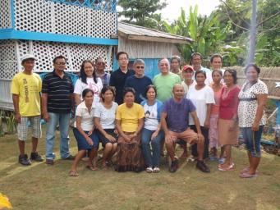
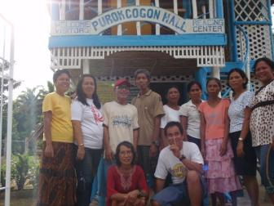
PUROK ORGANIZATIONAL STRUCTURE
NAME OF BARANGAY
BARANGAY CAPTAIN
BARANGAY HALL
NAME OF SITIO
BARANGAY KAGAWAD
PUROK HALL
NAME OF PUROK
PUROK PRESIDENT
SET OF OFFICERS
PUROK
KAGAWAD
COMMITTEE
ON
HEALTH &
NUTRITION
PUROK
KAGAWAD
COMMITTEE
ON
AGRICULTURE
& LIVELIHOOD
PUROK
KAGAWAD
COMMITTEE
ON
EDUC. &
SOLID WASTE
MNGT.
PUROK
KAGAWAD
COMMITTEE
ON PEACE & ORDER,
ENVIRONMENT,
DISASTER RISK
REDUCTION
PUROK
KAGAWAD
COMMITTEE
ON
TOURISM &
WOMEN/
CHILDREN
PUROK
KAGAWAD
COMMITTEE
ON
INFRASTRUCTURE
PUROK
KAGAWAD
COMMITTEE
ON
YOUTH &
SPORTS
DEV’T
PUROK
KAGAWAD
COMMITTEE
ON
FINANCE,
BUDGET&
APPROPRIATION

Slide 15
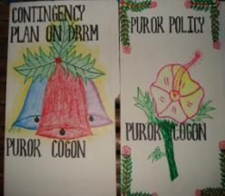
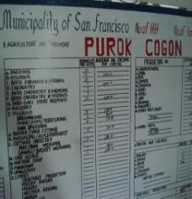
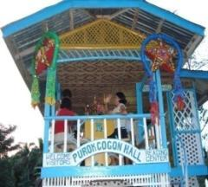
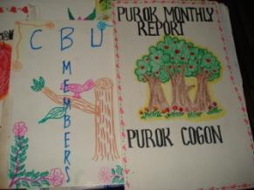
“PUROK SYSTEM” -system to guide the community to work together to attain their basic needs and system that helps the town in carrying out its risk reduction program such as the following :
DRRM activities at the purok level
Purok-level MRF
Barangay Information system, purok-based hazard and risk maps
Early warning system
Tree planting and growing, watershed rehabilitation
Mangrove reforestation
Disaster drills

Slide 16
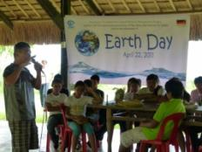
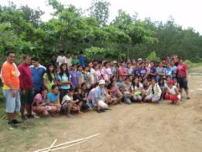
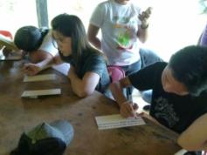
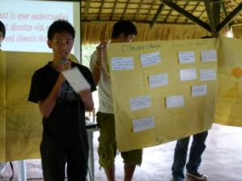
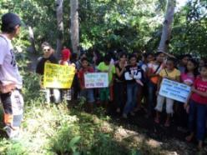
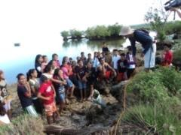
Involving Youth Leaders in DRR

Slide 17
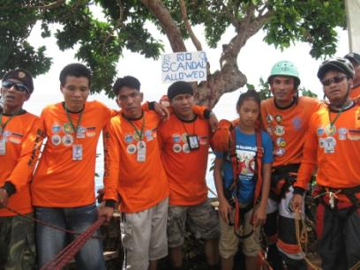
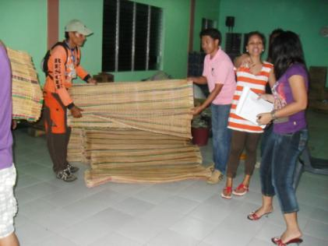
Revitalizing Camotes Island Emergency Respose Team (CiERT)
CiERT during Municipal Typhoon Drill
The CiERT Group assisted Saint Bernard through donations of sleeping mats for the evacuees.

Slide 18
COMMUNITY BASED DISASTER RISK REDUCTION & MANAGEMENT
(Essential No. 2, 3, 4, 9)

Slide 19
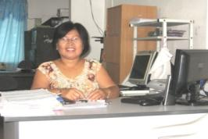
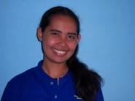
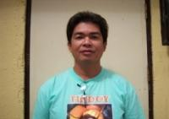

Creation of the Local Disaster Risk Reduction & Management Office
Local Disaster Risk Reduction Management Officer
Administration & Training
Operations & Warning
Research & Planning

Slide 20
Municipal Disaster Risk Reduction and Management Council structure
MDRRMC (Chairperson: Municipal Mayor)
DRRM Officer
Administrative and Training
Operation and warning
Research and Planning
Early Warning Service
Damage Assessment and Needs Analysis
Rescue and Evacuation Service
Relief and Rehabilitation Service
Medical and Health Service
Camp Management Service
Security and Police Service

Slide 21
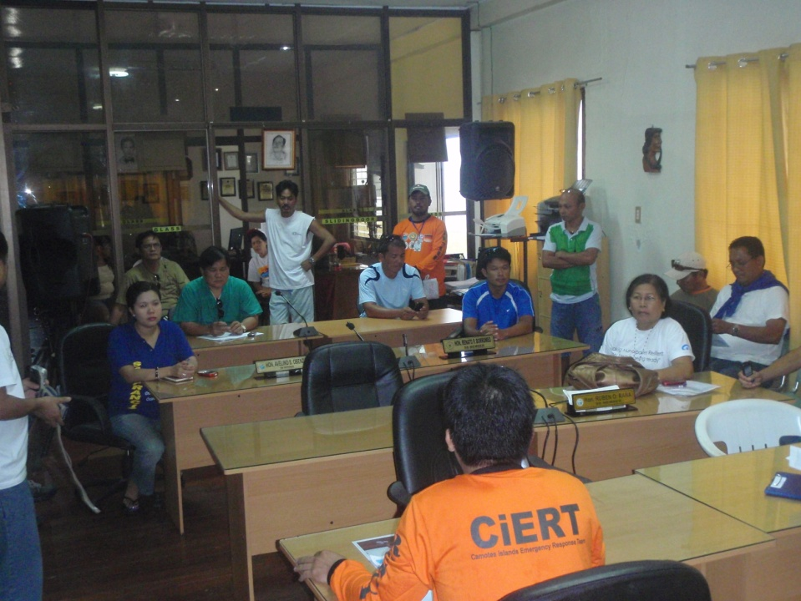
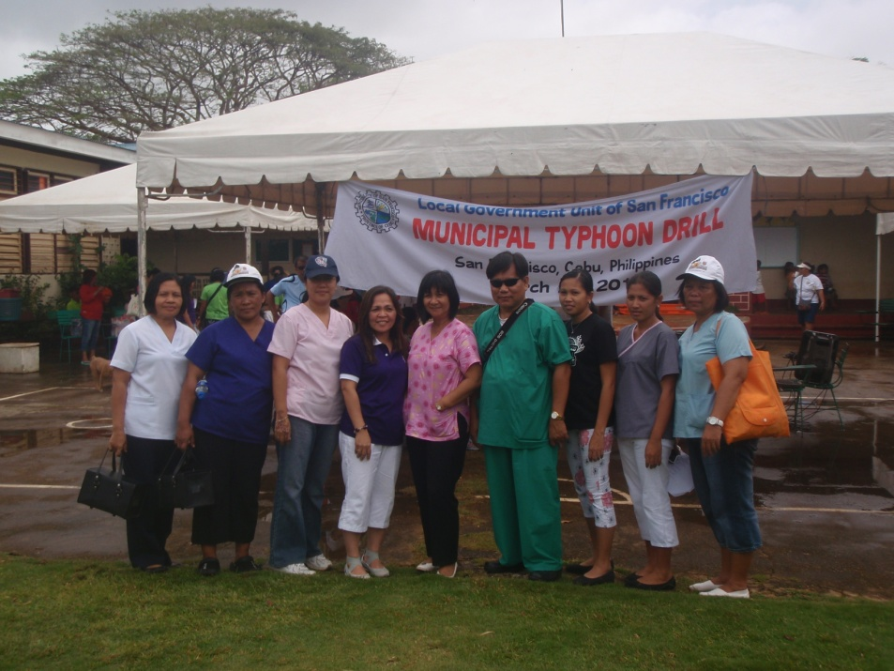
Strengthening the Local Disaster Risk Reduction and Management Council (LDRRMC)

Slide 22
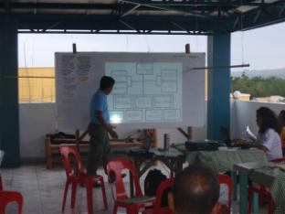
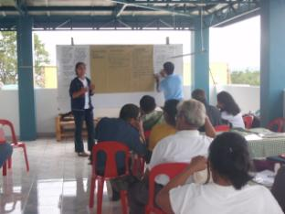
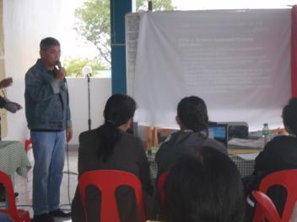
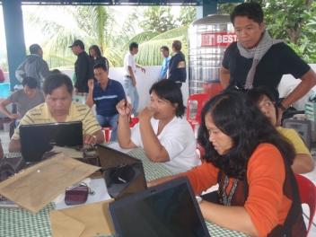
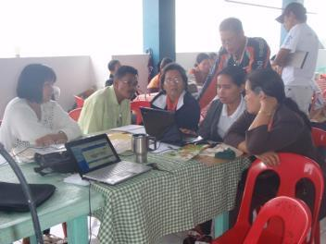
Consultative Planning in the formulation of Five Year LDRRM Plan

Slide 23
Prioritizing DRRM activities in the municipal budget
In line with the Millennium Development Goals, 5% of the Municipal Budget is allocated to LDRRM to ensure that the programs identified in its Five Year Plan are implemented.

Slide 24
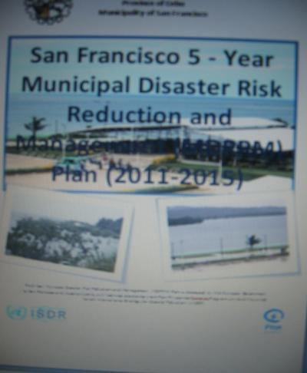
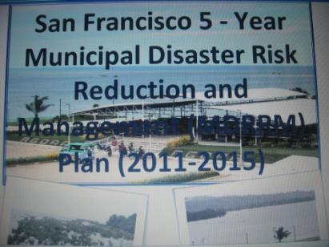
Allocated budget for San Francisco DRRMP Implementation for Five Years

Slide 25
5 Year Financial Budget for LDRRMP
Year | 5%LDRRM Fund | Prevention | Mitigation | Preparedeness | Year Total budget
1 | 2,335,776.70 | 1,456,365 | 631,000 | 370,000 | 2,457,365
2 | 3,336,811.00 | 463,770 | 1,525,000 | 407,000 | 2,395,770
3 | 3,336,811.00 | 563,770 | 1,525,000 | 307,000 | 2,395,770
4 | 3,336,811.00 | 563,770 | 1,475,000 | 277,000 | 2,315,770
5 | 3,336,811.00 | 363,770 | 1,475,000 | 277,000 | 2,115,770
 | TOTAL | 3,411,445 | 6,631,000 | 1,638,000 | 11,680,445

Slide 27
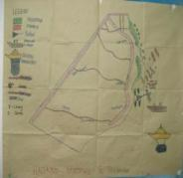
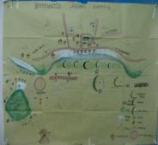
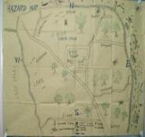
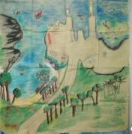
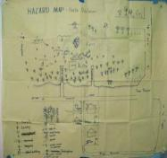
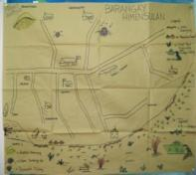
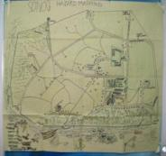




11 COASTAL BARANGAY HAZARD MAPS
SOUTHERN POBLACION
ESPERANZA
STA CRUZ
NORTHERN POBLACION
CONSUELO
HIMENSULAN
SONOG
SAN ISIDRO
UNIDOS
SANTIAGO
UNION

Slide 28



Hazard Maps: Installed in the strategic location in the barangay for awareness

Slide 29




Drainage Canal
Harnessing the sun’s power

Slide 30





San Francisco Seawall
Municipal Gymnasium/Evacuation Center

Slide 31




Built environment designed to withstand typhoons
Market
School

Slide 32



Teaching Preparedness to the Most Vulnerable

Slide 33






Typhoon, Earthquake and Fire Drills
Converting vulnerabilities to capacities

Slide 34


Community-based Swimming Lessons for Youth & Kids

Slide 35





EARTH DAY CELEBRATION: ENJOINING THE YOUTH

Slide 36




International Day for Disaster Risk Reduction: A Community Event

Slide 37


Organizing & Preparing the most vulnerable group “people with dis-abilities (PWD) “

Slide 38




Training local “weather forecasters”: Using the Rain Gauge

Slide 39


Barangay based Early Warning Device

Slide 40






Water Search & Rescue (WASAR) Training

Slide 41

Leading the Mayors of Camotes Islands to join disaster-preparedness campaign
(December 11, 2010, Santiago, San Francisco , Cebu,)

Slide 42
Community based Health Program thru Health Ambassadors
(Essentials 5)

Slide 43


Upgrading of Health Facilities

Slide 44



Health Ambassadors: Bringing Doctors to the Purok

Slide 45


Information, Education and Communication (IEC)

Slide 46
Community based Concept of Sustainable Development
(Essential 6, 10)

Slide 47




Slide 48

BARANGAY Contingency Plans

Slide 49



Conducted Annual building assessment and Implementation of the San Francisco Camotes Development Plan

Slide 50

Engendering DRR: Protecting the Women and Children

Slide 51






Sustainable Livelihood

Slide 52


Promoting Green Economy

Slide 53
Community based environmental Protection & Management
(Essential 8)

Slide 54





Establishment of Marine & Bird Sanctuaries

Slide 55



Mangrove Reforestation: A Testament to the Bayanihan Spirit

Slide 56




Community Tree Planting and Coastal Clean-up

Slide 57


Two Million Trees Project for Green San Francisco

Slide 58
Community based Solid Waste Management Approach
(Essential 8)

Slide 59

Community Implementation on Solid Waste Management Program

Slide 60




COLOR CODED RECEPTACLES
Establishment of the Material Recovery Facility

Slide 61


COMMUNITY BASED GREEN TOURISM
(Essential Number 8)

Slide 62




Slide 63



Carbon offsetting Program for a Green Sanfran

Slide 64
“SANFRAN BELIEVES THAT THROUGH THE COLLECTIVE
EFFORT AND POWER OF THE PEOPLE, SOLVE THE BIG PROBLEM…and it starts small…

