Slide 1

“Engaging the Community: Volunteerism and Disaster Management”
OFFICE OF DISASTER PREPAREDNESS AND EMEREGENCY MANAGEMENT
UNV GLOBAL PLATFORM SIDE EVENT

Slide 2
Introduction
OFFICE OF DISASTER PREPAREDNESS AND EMEREGENCY MANAGEMENT
Disaster Risk Reduction given the resource challenges requires (especially in the Jamaican context) the input of multiple stakeholders including its citizens young and old.
Given the definition of volunteerism we can safely acknowledge that our thirty year engagement of community groups in DRR has been in support of strengthening volunteerism nationally

Slide 3
Policies that Support Volunteer Integration
OFFICE OF DISASTER PREPAREDNESS AND EMEREGENCY MANAGEMENT
Volunteerism in support of DRR can be located within the National Development Plan (Vision 2030):
Goal 4: Jamaica has a Healthy Natural Environment
Outcome 14: Hazard Risk Reduction and Climate Change
Strategy 14-1: Improve resilience to all kinds of hazards
National Strategy 14-2: Improve Emergency Response Capability

Slide 4
Policies that Support Volunteer Integration
OFFICE OF DISASTER PREPAREDNESS AND EMEREGENCY MANAGEMENT
The specific sector strategy :
Develop a larger core of trained volunteers to effectively manage/support emergency response”
The National Hazard Risk Reduction Policy established in 2005 also promotes community resilience and by extension volunteerism.
Volunteerism and Community Engagement has been at the heart of ODPEM’s strategic priority from as far back as the 1980’s

Slide 5
Programmes Utilizing Volunteers
OFFICE OF DISASTER PREPAREDNESS AND EMEREGENCY MANAGEMENT
An examination of the human resources needed for ODPEM to be effective in pre-impact and post disaster situations revealed a need for manpower beyond the formal paid capacities which exits.
Reinforced the need for building capacities at the community level and through specialized volunteer groups.

Slide 6
Programmes Utilizing Volunteers
OFFICE OF DISASTER PREPAREDNESS AND EMEREGENCY MANAGEMENT
Community Level:
  Community monitored Flood Warning System inclusive of flood teams and personnel to support the evacuation and emergency management planning of the communities
  Drain/sink hole cleaning and management
  Debris removal after major flood events
  Constructing Structural Mitigation Interventions

Slide 7
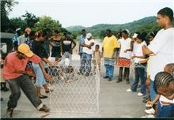
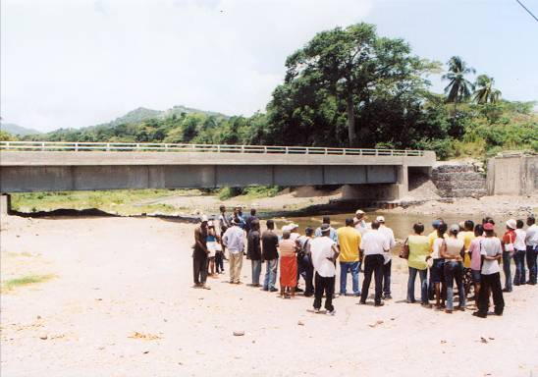
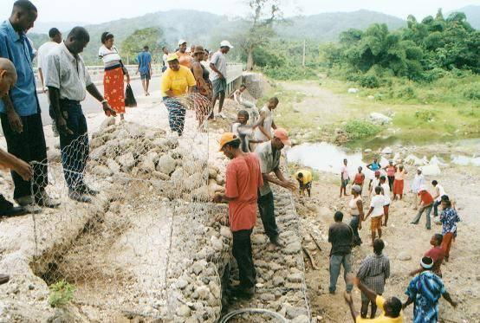
OFFICE OF DISASTER PREPAREDNESS AND EMEREGENCY MANAGEMENT

Slide 8
Programmes Utilizing Volunteers
OFFICE OF DISASTER PREPAREDNESS AND EMEREGENCY MANAGEMENT
Community Level:
Independent risk awareness activities
Fund raising activities to support community level DRR activities
Management of shelters post impact including the identification of initial mobilizing resources

Slide 9
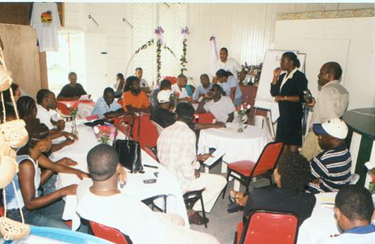
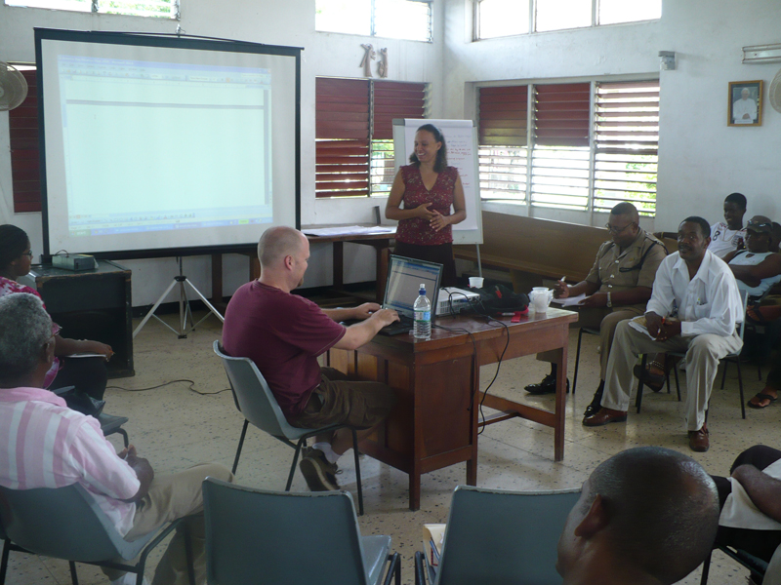
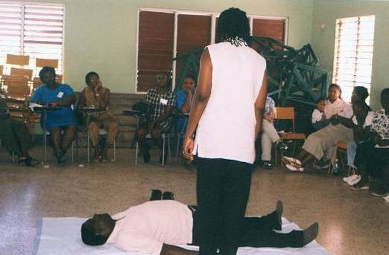
OFFICE OF DISASTER PREPAREDNESS AND EMEREGENCY MANAGEMENT
Emergency Response Plan
Flood Alert Team
First Aid
Hazard Identification & Damage Assessment

Slide 10
Programmes Utilizing Volunteers
OFFICE OF DISASTER PREPAREDNESS AND EMEREGENCY MANAGEMENT
Community Level Actions During Hurricane Ivan:
  Established Community Disaster Response teams in the communities of Yallahs and Cedar Valley went from street to street issuing warnings in the wake of Hurricane Ivan in 2004. They had established their community high risk maps and knew exactly where the vulnerable people within their community lived and was called upon to evacuate the blind and disabled.
“We look for the most indigent, most vulnerable, those who do not have anybody,” says Joshua Davis…..World Disasters Report 2005

Slide 11
Programmes Utilizing Volunteers
OFFICE OF DISASTER PREPAREDNESS AND EMEREGENCY MANAGEMENT
All facets of the National Disaster Management Organization’s work has utilized volunteer support:
Preparedness:
  Specialized skills in training, Public Relations, Media Communications, Logistics, telecommunication and GIS Mapping
  Drawn from private and public sector and community based personnel
  Creation of a youth corps of volunteers ages 16-22 branded the Preparedness Emergency Response Corps (PERC)

Slide 12
Programmes Utilizing Volunteers
OFFICE OF DISASTER PREPAREDNESS AND EMEREGENCY MANAGEMENT
Response:
  Search and Rescue, Swift Water Rescue, First Aid, Damage Assessment, Spatial Mapping of the Impacted Area, Shelter Management and Welfare Relief Management
Graduates and Professionals that are either jobless are also encouraged to volunteer their skills in support of day to day organizational operations.

Slide 13
Lessons Learned
OFFICE OF DISASTER PREPAREDNESS AND EMEREGENCY MANAGEMENT
A structured volunteer programme has allowed for expanded and efficient use of volunteer resources
Facilitate the building of a culture of safety
A volunteer recognition programme provides incentives for sustainable volunteer action

Slide 14
Lessons Learned
OFFICE OF DISASTER PREPAREDNESS AND EMEREGENCY MANAGEMENT
Volunteerism is at a significant cost to volunteers who themselves lack the means to adequately sustain themselves economically.
The harsh economic environment have switched the focus of community persons away from voluntarism and more towards trying to eek out a living
Community Based Disaster Risk management must concentrate on what affected communities can do for themselves and how best to strengthen them.

Slide 15
Conclusion and Recommendations
OFFICE OF DISASTER PREPAREDNESS AND EMEREGENCY MANAGEMENT
Establish the Framework within which the community/volunteer programme will function
A volunteer management policy should be developed to govern the sourcing, capacity building and deployment of volunteers in DRR
A recruitment strategy is also a key tool
Strong Local Governance Mechanisms Necessary for effective volunteer management at the community level

Slide 16
Conclusion and Recommendations
OFFICE OF DISASTER PREPAREDNESS AND EMEREGENCY MANAGEMENT
The planning process for engaging volunteers in disaster risk management must be linked to a wider process of community and national development to improve its sustainability While there have been numerous successes in placing the community volunteerism as key strategy towards establishing strong risk reduction programmes nationally there are still numerous challenges to overcome.
The issue of ownership of the process and the sustainability of community actions are still major hurdles to “jump”.
Building Disaster Resilient Communities Initiative and the revamping of its volunteer programme

Slide 17
OFFICE OF DISASTER PREPAREDNESS AND EMEREGENCY MANAGEMENT
Ronald Jackson
Director General
Office of Disaster Preparedness and Emergency
Management
Jamaica
rjackson@odpem.org.jm
www.odpem.org.jm

