Slide 1


Slide 2
Engineering Field | Total No. of Members |  | Holders of Professional Competence
 | Female | Male | Female | Male
Civil Eng. | 281 | 9025 | 151 | 6226
Surveying | 14 | 229 | 6 | 115
Traffic | - | 23 | - | 12
Architecture | 1153 | 1666 | 547 | 909
Urbanization | 138 | 109 | 36 | 50
Electrical Eng. | 496 | 4168 | 150 | 1671
Mechanical Eng. | 126 | 3480 | 72 | 1948
Sum | 2208 | 18700 | 962 | 10931
Total | 20908

Slide 3
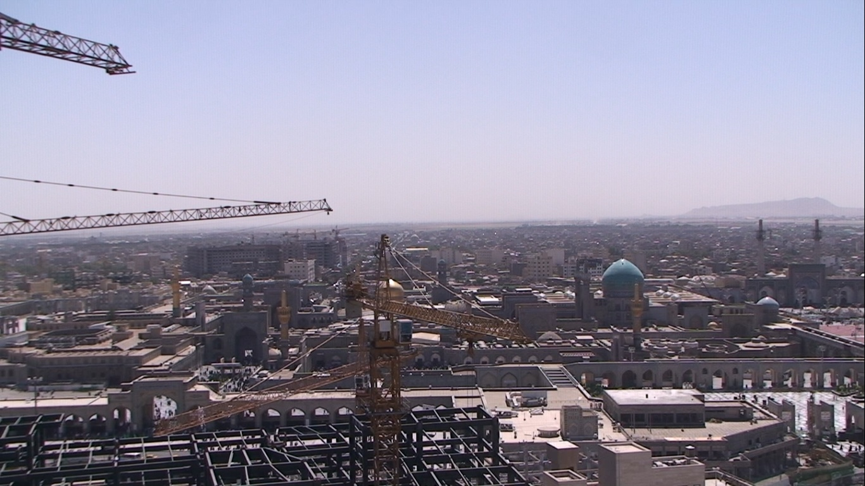
The members of engineering organization of Khorasan Razavi also have legal activities in form of committees and different technical-engineering groups such as:
Description | Numbers
Engineering offices | 349
Legal Supervisor | 79
Qualified Executive | 131
Engineering Association | 15
This group of engineers has supervision on about 10,000,000,000 square meters of constructions in Mashhad and other cities of Khoarasan Razavi province.

Slide 4
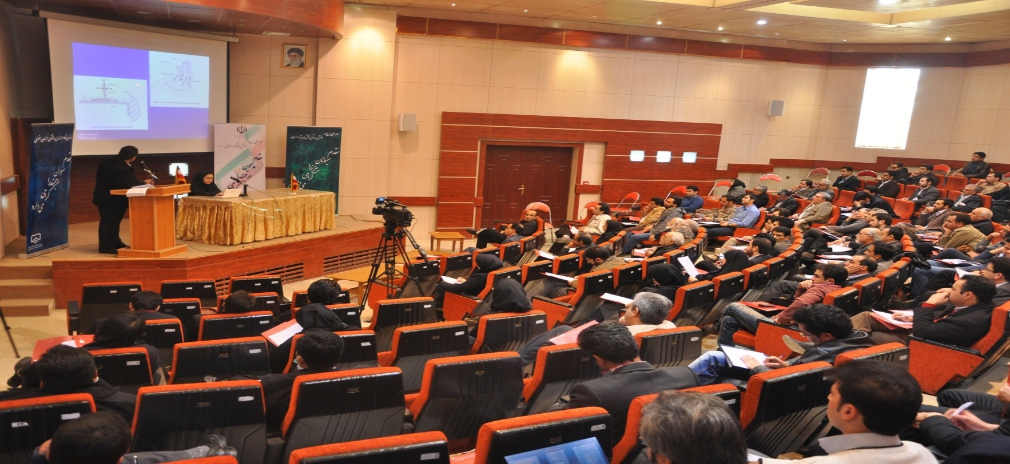
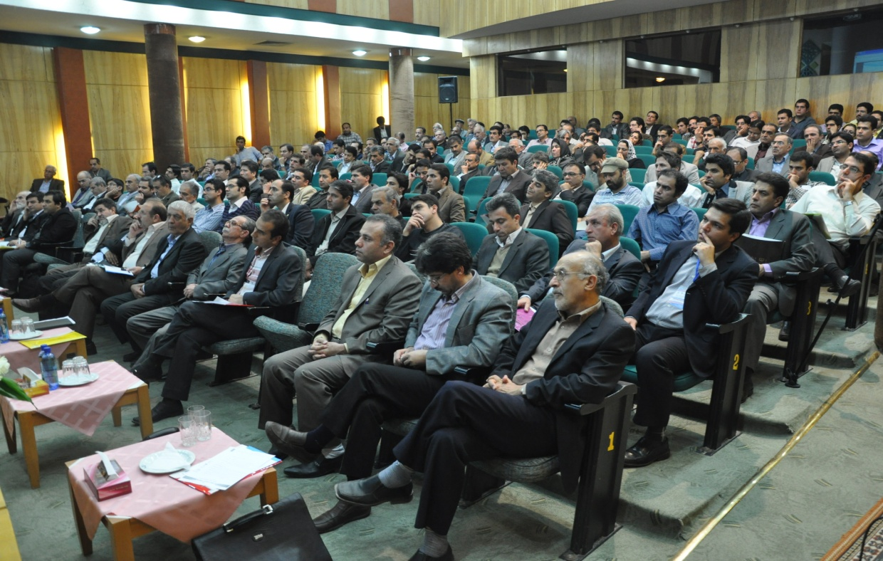
Khorasan Razavi’s Construction Engineering Organization Activities in Brief:
Holding different Training courses for improving technical knowledge of the members and updating their information based on national construction standards and regulations of Iran.

Slide 5
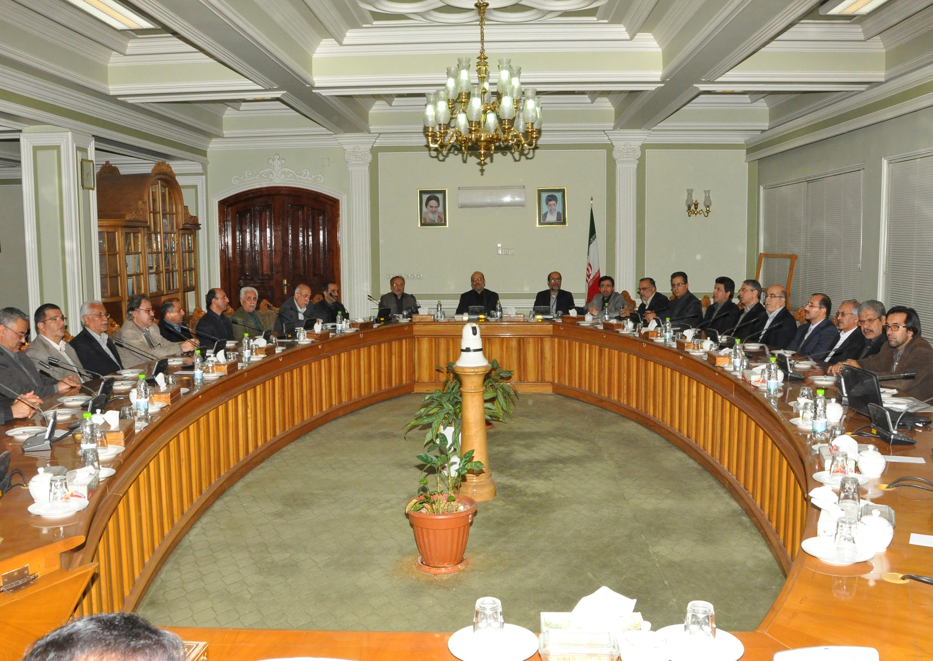
Holding different seminars with cooperation of different organizations and institutions that are concerned with construction.
Extended interaction with different organizations concerned with construction industry, in order to assimilate all constructions

Slide 6
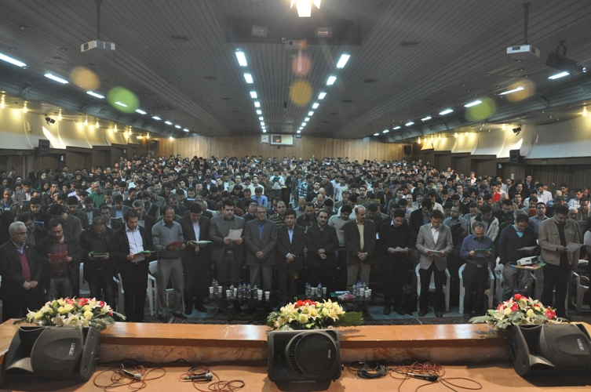
Holding instructional courses and oath taking from new members in every period of profession entrance exam.

Slide 7
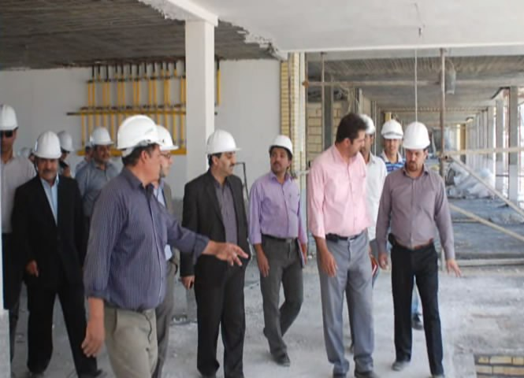
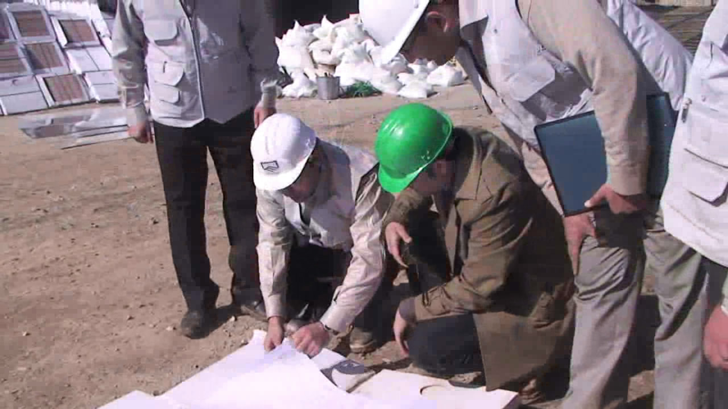
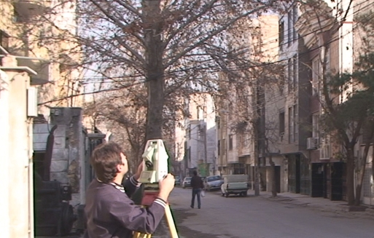
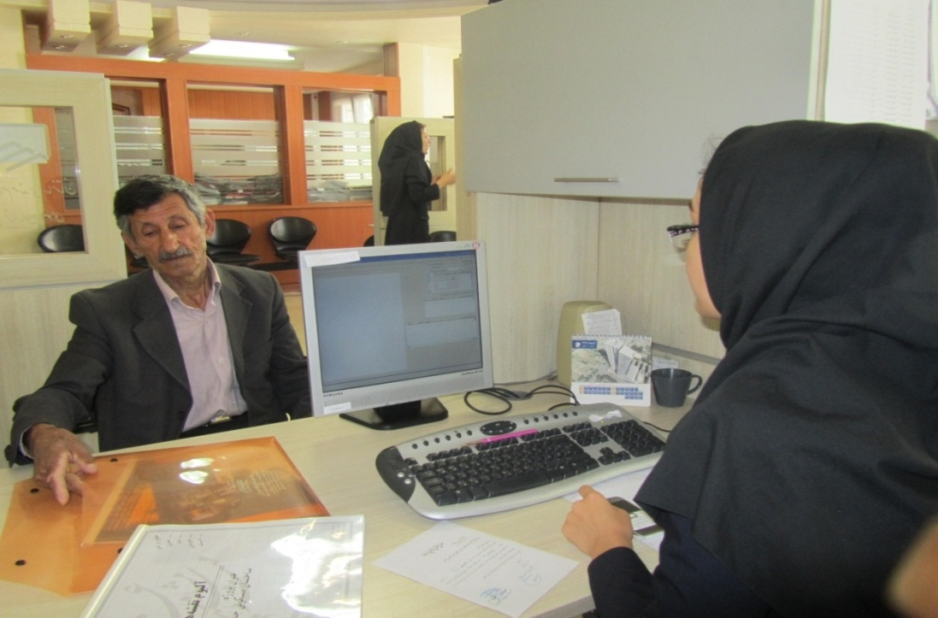
Conducting extra supervision on projects which have already been supervised by engineers
Controlling construction plans by different technical commissions
Providing separated and as-biult of apartments maps in order to make legal ownership certificates

Slide 8
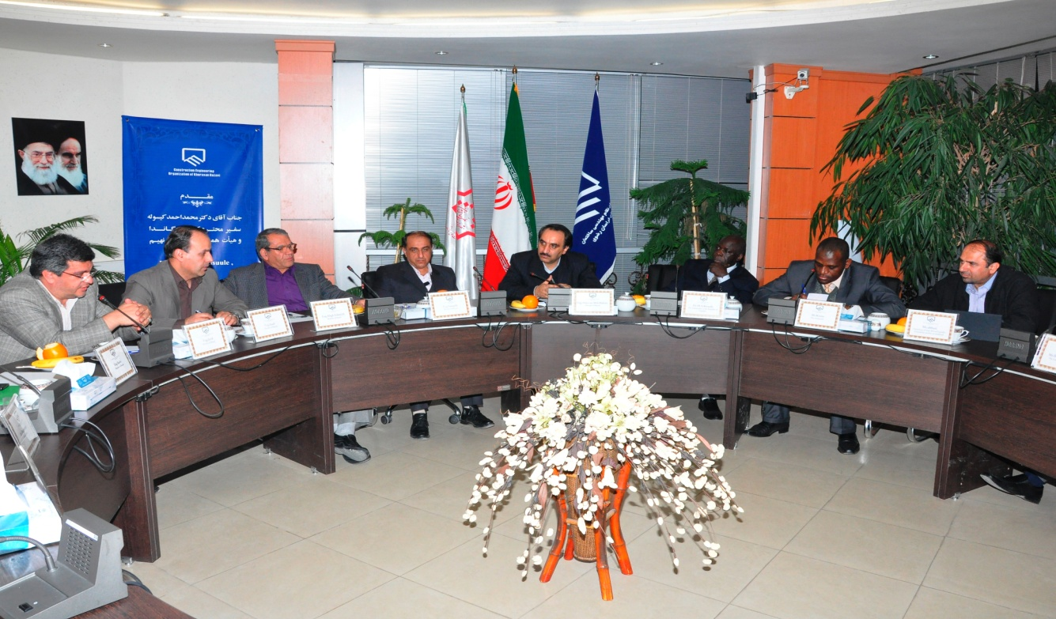
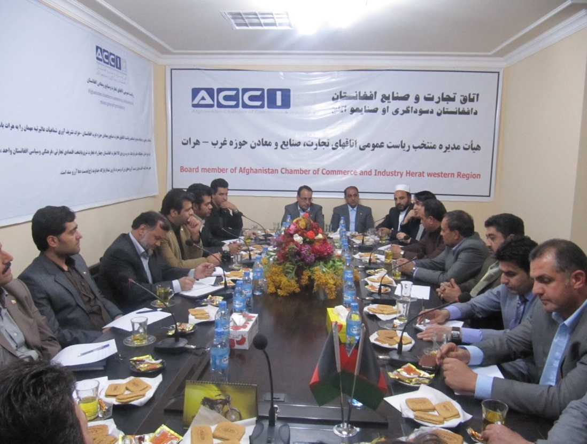
Pursuing of construction engineering services emission, especially in Middle East countries and establishing a representative office in one of neighbor countries

Slide 9

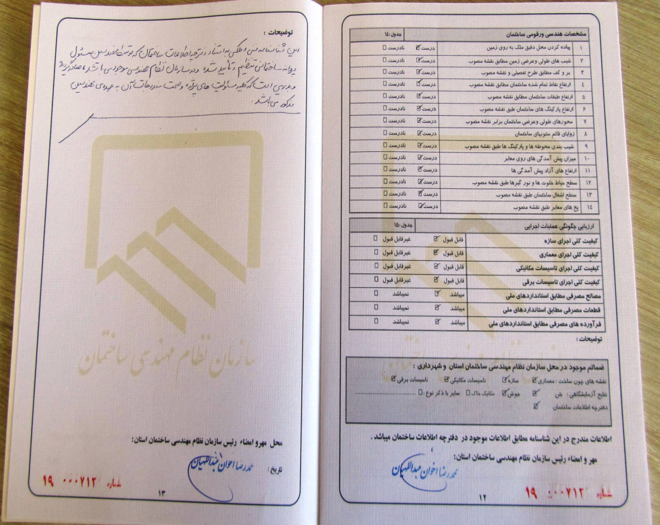
Certificate issuance for the buildings which have been considered all technical and engineering regulations

Slide 10
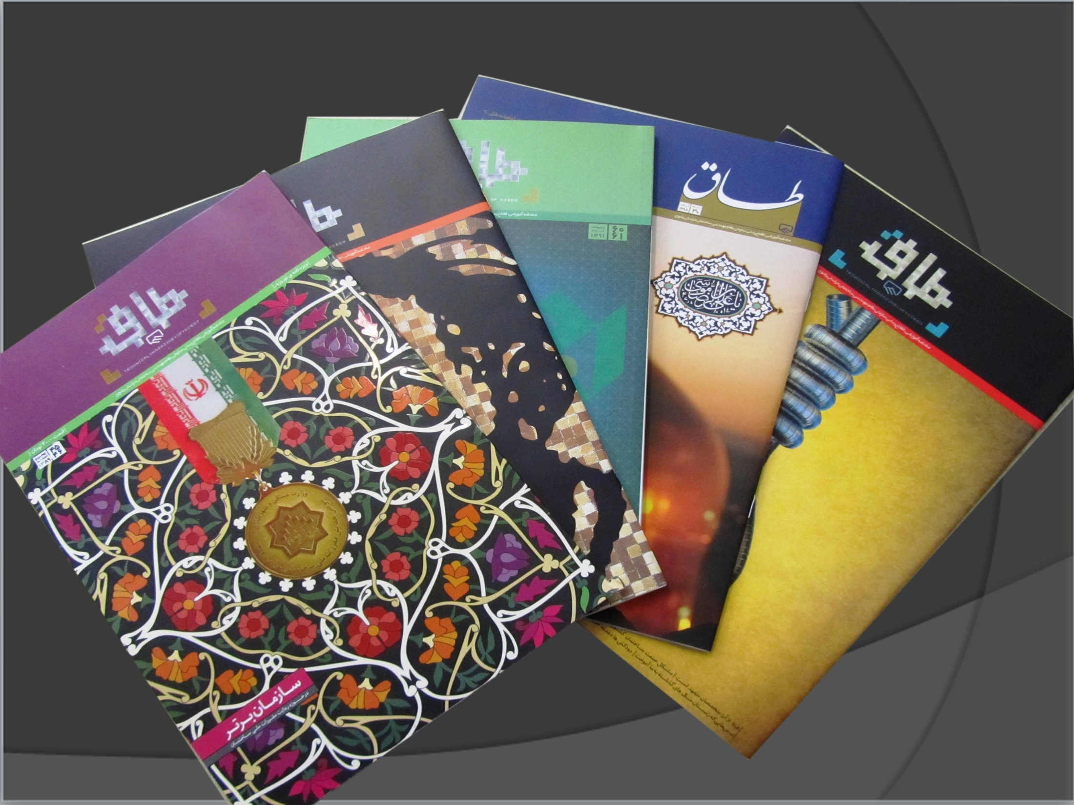
Publishing monthly technical-instructional magazine of the organization named “TAAGH”

Slide 11
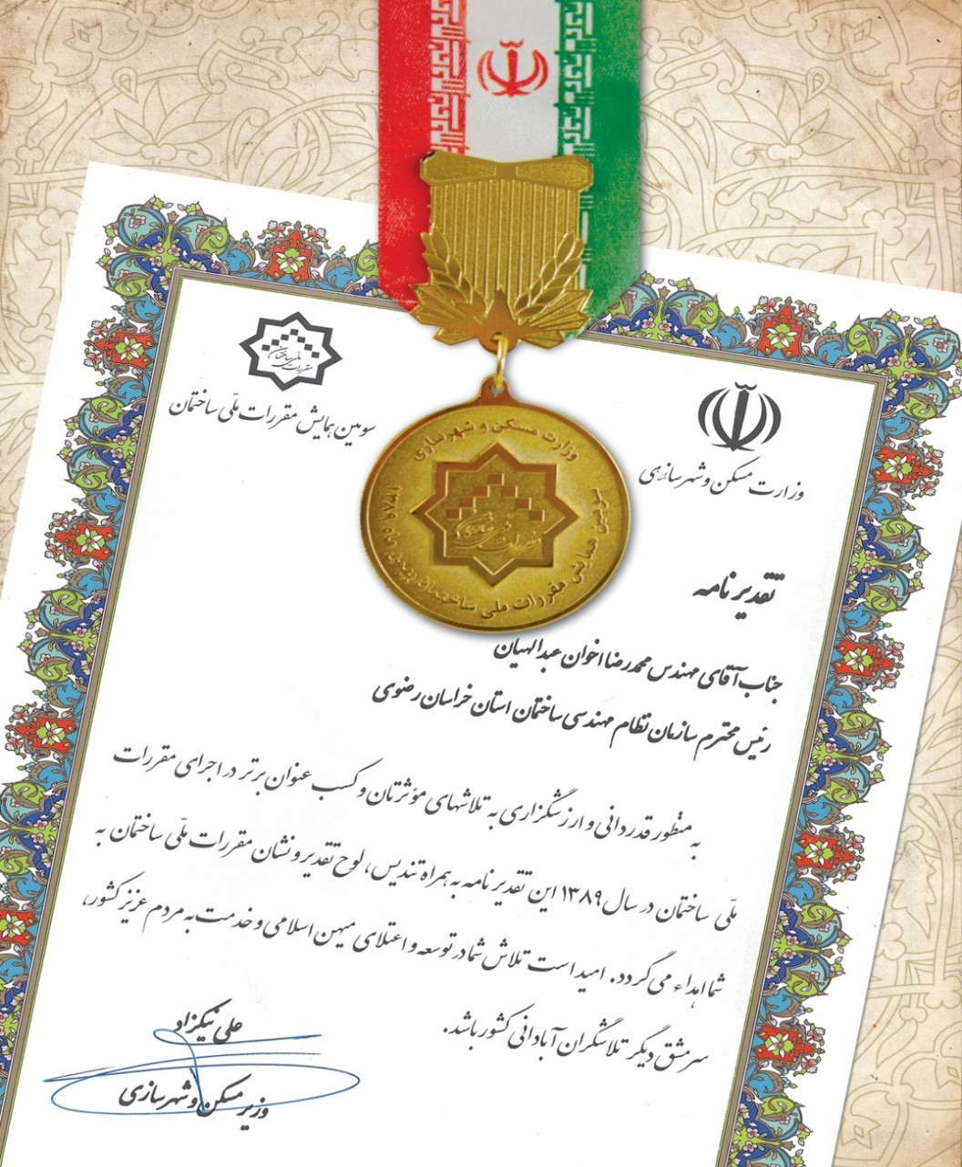
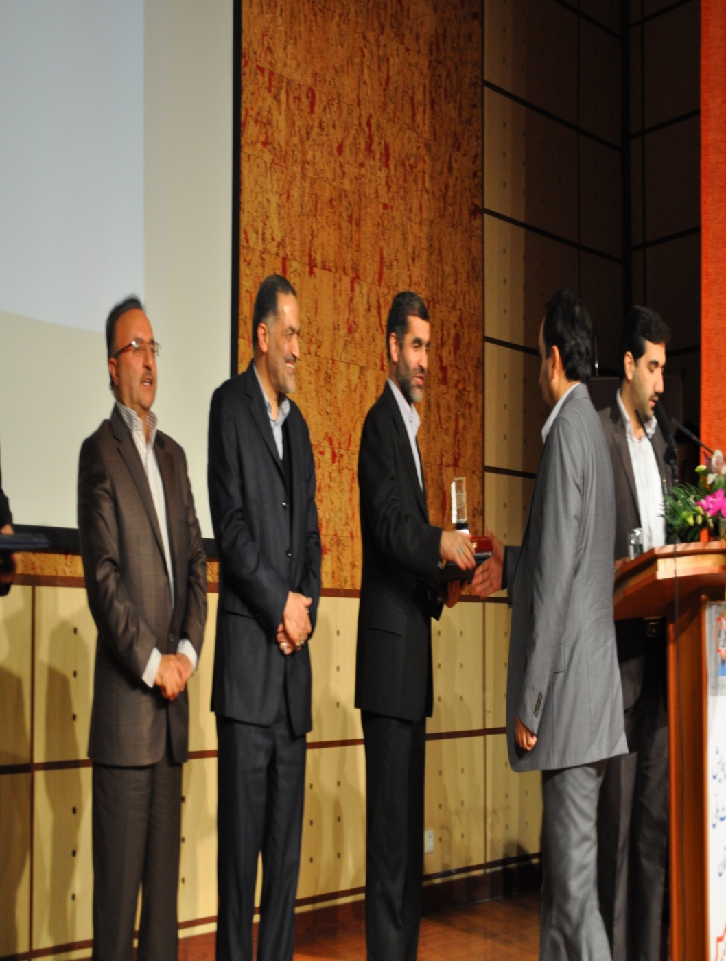
Achieving the highest rank of performing national construction regulations from road and urbanization ministry of Iran

Slide 12

Iranian Construction Engineering Organization, Khorasan Razavi Province
DRR Activities
Ladies and gentlemen:
We know that crisis means being in imbalance and disorder and for the sake of preventing a crisis we need to know that prevention is the best solution.
Of course mental model management cannot be a positive response for crisis management. Through a devised plan we have to foresee the crisis because foreseeing cannot be wrong, and it is acceptably right.

Slide 13
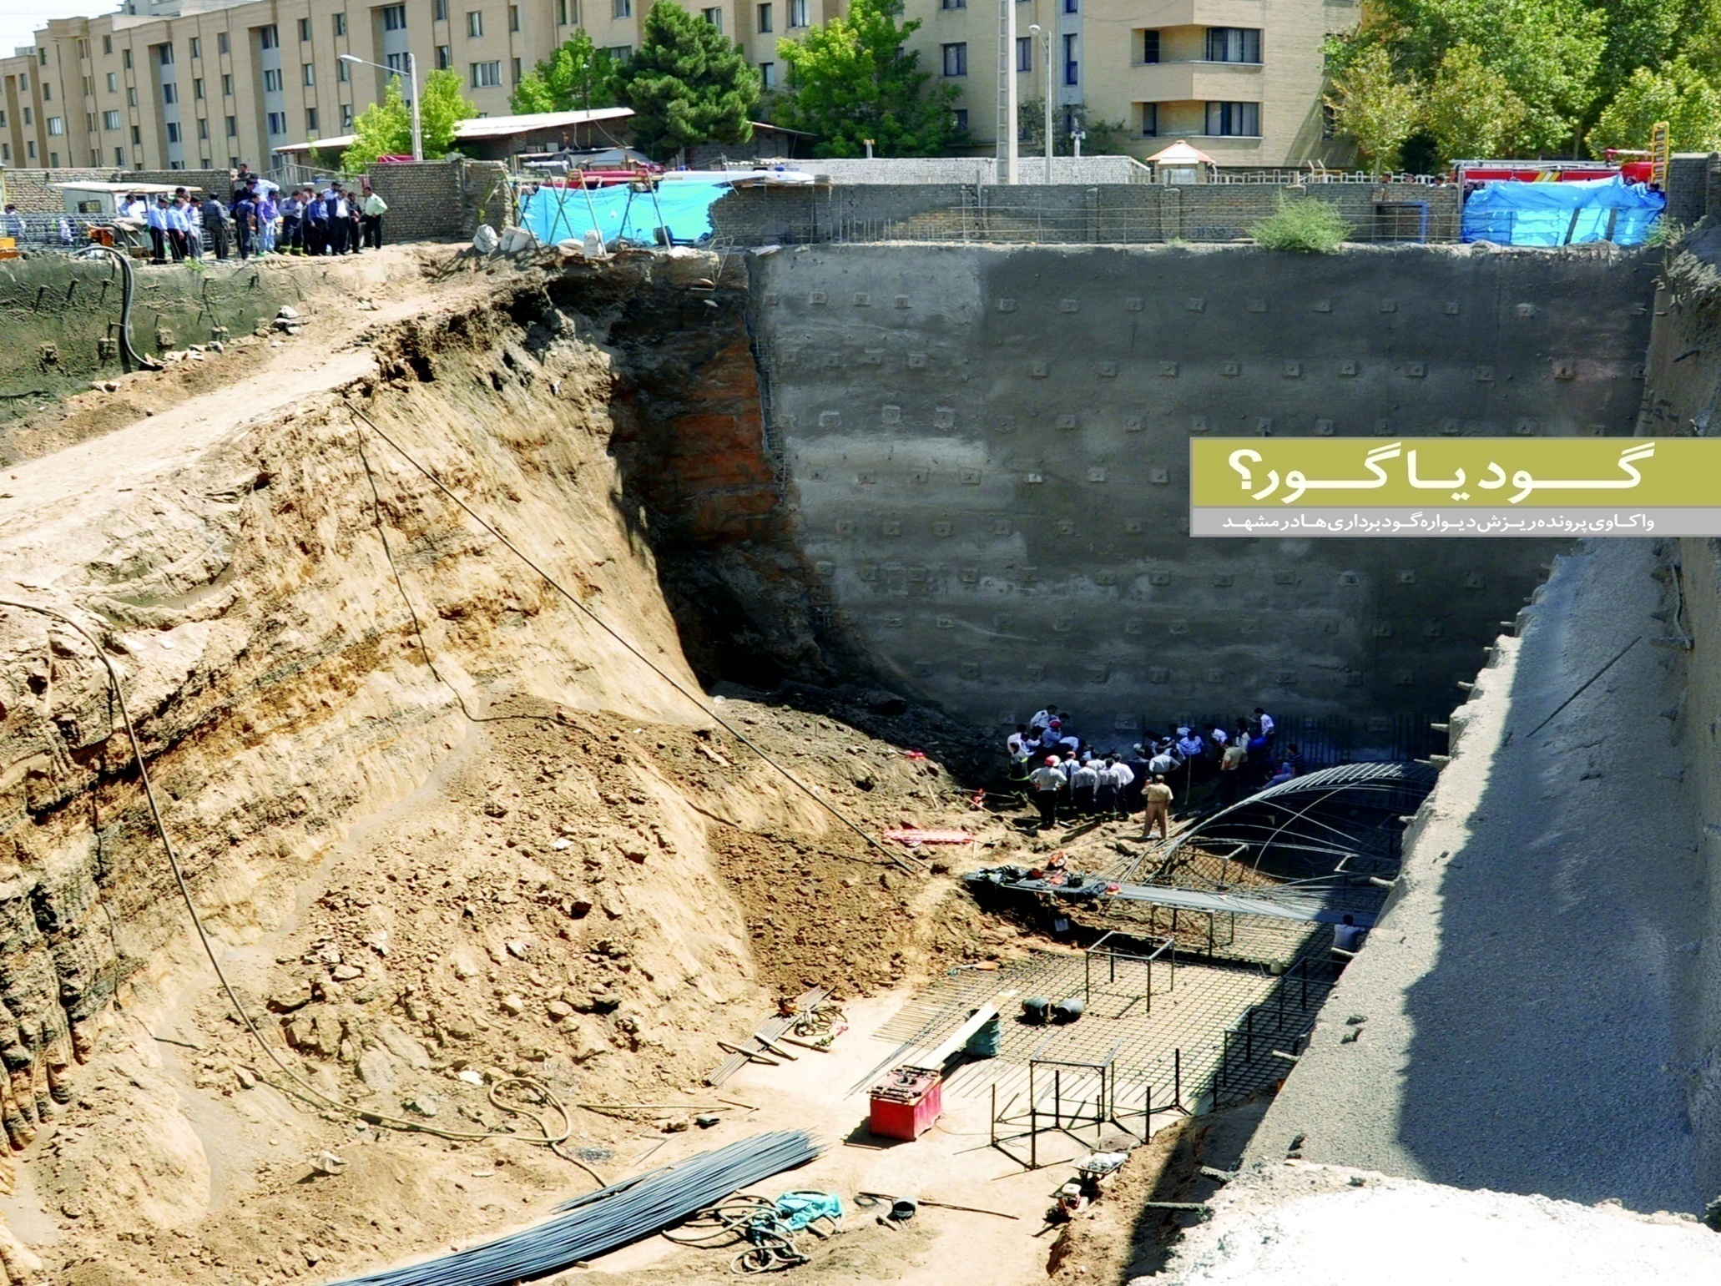
Our organization has been trying to decrease harmful effects of natural disasters in constructions.
Excavation Pit or Grave?

Slide 14
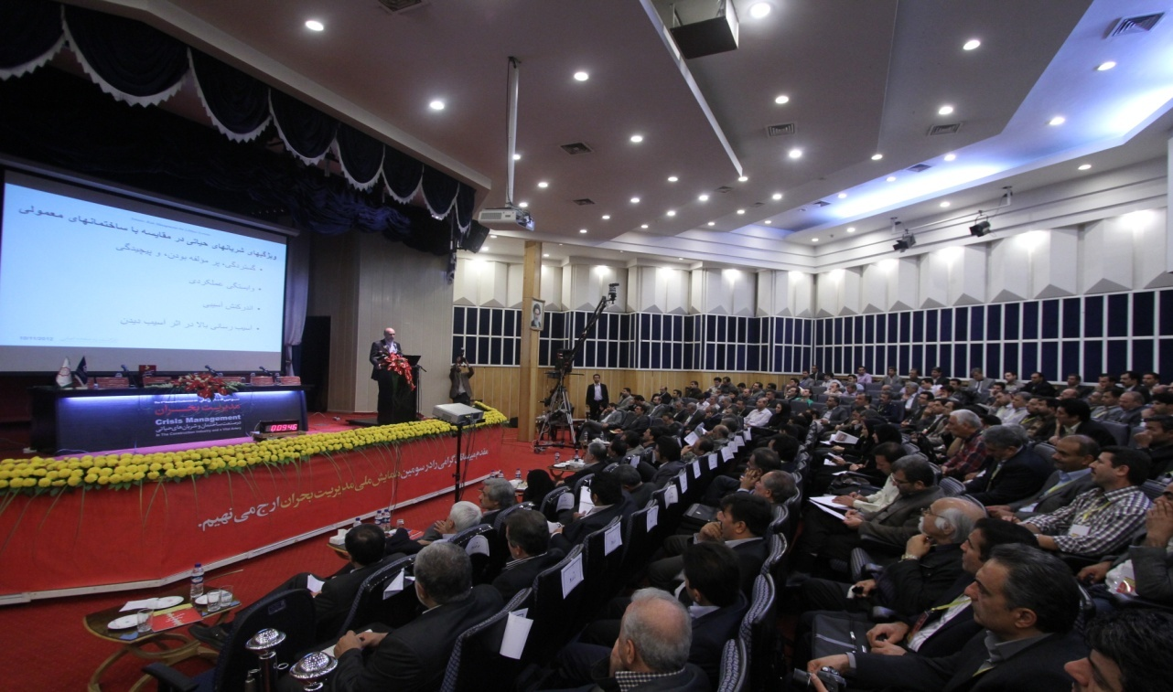
Holding conferences, seminars and instructional courses of crisis management.

Slide 15
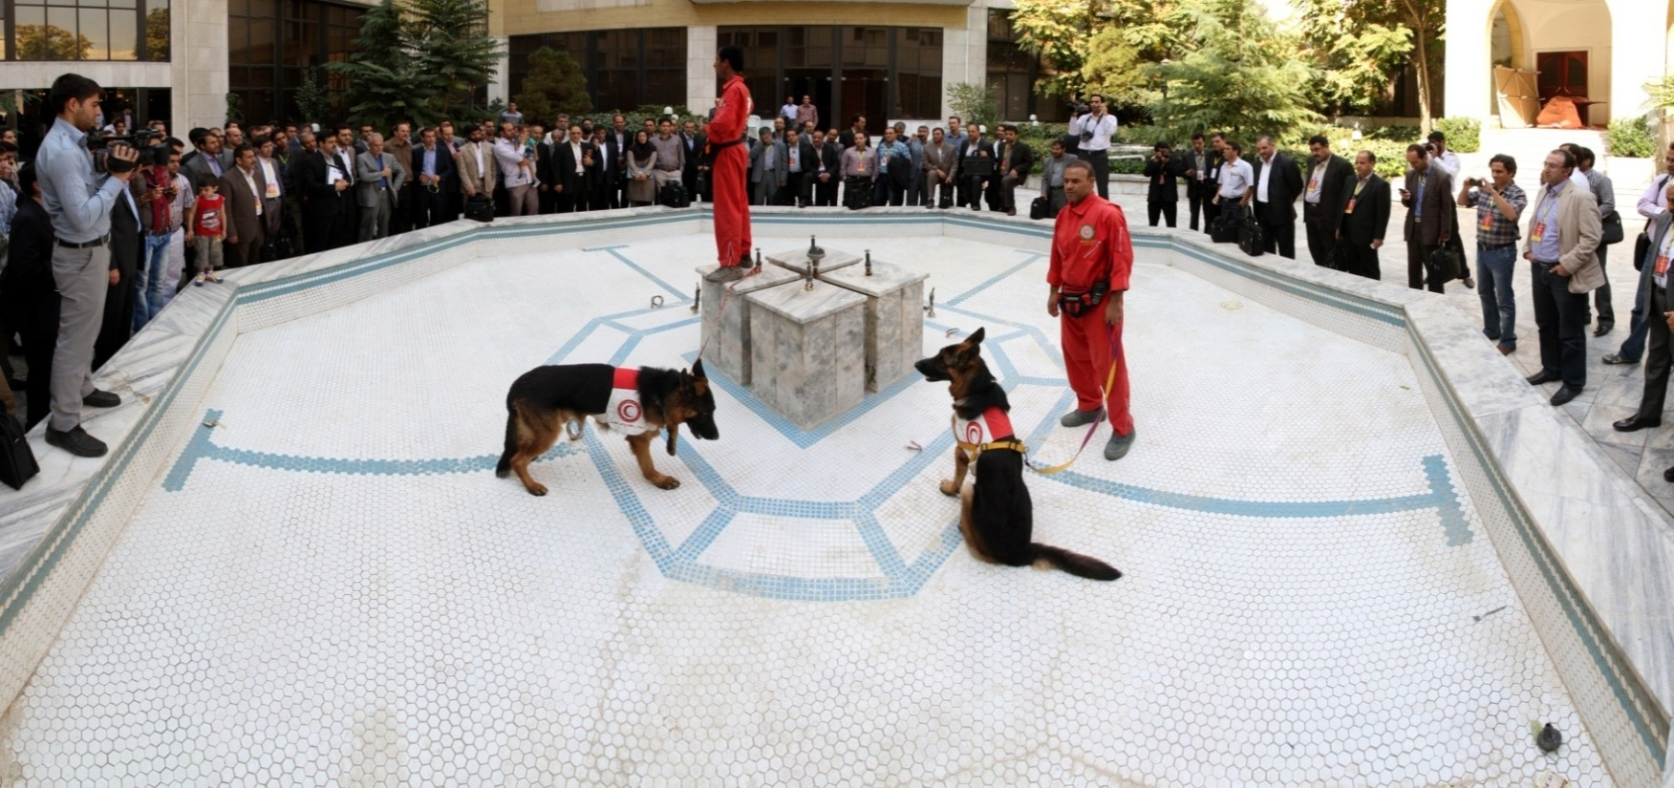
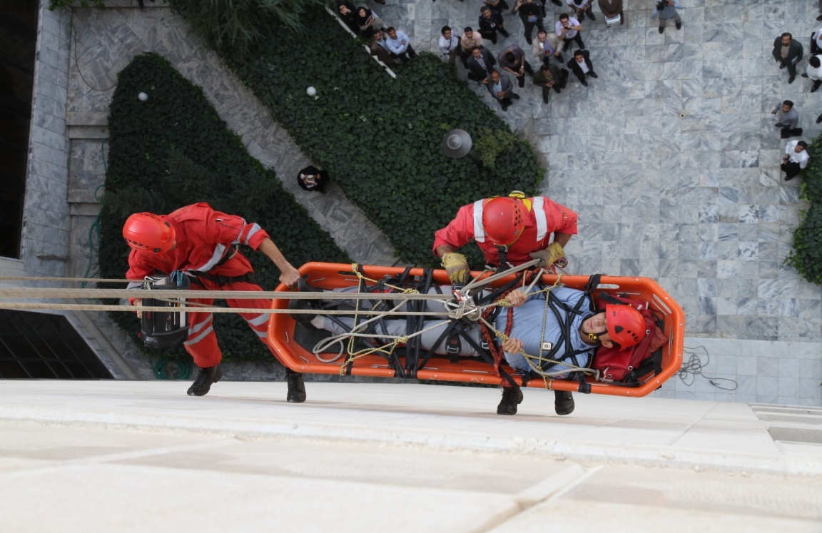
Holding crisis drills and helping the injured
Improving the culture of crisis management and acquaint the public

Slide 16
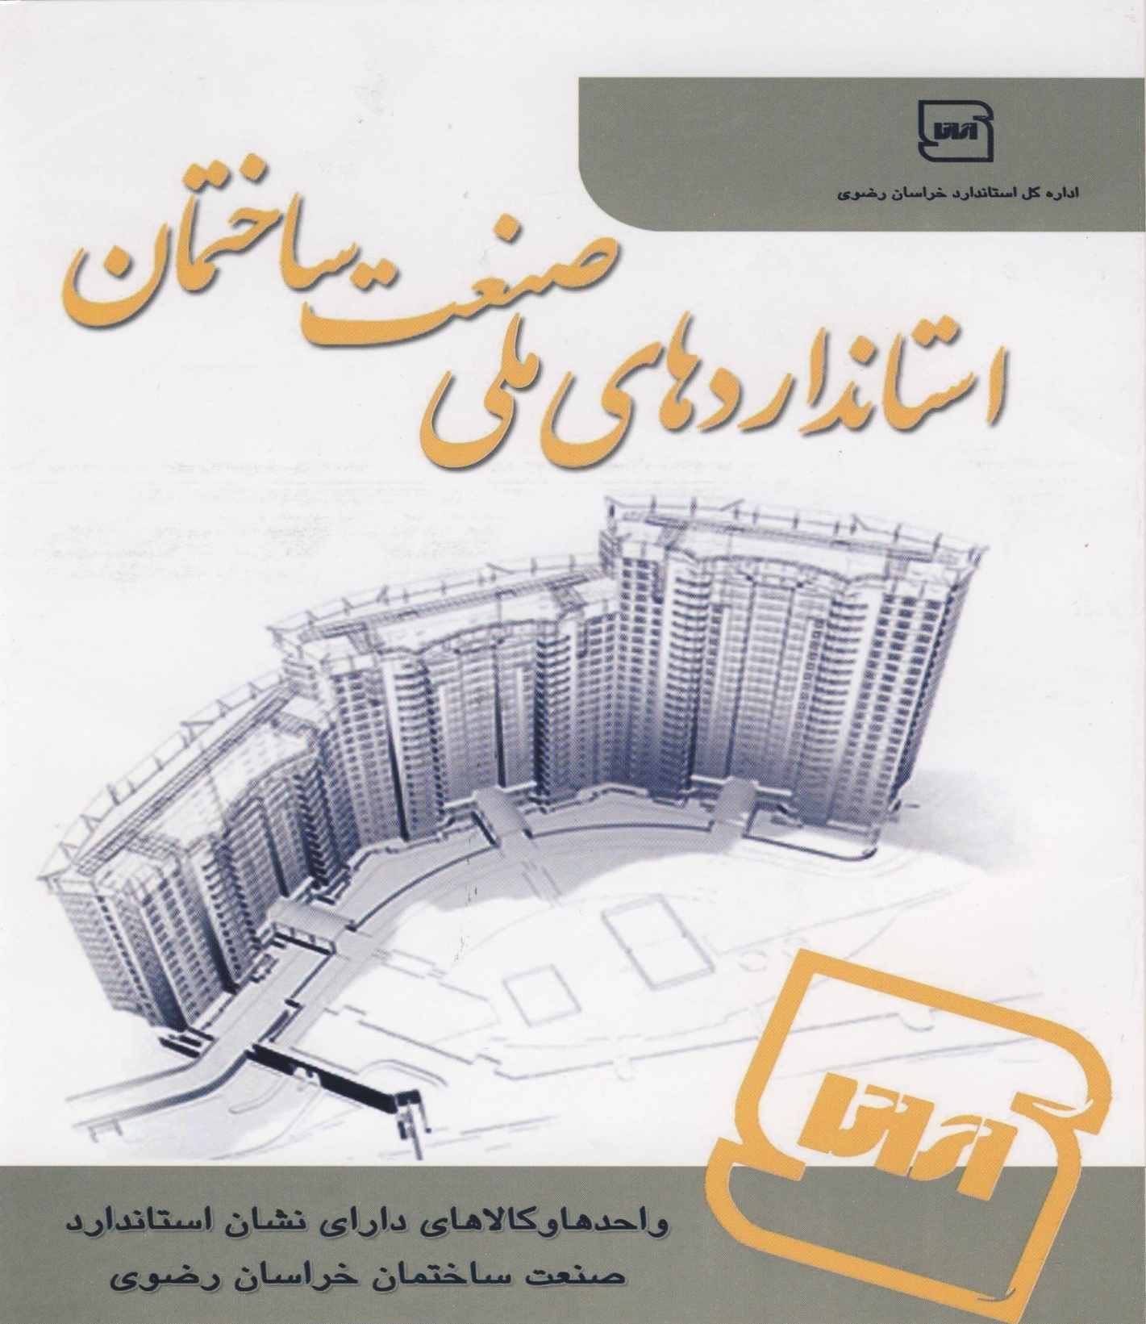
Establishing a representative agency of “road and urbanization ministry’s construction research center”
Cooperation with central organization of standard and industrial researches in order to publish and distribute standard book of construction materials

Slide 17
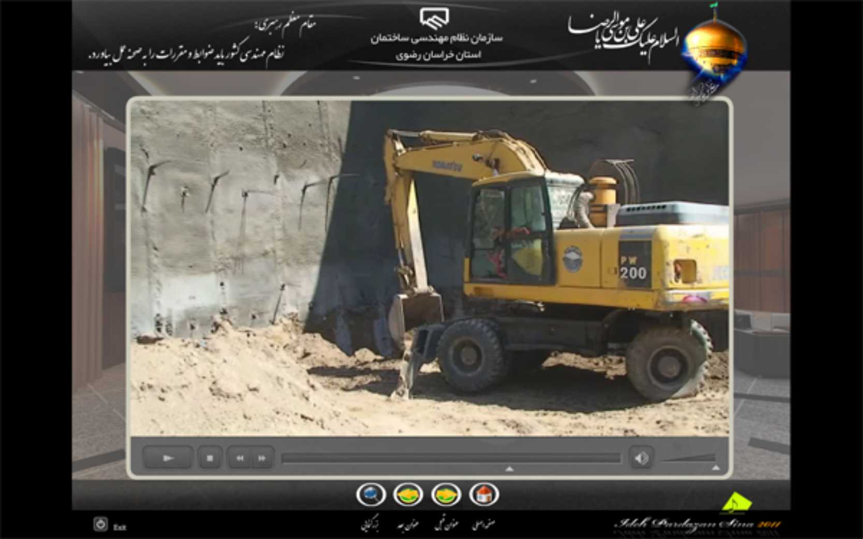
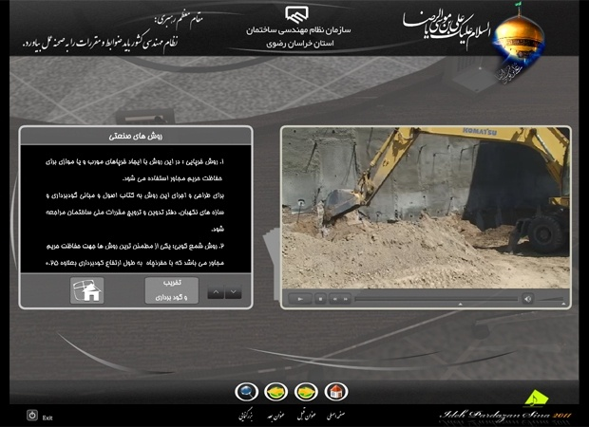
Producing instructional CDs of engineering services and new construction technologies

Slide 18
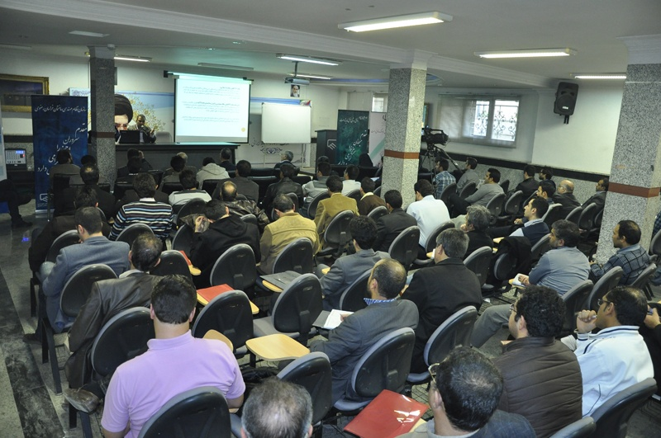
Instructing the owners and volunteers of constructional projects, and making them accustomed with their own rights and services of engineers and construction supervisors.
Holding some courses related to “how to use new technologies to be safe during earthquakes”

Slide 19
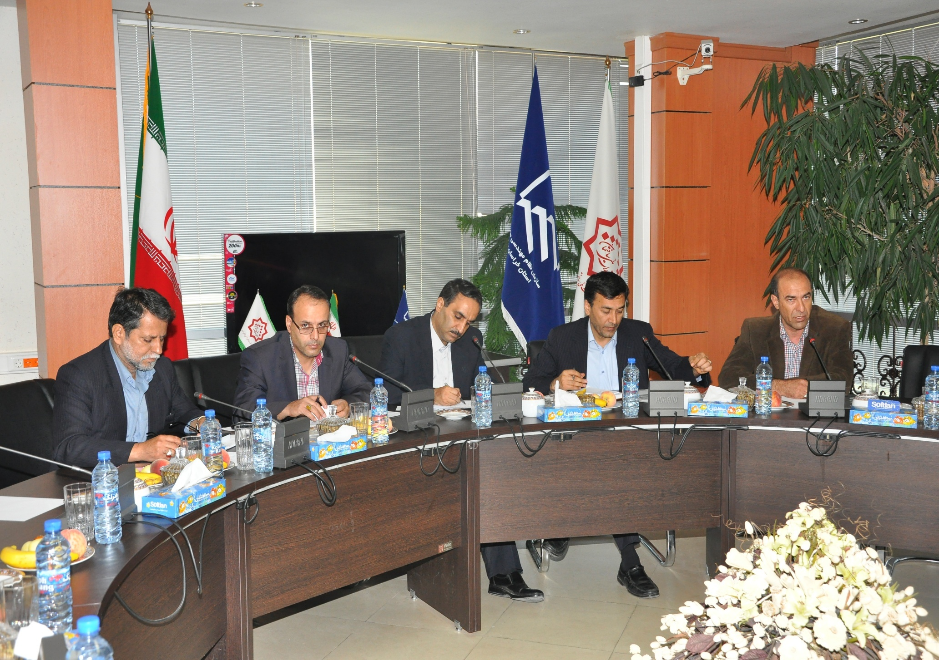
Cooperation with municipality in preparing earthquake risk model of Mashhad

Slide 20
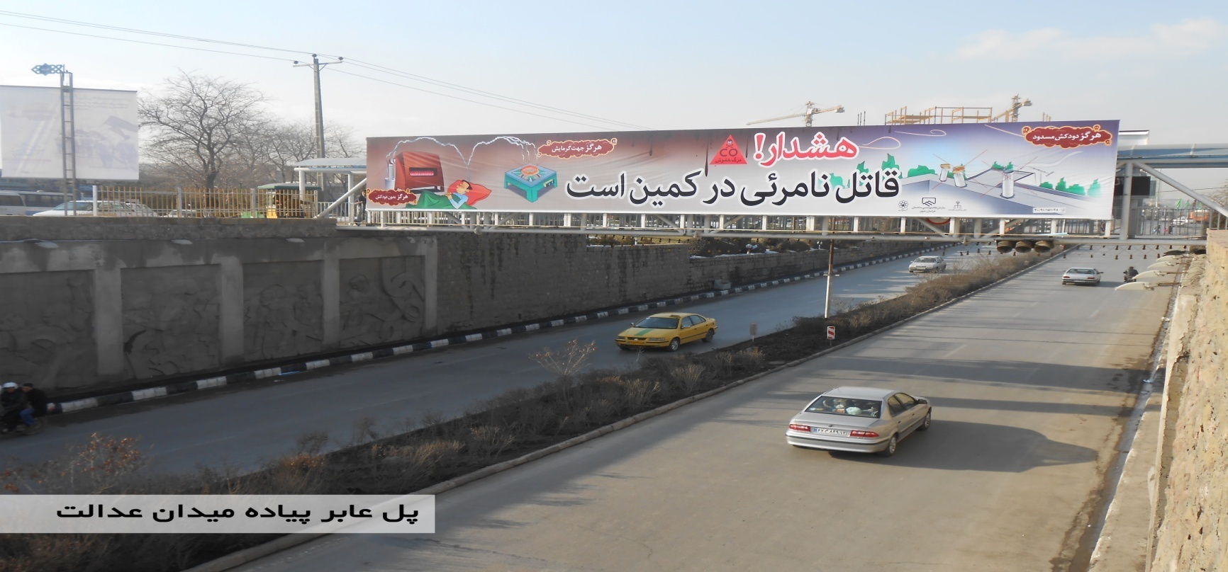
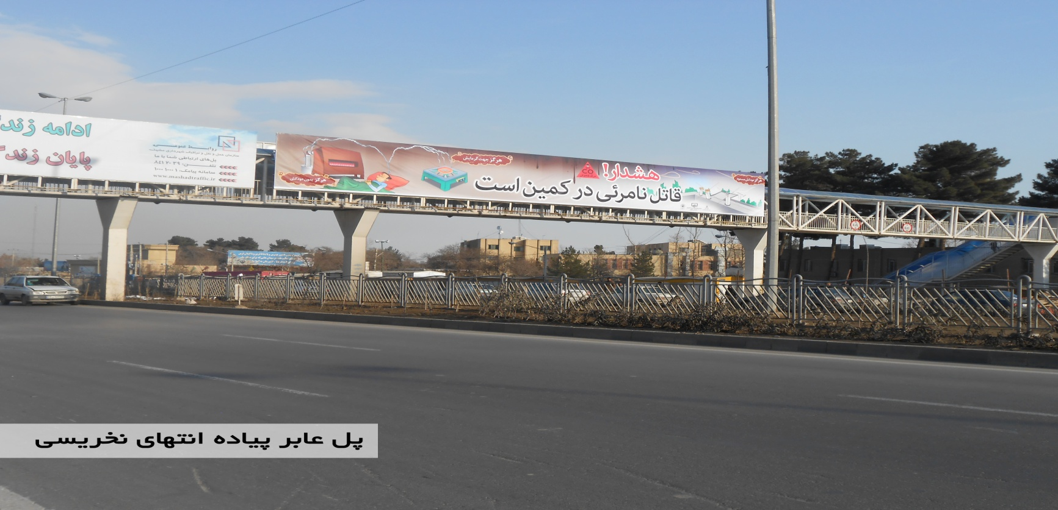
Informing people about the dangers in using non-standard construction materials and not paying attention to suggestions of engineers.

Slide 21
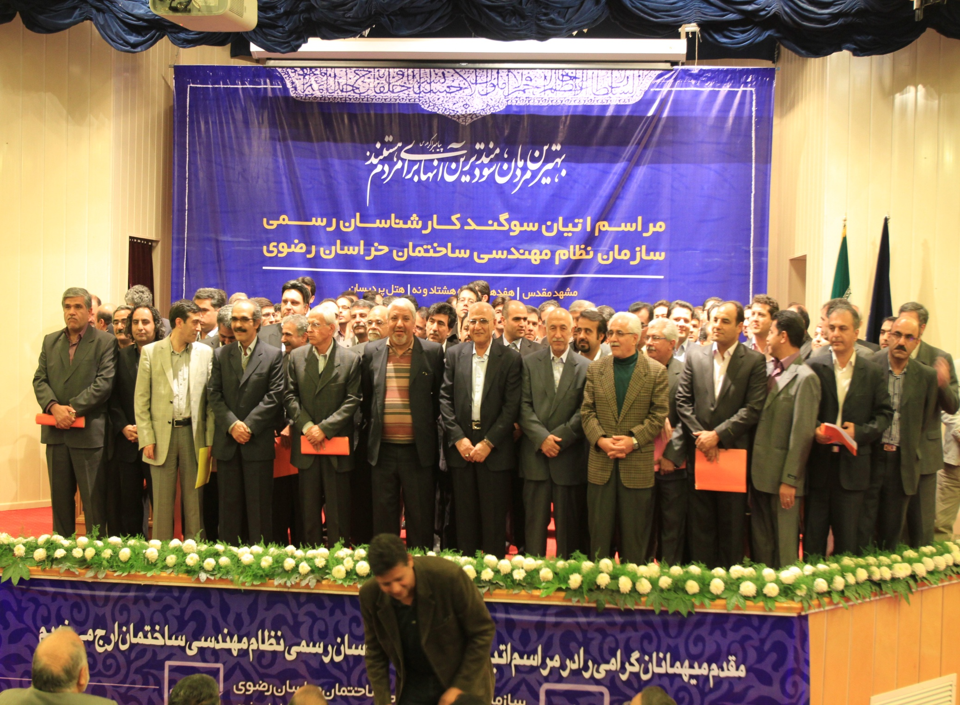
Instructing official experts of engineering organization, in order to solve the problems between the owners and construction supervisors and also paying attention to complaints of people

Slide 22


I hope Integrated Risk Management with an operational approach, according to the needs of each country, could have beneficial effects in preventing fatalities and impacts due to natural disaster.
Thanks for your attention
Iranian Construction Engineering Organization, Khorasan Razavi Province

