Slide 1
towards an Open Humanitarian Risk Index
A comprehensive, widely-accepted and open evidence base with which to reach common understanding and coordinated action
Tony Craig, co-chair IASC Sub Working Group on Preparedness
Tom De Groeve, Joint Research Centre of the European Commission

Slide 2
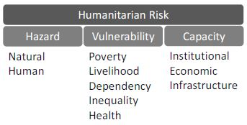
Open Humanitarian Risk Index
  A shared, transparent humanitarian risk index with global coverage,
  regional / sub-national detail and
  seasonal variation

Slide 3
Why do we need an Open Humanitarian Risk Index?
Goals
  OHRI will help
    humanitarians, donors, member states and other actors
    focus DRR and emergency readiness
    on a common risk picture
  OHRI will be open
    with all data and methods available free online
  Objectives
  Support DRR, funding and readiness decisions with evidence
  Complement existing
    risk-focused early warning at the IASC SWG for Preparedness
    needs assessments in ECHO and other organisations
  Enable regional / sub-national perspective

Slide 4
5 principles
  Global coverage
    datasets with broad global coverage
    international standards for the calculation of missing values
    future development will aim for subnational analysis
  Openness
    evidence collectively gathered
    owned by the public, agencies, governments, NGOs and academia,
    Participation of agencies that generate much of the source data
  Continuity
    five years of historical data
  Transparency
    methodology and data sources will be published and available for review
  Flexibility
    a standalone model to establish a common, basic understanding of risk
    provide a framework for incorporating additional components to allow for more nuanced analysis of specific issues or geographic regions.

Slide 5



Current partners
  OCHA
  UNICEF
  WFP
  UNHCR
  WHO
  FAO
  ECHO
  DFID (UK)
  JRC
  ISDR
  Interested
    World Economic Forum, World Bank

Slide 6
Risk Model
  Based on previous work
    Global Focus Model (OCHA)
      2006-2013
    Global Needs Assessment (ECHO)
      2004-2013
  Based on available data
    Mostly provided by partners (e.g. refugees, health, children)
  Model
    Multiplicative model
    Hazard: natural and man-made
    Vulnerability: population
    Capacity: emergency management
x
x

Slide 7
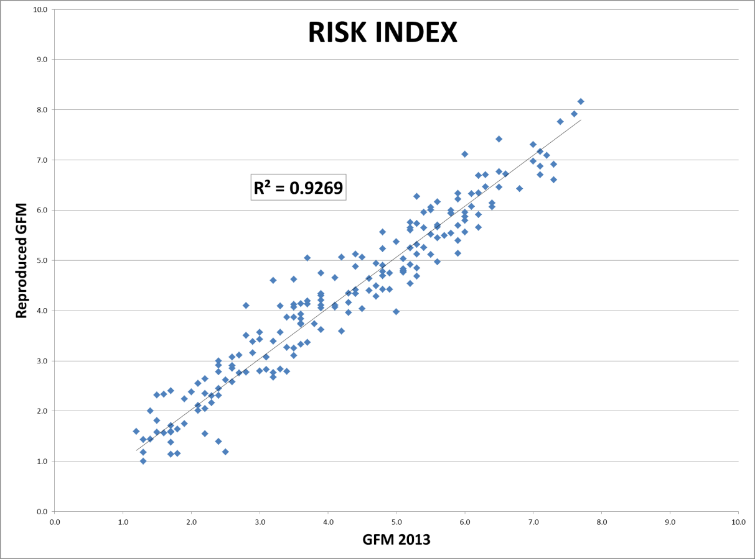
Statistical soundness
  Joint Research Center of the European Commission
    Database implementation
    Statistical audit
      Also for HDI etc.
  Issues
    Multiplicative model
    Geometric average versus arithmetic average
    Weights and implicit weights
    Basket independent normalization
    Missing data handling

Slide 8
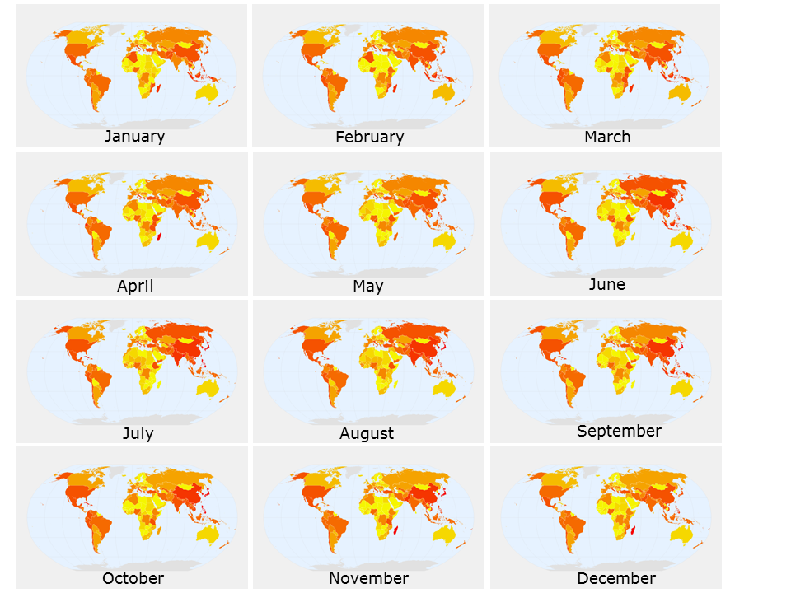
Seasonal risk index
  Hazard
    Seasons: cyclone, monsoon
    El Nino, ENSO
  Vulnerability
    Crop seasons, migration patterns
Draft

Slide 9
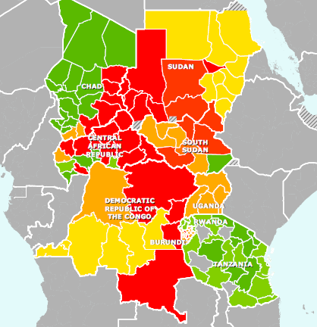

Regional / sub-national risk index
  Selected countries or regions
    In collaboration with countries
  Same overall methodology as global
    Substitution of sub-indicators allowed
Draft

Slide 10
Additional component: Crisis Index
  Goal: continuous update of the OHRI requires up-to-date data
  Fastest changing data are:
    Natural Hazards (recent disasters)
    Human Hazards (new conflicts)
    Refugee / IDP population
  How is this used?
    Not used in standard OHRI
    Used in specific versions of methodology (e.g. ECHO’s Global Needs Assessment, which emphasizes new and ongoing hazards)
Crisis Index
Conflict
Refugees / IDPs
Recent disasters

Slide 11
Timeline… time to join?
  October 2012: conceived by core group, joining initiatives at UN and in European Commission
  January 2013: proof of concept, analysis of correlation of existing models
  March 2013: first model
  May 2013: public presentation of initiative at Global Platform
  Please talk to us to participate
  June-August 2013: building partnerships and collecting support
  October 2013: technical meeting, early results
  January 2014: First publication of OHRI

Slide 12
Web site and Contacts
    ohri.jrc.ec.europa.eu
  IASC SWG on Preparedness: Co-chairs
    anthony.craig@wfp.org
    mlepechoux@unicef.org
  Joint Research Centre (technical contact point)
    tom.de-groeve@jrc.ec.europa.eu

