Slide 1
A CONNECTIVITY SOLUTION FOR RELIEF WORKERS ON THE FRONTLINE

Slide 2
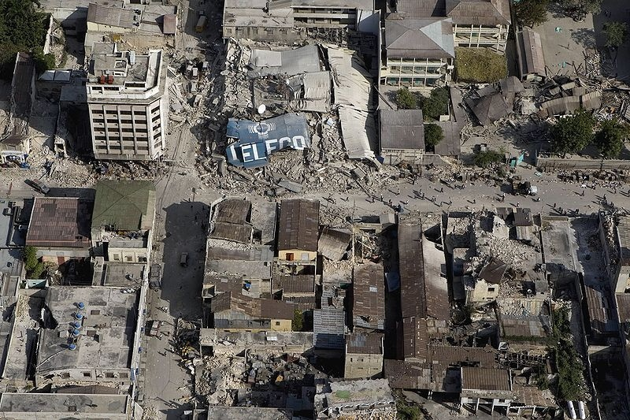

Slide 3
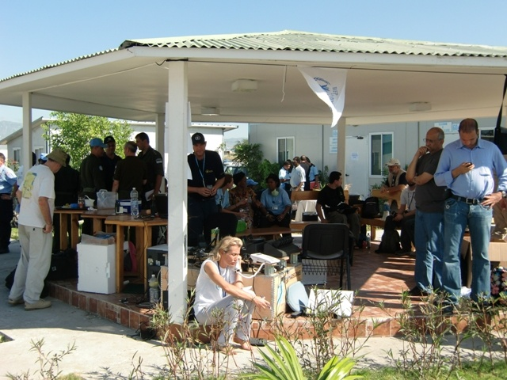

Slide 4
PREPAREDNESS
T0
T0 + 2 hours
T0 + 12-20 hours
T0 + 72 hours
Deployment team
In the air
emergency.lu
installed & operational

Slide 5
PRINCIPLES
  public private partnership
  close cooperation with WFP, as Emergency Telecommunications Cluster (ETC) lead agency
  open to other partners
  free global public good

Slide 6



PUBLIC-PRIVATE PARTNERSHIP

Slide 7
END-to-END Approach
Air Transport
Ground Terminal
Services
Satellite Infrastructure

Slide 8


TECHNICAL PARTNERS

Slide 9
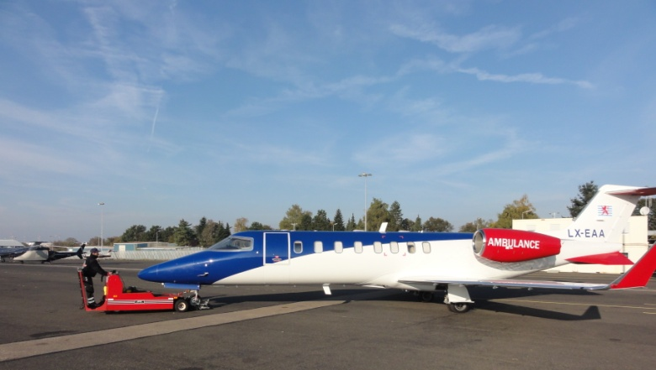


RAPID-DEPLOYMENT LOGISTICS

Slide 10
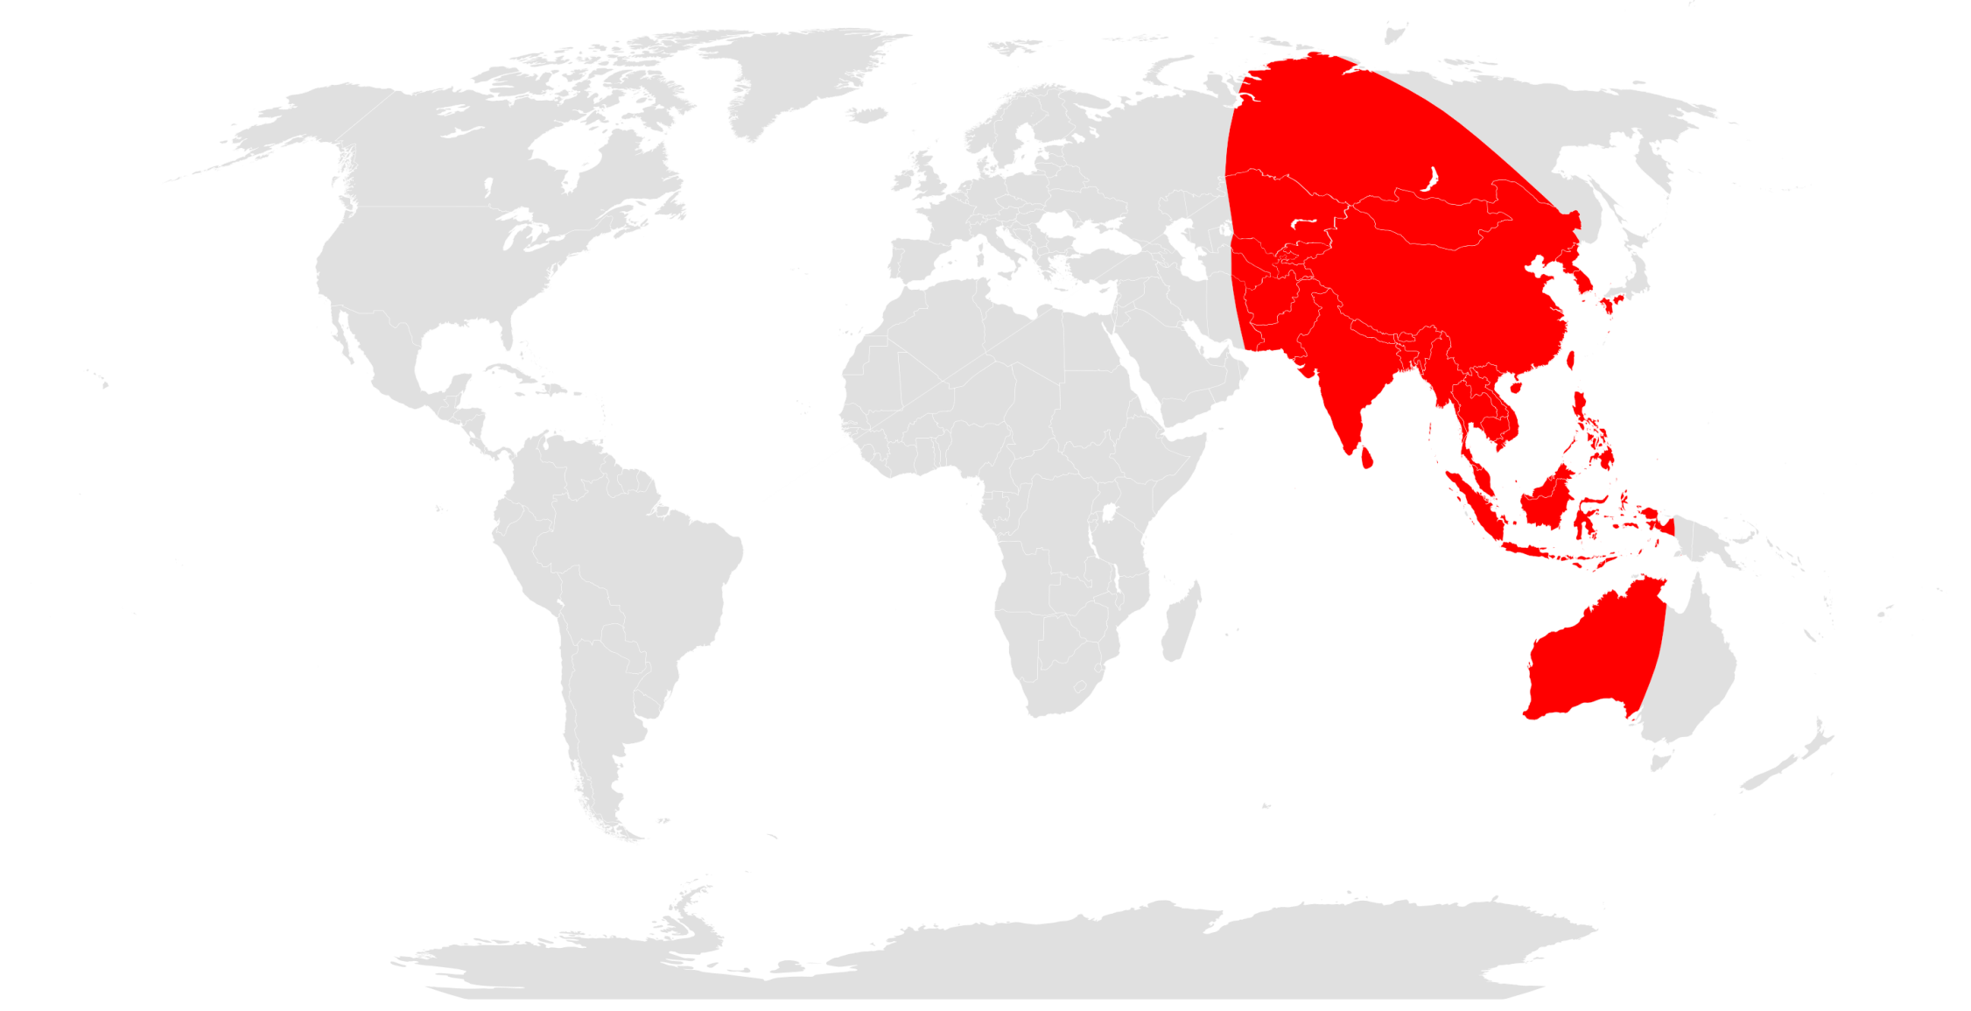
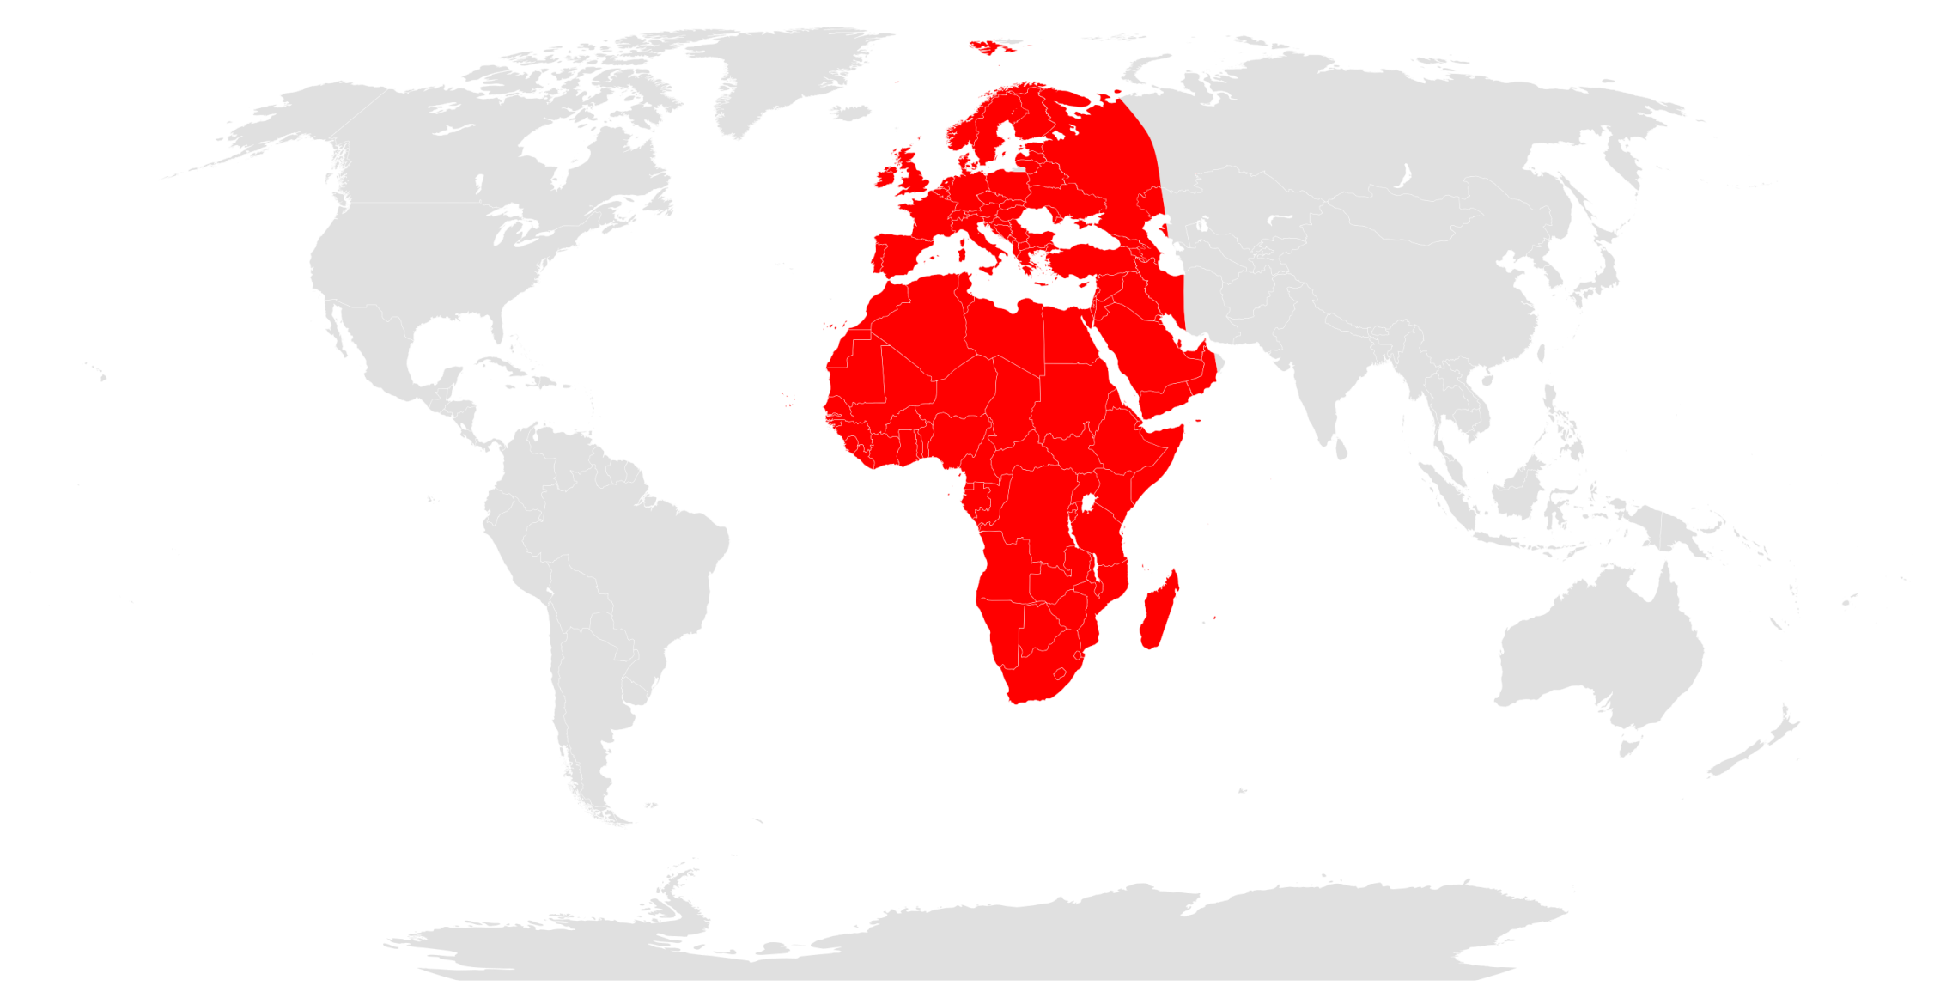
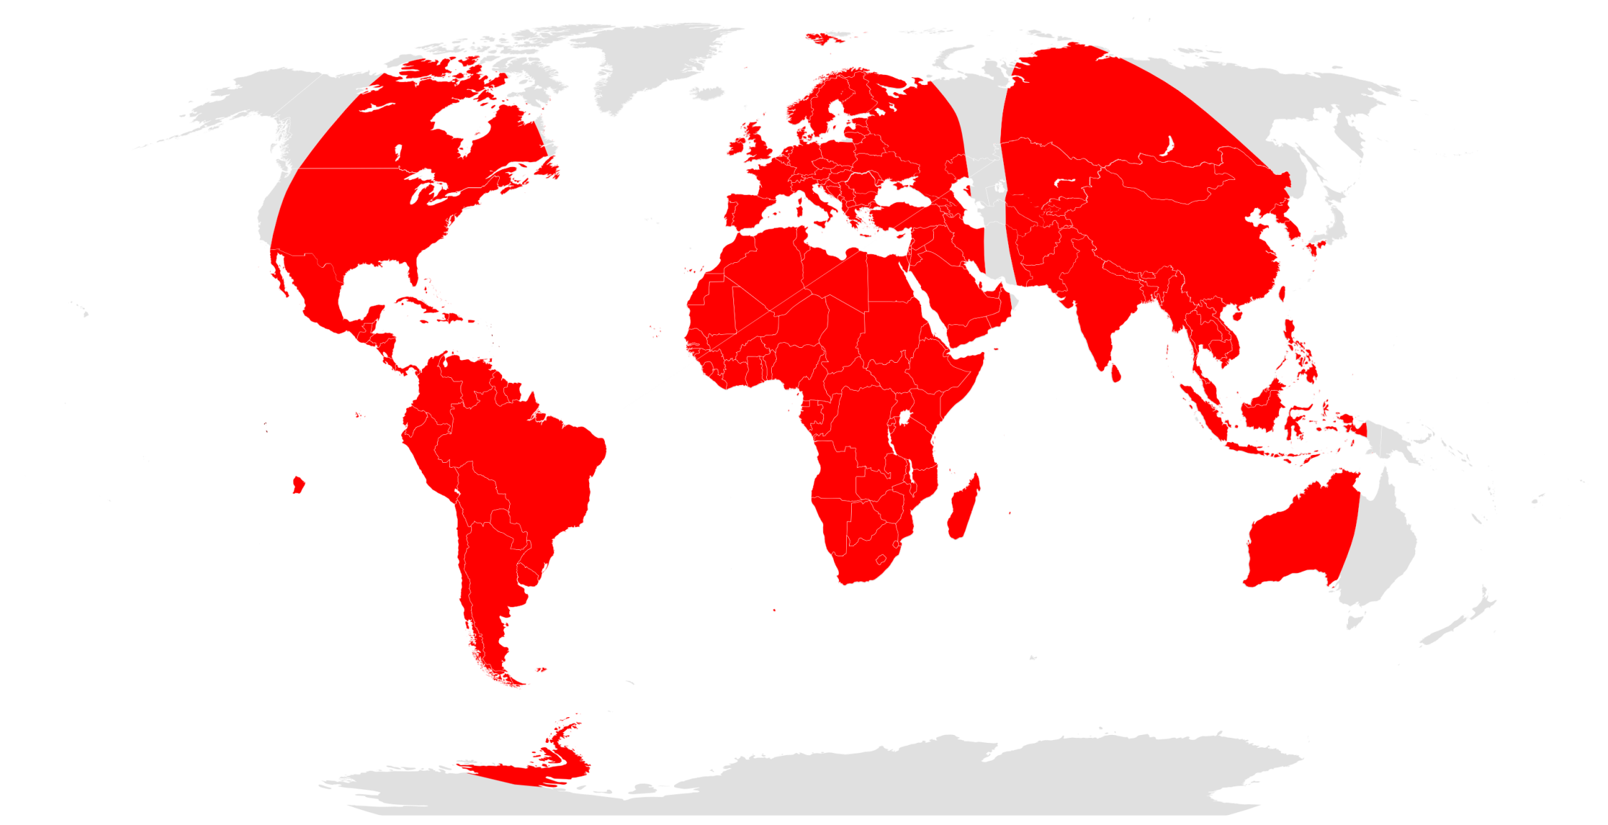
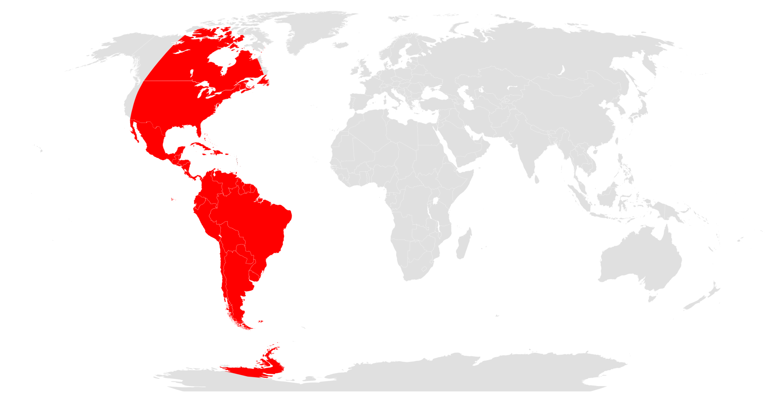


Slide 11
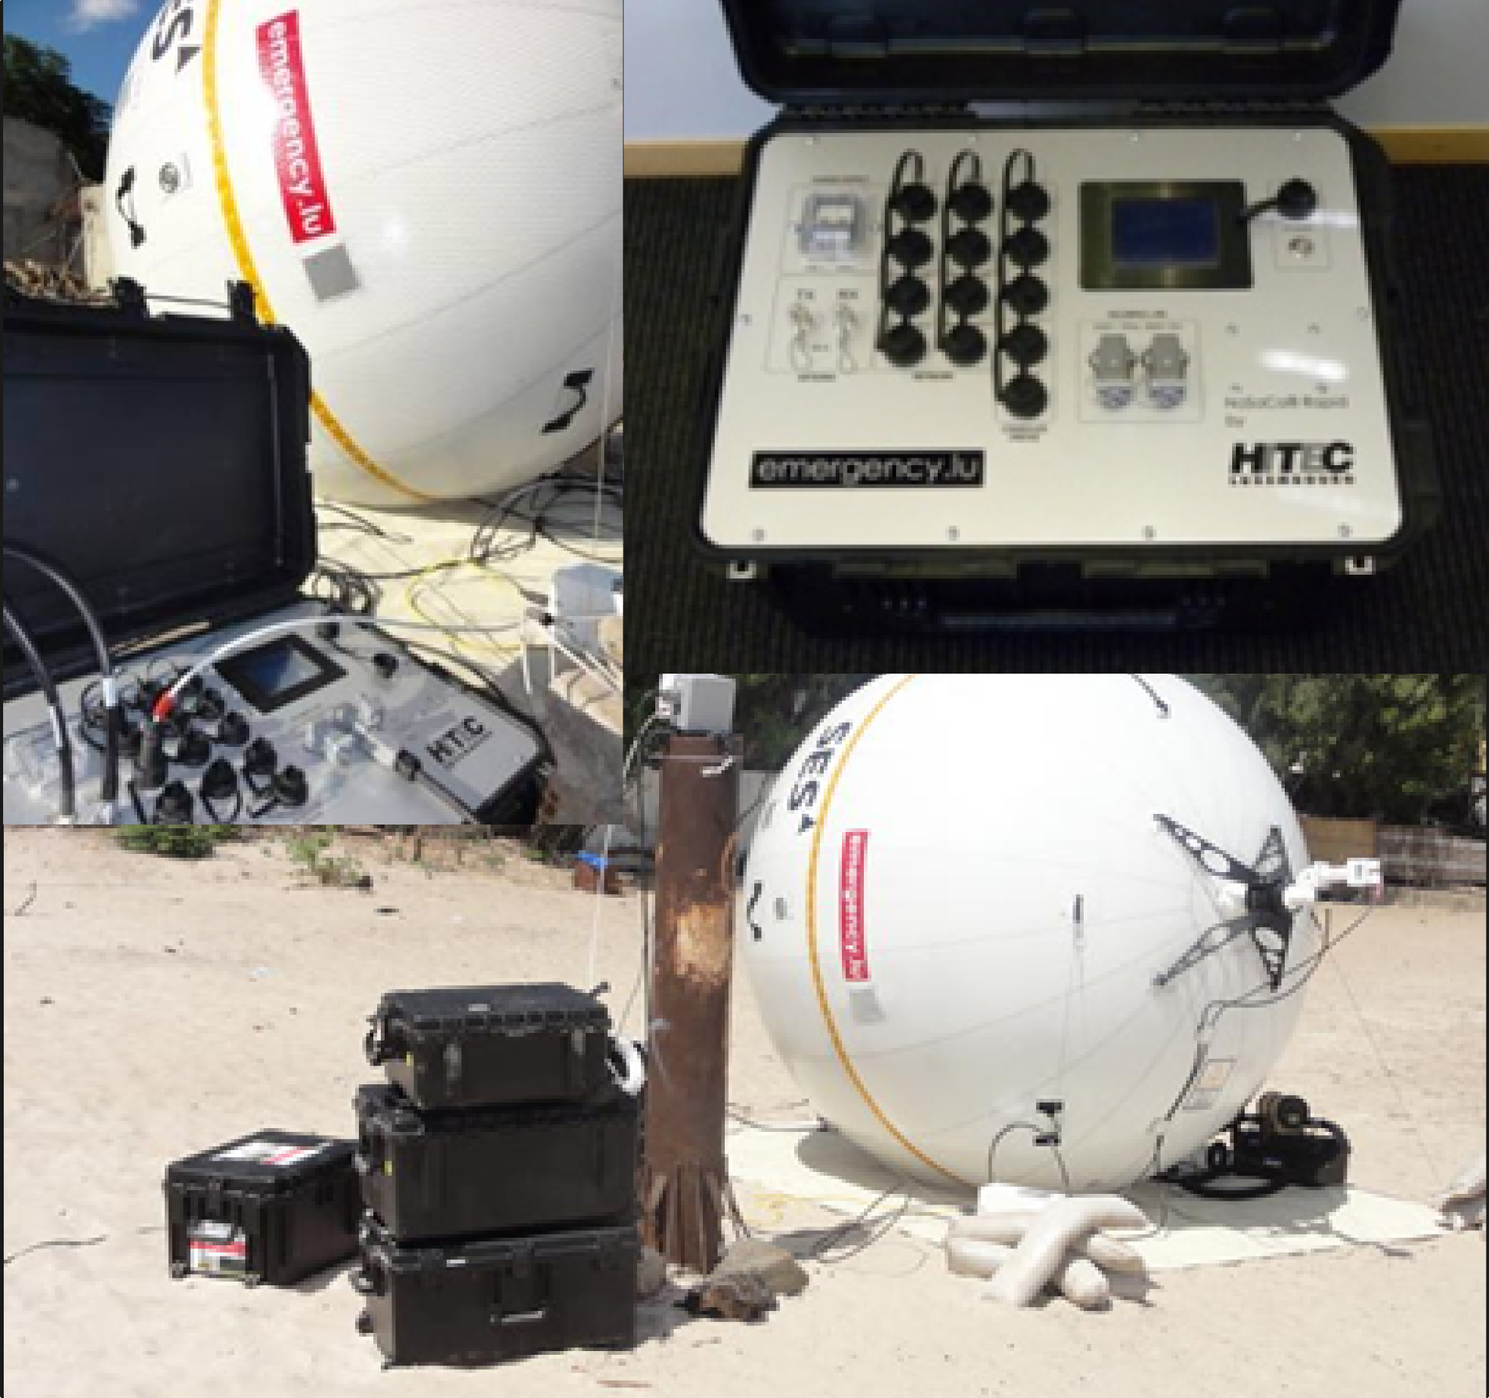
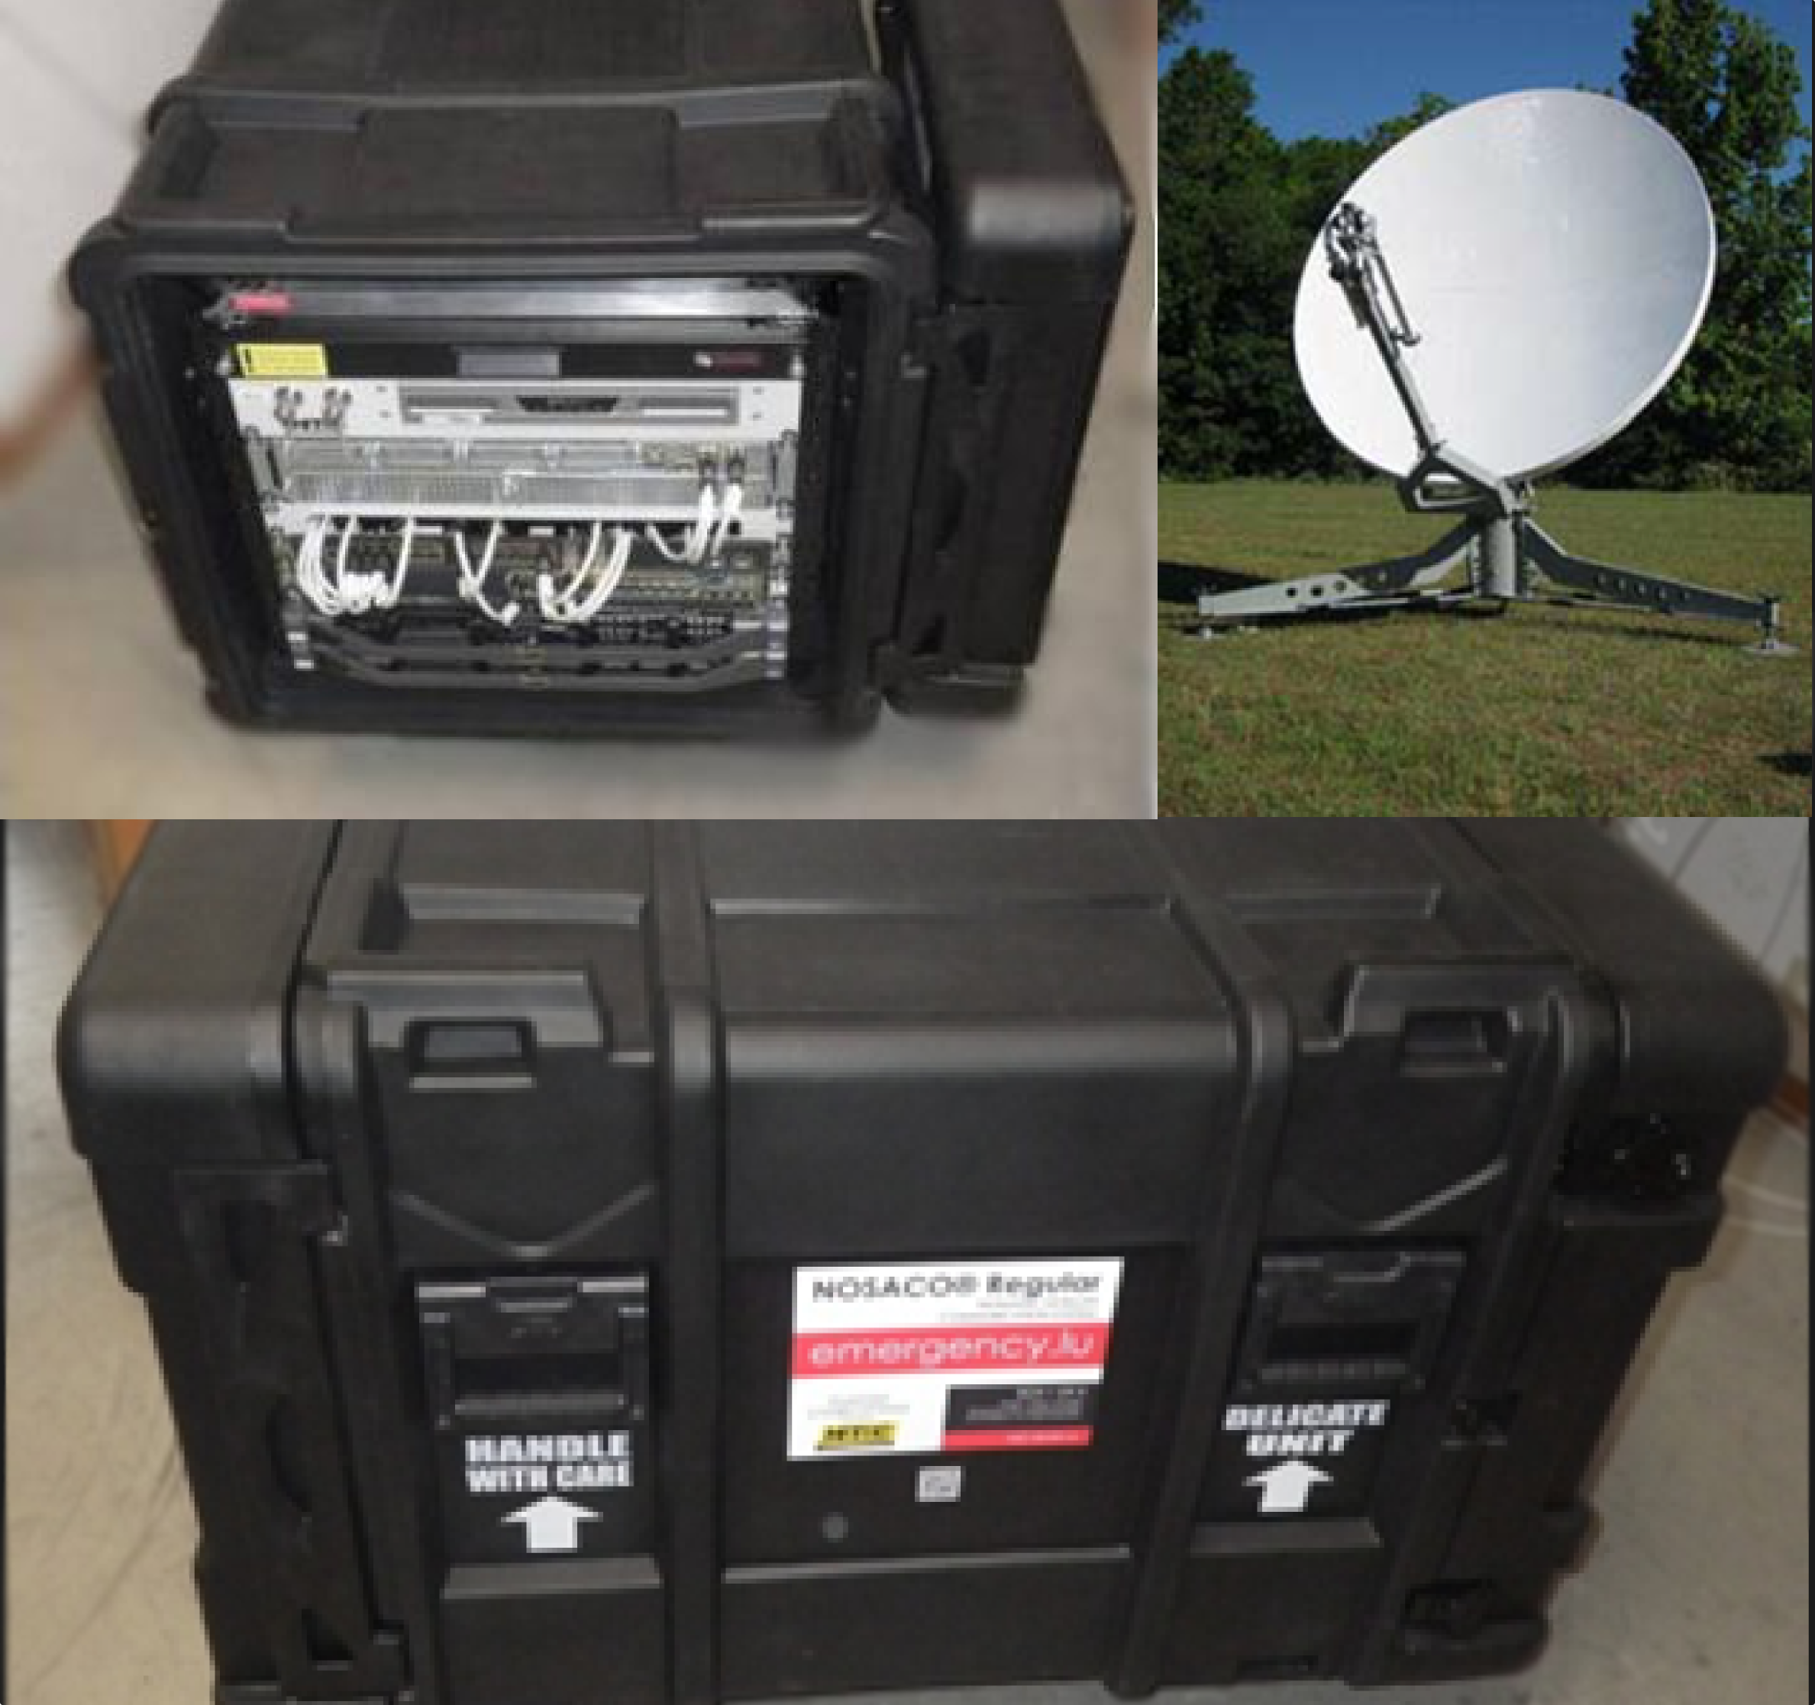
DeployMENT KITS

Slide 12







SERVICES
Situation
analysis
Tracking
& Tracing
Instant
messaging
Maps
Data sharing
Internet
connectivity
Voice

Slide 13
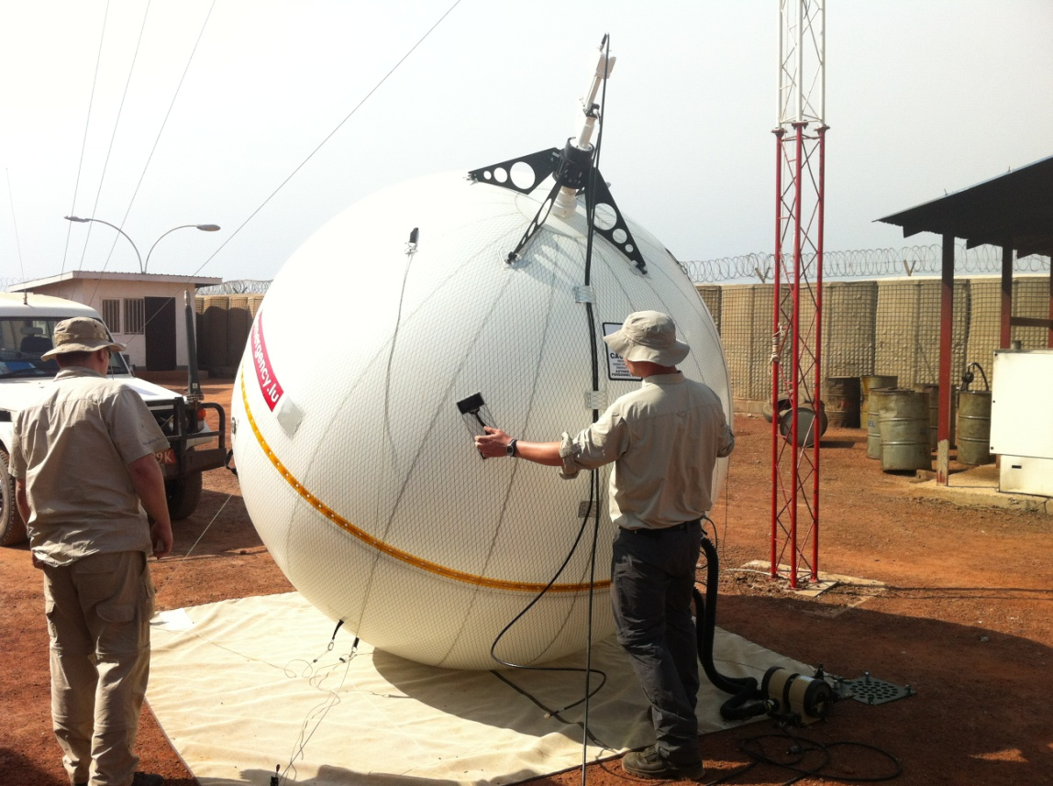
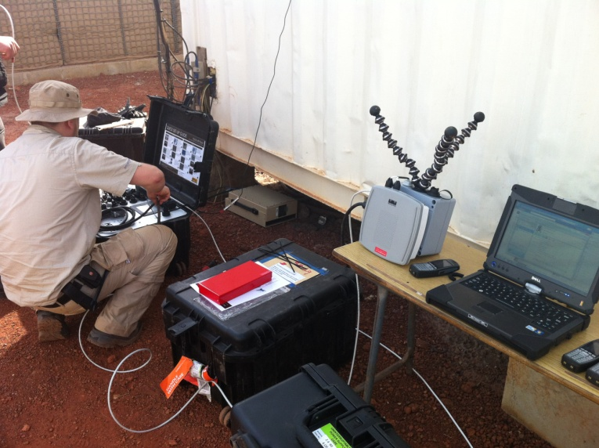
DeploymentS in SOUTH SUDAN (2012-2013)
WFP compound

Slide 14

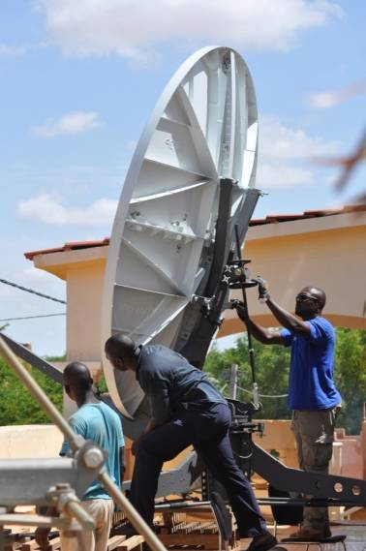
DEPLOYMENT IN MOPTI, MALI (2012-2013)
WFP compound

Slide 15
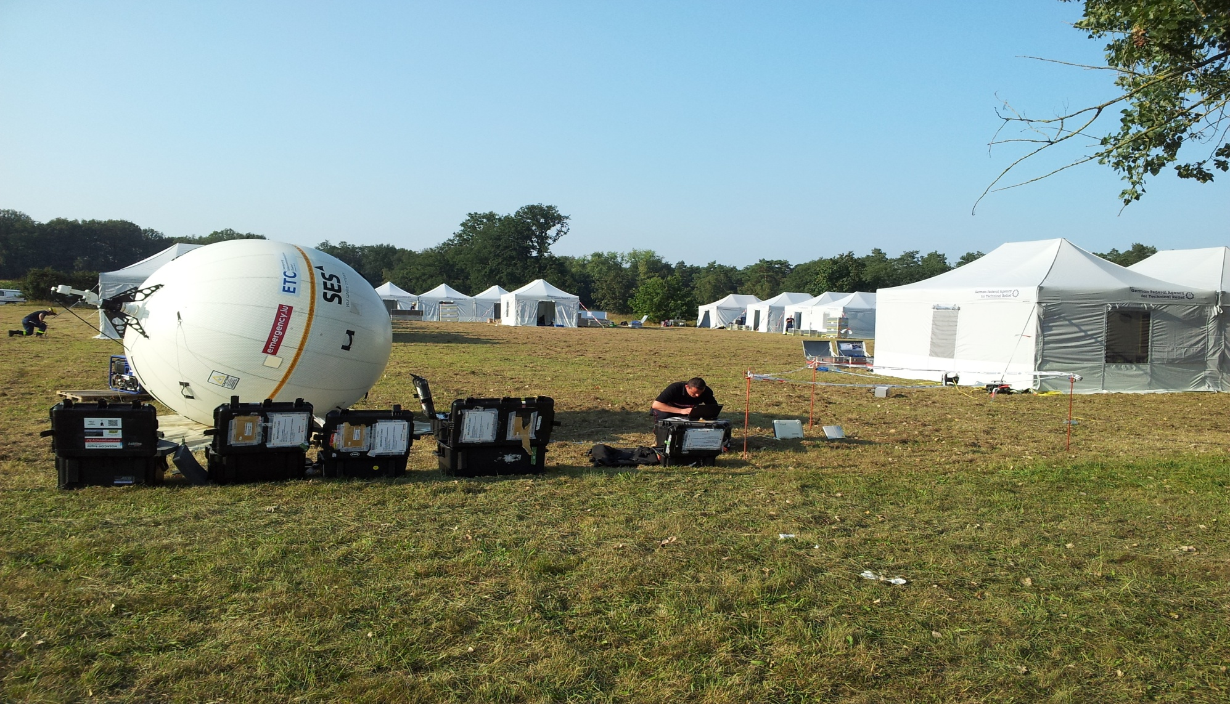
Trainings & simulations

Slide 16
Potential next deploymentS:
Syria (ETC/WFP) ?
Myanmar (UNHCR) ?
?

Slide 17

6, rue de la Congrégation
L-1352 Luxembourg
Tel. : +352 247-82351
Fax : +352 46 38 42

