Slide 2
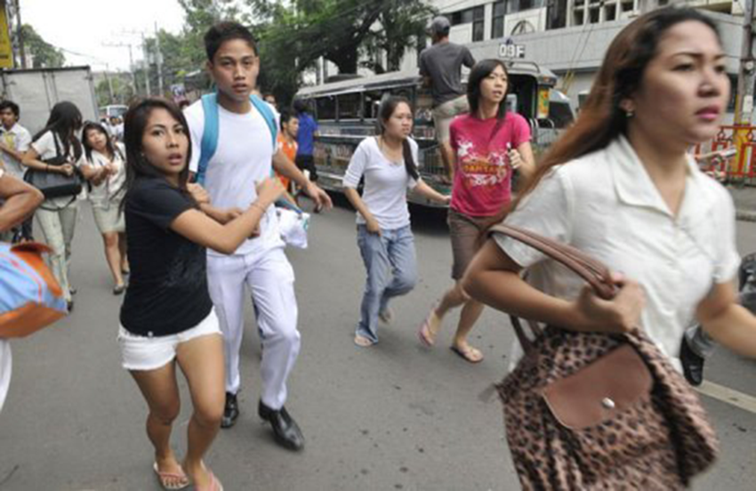
Notes:
NOT ONLY TO WAKE YOU UP
ALSO A MESSAGE THAT APPLIES TO WHAT I WANT TO TALK TO YOU ABOUT IN THE NEXT 10 MINUTES

Slide 3
Where are we running?
Notes:
Or… where do we think to run? But because often it is already too late and much damage is done.
Earthquakes simply do not come with so much warning..
So what do what do we do INSTEAD?
And what information do we need to take the action that fits our situation?
Before we do a little exercise, let me first introduce myself…

Slide 4
What do we know?
Notes:
Now I would like to ask those of you to believe they know what the earthquake risk is in their area to stand up. I do realise not all of you live in so-called earthquake prone areas, but I actually believe that from what we have seen over the past years, such as in North Italy in 2012 and what predictions say about if an earthquake were to hit the city of Accra in Ghana.
So stand up….
who thinks they know what the earthquake risk is in their area?
who has ever genuinely thought about the safety of the latest house you bought or rented for the disasters relevant to you?
who has looked into the different mitigation options they have or their organisation has?
So what does this say about you?
That you don’t care?
That you rely on your government so much that you don’t feel to take action?
Or.. that you don’t know where to get good information and/or solutions to help you mitigate risk?

Slide 5
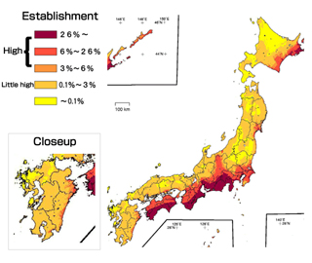
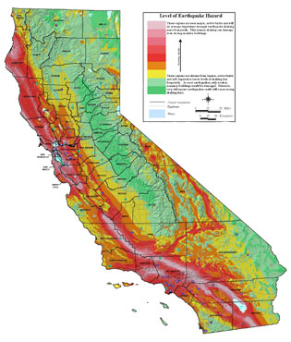
access
≠
Notes:
It is much easier said that done to really assess risk the best way we can, especially if you do not have access to sufficient tools, resources or knowledge, either directly or through the organisations and agencies you trust.
And despite the well-known damage that earthquakes can cost, reliable risk assessment tools and risk information are not accessible to many, either because they are proprietary and cost too much, or because they have never been put together in a logical way, or sometimes because information is withheld.

Slide 6
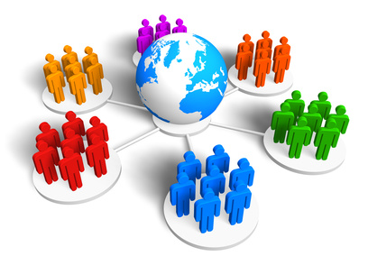
risk management financing
urban & rural planning
risk awareness
open risk assessment & modeling (science)
Notes:
Action needs to be taken locally, but only if we work together globally can we pull knowledge together. By using the same open tools and resources, we can compare risk between regions, countries and areas. We can learn and improve risk assessment together, leading to concrete products and outputs to help us manage the risk.

Slide 7
“working together to assess risk”
Notes:
And that is what we are trying to do in GEM.

Slide 8
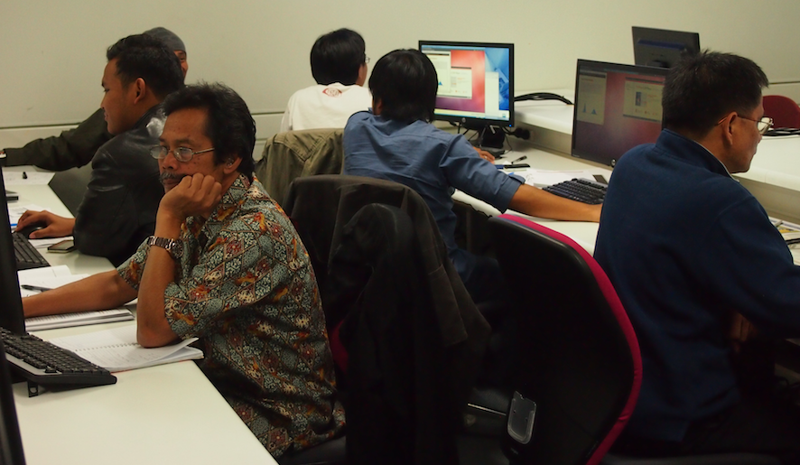
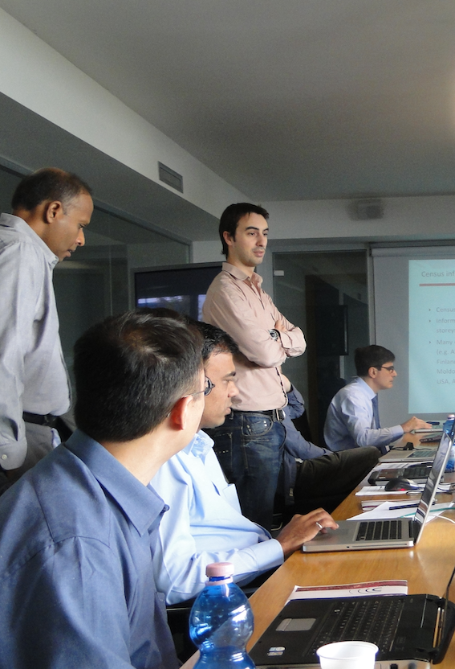
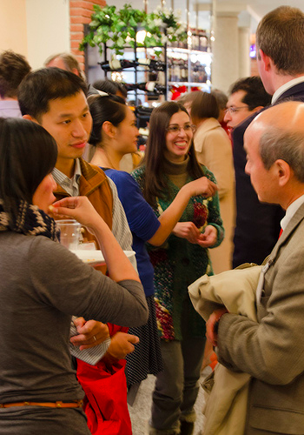
Notes:
AND THEREFORE WE NEED TO TAKE ACTION BEFORE!

Slide 9
25+ public and private organisations governing & funding
250+ leading experts developing global best practice from 80+ organisations
10+ regional science collaborations / programmes
50+ workshops, training and technology transfer activities carried out from kathmandu to capetown
1000+ individuals using the open-source modelling software, databases, reports and other resources that are already available

Slide 10
integrated earthquake risk assessment
damage and loss (of life and money)
based on that likelihood
incorporating knowledge on the socio-economic context
likelihood of earthquakes happening
HAZARD
RISK
INTEGRATED RISK
Notes:
Integrated, because all factors play a role in managing risk

Slide 11
..based on the most advanced global and regional science and knowledge..
Notes:
Analysing risk can be done in many ways, but only by using the latest and collaborative science will you be able to have the most reliable and nuanced resources to base important decisions on

Slide 12
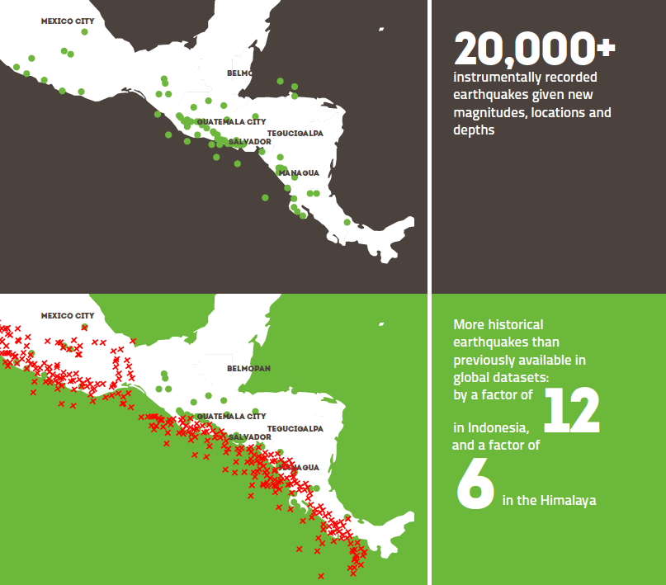
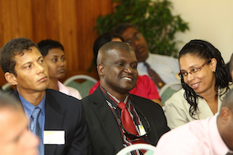
Notes:
Really leveraging science for society… leading to products such as this

Slide 13
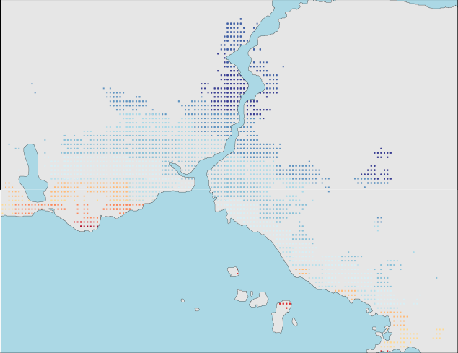
Notes:
Leading to products such as a retrofit cost-benefit map

Slide 14
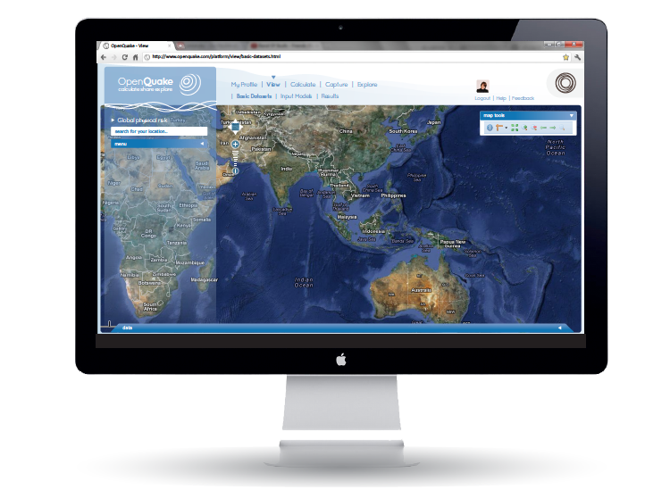
global datasets
regional and global “models”
risk information products
tools & apps
OpenQuake Platform v1: 2014
EXPLORE, CALCULATE, SHARE

Slide 15
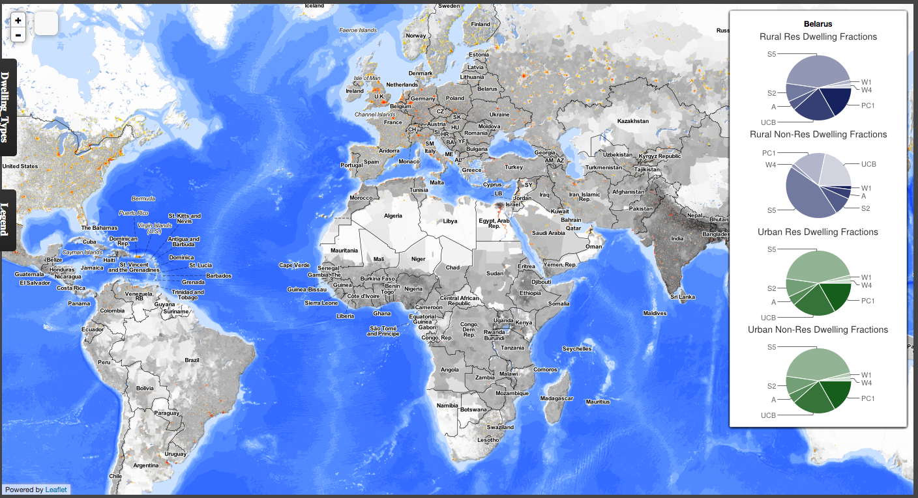
VIEW global datasets
View global datasets
building typologies
urban / rural
per country

Slide 16
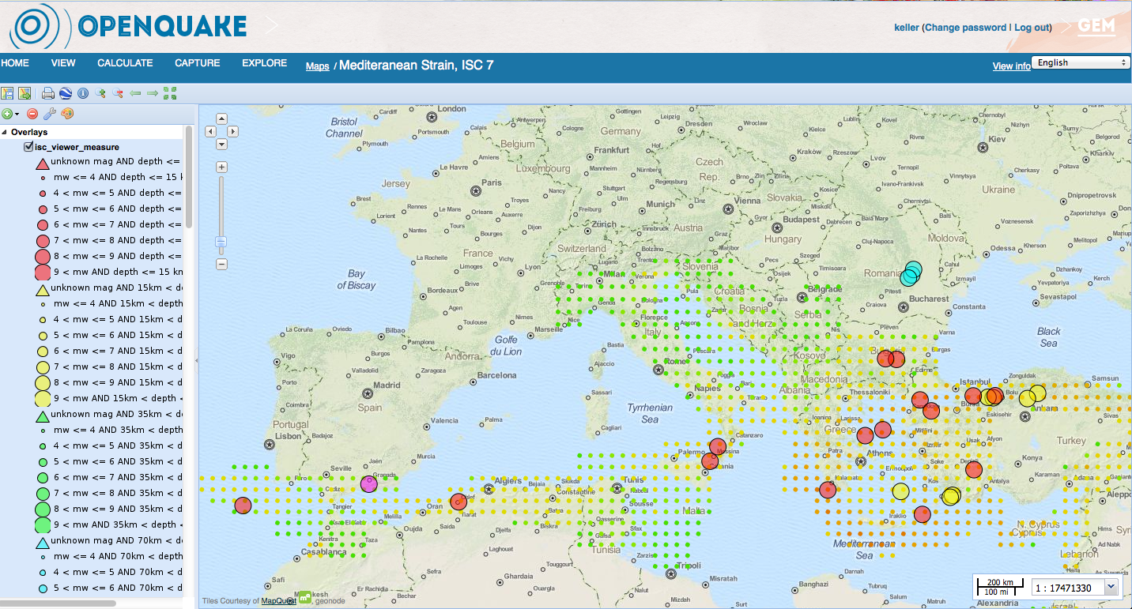
Explore risk data and information
Creating maps with several datasets:
Events from the instrumental catalogue >7
Geodetic strain rate in the Mediterranean

Slide 17
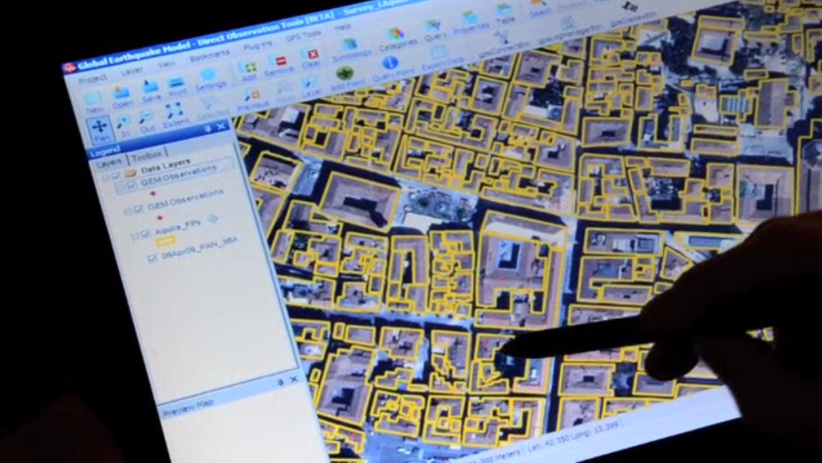
Capture (and integrate) new data

Slide 18
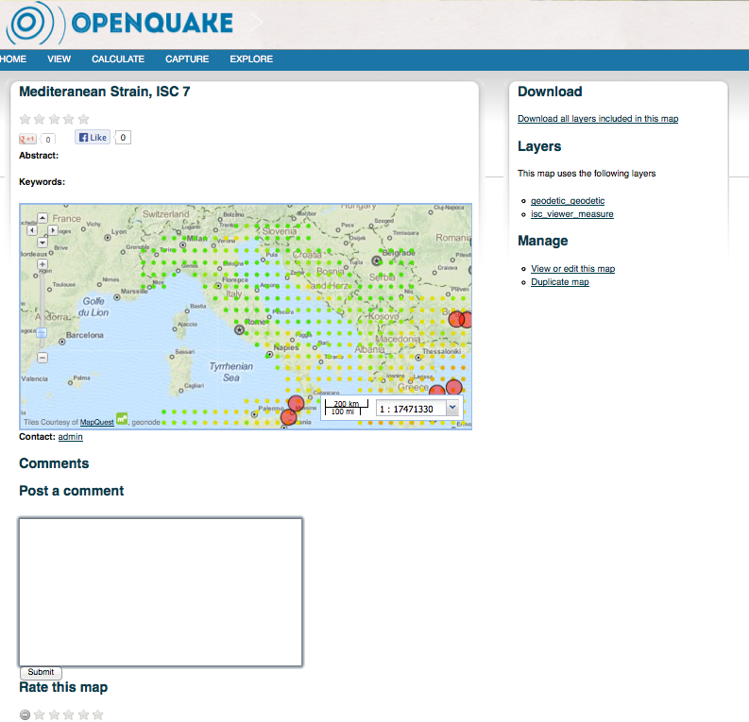
Share maps, results and more..
rate products for better use and understanding
download
manage & edit
rate

Slide 19
regional and global “models”
global datasets
historical earthquakes
(1000-1900)
historical earthquakes
(1900-2010)
strain rate
exposure (buildings and population)
consequences (loss and damage data)
vulnerability curves
socio-economic indicators
risk information products
hazard maps
loss maps
cost-benefit maps
average annual loss curves
tools & apps
open-source modelling software
modelling tools
data capture tools
socio-economic indicator & integrated risk tools
other resources
building reports and glossary
technical reports
videos and tutorials
infographs

Slide 20
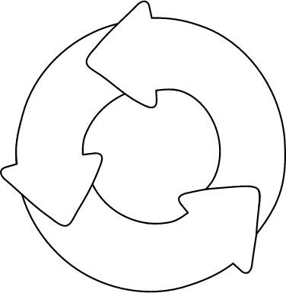
From global to local
Organisations and individuals
(data, results, discussion)
Regional, national and local projects & collaborations
(data, knowledge)
platform
tools
online resources
Global framework
(tools, data, methods, expertise)
Notes:
tools and resources becoming more valuable over time for local decision-making

Slide 21
only together we can make it work!

Slide 22
work together on development of city scenarios
collaborate to develop on an app for humanitarian purposes that can link to the OpenQuake platform
share census data on buildings for south-asia
execute a training in socio-economic vulnerability indicator development
fund a series of workshops

Slide 23
Lets run in the same direction.. but mainly work together!
www.globalquakemodel.org

