Slide 1

Open Data for Resilience
John Crowley

Slide 2
To use
science, technology & innovation
to inform decision making
and
reduce the vulnerability
of the developing world
to disasters
in a changing climate

Slide 3
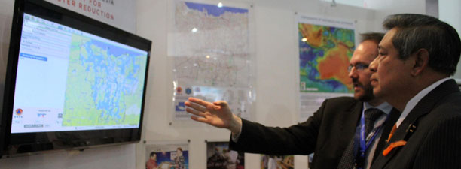
We empower decision makers in the countries where we work
Notes:
Managing risks starts in the governments which must mitigate aging infrastructure and plan for growth amidst increasing threats from climate change and increasing awareness of their exposure to natural hazards. We work with partners from science agencies, reinsurers, and development organizations to focus investments on building capacity of governments to collect, analyze, and curate data about their own exposure, vulnerability

Slide 4
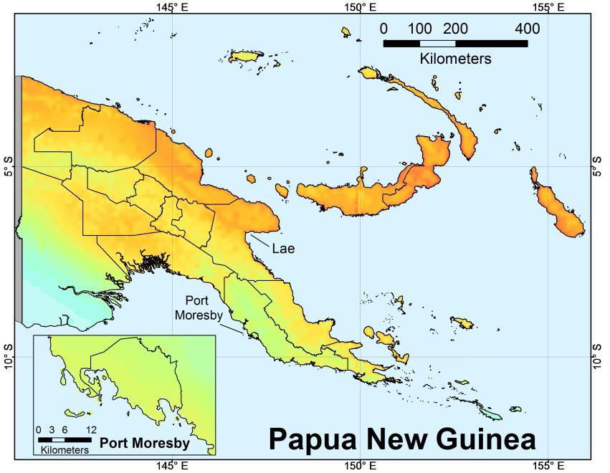
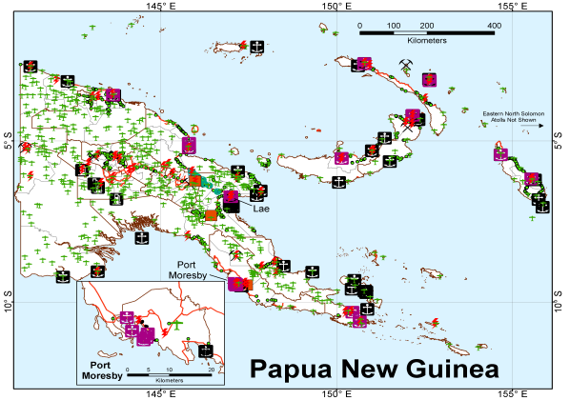
Hazard
Exposure/Vulnerability
x
Risk
Notes:
A core engine of this work is providing tools that enable governments to develop processes to work with the basic equation of risk being a function of the combination of the exposure of the built environment and vulnerability of human activities to hazards

Slide 5
Without high-resolution
exposure and vulnerability data,
high-resolution hazard models
are not as useful
x
=
Notes:
While we may have high resolution hazard data, exposure data is often quite coarse. Vulnerability data are generally lagging behind. The result is a low resolution risk model.

Slide 6
OpenDRI confronts a challenge:
How to enable our clients
to build the information they need to drive their decisions about managing risk
Notes:
We work to increase the resolution of data involved in building risk models and help with the application of those models to investment decisions for our clients. How do we focus on the health clinics and schools that are most at risk? Find several problems building out these data:

Slide 7
Data might not exist
Notes:
Data on built environment, locations of schools and hospitals, may not exist.

Slide 8

Some data may exist
but is inaccessible:
not open, fragmented, or locked in proprietary systems or files
Notes:
Some data may exist, but be locked away for various reasons: lack of an open data program, fragmentation across ministries, or locked in static documents

Slide 9
Or data may exist and
be accessible,
but our clients lack the
tools or capacity
to use it effectively
Notes:
Some data may exist and be accessible, but our clients cannot use it effectively without capacity building around tools and practices.

Slide 10
Without open data,
at-risk populations struggle
to make informed decisions
Notes:
Our work is for the communities in which we work. We want to give local decision makers the data they need to make informed decisions. At all levels. This requires that the data be open..

Slide 11
Why Open Data for Resilience?
Notes:
Open Data for Resilience was designed to address these challenges.

Slide 12
Open data is the foundation of the scientific method.
It has become the foundation of
open government.

Slide 13
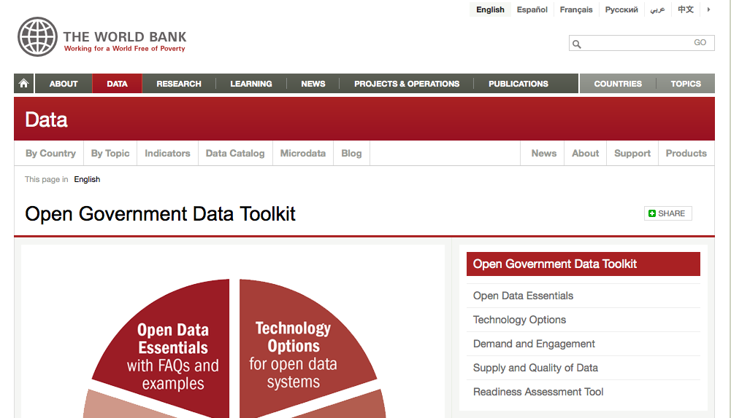
The World Bank launched its
open data initiative in 2011.
Notes:
The World Bank’s Open Data iniitiative builds data that is legally and technically open: capable of being accessed using open standards and licensed for reuse.

Slide 14
Key Principles of Open Data
Accessible at published address (URI)
using open data standards
allowing for the discovery of related data
all under a license that allows for reuse

Slide 15
Open Data for Resilience (OpenDRI) aims to reduce the impact of disasters by empowering decision makers with better information and tools to support their decisions.
Notes:
OpenDRI builds on open data. Its goal is to enable our clients—governments and the communities that make up a country—to make better decisions using more complete information about their risks.

Slide 16
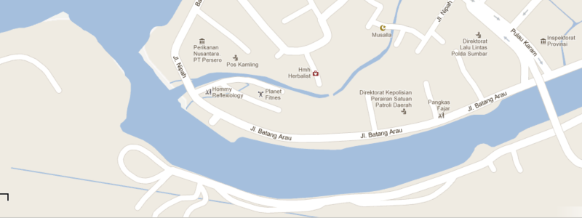
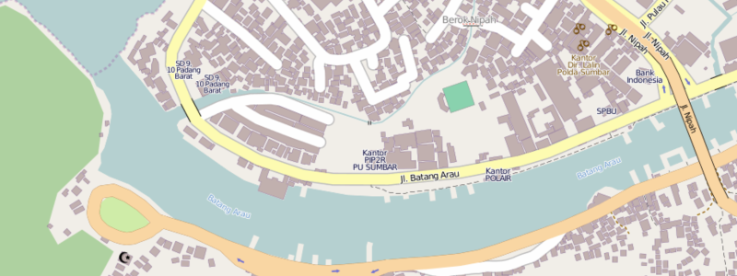
OpenDRI works with partners to collect and curate high-resolution exposure data
using open technologies

Slide 17
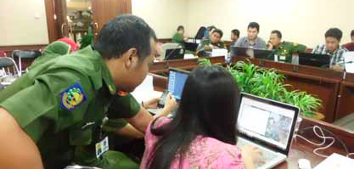
Where collectors and curators are
the members of
communities at risk

Slide 18


We help governments and partners
open their data using
open source tools and open standards
Notes:
We approach the problem by using tools that allow us to build a local ecosystem of developers and curators. We want these solutions to be sustainable using tools that are free and open source wherever possible. It also allows for translation into local languages, extemsion of functionality to local context, and network effects when out clients begin to partner.

Slide 19
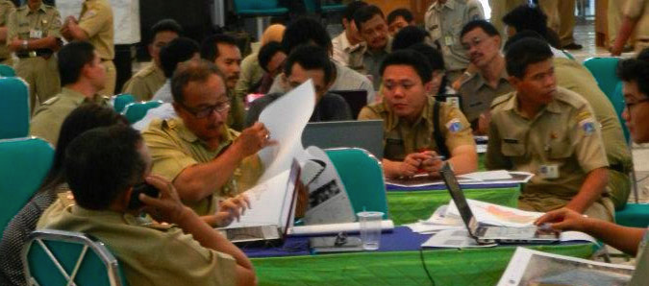
We empower local decision makers to use their own
local data to drive local decisions

Slide 20
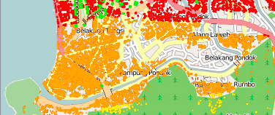
In partnership with scientists,
we combine hazard models
with exposure data
to create risk models

Slide 21
and target investments in DRR activities that have the greatest potential impact
Visualization of hazard and risk
Scenario analysis for emergency preparedness
Territorial planning
Immediate damage assessment
Infrastructure design
Analysis of financial exposure
Cost Benefit analysis for mitigation and prevention investments
Climate Change
Notes:
We focus on targeting investments in areas that will have greatest impact. To get to this point, we need data.

Slide 22
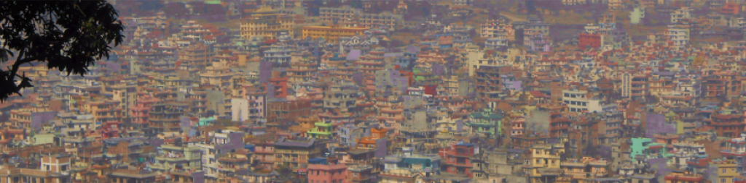
OpenDRI: Nepal
Open data and community engagement creates a more dynamic and engaged understanding of risk and resilience.
UNDP Photo

Slide 23
A Plan to Increase Resilience in Kathmandu
Analyze the Seismic Hazard
Map the Exposure and Vulnerability
Develop Detailed Seismic Risk Assessment
Create a Portfolio of Activities to
Increase Resilience
Invest in retrofitting critical assets
Re-think Urban Planning
Consider Financial Protection
Prepare for the worst

Slide 24
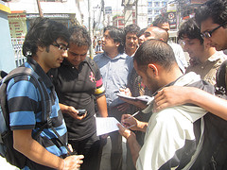
A community of volunteers:
making a difference, and learning about resilience through mapping their own city
Values
Building Polygon
Roof Type
Building Type
Number Stories
Building Usage

Slide 25
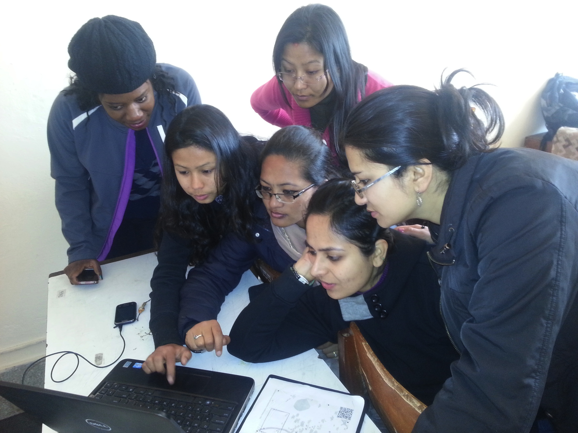
Building Women Mappers
through tailored training and events

Slide 26
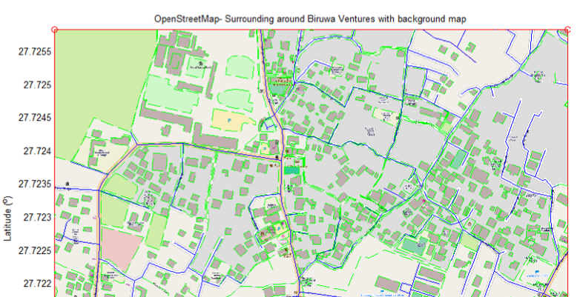
Addition of exposure data into OpenStreetMap is easy to train.
Notes:
Easy to do. Can be done in web browser or free GIS tools, including one called Quantum GIS. Drawing polygons is relatlively straightforward—a matter of a basic training. Show the results.

Slide 27
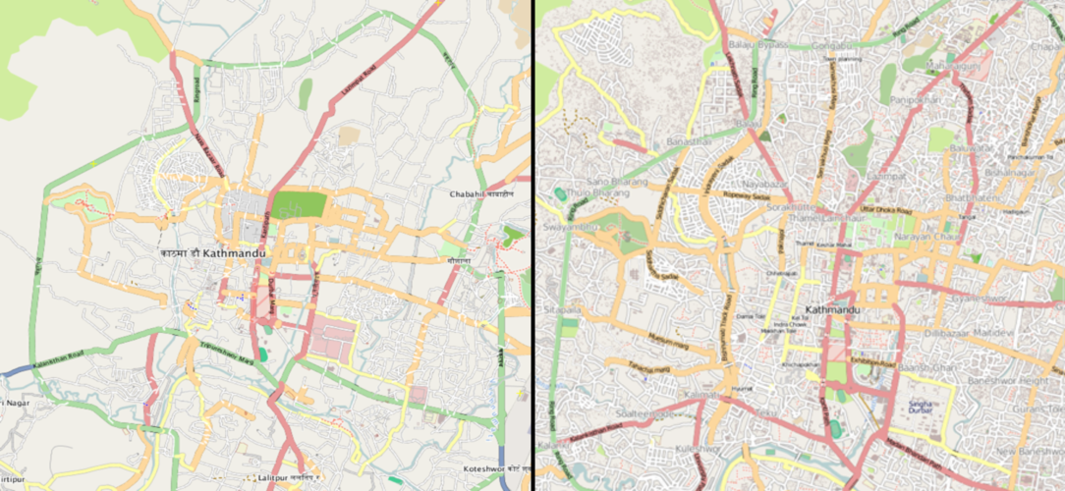
Rapidly Mapped City of
Kathmandu

Slide 28
Rapidly Mapped City of
Kathmandu

Slide 29
Rapidly Mapped City of
Kathmandu

Slide 30
Rapidly Mapped City of
Kathmandu

Slide 31
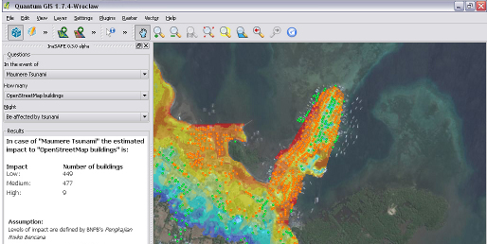
Building capacity to undertake a comprehensive seismic risk assessment using open source techniques

Slide 32
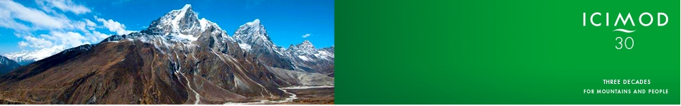
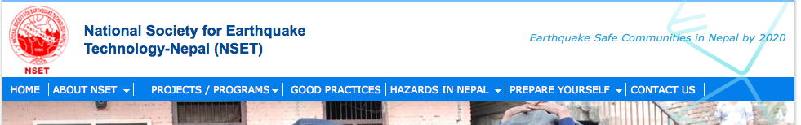


Partnering with sector experts and technologists to support the development of software applications
Notes:
Working with a range of partners. From NGOs to Nepal Risk Reduction Consortium

Slide 33

Creating an ecosystem around
open data between partners.
Local curation of local data
Work with existing systems
Pull in dynamic data feeds from partners

Slide 34
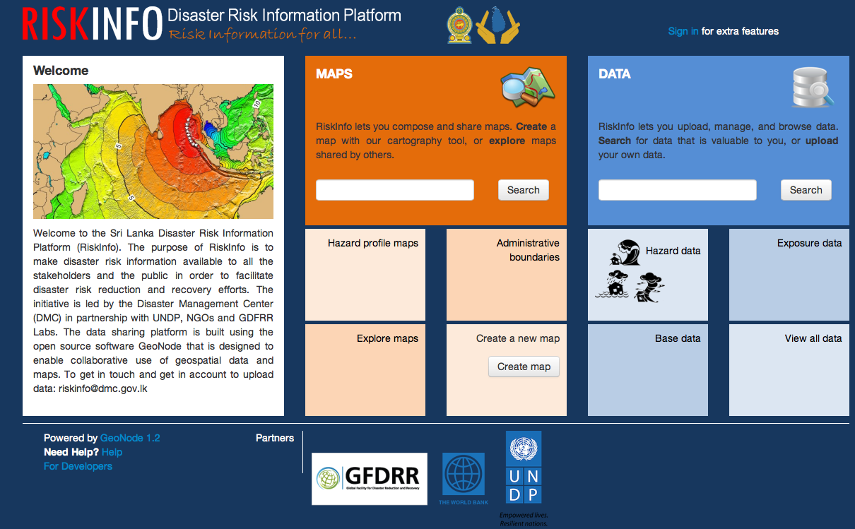
GeoNode allows partners to expose and share data
stored on their own GeoNodes

Slide 35
John Crowley
Consultant
Open Data for Resilience
GFDRR Labs
The World Bank Group
jcrowley@worldbank.org

