Slide 1
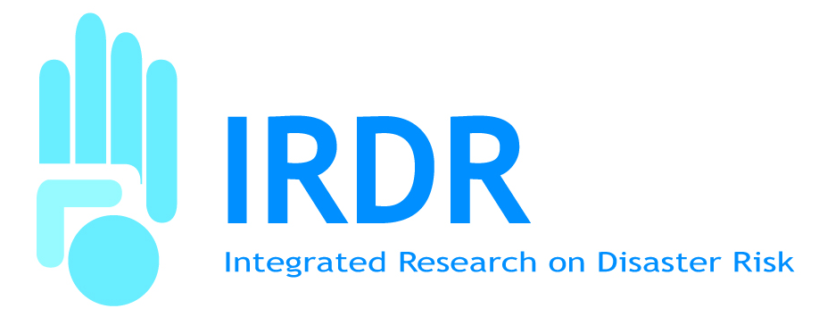
Linking Science to Disaster Risk Management
Jane E. Rovins, PhD, CEM
Executive Director
Integrated Research on Disaster Risk (IRDR) International Programme Office
Beijing, China

Slide 2
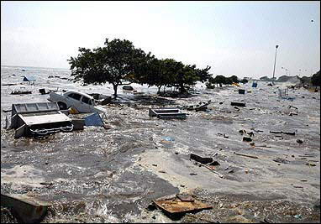
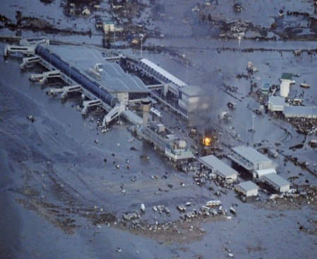
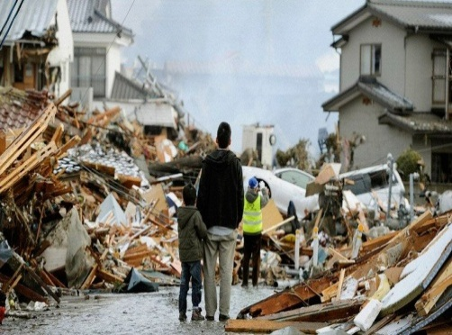
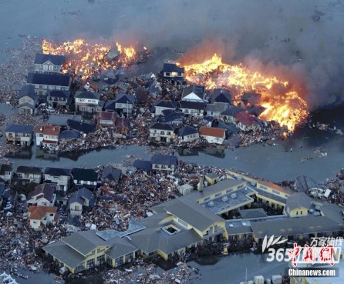
Background
Why, despite advances in the natural and social sciences of hazards and disasters, do losses continue to increase?
How do we address the lack of sustainability in current disaster practices?

Slide 3
IRDR Science Plan
Capacity Building
Addressing the challenge of
natural and human-induced
environmental hazards
An integrated approach to research on disaster risk through: an international, multidisciplinary (natural, health, engineering and social sciences, including socio-economic analysis) collaborative research programme.
Case Studies & Demonstration Projects
Assessment, Data Management & Monitoring

Slide 4
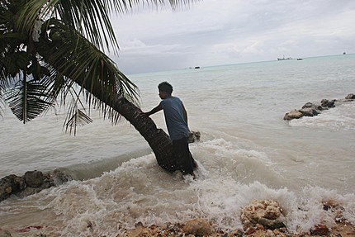
Research Objective #1
Characterization of hazard, vulnerability and risk
Identifying hazards and vulnerabilities leading to risks
Forecasting hazards and assessing risks
Dynamic modelling of risk

Slide 5
Research Objective #2
Effective decision-making in complex and changing risk context
Identifying relevant decision-making systems and their interactions
Understanding decision making in the context of environmental hazards; and
Improving the quality of decision-making practice.

Slide 6
Research Objective #3
Reducing risk and curbing losses through knowledge-based actions
Vulnerability assessments
Effective approaches to risk reduction

Slide 7
Activities
Improve scientific knowledge and integrated research
Foster networking and collaboration among domestic, regional and international disaster risk reduction science and technology activities
Enhance the integration of science in disaster risk reduction planning, policies and programmes
Engage in the discussions for the post-2015 “HFA” and MDGs
Contribute to the national/regional discussions for other relevant global negotiations (Future Earth, climate change adaptation, etc.).
Provide scientific advice to policy-makers

Slide 8
Partners
National & international science institutions
National & international development assistance agencies and funding bodies
Other research organizations
ICSU Unions
ISSC Unions
Regional Offices
UN Organizations
IRDR National Committees
IRDR International Centres of Excellence

Slide 9
Forensic Investigations of Disasters (FORIN)
Common template & methodology
Trace out and assign causal explanation of losses and intervening conditions that increased or reduce losses
4 completed – Japan
15+ underway – Algeria, CEDIM (Germany), China, El Salvador, EU JRC, Haiti, Honduras, Japan, Pakistan, Philippines, Thailand, Taipei, volcanoes
Community of Practice, workshops

Slide 10
Disaster Loss Data WG
Identify what data and quality are needed to improve integrated disaster data management; Educate users
Increase downscaling of loss data to sub-national geographies for policy makers
Common peril terminology and hazard identification
Munich Re; NOAA NCDC; SHELDUS; Swiss Re
ADRC, CoDATA, CRED, EU JRC, GRIP, ICHARM, UNDP, UNISDR, WDS
Federal Ministry of Agriculture Forestry, Environment and Water Management (Austria); National S&T Center for Disaster Reduction (Taipei)

Slide 11
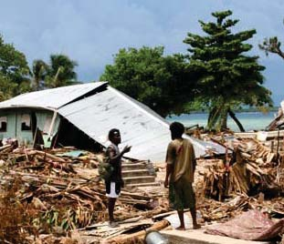
Assessment of Integrated Research on Disaster Risk (AIRDR)
First systematic and critical global assessment of published research on disaster risk
Provide a baseline
Use to identify and support longer-term science agenda
Provide scientific evidentiary basis in support of policy and practice
Promotion of an Intergovernmental
Panel
Notes:
SWOT – what is know well
What is known less well?
What can we learn from the co-production of knowledge?
What don’t we know, that we should?

Slide 12
Risk Interpretation & Action (RIA)
Estimation of the likelihood, magnitude of event and vulnerability of physical infrastructure
Social and behavioural factors leading to greater or lesser risk including decision-making
Article in IJDRR; UK Workshop
ISSC Fellows Program (ICoE Taipei & NZ Partnership)

Slide 13
WWRP/IRDR Societal and Economic Research and Applications (SERA)
Joint WWRP (WMO) and IRDR project
To advance the science of the social and economic applications of weather-related information and services
Development, review and promotion of societal and economic-related demonstration projects focused on high-impact weather and information

Slide 14
IAP Science, Academia, and Research Stakeholder Group
In partnership with the countries of Asia and the Pacific, UNISDR, NGOs, and others
Supporting the Asian Ministerial Conference on Disaster Risk Reduction and Declaration
Annex 10 - Research, integration, global standards, awareness, education, increase funding
18 specific deliverables
Community of Practice established

Slide 15
National Committees & ICoE
Canada
China
France
Germany
Japan
New Zealand
Others Welcome!!
Taipei ICoE
Vulnerability & Resilience Metrics (USA)
Community Resilience (NZ)

Slide 17
Thank you connect@irdrinternational.org
www.irdrinternational.org

