Slide 1

TRADITIONAL EARTHQUAKE-RESISTANT TECHNIQUES: THE CASBAH OF ALGIERS (ALGERIA)
Global Platform for Disaster Risk Reduction
Geneva, 22 May, 2013
Djillali BENOUAR and Amina FOUFA
USTHB
ALGERIA

Slide 2
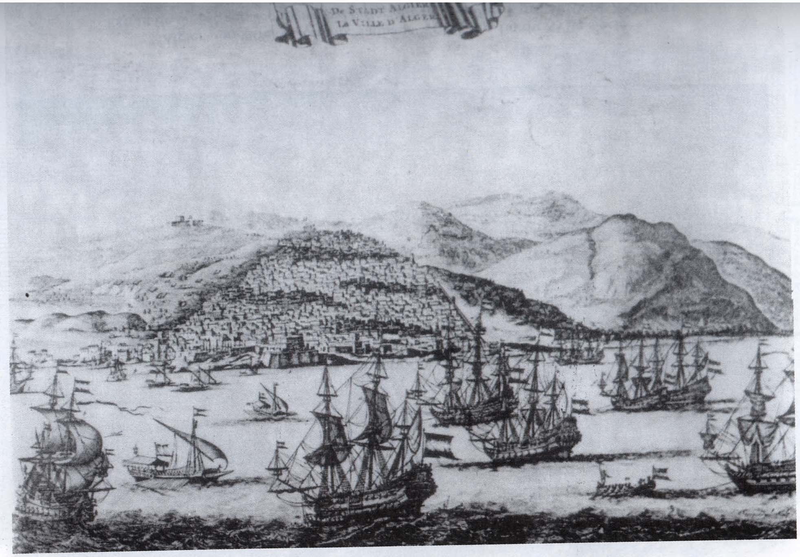
Algiers at the XVIIth century
(After Daniel Stopendeal, towards 1680)

Slide 3
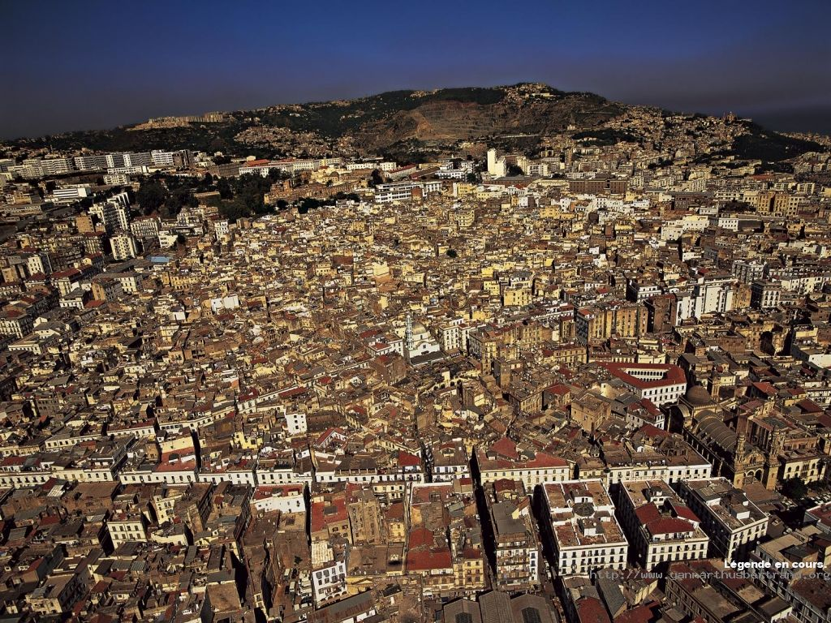
CASBAH OF ALGIERS

Slide 4
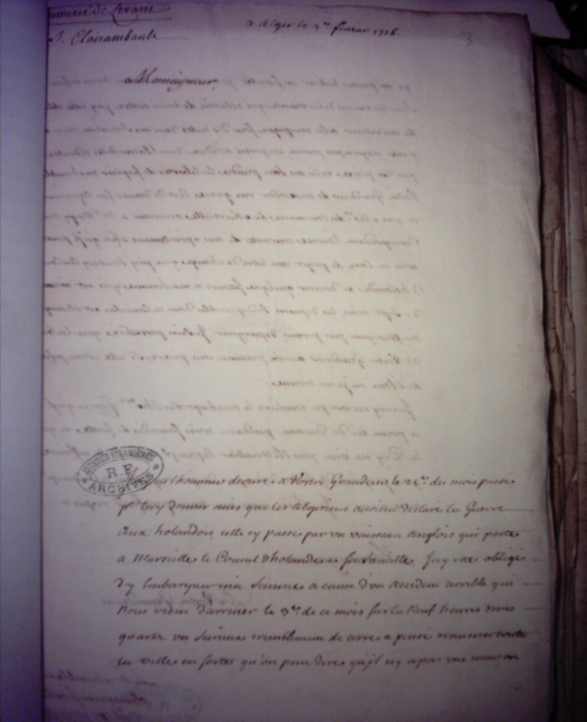
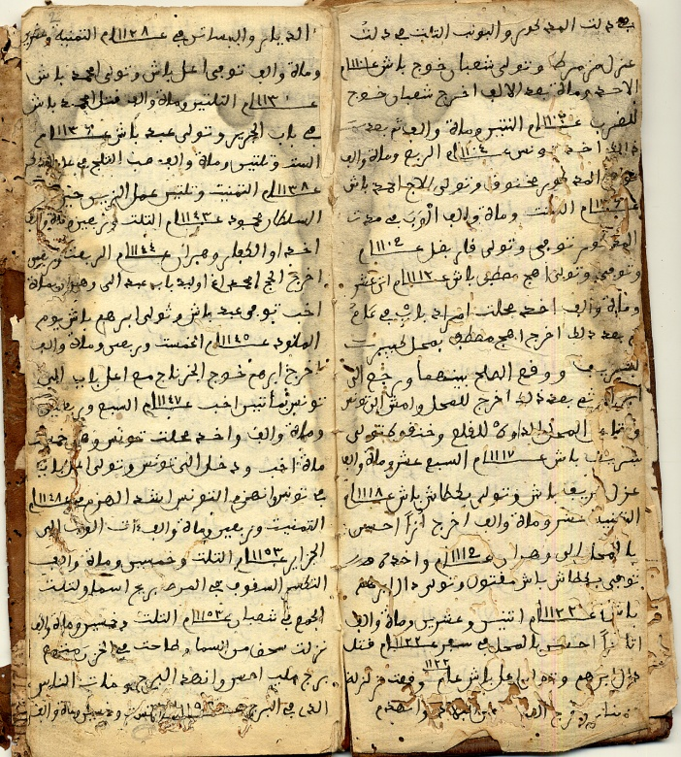
Archives
Ottoman domanial act 1716
French files
(Consular courier 1716)
Arabic manuscript
(no date available)

Slide 5
IN THE WAKE OF 1716 ALGIERS EARTHQUAKE SEISMIC-RESISTANT TECHNIQUES CONCERNING THE FOLLOWING ASPECTS WERE IMPLEMENTED:
URBAN
ARCHITECTURAL
STRUCTURAL

Slide 6
URBAN SCALE
THE BLOCKS : varying number of houses, are individualized by communication streets which surround them. This makes each block reacts independently from the others during the shakings.
THE HOUSES: are semi-detached, overlapping and leaning against each other forming a compact homogeneous unit.

Slide 7
URBAN SCALE
THE SABATS: Number of streets are covered by galleries on top of which the houses extend and thus creating roofed passageways.
They can be flat with wooden logs incorporated or vaults built out of stones or bricks.

Slide 8
URBAN SCALE:
DISCHARGING ARCHES: In urban framework, number of arches built out of stones or bricks. Allow transfer of horizontal loads to the ground.
Constructions are not isolated elements but compact dynamic block.

Slide 9
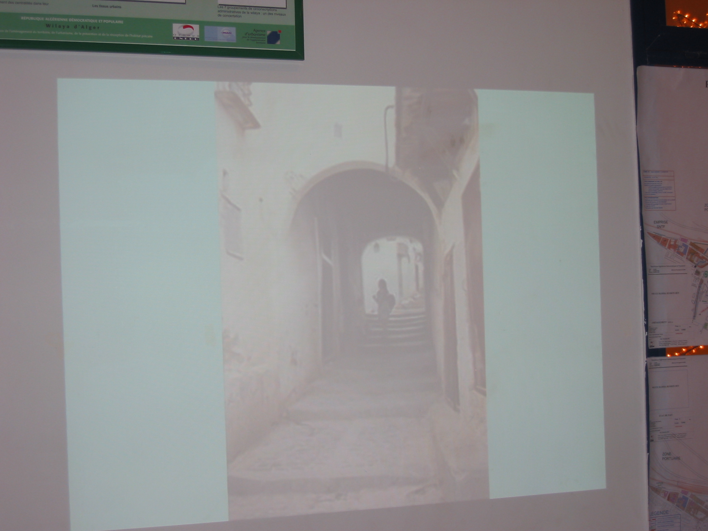
DISCHARGING ARCHES

Slide 10
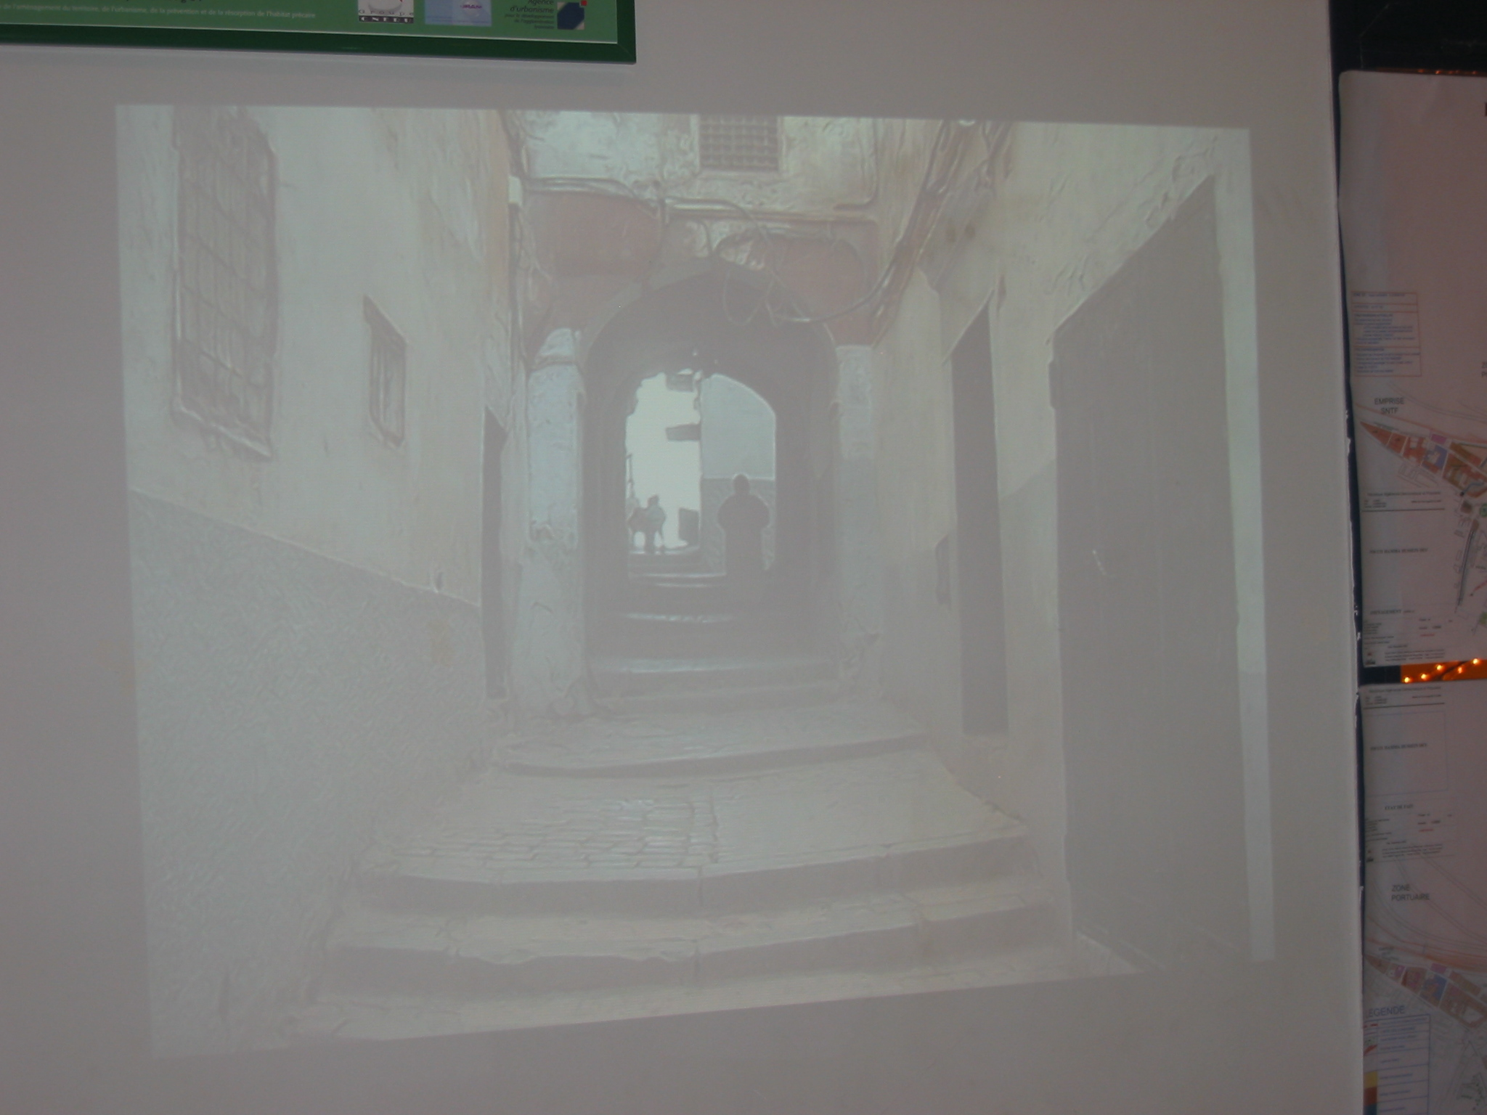
DISCHARGING ARCHES

Slide 11
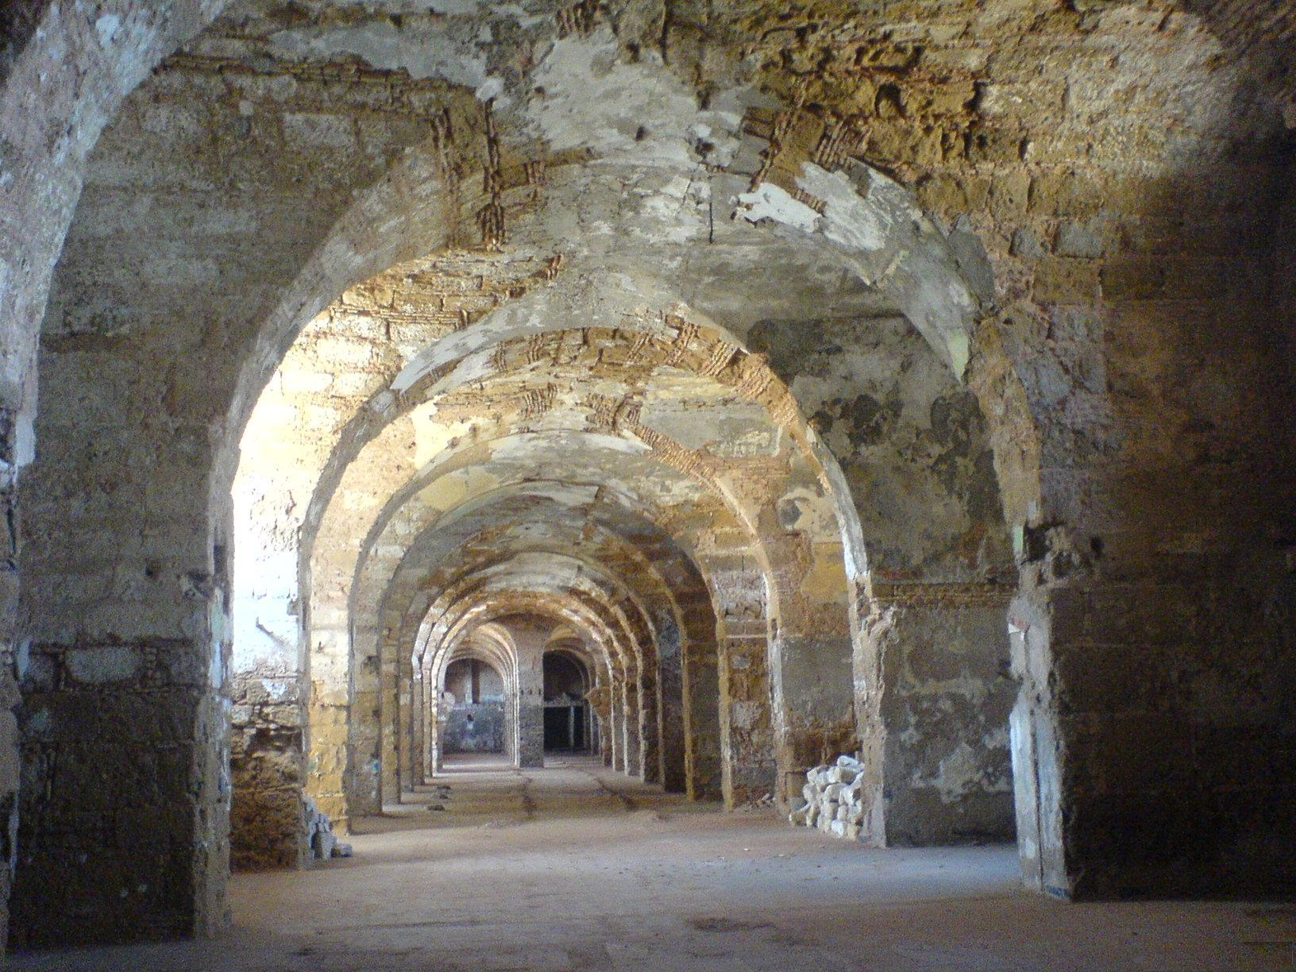

Slide 12
ARCHITECTURAL SCALE:
TYPOLOGY OF HOUSES: Most of them have a central patio of square form around which the rooms are distributed (2 or 3 levels).
SHAPE OF HOUSE: Square form

Slide 13
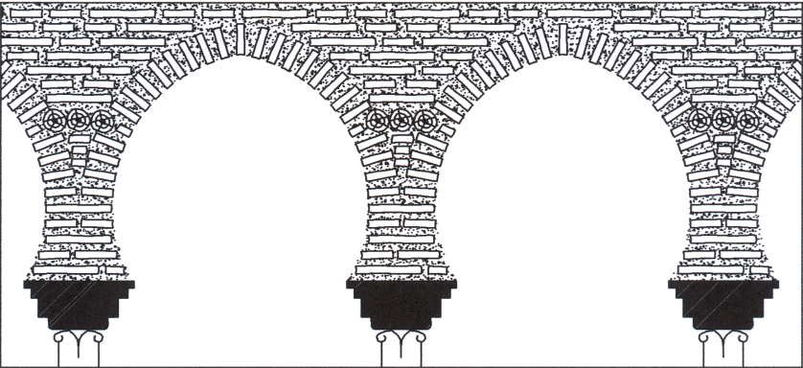
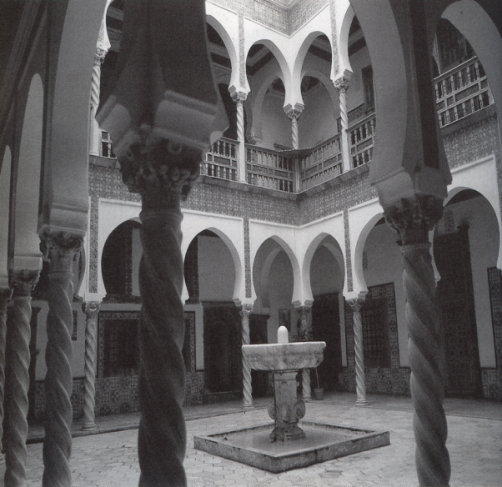
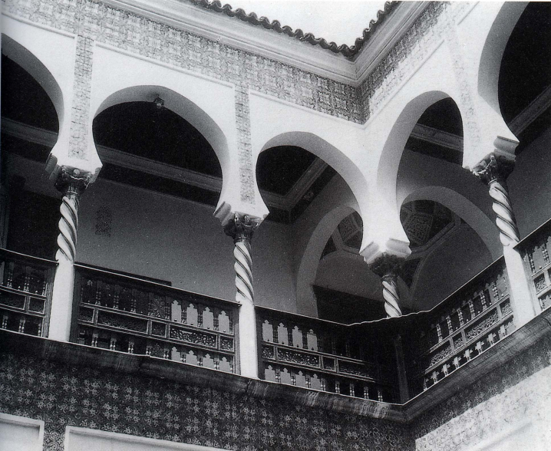

Slide 14
STRUCTURAL SCALE:
LINKS OF WALLS: Linked one to another by alternate crossing of wood logs (consolidating the angles). Every 50 cm in height, wood logs of about 2 m long.
PARTITIONS: Well connected to main walls by wood logs.

Slide 15
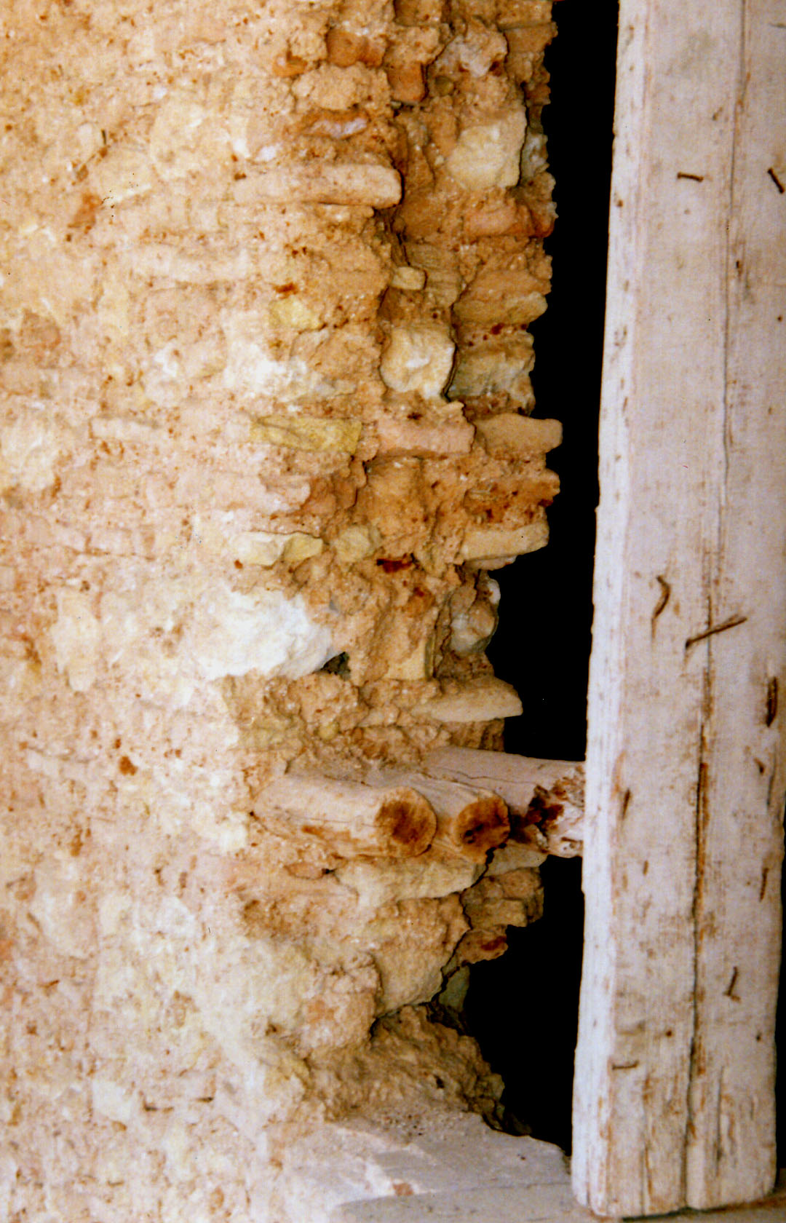
STRUCTURAL SCALE:

Slide 16
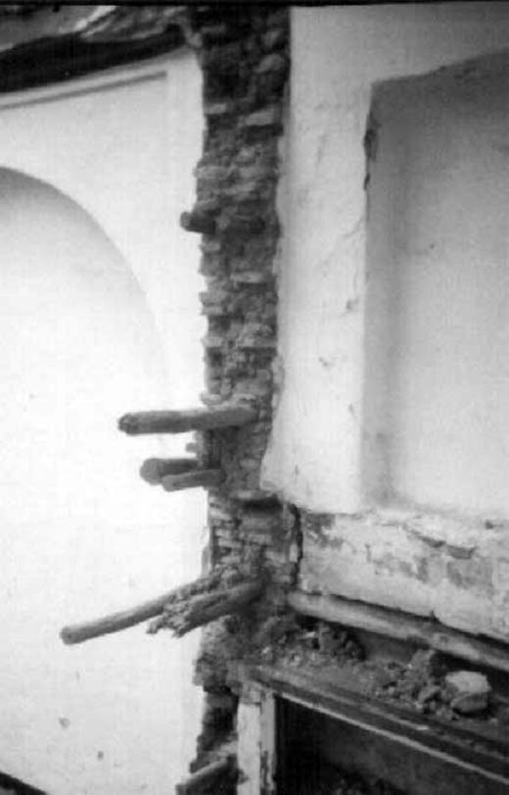

Slide 17
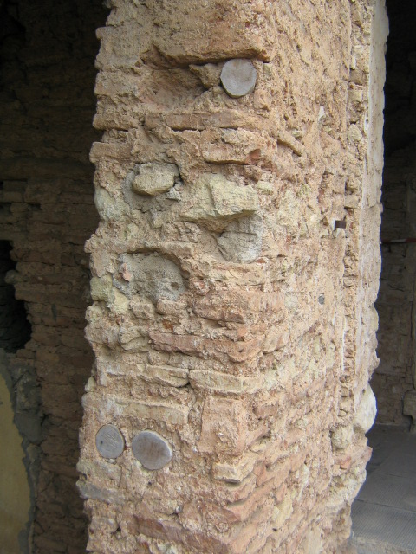

Slide 18
STRUCTURAL SCALE:
FLOORS: built by superposition of two layers of wood logs inserted in all width of bearing walls (rigid diaphragm).
CORBELLINGS: Frontal balcony overhanging and supported by wood logs forming an angle with bearing-wall.

Slide 19
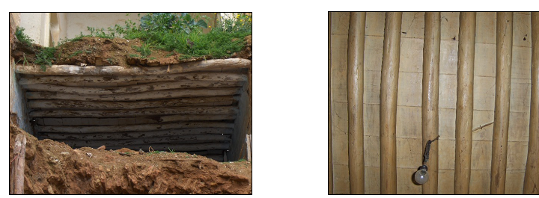
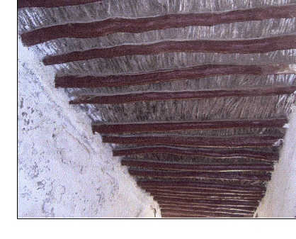
FLOORS

Slide 20
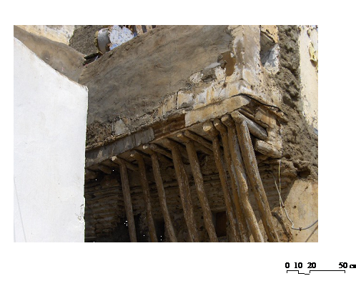
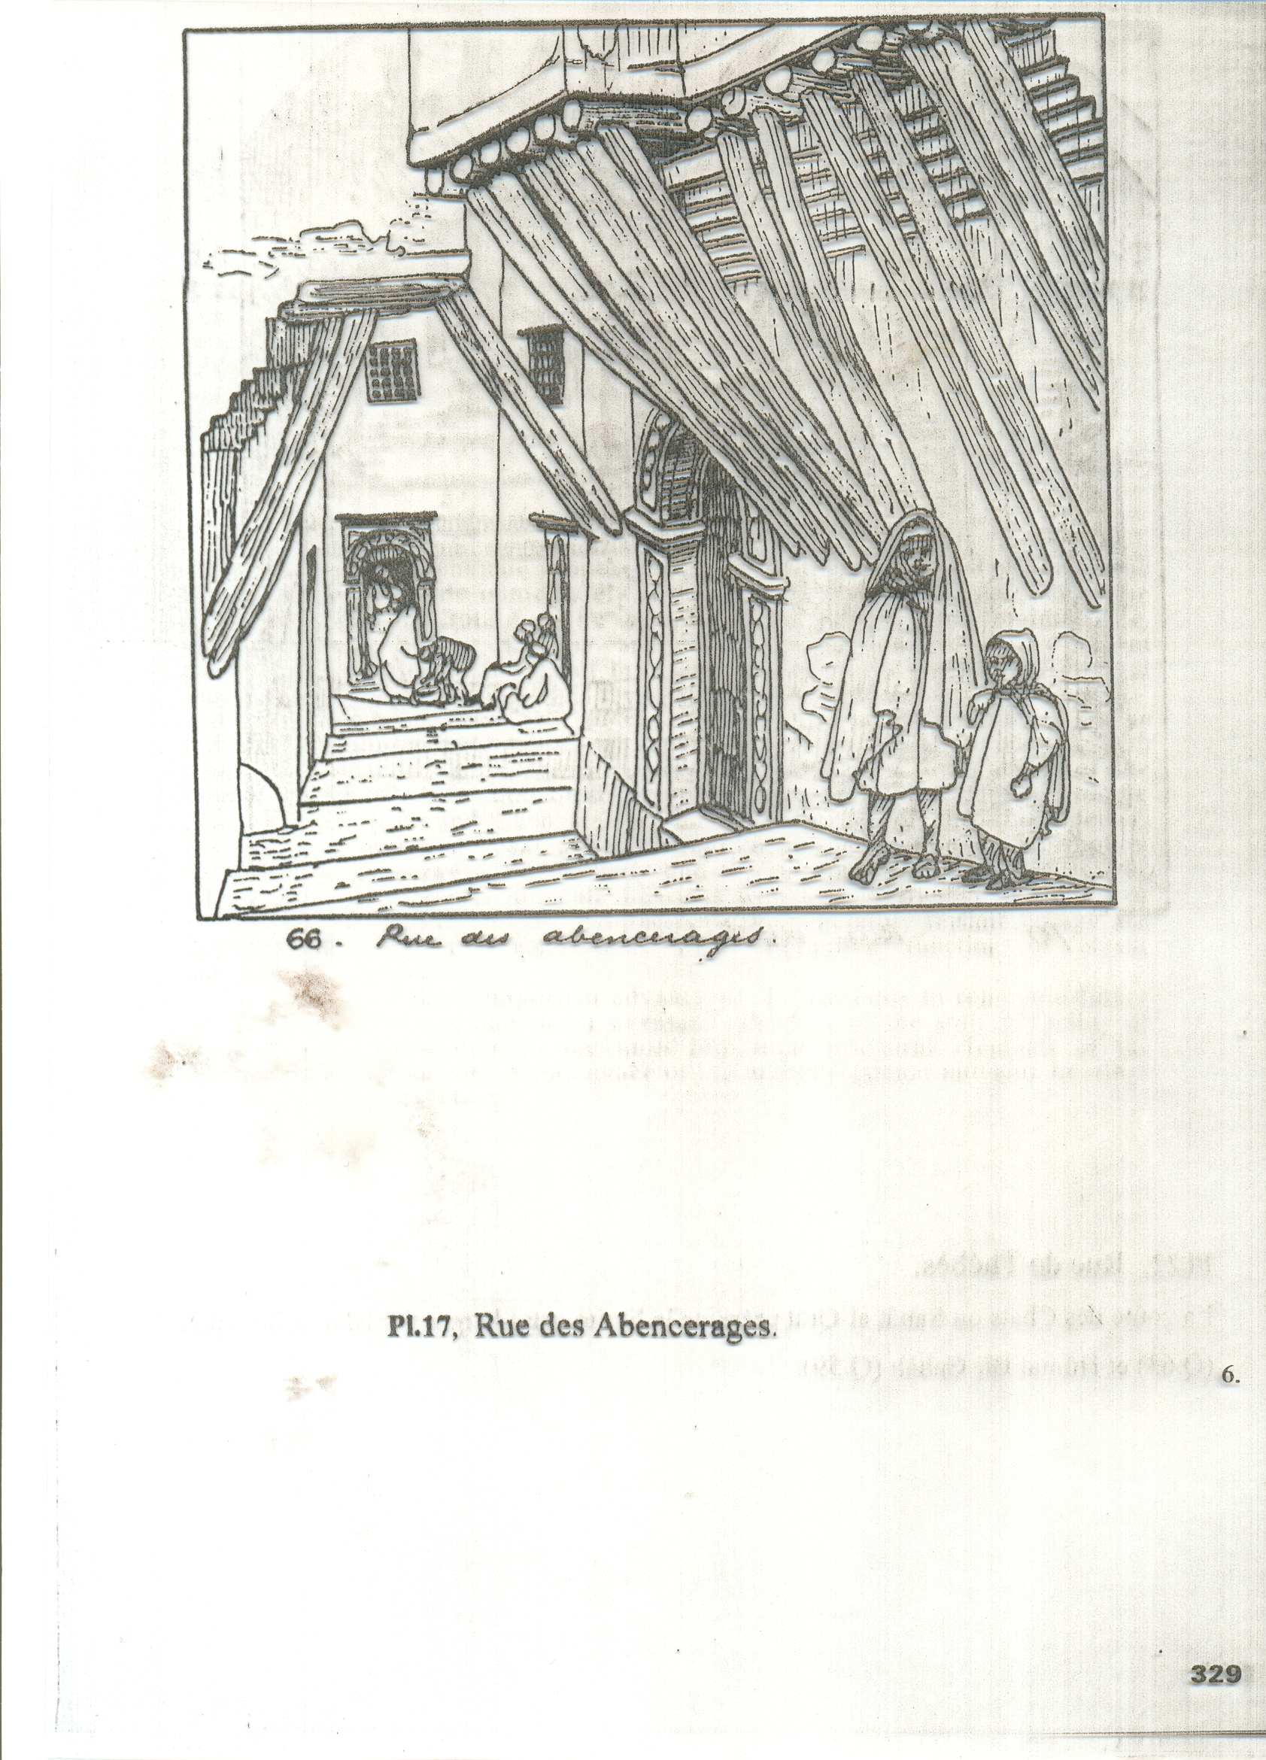
CORBELLINGS

Slide 21
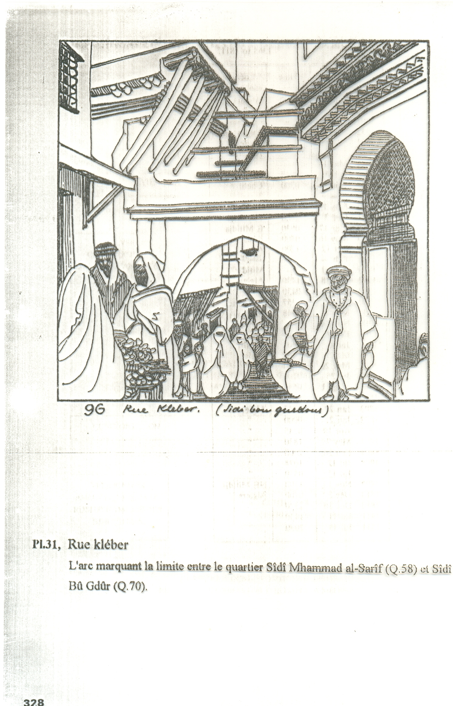

Slide 22
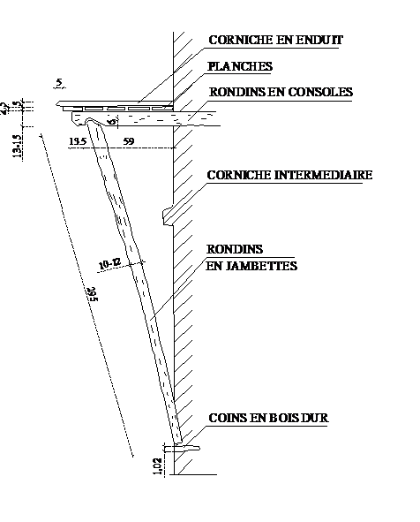
CORBELLINGS

Slide 23
STRUCTURAL SCALE:
OPENINGS: Wooden framing is found around the openings

Slide 24
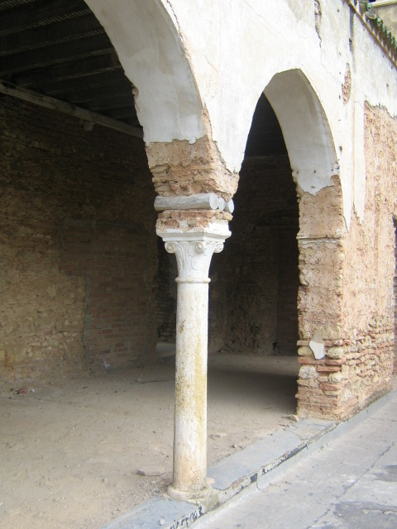

Slide 25
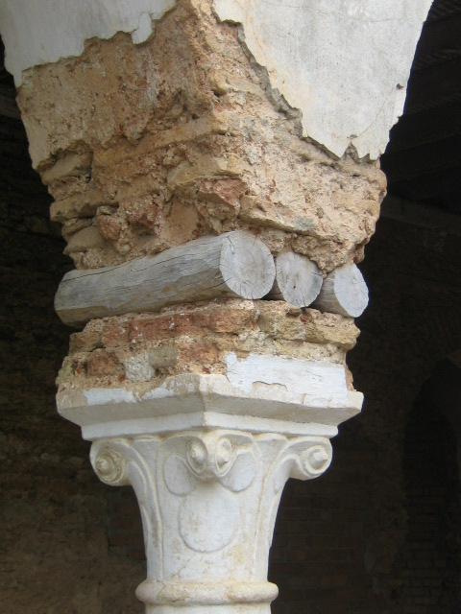

Slide 26
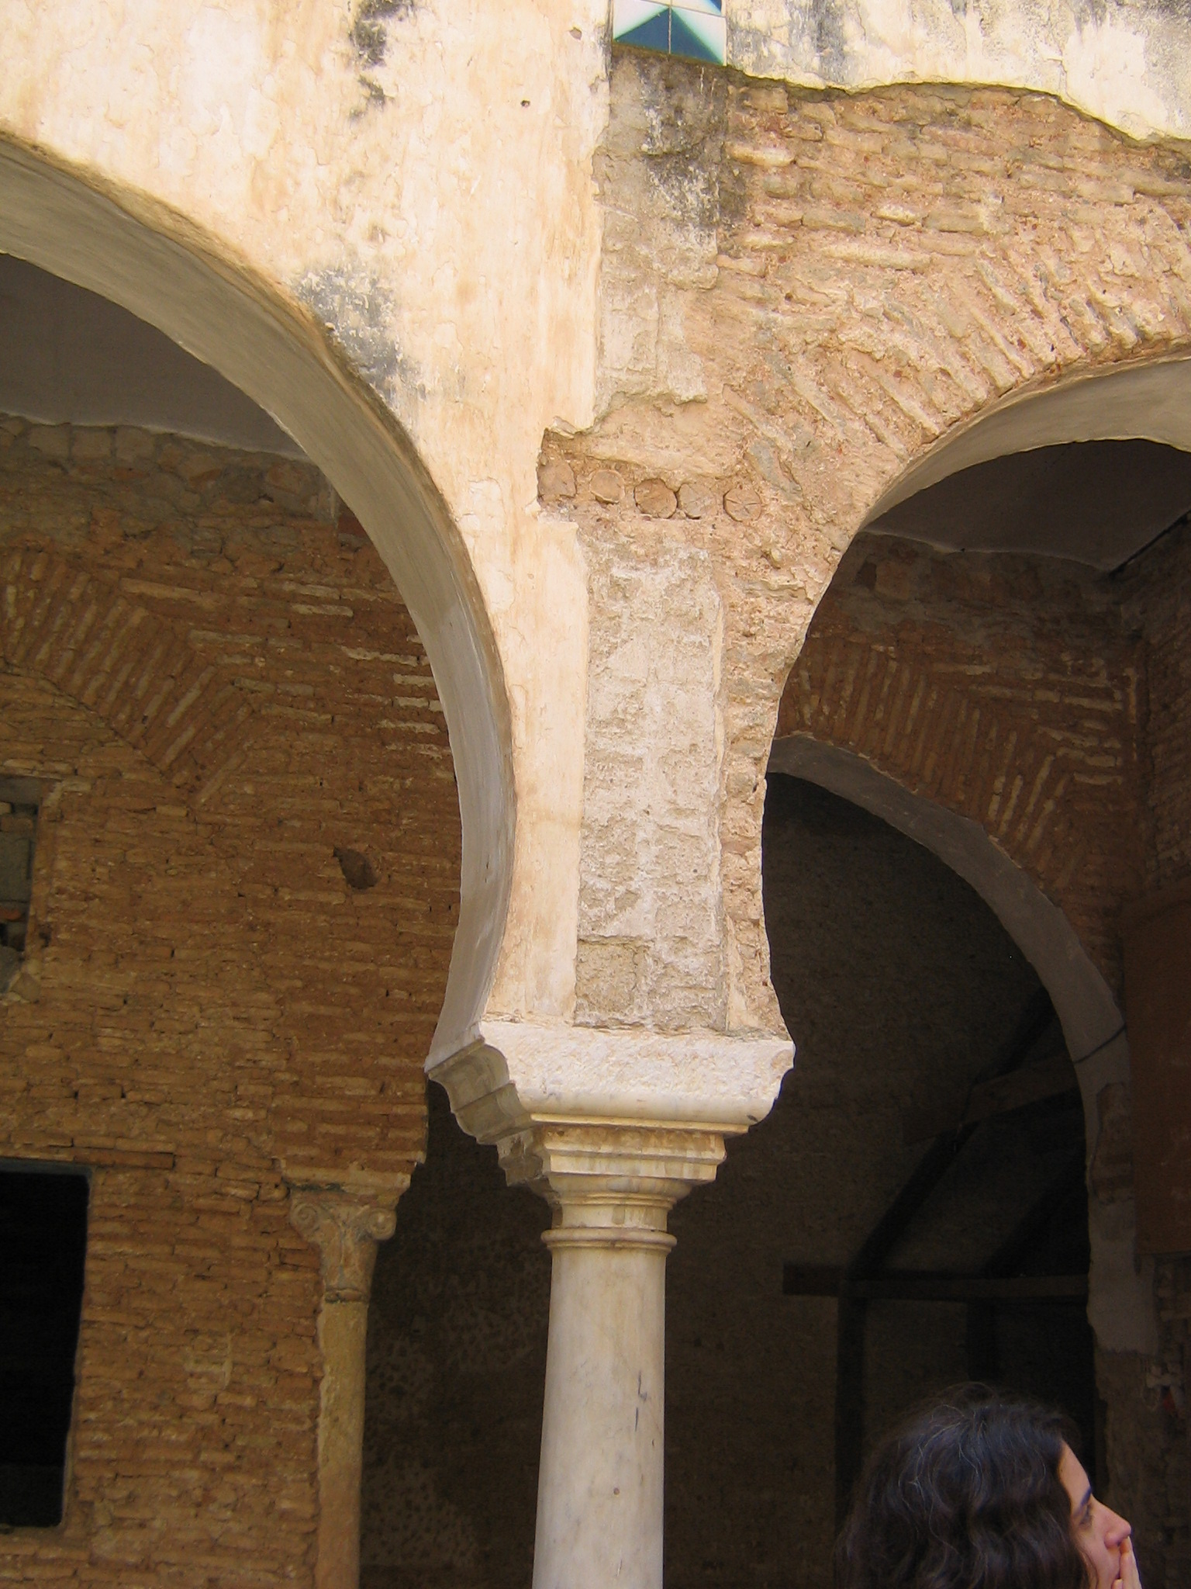

Slide 27
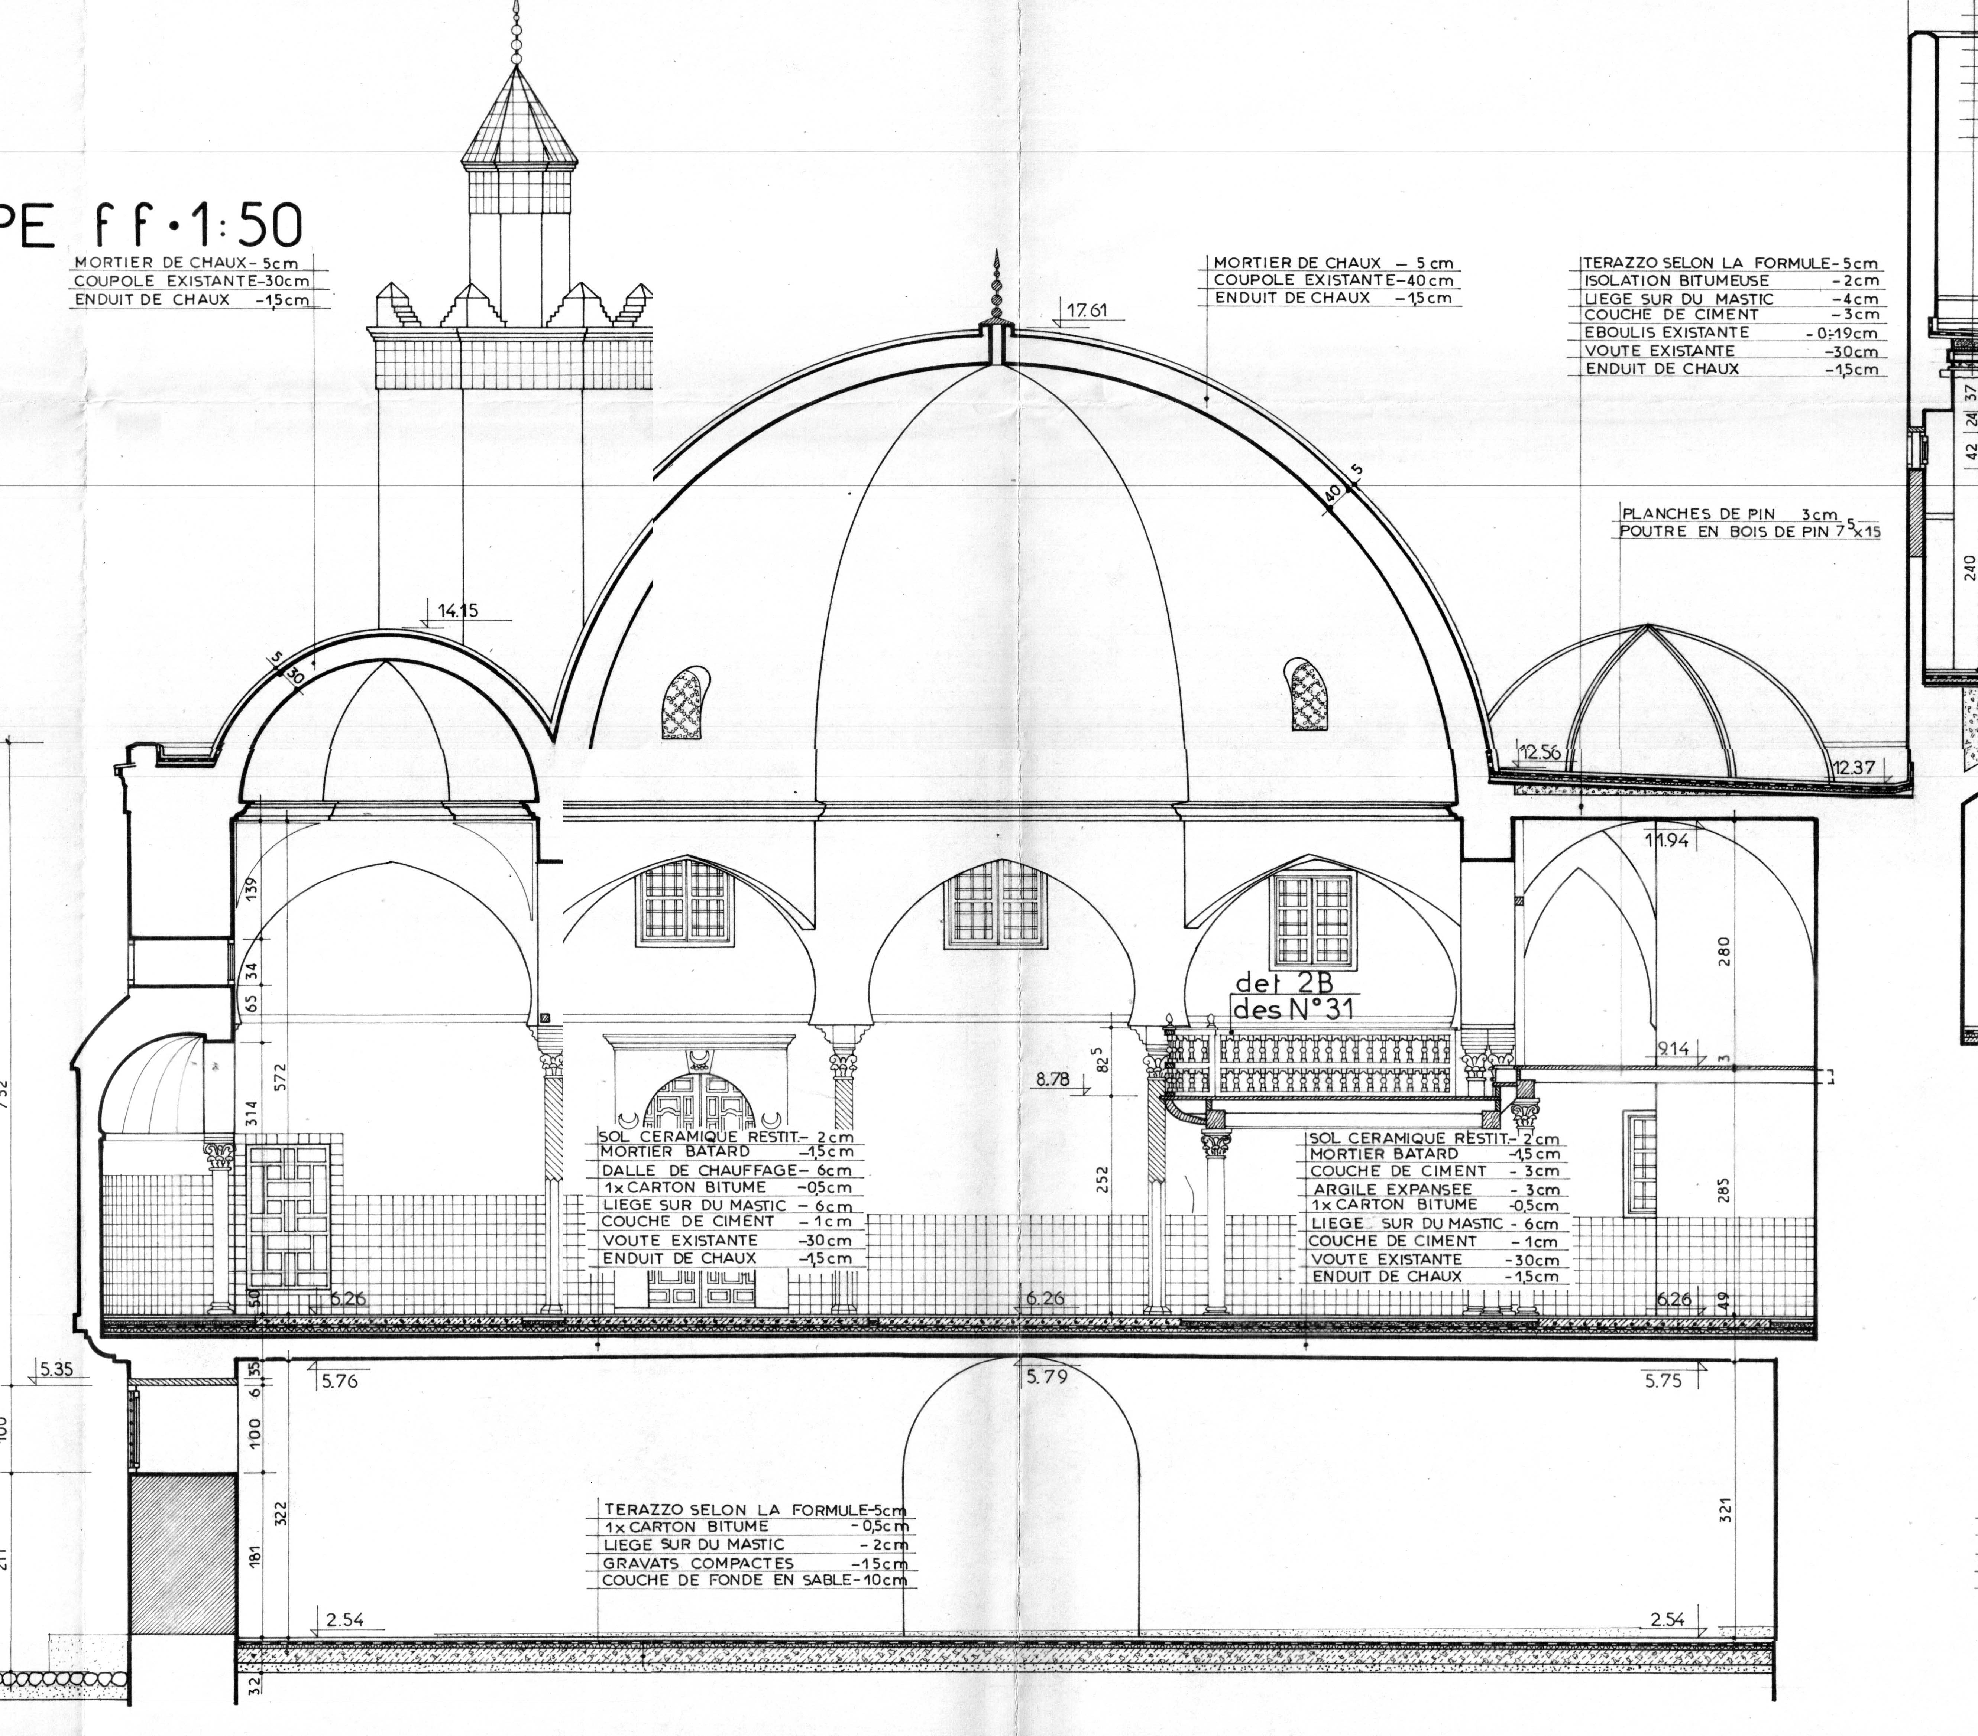
MOSQUE OF THE DEY

Slide 28
MOSQUE OF THE DEY

Slide 29
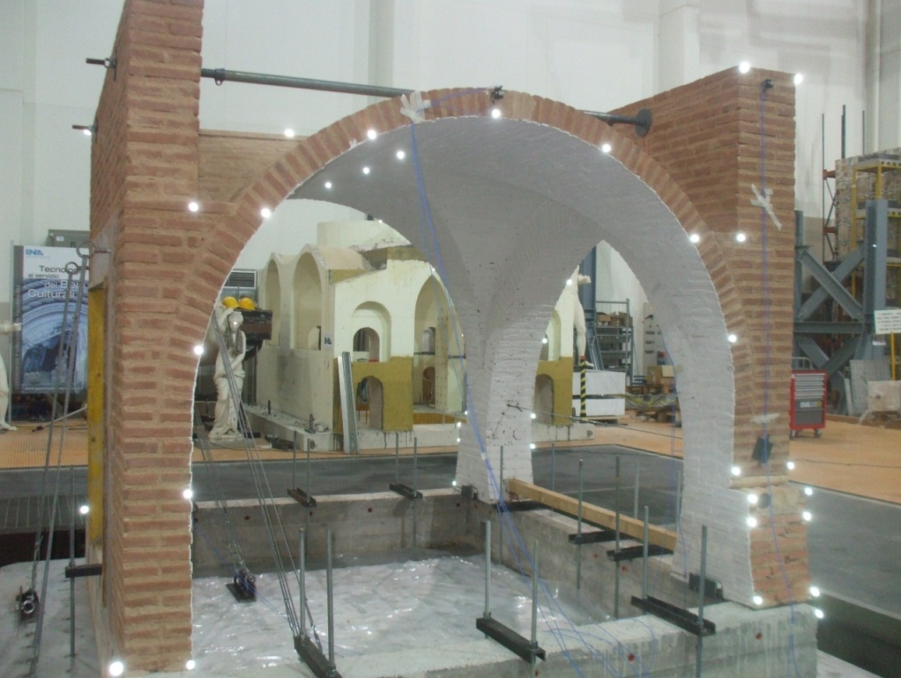
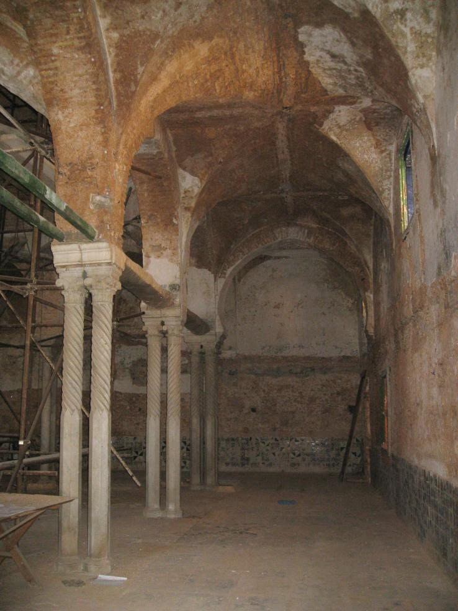
ARCH BUILT ON SHAKING TABLE (ENEA, ITALY)

Slide 30
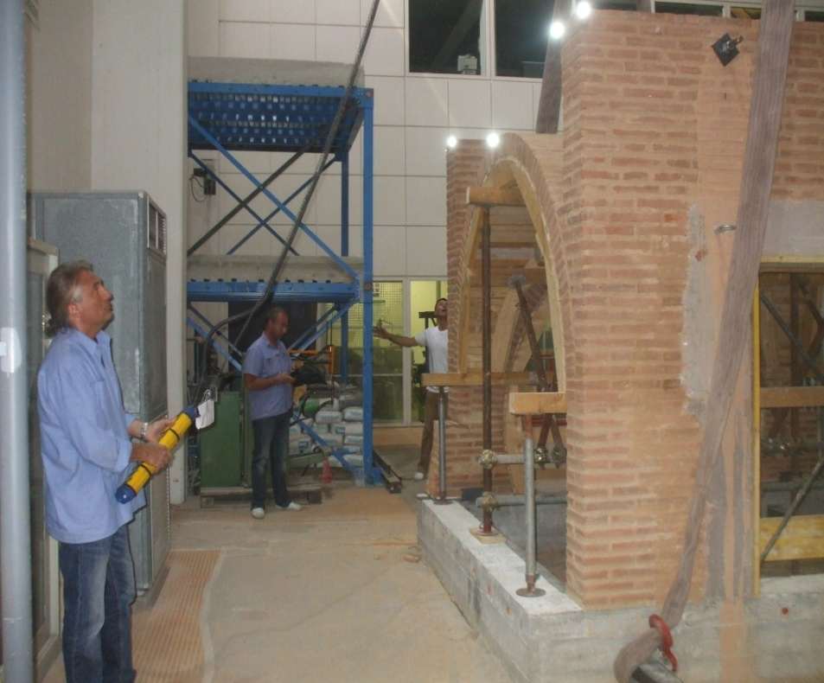
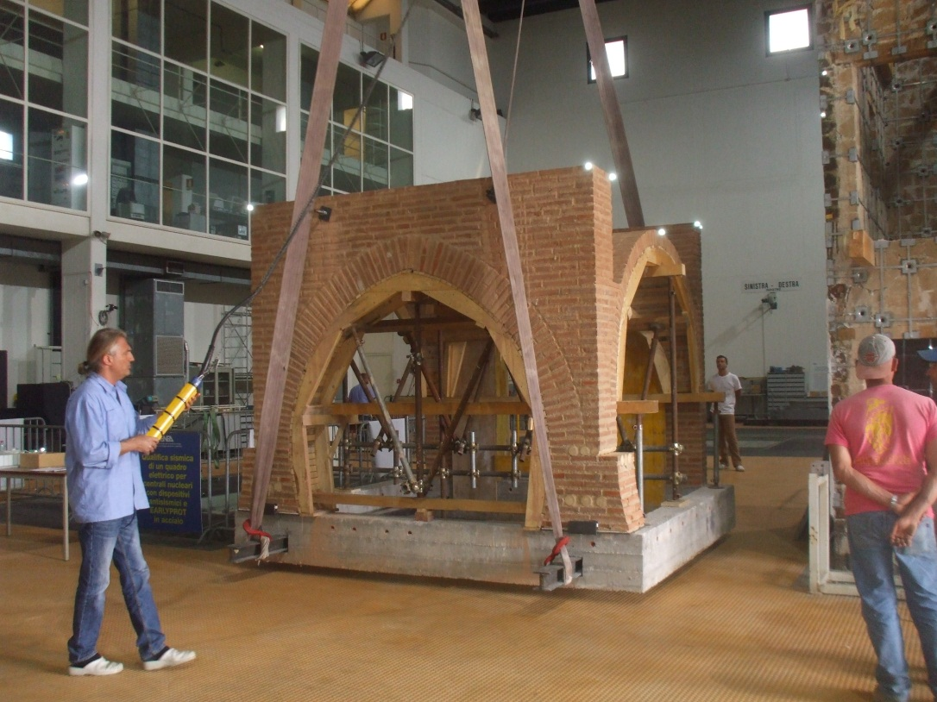
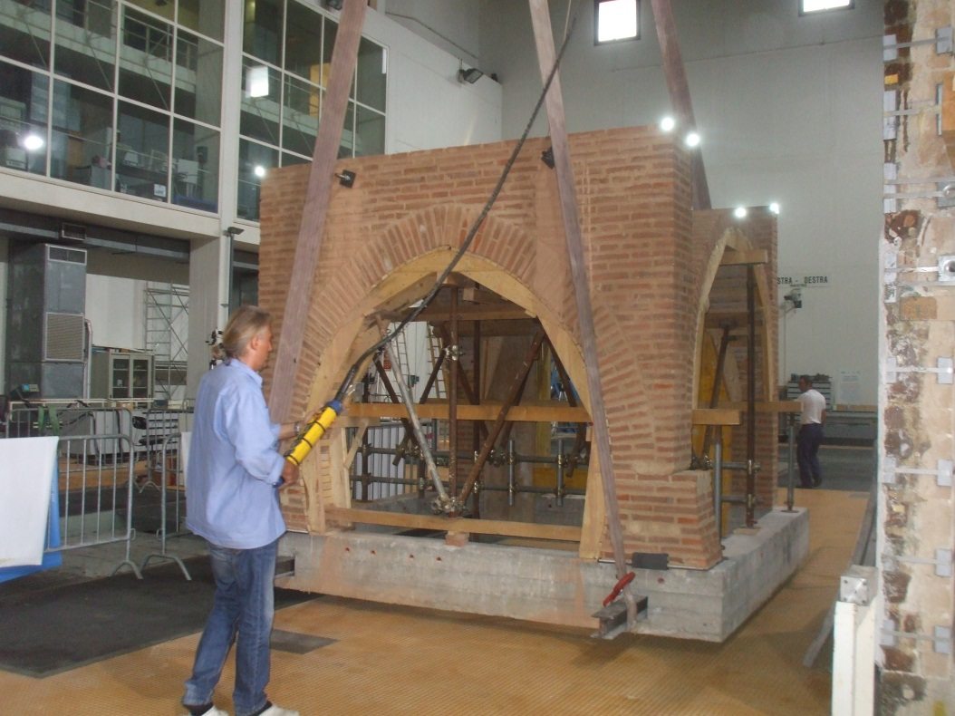
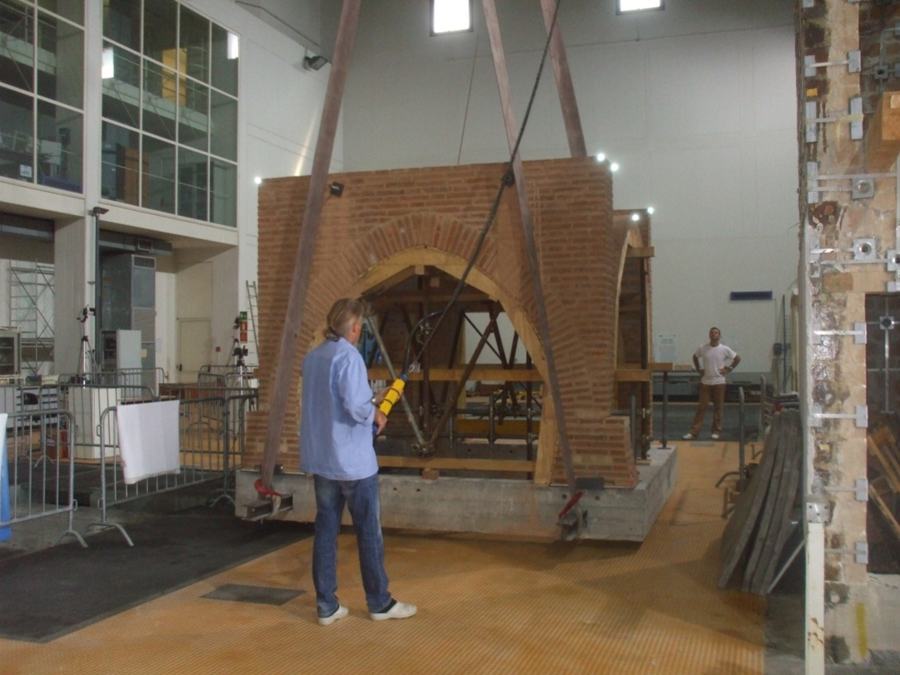

Slide 31
WANT TO SEE MORE….
VISIT THE CASBAH OF ALGIERS
THANK YOU VERY MUCH FOR YOUR ATTENTION

