Slide 1
FEBRUARY 2013

Slide 2
IMAGINE AN APP….
An App that makes every citizen, employee, volunteer an actor of global monitoring and security wherever he is
That allows detection of the first stages of events,
minor as well as catastrophic, expected or unforeseen hazardous for all types of man made or natural disasters
Is a personnel early warning system
which detects automatically the events reported by other citizens around me, advise me of the evolution of the event
Complete the institutionnal physical sensors networks and can be coupled with crisis mapping systems
Provides real time insight views of phenomenons
by witnesses , describes the physical characteristics and damages
Is an ascending and descending link
between the authorities and the witnesses or victims to pilot safety and rescue actions
Analyse the flows of informations on social networks
and correlates them to witnesses reports with the App.

Slide 3
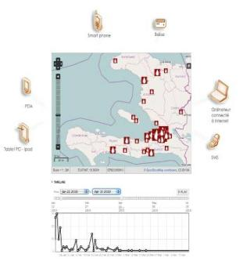
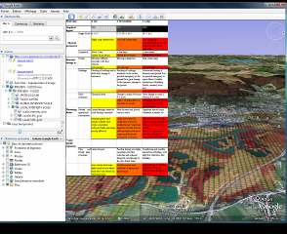
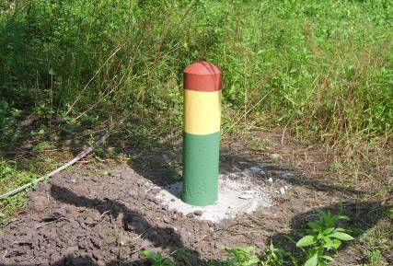
WHERE AND HOW WAS BORN SIGNALERT
A team
5 specialists of disasters and CC monitoring and mitigation, ICT, Advertising, early warning and alert systems
Recent Disasters
Involvement and follow up in new technologies applied to post-disasters situations since the 2004 Indian Ocean tsunami.
Emerging technologies
Crowd sourcing
Volunteered Geographic information
Expanding use of smartphones
CROWDSOURCING
INTENSITY SCALES
SIMPLE MARKERS

Slide 4
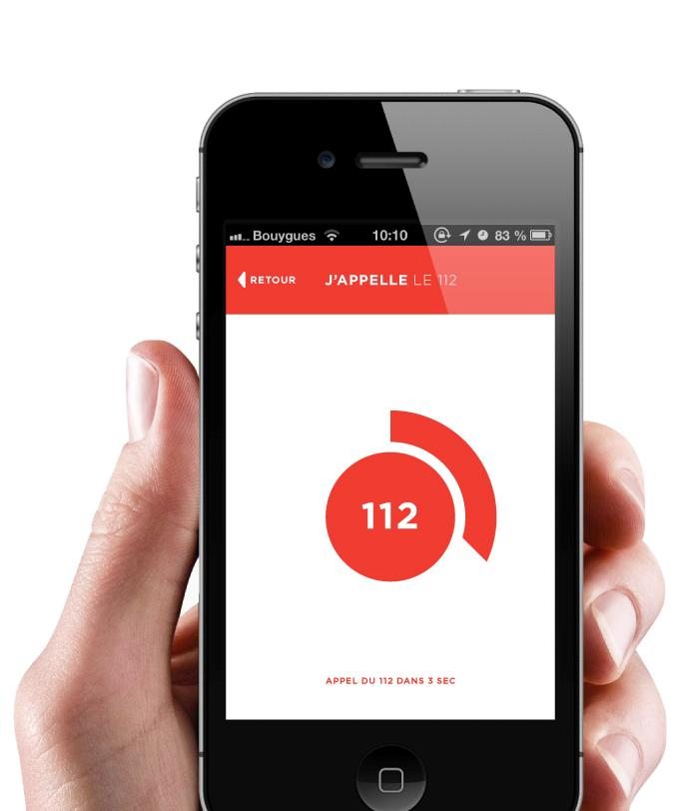
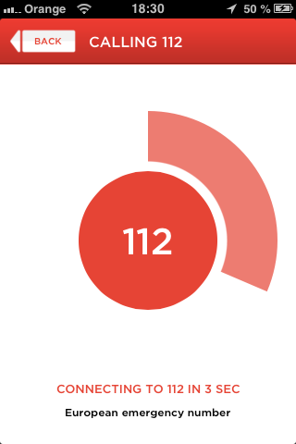
SIGNALERT KEEPS WATCH FOR SITUATIONS THAT POSE A THREAT TO EVERYONE
Instant data-processing for early warning and hazard prevention
Torrential and slow-onset flooding
Coastal hazards and tsunamis
Tornadoes, storms and thunderstorms
Snow and avalanches
Earthquakes
Drought
Mass movements
Heatwaves
Air and water pollution
Waste and refuse
Explosions and fires
Mines, bombs
Major road or industrial accidents
Storm water runoff
Weak widespread signals and markers of slowly evolving phenomenon detection (climate change)
Symptoms of illness and epidemics
… or your own event description protocol fit to classify an event
CALLING 112 IN 3 SEC

Slide 5
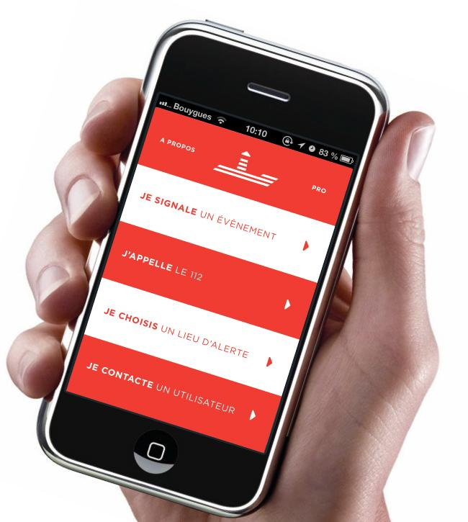
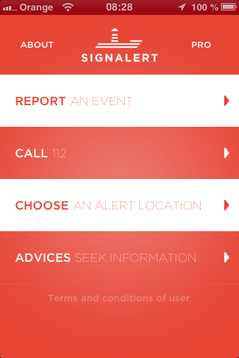
HOW DOES SIGNALERT WORK?
A range of digital surveillance protocoles without geographical limits, working on citizens’ observations to provide additional support to official prevention networks
A customisable smartphone App
Access to the information centre
Synchronisation with existing monitoring systems
Automatic detection of emerging events, together with follow-up on further developments
Introduction of professional-level applications for employees and public officials
Processing of relevant information trading on social networks
A network of designated local lookouts

Slide 6
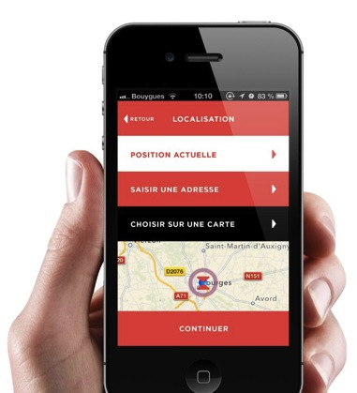
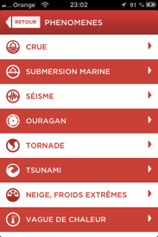
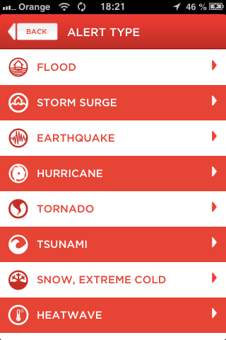
A SMARTPHONE APP FOR EVERYONE
Testify through a simple process accessible to anyone with the App on a smartphone
Successive screens with simple questions to describe the physical characteristics and damages of an observed phenomenon:
Nature of event
Place
Time
Local physical intensity
Local damaging effects
Pictures
Victims to rescue
A feeback to the individual contributor allowing him to assess the situation around him
A descending link to the public to inform and forward official messages of warning, safe behaviour

Slide 7
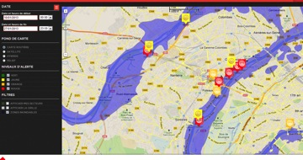
A CROWD SOURCING PROJECT
STRUCTURING
BIG DATA
A tool for individual and common, global security, early warning, awareness and prevention on anomalous situation with potential danger
Early warning, Emergency and rescue actors
Smartphone
user
Sensible sites and
Businesses risk managers
Processing of ascending and descending dataflow of SIGNALERT users
Mapping, statistics

Slide 8



INTEGRATION OF SOCIAL NETWORKS INFORMATION FLOWS AND CORRELATION TO SIGNALERT EVENTS
Parallel analysis of information and data flow on social networks & correlation to SIGNALERT detected events
Sophisticated tool for research of key information on dangerous or catastrophic situations transiting on social networks
A gauging tool to measure the growth, size, extent, danger potential danger of new events even of small size
Integration in a single interface of the SIGNALERT reports and social networks contents providing the evolving images ot field situations and crisis

Slide 9
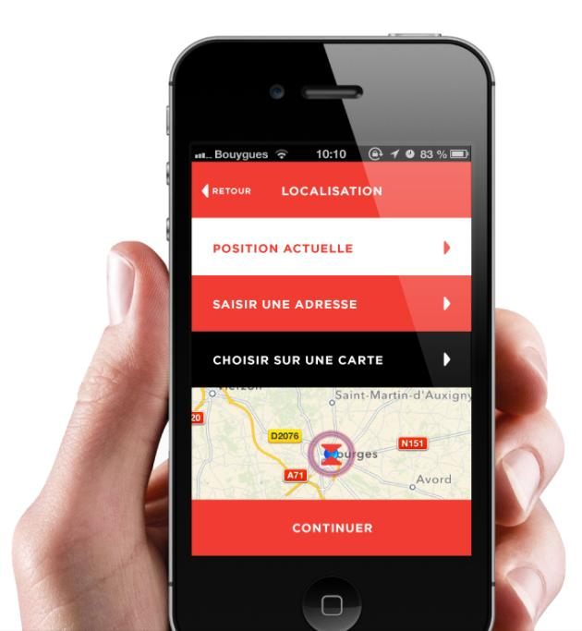
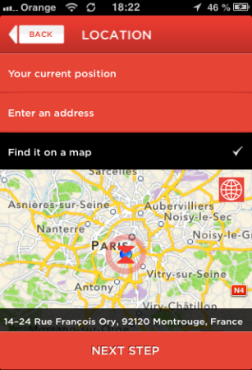
SIGNALERT, AN OPPORTUNITY FOR COMMUNITIES AND ENTERPRISES
A new citizen-security service
The dynamic link between individual vigilance and community mobilisation
Real-time information processing
To fill in the gaps between institutional warning and prevention set-ups - to pick up on the few events that go undetected by these networks
An ever-expanding information channel
To determine and pinpoint the earliest signs of natural of accidental disaster, together with real-time follow up of further developments
A top-down information channel
To provide information and updates on the shelters and safety measures put in place by a local emergency action plan

Slide 10

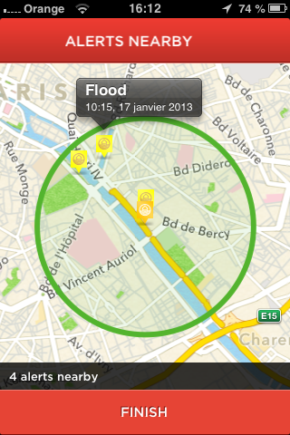
SIGNALERT, AN OPPORTUNTIY FOR INDIVIDUALS
A free monitoring service in the event of major risks
Take advantage of active community support in the face of major danger
Stay in command of all multi-hazard information within a 1km radius in the event of any phenomenon detected by designated local lookouts
A specialised, personal multi-site surveillance service
Protection of identity and privacy on a network interested only in the public good
Subscription to a paid smartphone version of the application, delivered to a platform of the user’s choice
Free from advertising and other commercial interferences

Slide 11
PRODUCTS & SERVICES
Includes parametric & automatic detection of new emerging events
SIGNALERT APP
Free App with ascending and descending link on contextual data to use wherever you are
MY SIGNALERT
Personnal App to monitor SIGNALERT reports on a specific site.
SIGNALERT CONSULT
Subscription of data consulting service including event detection and notification
SIGNALERT DATA
Data mining for use of SIGNALERT info on your own system
SIGNALERT EXPLORE
Complementary subscription for cross correlation with social networks informations flows
Includes innovative analysis of links between social networks information flows and SIGNALERT detected events
No development required for clients on App or exploitation interface. We take in charge

Slide 12

SIGNALERT, DEVELOPMENT AND PARTNERSHIP PROPOSAL
A partner in the rolling out and implementation of the test system
Joint-running of drills on a given area and specified disaster type
Use of the interface by a pre-selected testing panel
Simulation of past or imagined events
Large-scale, long-duration operational testing
Joint feedback session
Integration with existing emergency management tools and response plans
Translation and adaptation to your national langage
Scientific collaboration with co-development of event protocole description for a specific hazard
Contact us to check for the various partnership types and/or the range of services proposed.

Slide 13


Soon on
Contact us for download of trial version, tests and partnerships
Contact: M. Richard Guillande
signalert@orange.fr
++33(0)145469315 / +33(0)682689192
7 rue Danton 92120 Montrouge, France
website under condomain name signalert.net set aside struction

