Slide 1
Improving the resilience of society
to catastrophic natural hazards through
Multi Sectoral Partnerships (MSPs)
Jeroen Aerts

Slide 2
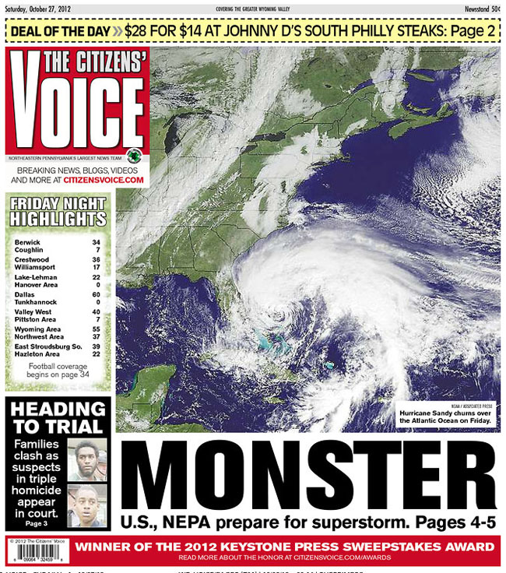
^{Hurricane Sandy, October 2012}

Slide 3
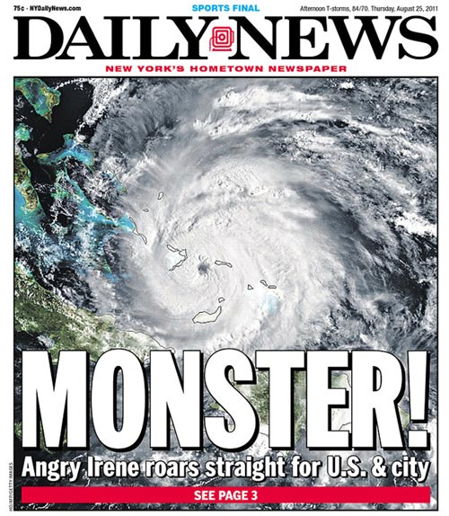
^{Hurricane Irene, August 2011}

Slide 4
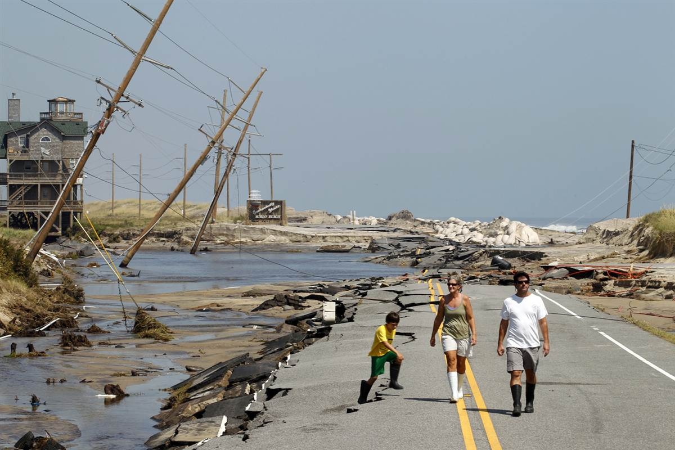
> U$ 50 Bn Damage
> 200 Deaths

Slide 5
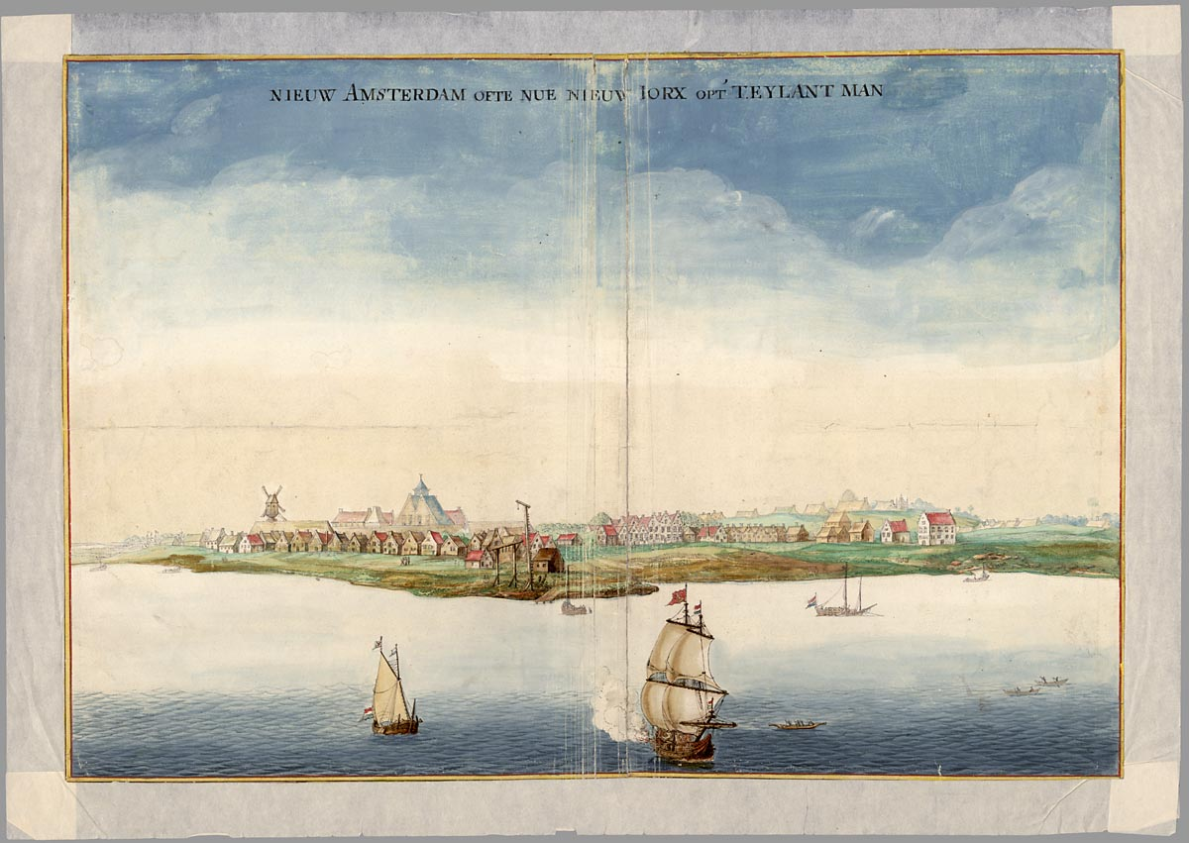
Manhattan (1664)
Notes:
5

Slide 6
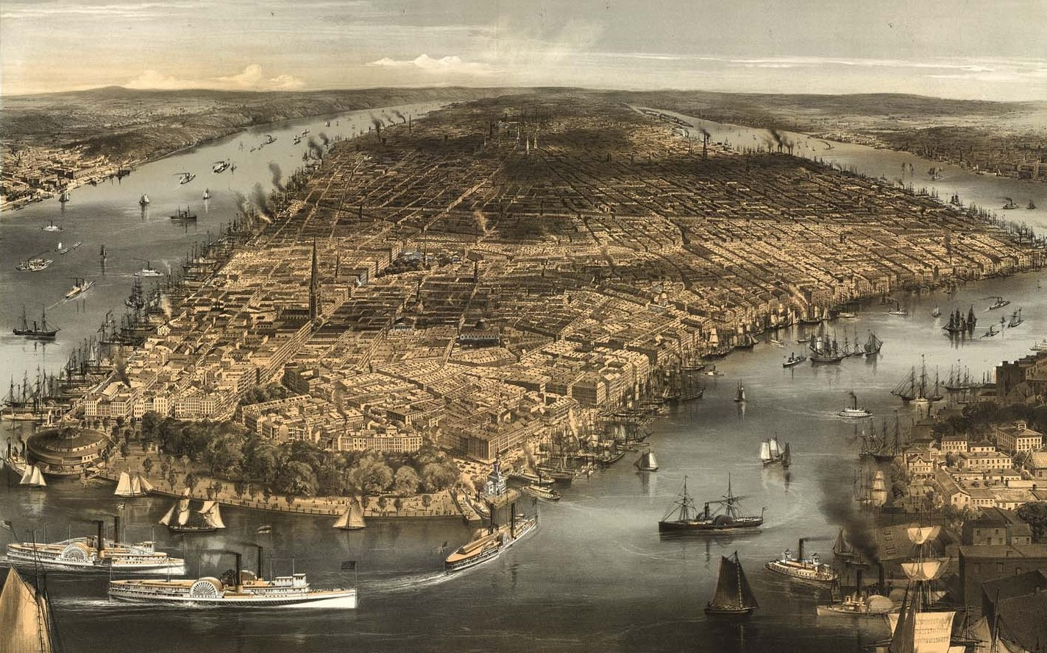
Manhattan (~1850)
6
Notes:
6

Slide 7
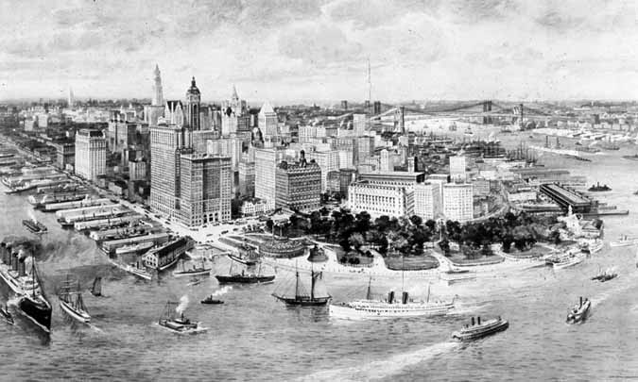
Manhattan (~1915)

Slide 8
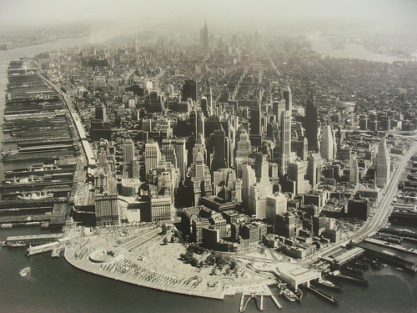
Manhattan (~1930)

Slide 9
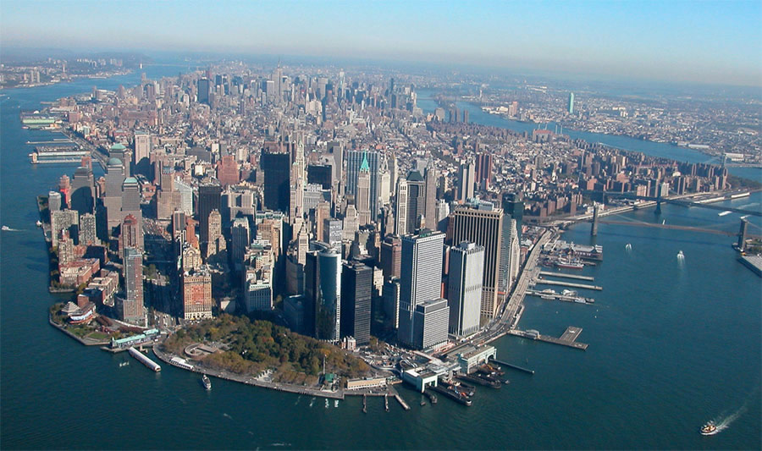
Manhattan (~2007)
9
Notes:
9

Slide 10
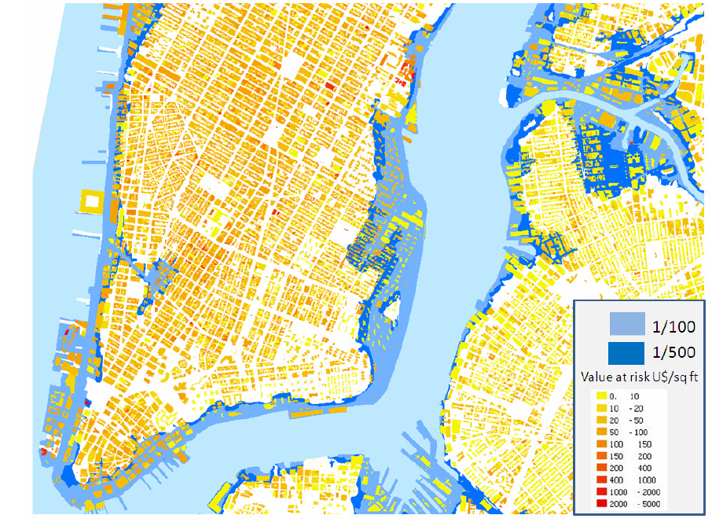
FEMA Floodzones (1/100 and 1/500)

Slide 11
Multi Sectoral Partnerships, MSPs
Risk Governance
Public
Private
Risk from hazard
Probability
€
People
Vulnerability /
exposure

Slide 12
Multi Sectoral Partnerships, MSPs
Risk Governance
Public
Private
Risk from hazard
Probability
€
People
Vulnerability /
exposure
NYC : 6 billion Euro -> Sandy: 50 bn Euro

Slide 13
Multi Sectoral Partnerships, MSPs
Risk Governance
Insitutions /
legislation
Public
Private
Risk from hazard
Probability
Capacity /
knowlegde
€
People
Vulnerability /
exposure
Perception

Slide 14
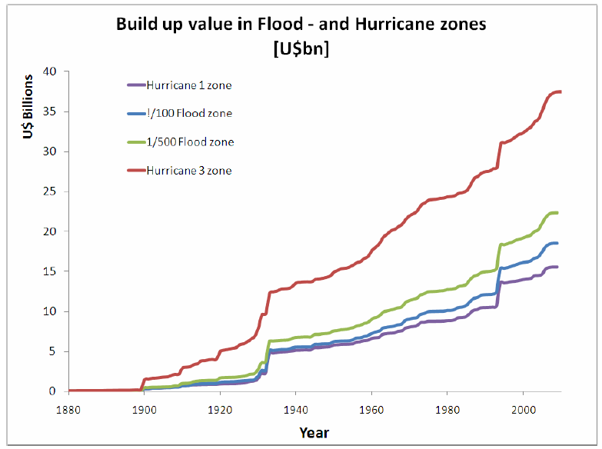

Slide 15
Multi Sectoral Partnerships, MSPs
Risk Governance
Public
Private
Risk Assessment
Risk from hazard
How to organize institutions, such they lower risk?
Risk from hazard
People

Slide 16
Multi Sectoral Partnerships, MSPs
Risk Governance
Public
Private
Risk from hazard
People
DRR measures

Slide 17
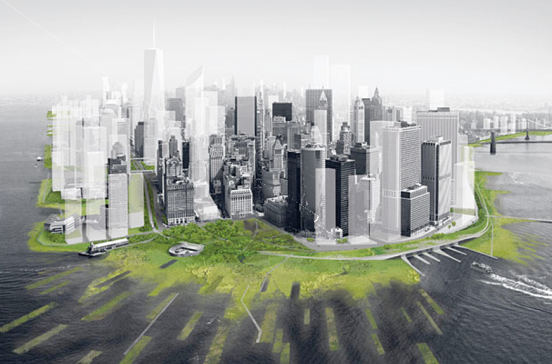

Slide 18
Multi Sectoral Partnerships, MSPs
Which MSPs are most effective in lowering risk?
Public
Private
Risk from hazard
People
DRR measures

Slide 19
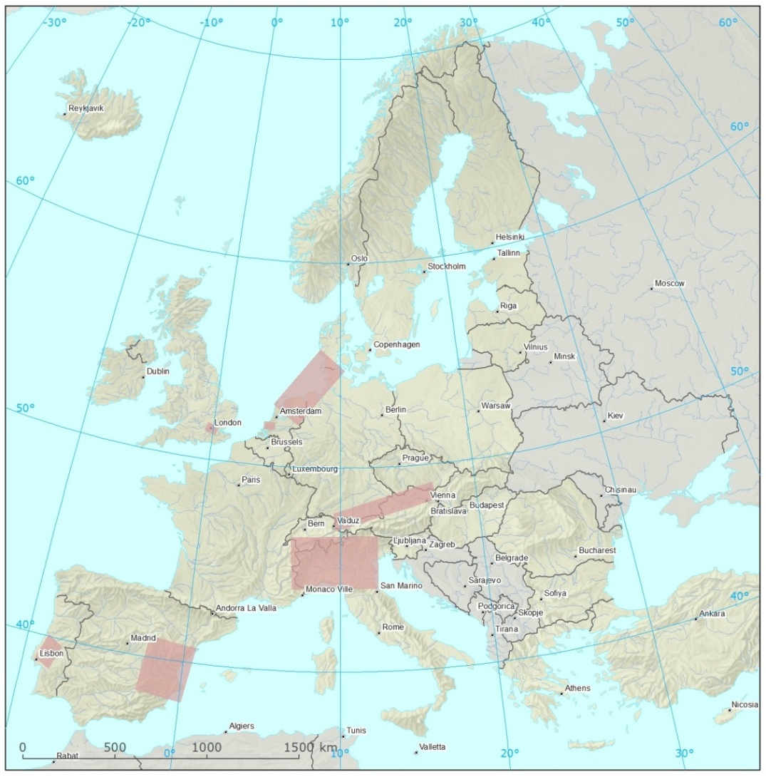
^{Core: 10 Case studies}
7 regional case studies
3 pan European case studies
DE+: Wadden Sea
UK: Greater London
NL: Rotterdam Port
AT+: Austrian railways
PT: Chamusca
IT: PO RBD
ES: Jucar RBD

Slide 20
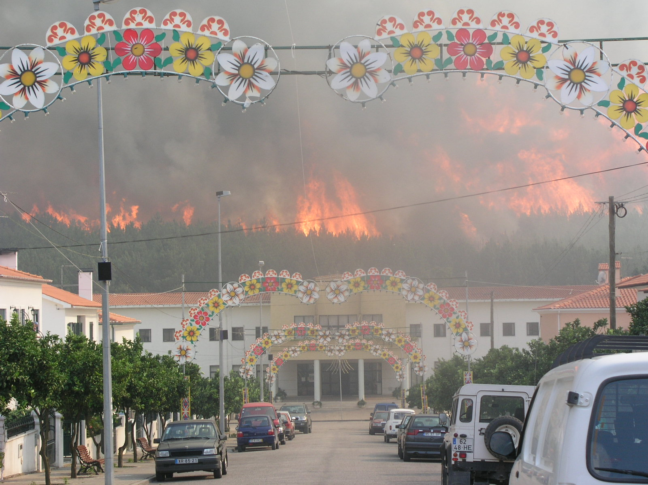
^{Forest Fires}
Chamusca, Postugal: Forest Fires

Slide 21
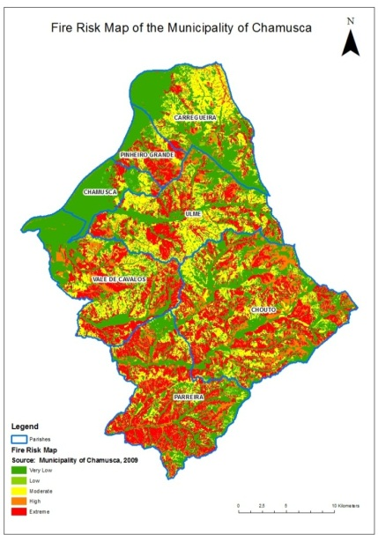
^{Forest Fires}
Chamusca, Portugal: Forest Fires
Public
Building code
Restriction urbanization
Risk
People

Slide 22
^{Forest Fires}
Chamusca, Portugal: Forest Fires
Public
Building code
Restriction urbanization
Insurers
Risk
People

Slide 23
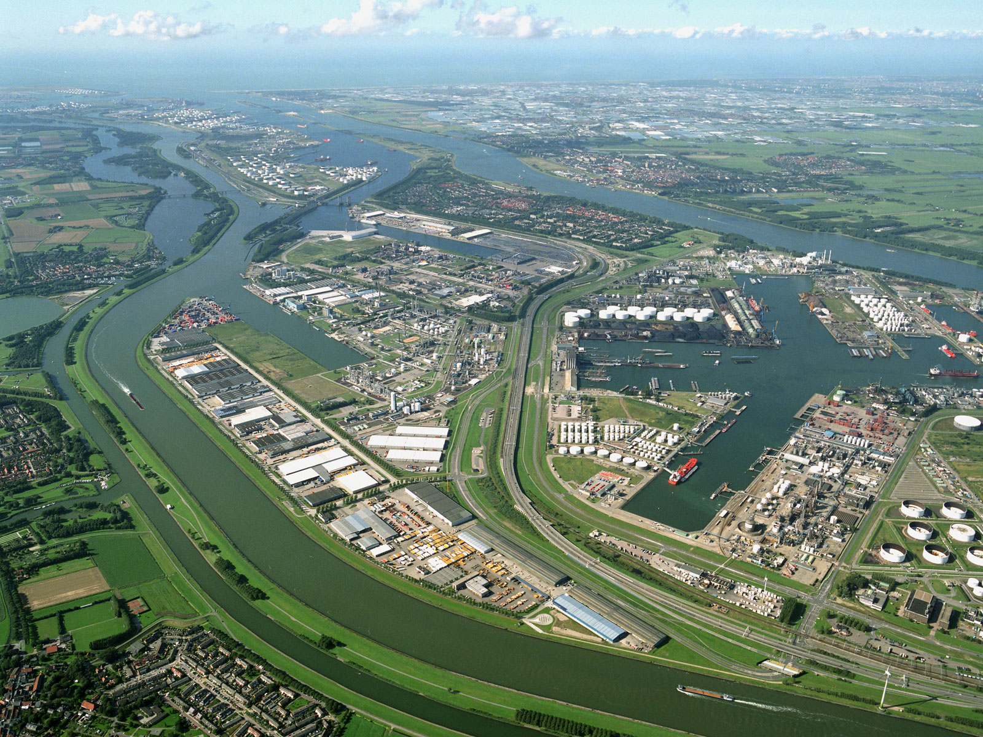
Port Cities & Flood risk
Notes:
Botllek – Chemical plants

Slide 24
Port Cities & Flood risk
London: Insurance
Rotterdam: no Insurance
Notes:
Botllek – Chemical plants

Slide 25
Port Cities & Flood risk
London: Flood Insurance
Rotterdam: no Insurance
Public
Insurers
Public
People
Notes:
Botllek – Chemical plants

Slide 26
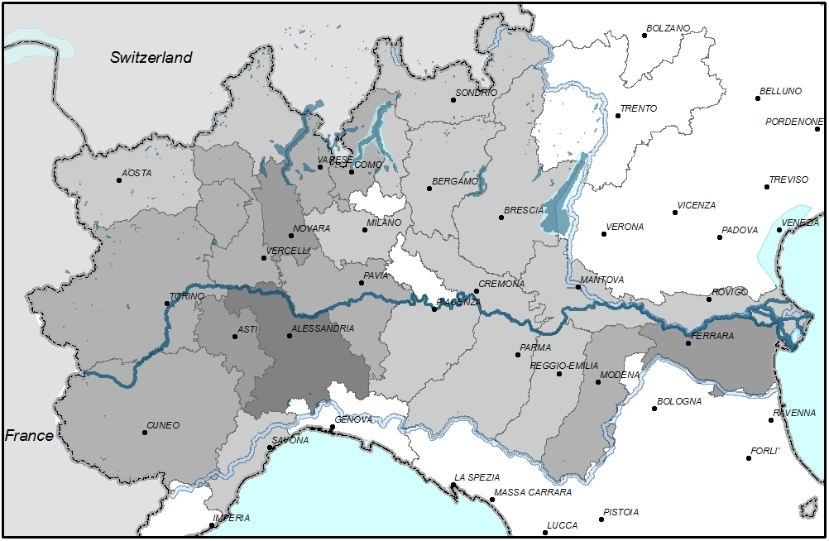
Risk Cascades : Po River Basin, Italy
Public
Insurers
Low Flows → Droughts → Salt intrusion from the sea → drinking water
People
Earth quake → Dike breach → Flood -> Damage

Slide 27
Heath Waves & Health
Flood damage & EU Solidarity fund
Volcanic ash & air traffic
^{Pan European Cases}

Slide 28
Stress test : EU Solidarity Fund
EU SF
Member state
RE-Insurers?

Slide 29
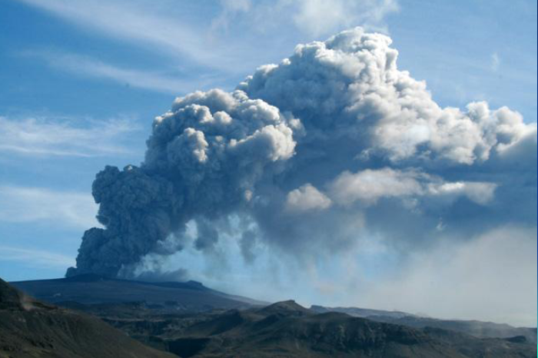
^{Volcanic Eruption & Aviation}

Slide 30
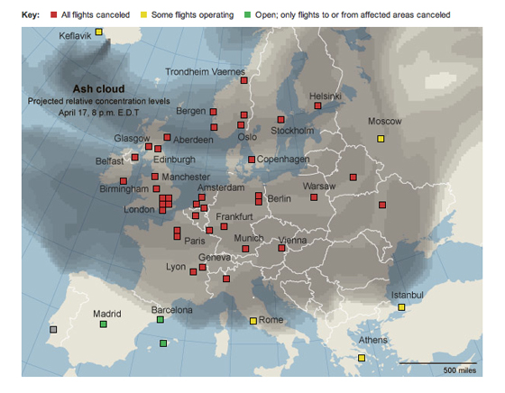
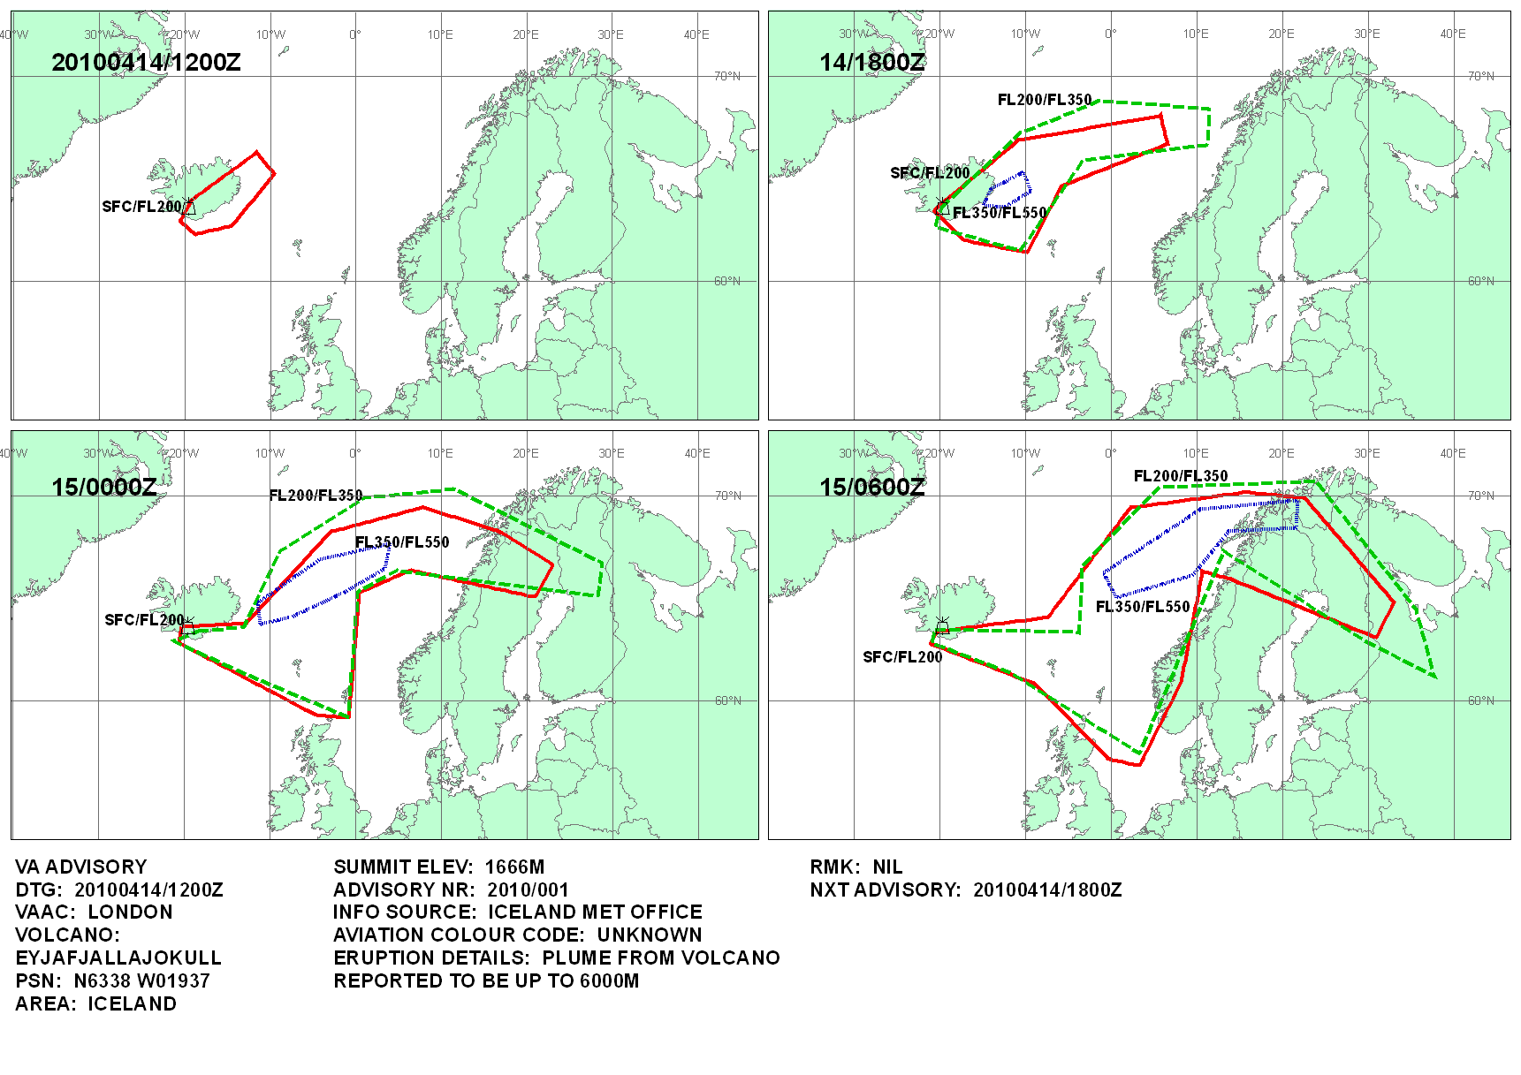
^{Volcanic Eruption & Aviation}

Slide 31
^{Volcanic Eruption & Aviation}
Eurocontrol
Public
Insurers
Limit cancelled flights
Meteo -services
People
Airlines

Slide 32
^{Outlook}
Public
Private
Testing MSPs using extreme scenarios
People
What if scenario?
Cascades/ Multi hazard
Scenarios & Hazard models

Slide 33
^{Outlook: Recommendations}
Role EU policies in effective MSPs
Special Focus on role Insurance in MSPs
Input Hyogo framework

Slide 34
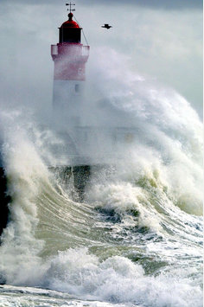
Thanks for your attention!
Website: www.enhanceproject.eu
Coordinator: jeroen.aerts@vu.nl
Communication: cedric.hananel@arctik.eu

