Slide 1


Slide 2
Disaster Risk Reduction in Post-2015 Development Goals
Dr. Tom Mitchell
Head of Climate Change
Overseas Development Institute
14th May 2013

Slide 3
1. Trajectory of the post-2015 development agenda

Slide 4
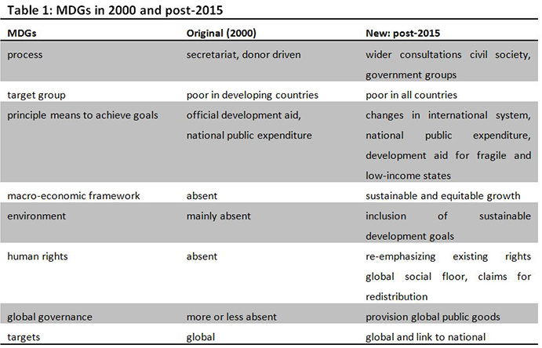
Post-2015 Goals – A new discussion
van der Hoeven, R. (2012). ‘MDGs post-2015: Beacons in turbulent times or false lights? A contribution to the discussion on a post-2015 Framework for Development’, UN-DESA Working Paper. New York: United Nations.

Slide 5



Where is this heading?
Melamed, C. (2012) http://post2015.org/2012/04/25/christmas-tree-jigsaw-or-bullseye-a-rough-guide-to-post-2015-frameworks/

Slide 6
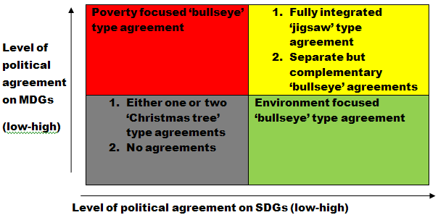
6 possible scenarios
Melamed, C. (2012) http://post2015.org/2012/04/25/christmas-tree-jigsaw-or-bullseye-a-rough-guide-to-post-2015-frameworks/

Slide 7
2a. The narrative for integration of disaster risk reduction

Slide 8
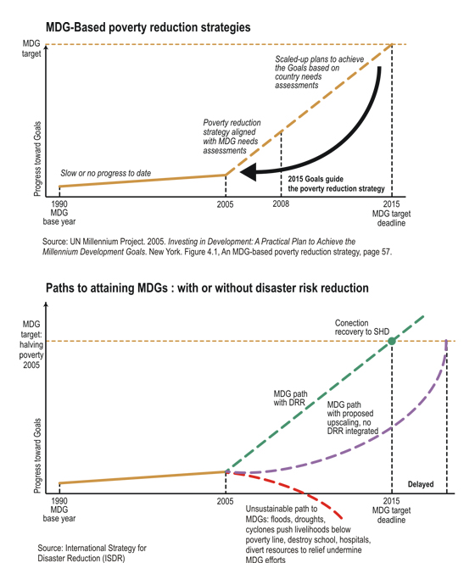
A poverty case …
http://www.unisdr.org/2005/mdgs-drr/link-mdg-drr.htm

Slide 9
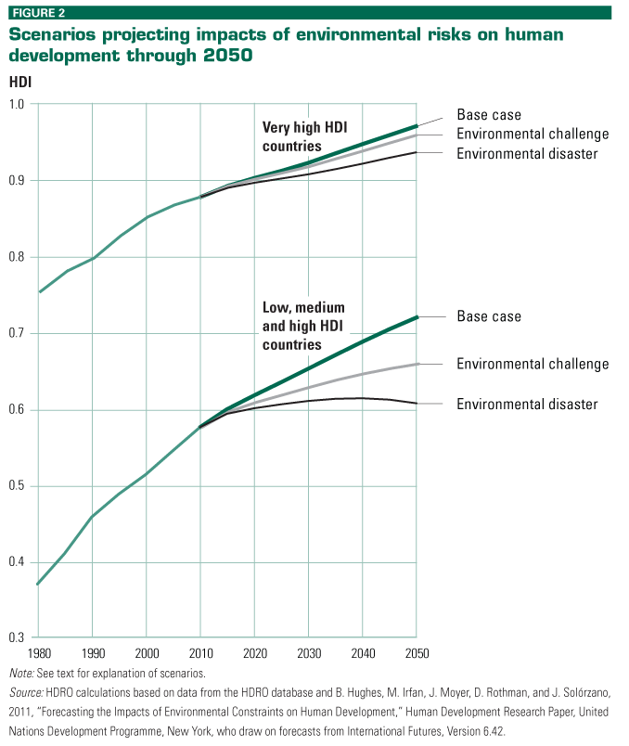
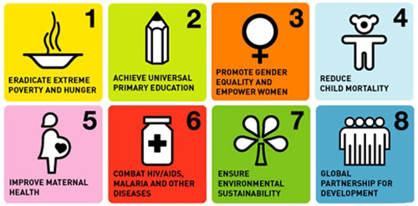
A human development case …
Human Development Report 2011: Sustainability and Equity: A Better Future for All

Slide 10
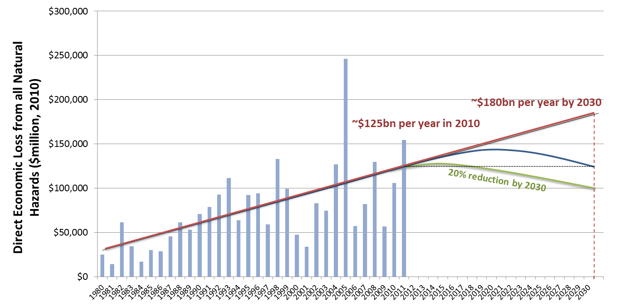
An economic case…
Figure 1: Global (direct) economic losses from natural disasters (corrected for inflation). Source: Natural hazard data provided by Munich Re and socioeconomic data from the World Bank.

Slide 11
A climate case …
“In many regions, the main drivers of future increases in economic losses due to some climate extremes will be socioeconomic in nature (medium confidence, based on medium agreement, limited evidence)”
Climate extremes are only one of the factors that affect risks, but few studies have specifically quantified the effects of changes in population, exposure of people and assets, and vulnerability as determinants of loss. However, the few studies available generally underline the important role of projected changes (increases) in population and capital at risk. [4.5.4]” (IPCC SREX)
Managing the Risks of Extreme Events and Disasters to Advance Climate Change Adaptation. A Special Report of Working Groups I and II of the Intergovernmental Panel on Climate Change (IPCC). Cambridge: Cambridge University Press.

Slide 12
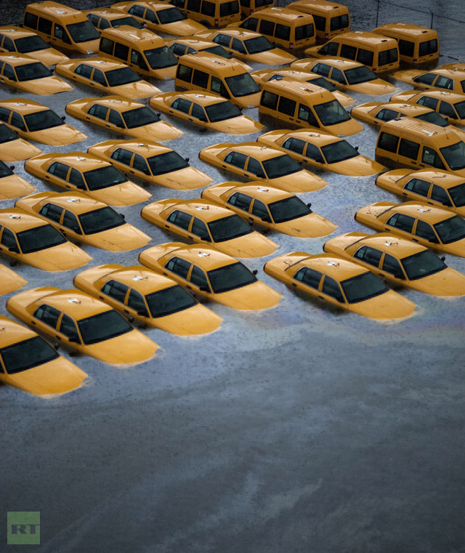
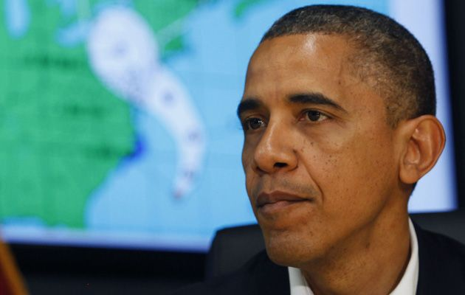
A political opportunism case …

Slide 13
A script …
Disasters have already made MDG attainment more difficult and costly.
Given increasing exposure and climate change, disaster risk is expected to increase over the next 15 years.
Disasters are a problem for every country.
Linear improvements in human development cannot be guaranteed, more risky interconnected world.
Disasters can hamper poverty reduction, even reverse development progress, cause impoverishment
The good news is that disaster risk management works, protects development progress, key part of sustainable development.

Slide 14
2b. Gaining Political Support

Slide 15
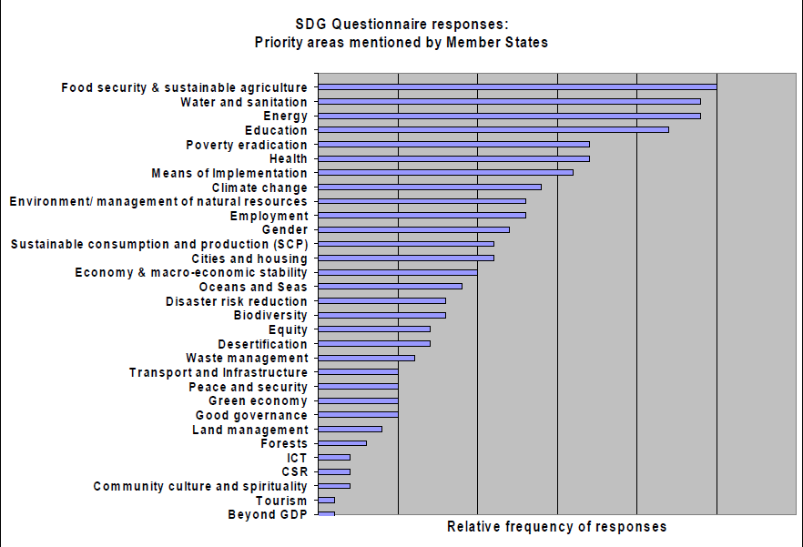
UNSGs SDGs Questionnaire
http://sustainabledevelopment.un.org/content/documents/1494sgreportsdgs.pdf

Slide 16
Who voted for it?
Japan
Mongolia
Nepal
Nicaragua
Pakistan
Switzerland
Thailand

Slide 17
Speeches …
President Yudhoyono said that Indonesia was committed "to ensure that the post-2015 development agenda takes into account the natural disaster dimension."

Slide 18
2c. Proposing Targets and Indicators

Slide 19
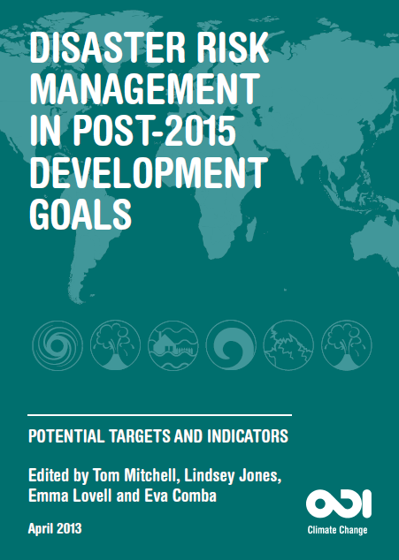
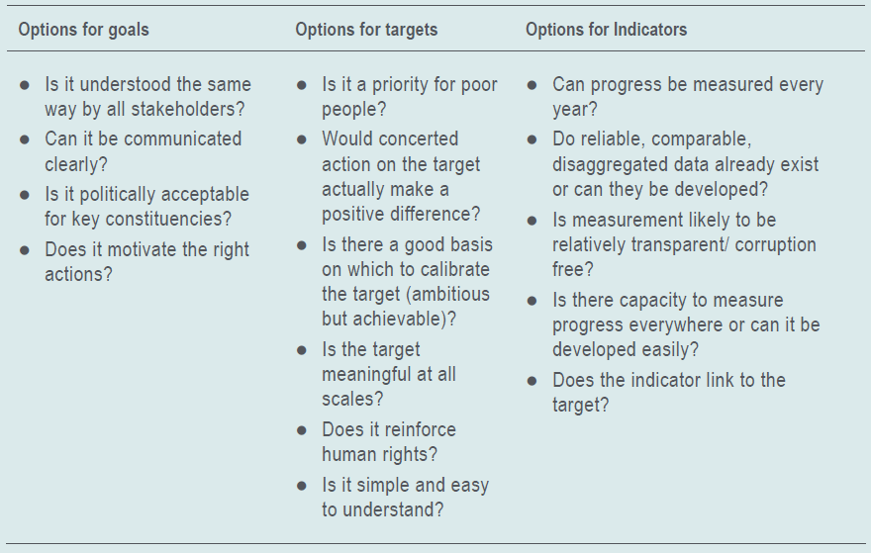
Potential Targets and Indicators

Slide 20
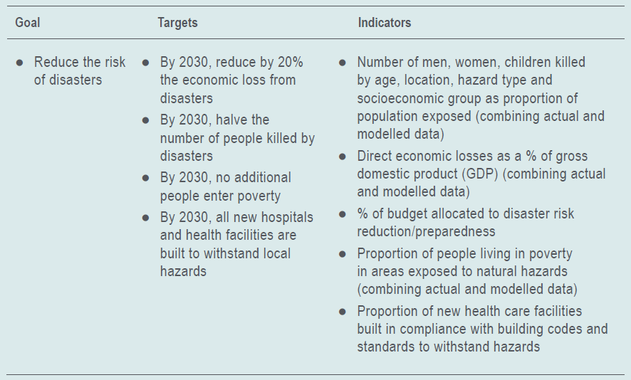
Scenario 1: Standalone disasters goal

Slide 21
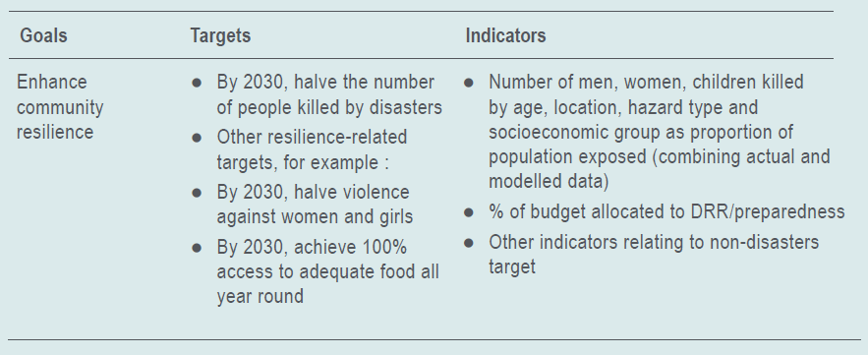
Scenario 2: Disasters within a resilience-type goal

Slide 22
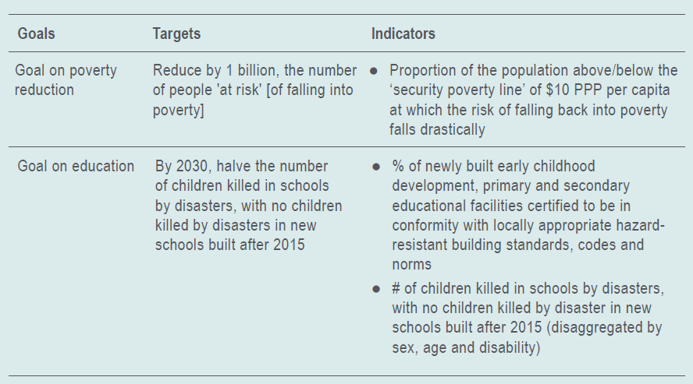
Scenario 3: Disasters mainstreamed across other goals

Slide 23
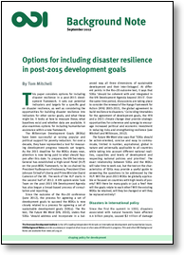
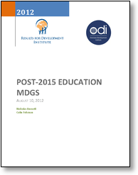
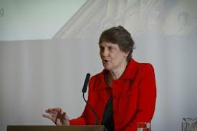
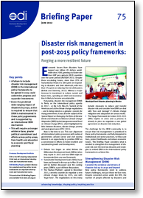
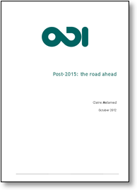
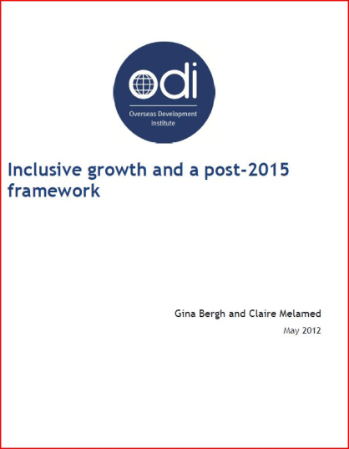
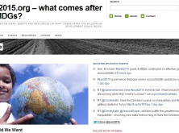

ODI on the post-2015 agenda …
Notes:
Develop a multidimensional risk index which integrates existing data on conflict and fragility, natural hazards, vulnerability, poverty and climate change. Ideally this should be sufficiently high resolution to consider sub-national areas and should include a process for weighting risk factors depending on the focus of different agencies. Monitoring changes to this index over time will help to highlight the co-dependency between different aspects of risk and vulnerability and allow progress to be tracked and subsequently analysed.
Develop and test conceptual frameworks and analytical tools. Specifically this should include: modifying existing analytical tools (such as conflict sensitivity frameworks and state building/peacebuilding frameworks) to reflect disaster risk and vice versa. This process could provide the model for more integrated risk modelling.
Increase the evidence base of what works in to increase resilience to multiple shocks and stresses in FCAS.

Slide 24
www.post2015.org
t.mitchell@odi.org.uk
Twitter: tommitchell_odi

Slide 26
Moderator’s Questions
How should disaster risk reduction be integrated in the Post-2015 Development Goals?
What will help make the case for disaster risk reduction to be included?
If the post-2015 development goals include disaster risk reduction, how should it be linked to the 2015 agreement on disaster risk reduction?

