Slide 1




Competitive and disaster resilient business enterprises
Global Platform for Disaster Risk Reduction
IGNITE stage: Geneve 21/05/2013
Lorenzo Carrera, Jaroslav Mysiak
Fondazione Eni Enrico Mattei and
Euro-Mediterranean Center on Climate Change

Slide 2
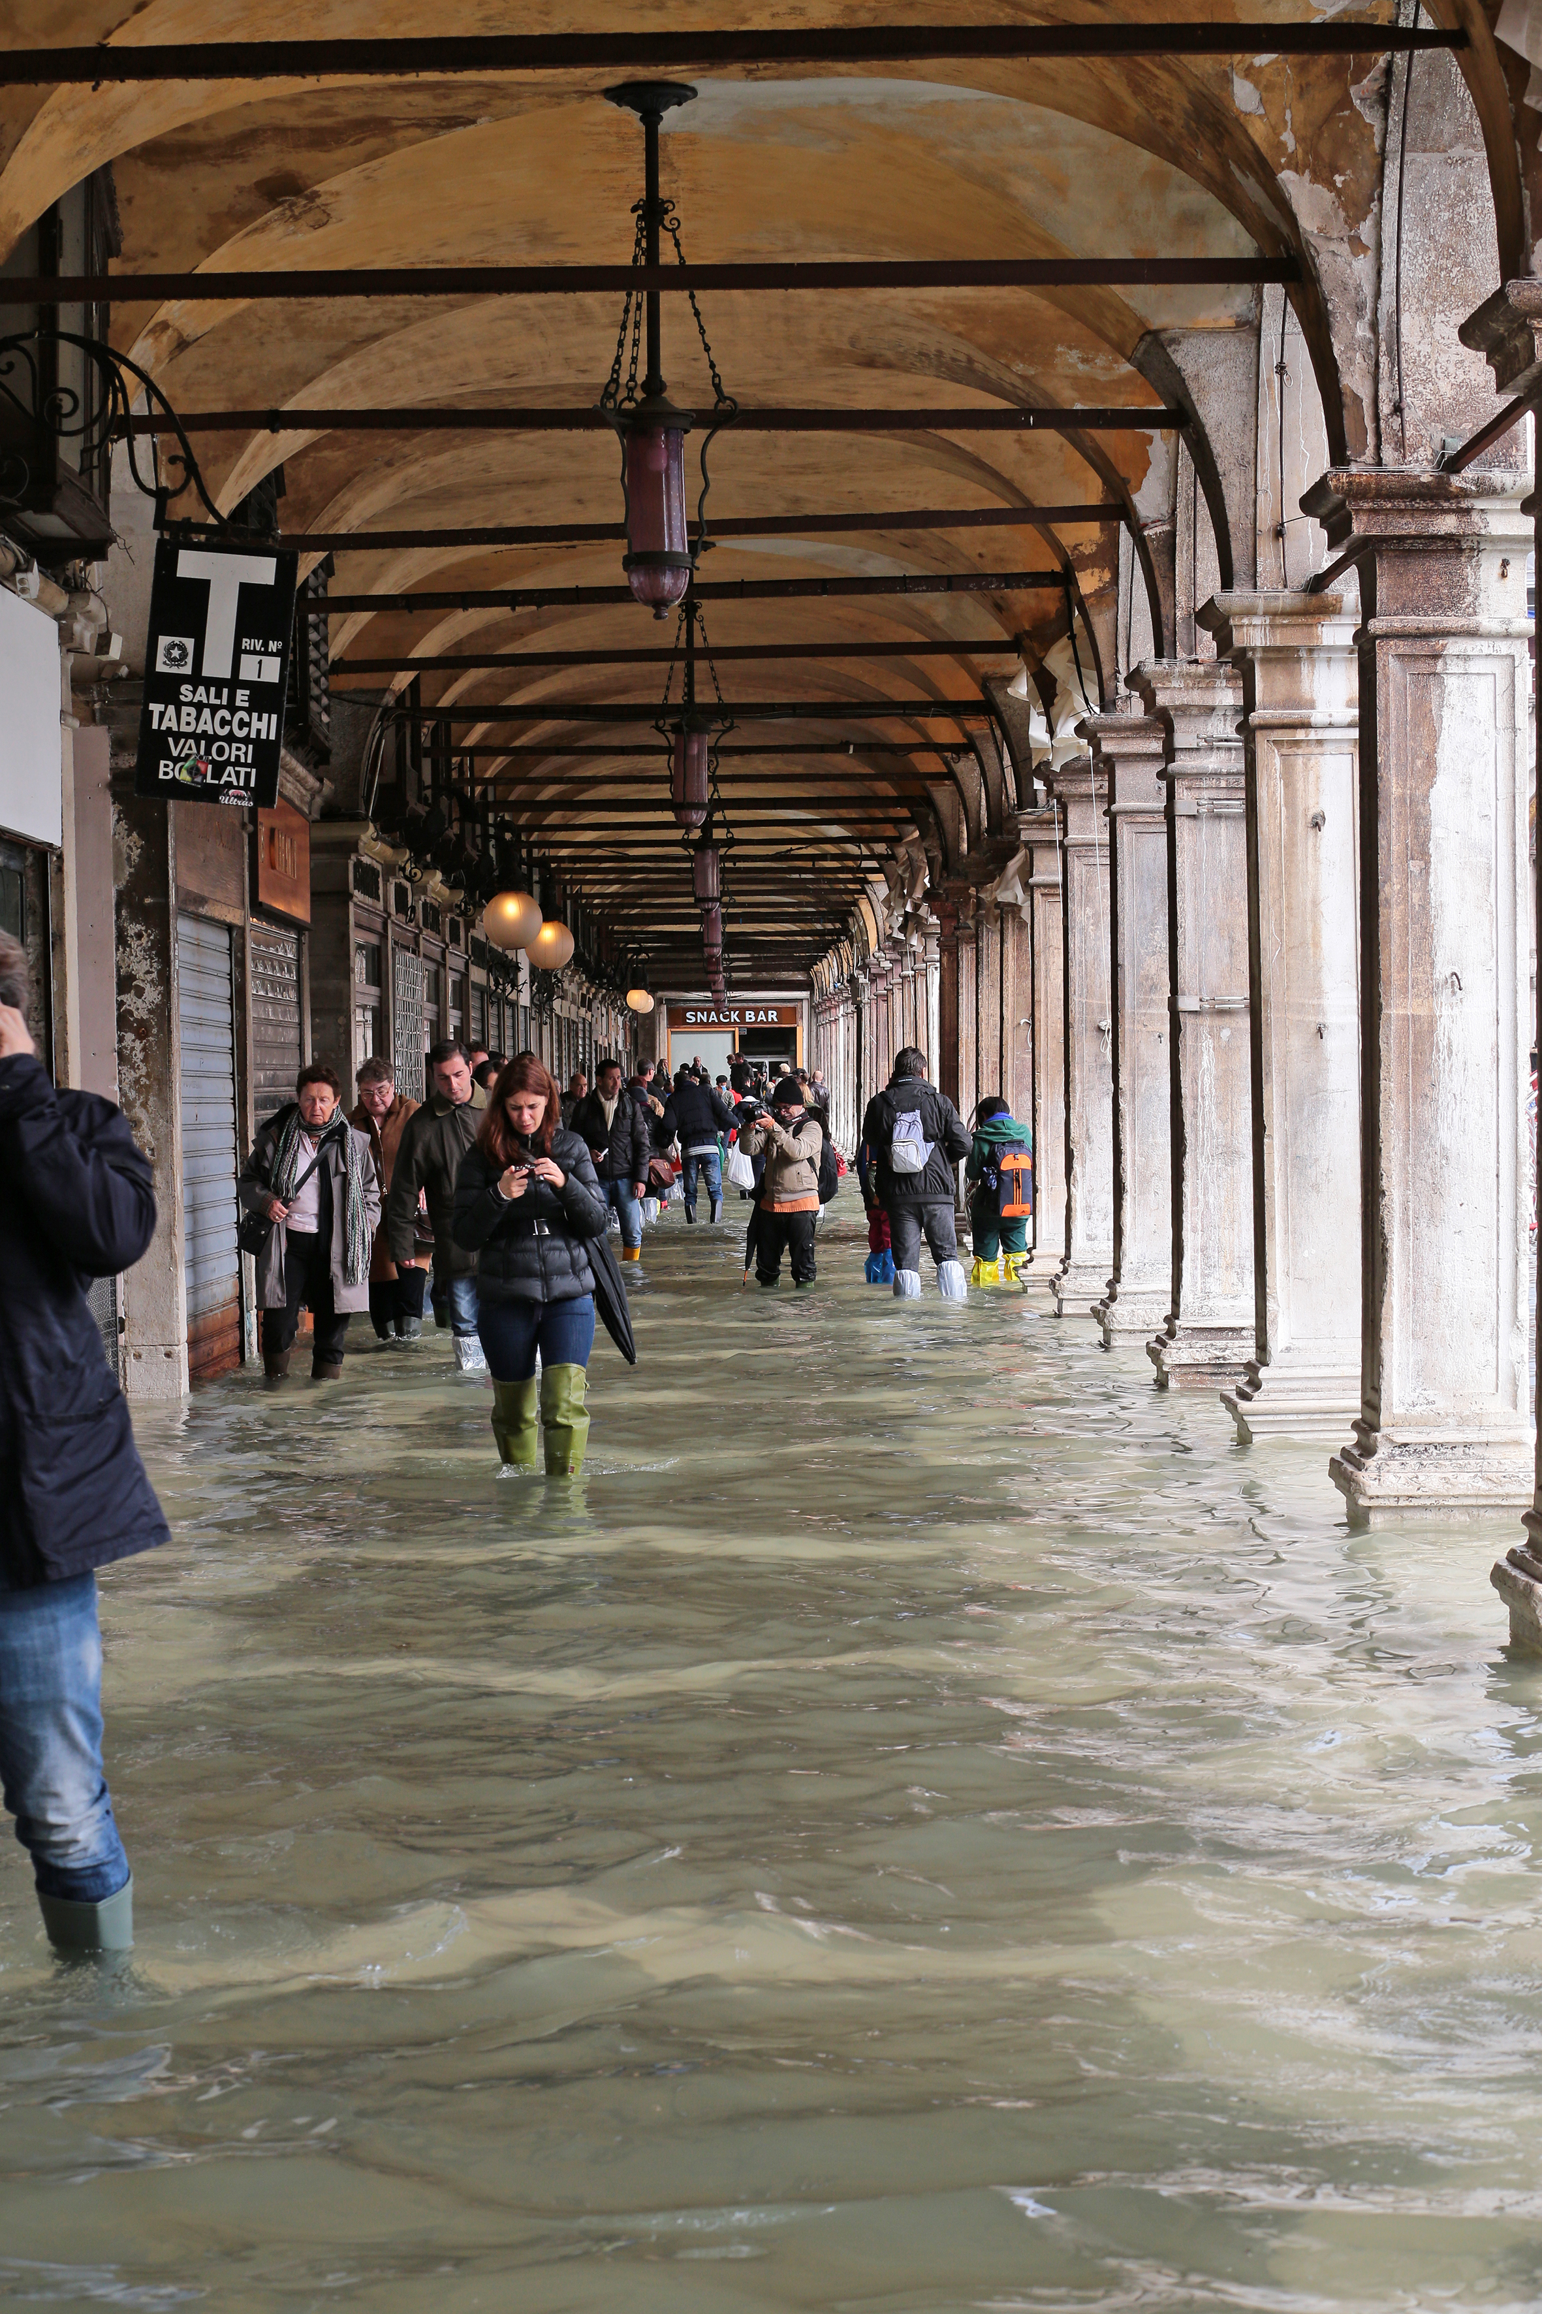
Essentials
“ Disaster risk reduction is everybody’s BUSINESS” (UNISDR)
Competition and resilience need to be addressed at all levels, including civil societies, governments, business enterprises.
Economic and social sustainable development depends on well functioning interconnected businesses operations.
In addition to study social resilience, it is increasingly important to think also about businesses.
Notes:
(Marshall, 2010)

Slide 3

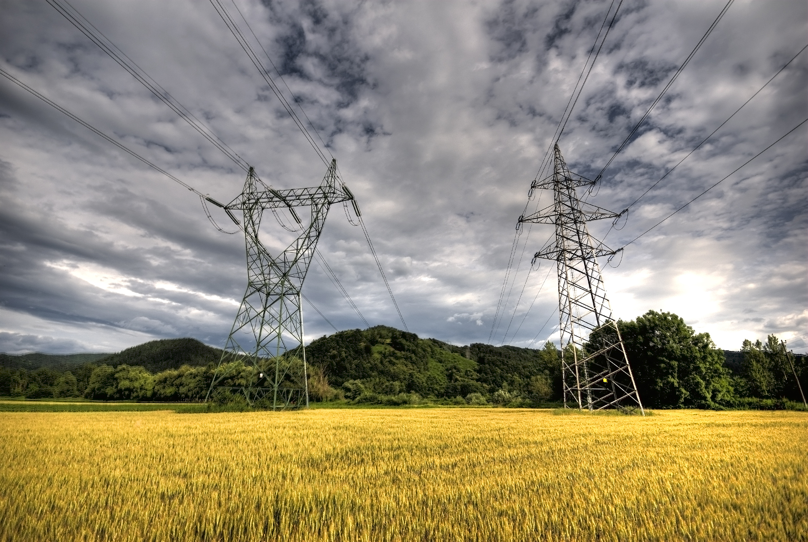

Late lessons learned
  Resource dependent businesses, such as energy production, agriculture production and civil water supply, should be resilient because the society is highly dependent on their services.
Disruptions to such businesses are very costly for the entire society.
Civil water supply: civil water utilities non prepared to extreme droughts. Barcelona 2008 impact was estimated as 1.6 billion Euro.
Energy production (and supply): cascading effects and energy dependency. Italian black out 2003 affected 56 million people (up to 48 h) and produced damages for 640 million Euro
Food production: lack of preparation to extreme heat wave and drought. 2003: 13 billion Euro of damage in Europe. In Italy prices increased up to 42% (vegetables)
Notes:
Trova qualcosa su Fukushima!
Civil water supply
civil water utilities are not prepared to extreme drought
Barcelona 2007/2008 – the total cost of drought has been estimated as 1.6 billion Euro (0.48% of regional GDP) (Martin-Ortega J. et al. 2012)
Aggiungere altre informazioni.
Energy production (and supply)
The Italian black out of September 28, 2003 affected 56 million people (Johnson C.W., 2007). Up to 48h disruption in domestic supply. Mobile phone and internet system affected. Estimated 640 million Euro damage (Rapporto Commissione d’indagine, 2003).
Food production
The impact of 2003 heat wave and droughts on European agriculture caused around 13 billion Euro damage (Easterling et al. 2007). In Italy agriculture products prices increased by 20-25%, with peaks of 42% on vegetables (Fanfani and Pieri, 2004).

Slide 4

Indirect and high order impacts
In a globalized and interconnected world, indirect and high order impacts may exceed direct impacts. However indirect impacts are poorly understood. There is an important knowledge gap.
Climate change will most likely increase the total losses of natural hazards.
For large scale disasters, indirect losses can be of the same order of magnitude than direct losses (e.g., Tierney, 1997; Hallegatte, 2008). There is no linearity is the ratio direct-indirect losses. The indirect component increases with the disaster size. +40% for 100 billion losses, +100% for 200 billion losses.
Notes:
CERCA QUALCOSA SU FUKUSHIMA
Hallegatte “existence of a nonlinearity in total economic losses with respect to direct losses. Indeed, the EAR, which measures the ratio of total losses to direct losses, increases with the disaster size. Actually, total costs differ from direct costs when direct costs exceed $50 billion. For a disaster like Katrina, with $100 billion direct losses, the EAR is found equal to 1.39. For a disaster with $200 billion direct losses, this ratio reaches 2.00, meaning that total costs are twice as large as direct costs.

Slide 5
Focus on businesses and water resources
Natural disasters could be costly also to business enterprises.
Natural resources
Businesses
Demand
Natural-resource-dependent businesses have high exposure to double-side-origin external shocks: upstream (supply) and downstream (demand). While demand shocks have low probability of occurrence due to the nature of businesses, disruptions in natural resources supply are very likely to occur.
The competitiveness and resilience of energy production, agriculture production and civil water supply are highly dependent on the good quality and quantity of water resources

Slide 6

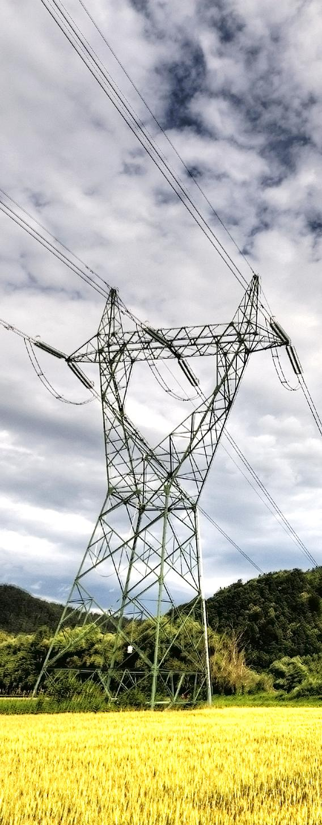
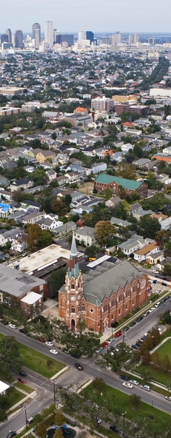
Impact on businesses in the Po river basin
Agriculture
Energy production
Water supply and sanitation

Slide 7
Agriculture production
Economic impacts (Net Revenue/ha) in Emilia Romagna Region (Northern Italy) for the last decade droughts have been estimated for the years 2003, 2006, 2007:
Year | Net Revenue variation (Euro/ha) [range]
2003 | 962 | 1,051
2006 | 42 | 158
2007 | -492 | -451
It is likely possible that market price increases of agriculture products compensated 2003 losses, but did not compensate 2007 losses, also because 2006-2007 (longer drought) had stronger impact on the production.

Slide 8
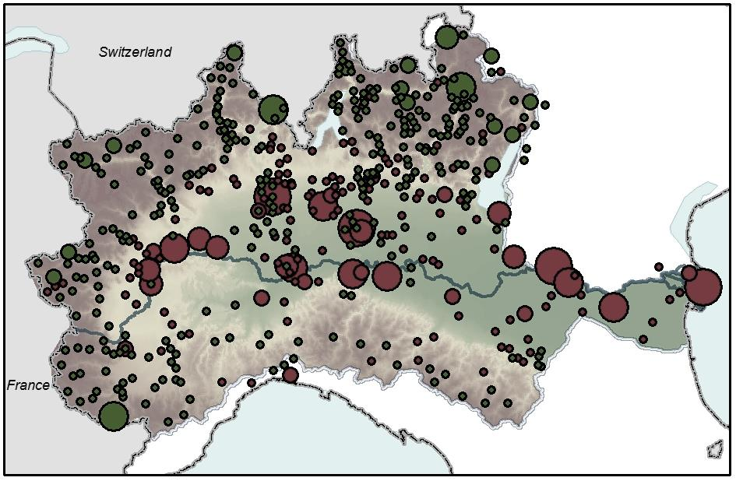
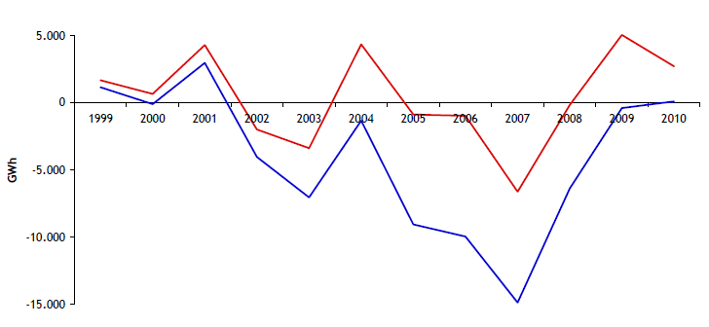
Energy production
Most of the capacity (18 thermo-elec. plants producing ∼ 60% electricity of the area) is concentrated along few rivers.
In June 2003, heat wave and drought effects caused several load shedding (controlled). In July low levels of Po river required stepping back from existing water withdrawal regulation (environmental).
Hydropower production losses: 280 million Euro in 2003 and 670 million Euro in 2007
Notes:
Capacity development, TE enterprises and plants
1 Basin (Po RBD):
Hydropower
1,000 plants
10.000 MW
26.000 GWh (48 % IT)
Thermoelectric power
400 plants
20,000 MW
80,000 GWh (30% IT)
Structural vulnerability – most of the capacity is concentrated in few river basins (quanta capacità produttiva ha il sistema rispetto alla domanda?)
Concentration of Italy’s installed thermo- and hydroelectricity capacity in the Northern Italy (over 2000-2010, +50% and +30% respectively)
2003 crisis, black-out, stepping back from the existing environmental regulation
EMAS shows positive results, the 18 TE plants (∼ 80% produced thermo-electricity) enrolled and substantially reduced water abstraction
The relatively high operating costs of domestic
generation facilities also increased incentives for
Italian suppliers to import electricity from other states
during periods of relatively low demand.
The analysis estimated that the cost of missing production in the sector during amounted to 280 million Euro in 2003 and 670 million
Euro in 2007, highlighting the extremely high vulnerability of the sector to meteo-climate variability.
During the exceptional drought occurred in 2003, a new institutional ordinary measure, the Protocol of Intent, has been activated. In order to promptly tackle with the emergency several authorities (NCDP, Po River Basin Authority, Regions Valle d’Aosta, Piedmont, Lombardy, Veneto, Emilia-Romagna, AIPO, GRTN, lake-discharge Consortia, ANBI and the hydro and thermo-electric plants) signed an agreement for a coordinated management of the (scarce) hydro-resources of the basin. The agreement, called ‘Protocol of Intent’ provided for the release of additional 3.7 millions m³/day from hydropower alpine intakes in order to cope with irrigation deficiencies further downstream. It also provided for the reduction of water derivations for agriculture purposes by 10 per cent from July 17th baseline observations, on all alpine rivers. The measures foresaw a total additional waterflow contribute of 8.13 millions m³/day to the Po River body downstream. The Agreement entered into force on July 19th until August 8th. The Protocol of Intent produced doubtless positive effects on the water regime of Po River affluents. Coordinated and integrated interventions at basin level provided to mitigate the water stress along the rivers. Thanks to the measures implemented power generation (thermoelectric) and agriculture production were assured during the drought. It was calculated that the implementation of the Protocol reduced the potential losses from 1.9 billion Euros to 1.3 billion Euros (Massarutto, 2009).
Nel bacino Padano sono installati più di mille impianti idroelettrici, per una potenza di oltre 10.000 MW e una produzione annua di circa 26.000 GWh, circa il 48 per cento dell’elettricità prodotta a livello nazionale sfruttando questa fonte rinnovabile (Terna, 2010).

Slide 9
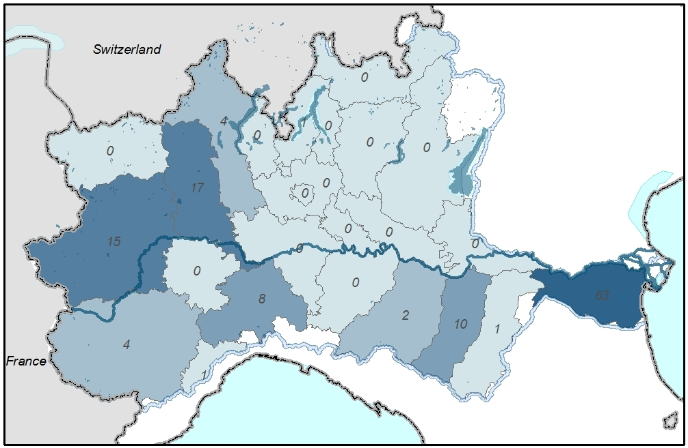
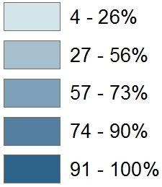
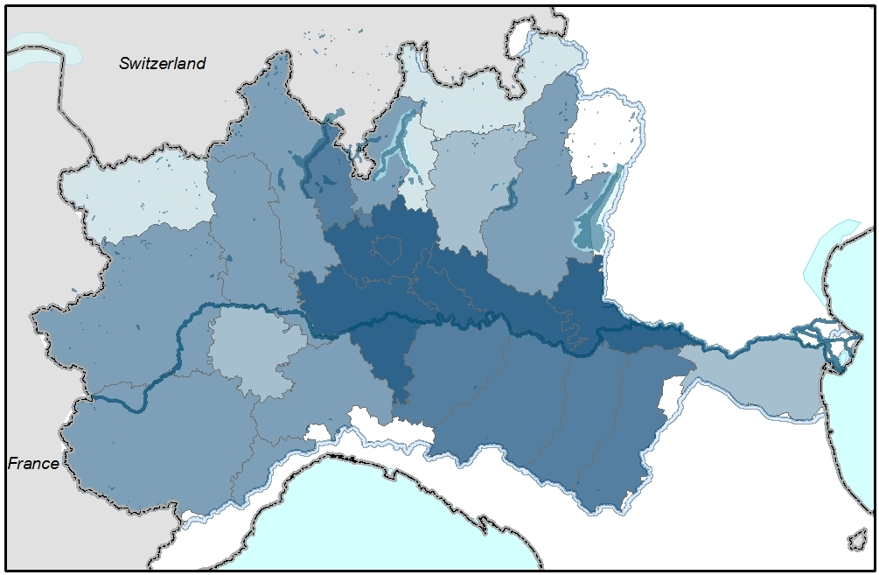
Civil water supply
High level structural dependency from one type of water-source increase the vulnerability of WSS utilities to disruptions.
Vulnerability could be costly: emergency supply, exploration of additional sources of water, extension of supply networks, water restrictions (risk of social uprising), reduction of water consumption (reduced income on the variable component of the water tariff).
Share of superficial water for civil water supply
Share of groundwater for civil water supply
Notes:
Water supply interrupted, emergency supply, low quality control, ….
High level structural dependency of river flow: Po river basin catchment (63% dependency) in Ferrara (2003 disruption)
High level dependency on water quality: increasing climate change induces drying out of soils (degradation) which affect both quality and quality of available groundwater, and groundwater recharge
Lack of resilience could be costly: emergency supply, exploration of additional sources of water, extension of supply networks, water restrictions, social uprising, reduction of water consumption (reduced income on the varible component of the water tariff).
A study on Parma Province (around 400,000 people) estimated that during the drought of 2001-2002 around 15,000 people (mainly on hillside and mountain areas) were affected and around 25,000 in 2003 . The organizational, operational and economic effort was intense: water truck use, installation of 37 temporary water reservoirs, water distribution network extraordinary maintanance, restoration and extension required.

Slide 10
Interdependent vulnerability from water
Interaction between the three sectors: 1) all three depend on water as critical input (competitors for water); 2) there are multiple interaction between the sectors and the crisis in one is propagated into the others.
Agricul-ture
Depuration
Supply
There is the need for a common water-management strategy, also among businesses.
Irrigation
Drainage
Biomass
WATER
Energy
CWS
Pumping, distribution, potabilization, depuration
Notes:
There is the need for a (common strategy)
Grafico da rifare!

Slide 11

Best practices considered
Best practice for disaster preparedness plan at the business enterprise level:
Cooperation → Public Private Partnership (PPP), Multi Stakeholder Partnership (MSP)
Plan for worse → given the slow progress made on reducing CO2 emissions, it is necessary to invest in Climate Change Adaptation
Knowledge enhancement, particularly on indirect losses → Research
Notes:
Invece di Knowledge

Slide 12
Partnership
Partnership is a relationship between individuals or groups that is characterized by mutual cooperation and responsibility, as for the achievement of a specified goal
Why to enter in a partnership?
making more with less: expectation to achieve more or with less resources; cost saving (including enforcement/transaction costs)
aligned forward consensus where the issue at hand is contentious or where the lack of knowledge or uncertainty is too large
limit liability or litigation

Slide 13
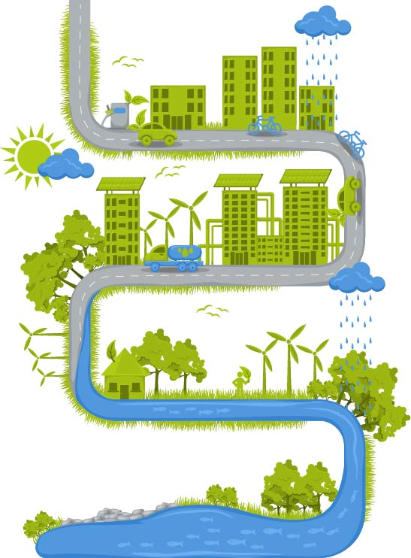
Climate change adaptation strategies
Institutional adaptation
Business adaptation
Notes:
Institutional adaptation ←→business adaptation

Slide 14
Research in DRR at FEEM and CMCC
Water-related natural-hazard impacts assessment
Water2Adapt: http://www.feem-project.net/water2adapt/
PREEMPT: http://www.feem-project.net/preempt/
Climate Change Adaptation Strategies
EU ADAPT STRAT: www.feem.it
Italian National Strategy for Climate Change Adaptation: www.cmcc.it
Cooperation
EPI-Water: http://www.feem-project.net/epiwater/
ENHANCE : www. enhanceproject.eu

Slide 15


Thank you for your attention
lorenzo.carrera@feem.it
The research leading to these results has received funding from the European Commission, FP7.ENV.2012- ENHANCE
Notes:
Inserire web di enhance

