Slide 1
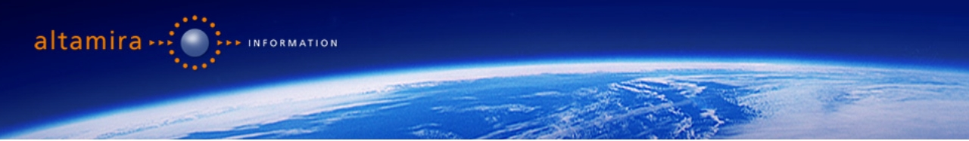


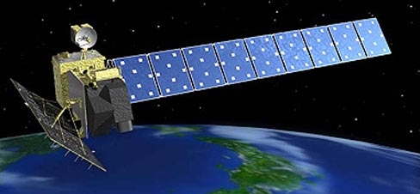
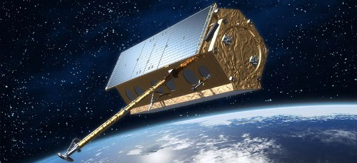
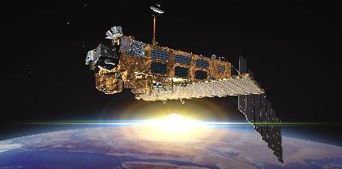
Ground motion measurements derived from space-borne data for DRR
Alain Arnaud
ALTAMIRA INFORMATION, BARCELONA

Slide 2
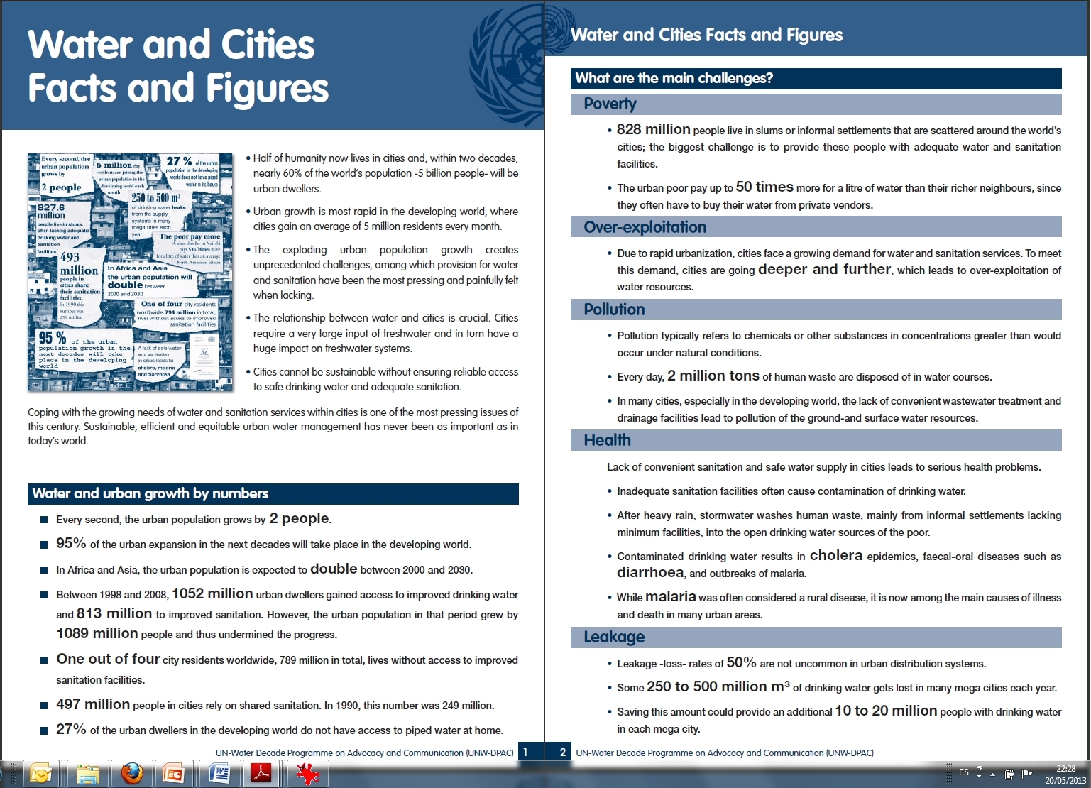
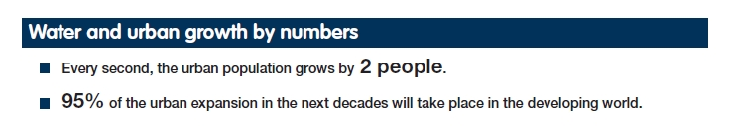
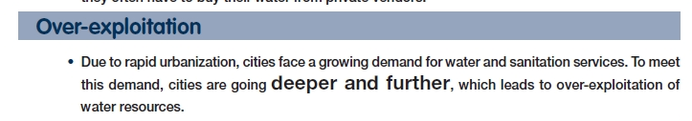
Context
Floods in the last decades vs Localisation of megacities

Slide 3
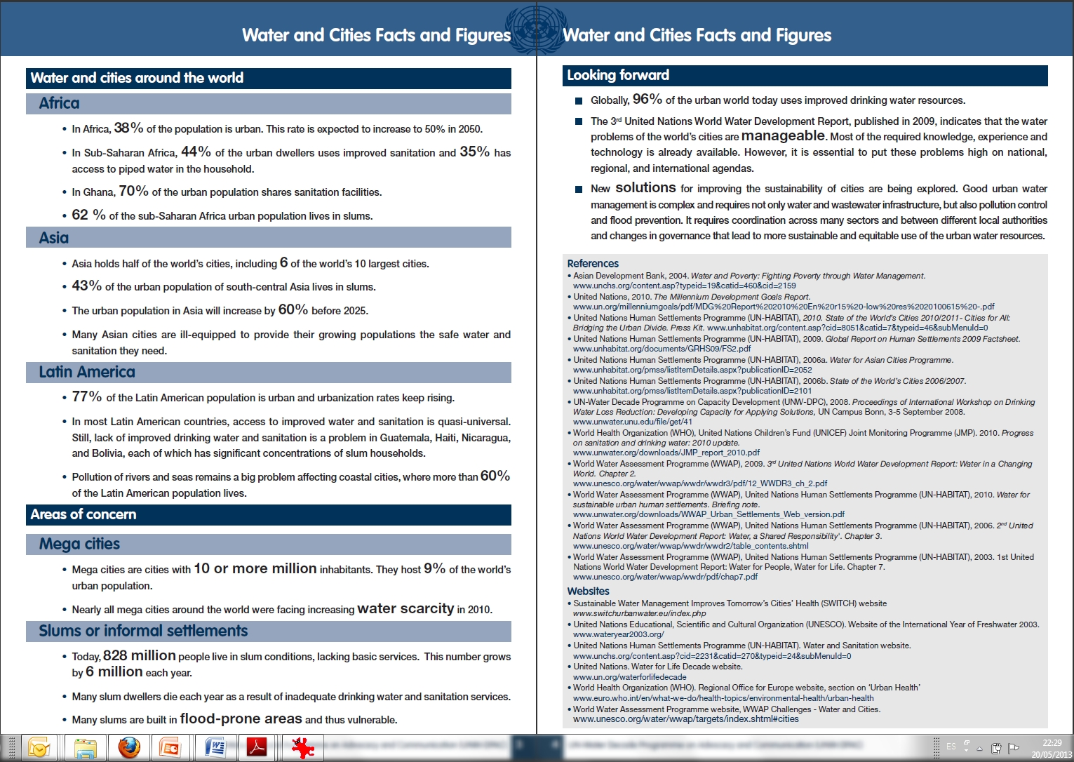
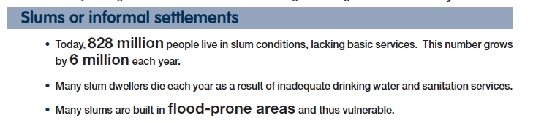
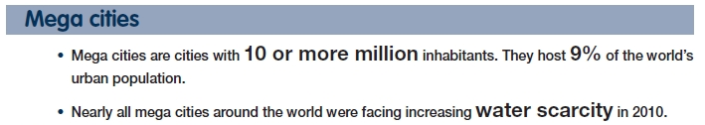
Context
Floods in the last decades vs Localisation of megacities

Slide 4
Context
Urban growth, Flood-prone areas, water scarcity, over-exploitation of resources

Slide 5
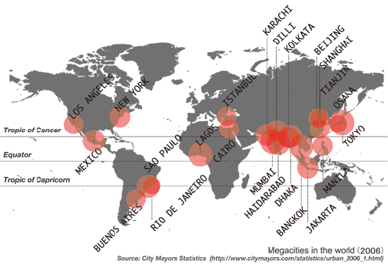
Context
Urban growth

Slide 6
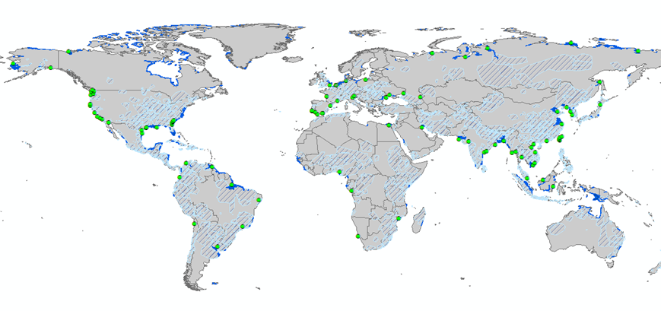
Context
Urban growth in flood-prone areas

Slide 7


Context
Impact of water scarcity and over-exploitation: Flood Vulnerability

Slide 8
Ground motion measurement and satellite ?
?
InSAR - Technique

Slide 9

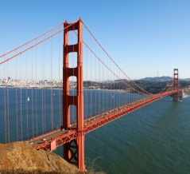
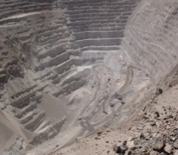
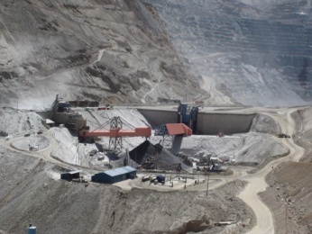
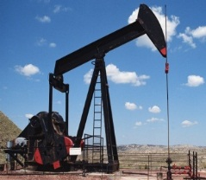
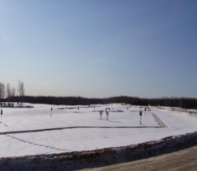
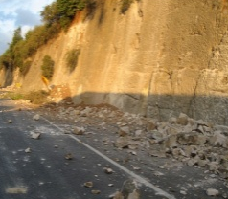

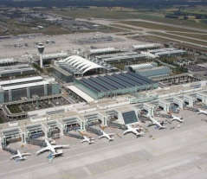
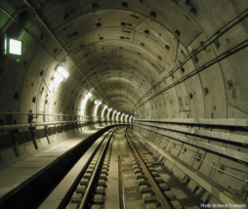
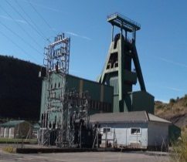
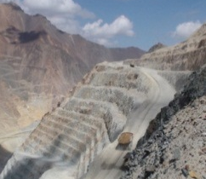
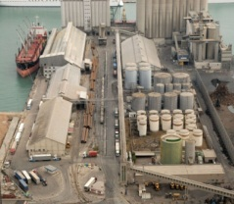
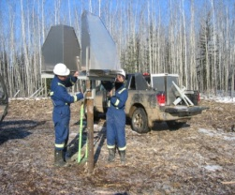
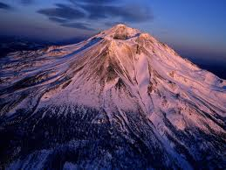
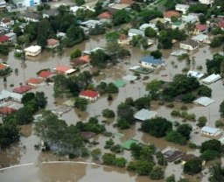
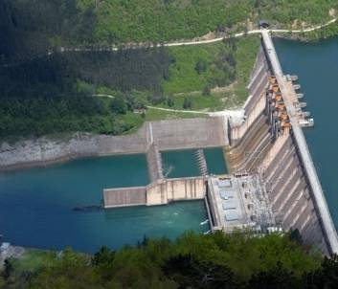
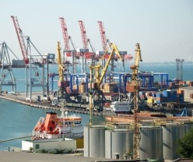
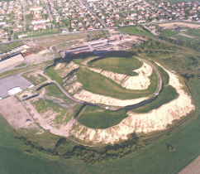
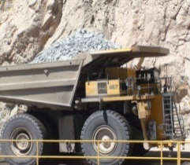
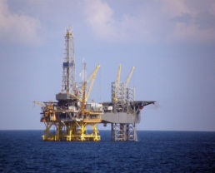
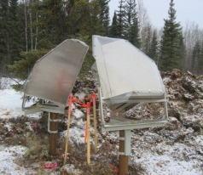
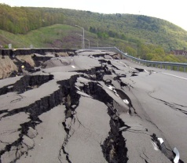
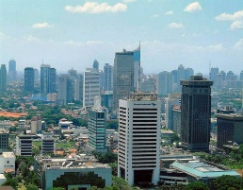
Ground motion measurement
The InSAR techniques and applications
Infrastructures
Mining
Oil & Gas
Institutional
Infrastructures (railway, ports, tunnel, metro, bridges..) monitoring
Planning, construction
Open pit mines and slopes
Underground mines
Infrastructures (dump
areas, tailing dams…)
Reservoirs and pipelines monitoring
Unconventional gas storage
LNG terminals…
Natural Hazards mitigation
Safety improvement
Hazard information services (floods, climate changes…

Slide 10














Ground motion measurement
Sectors of applications: Risk assessment projects
Institutional
Natural Hazards mitigation
Safety improvement
Hazard information services (floods, climate changes…

Slide 11
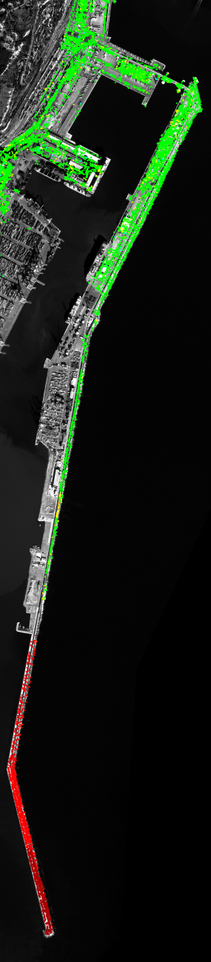
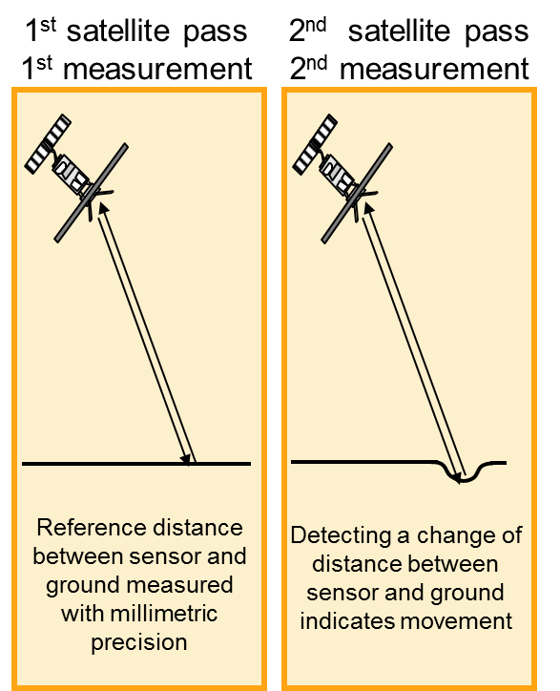
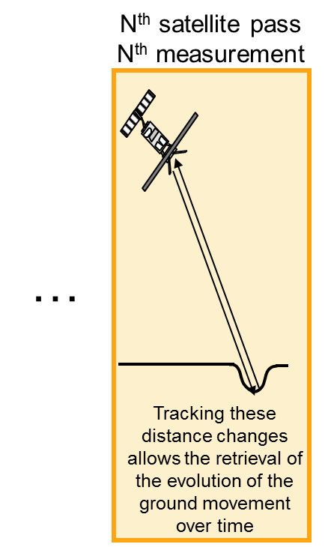
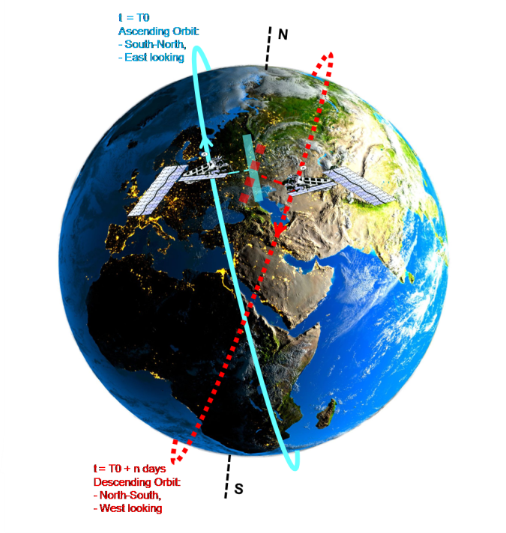
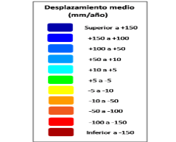
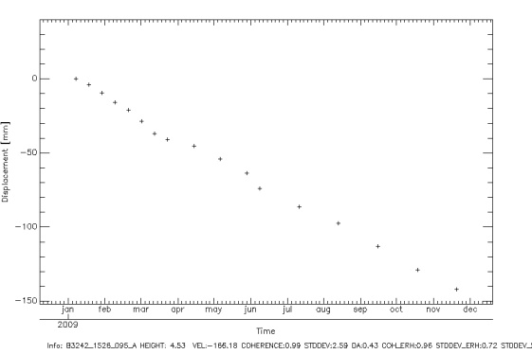
Ground motion measurement
What is SAR interferometry
Deformation maps
Mean displacement rate (in mm/yr) of each measurement point.
Time series
Temporal evolution of the displacement
Absolute displacement in mm
r₂
r_{n}
r₁
δd

Slide 12
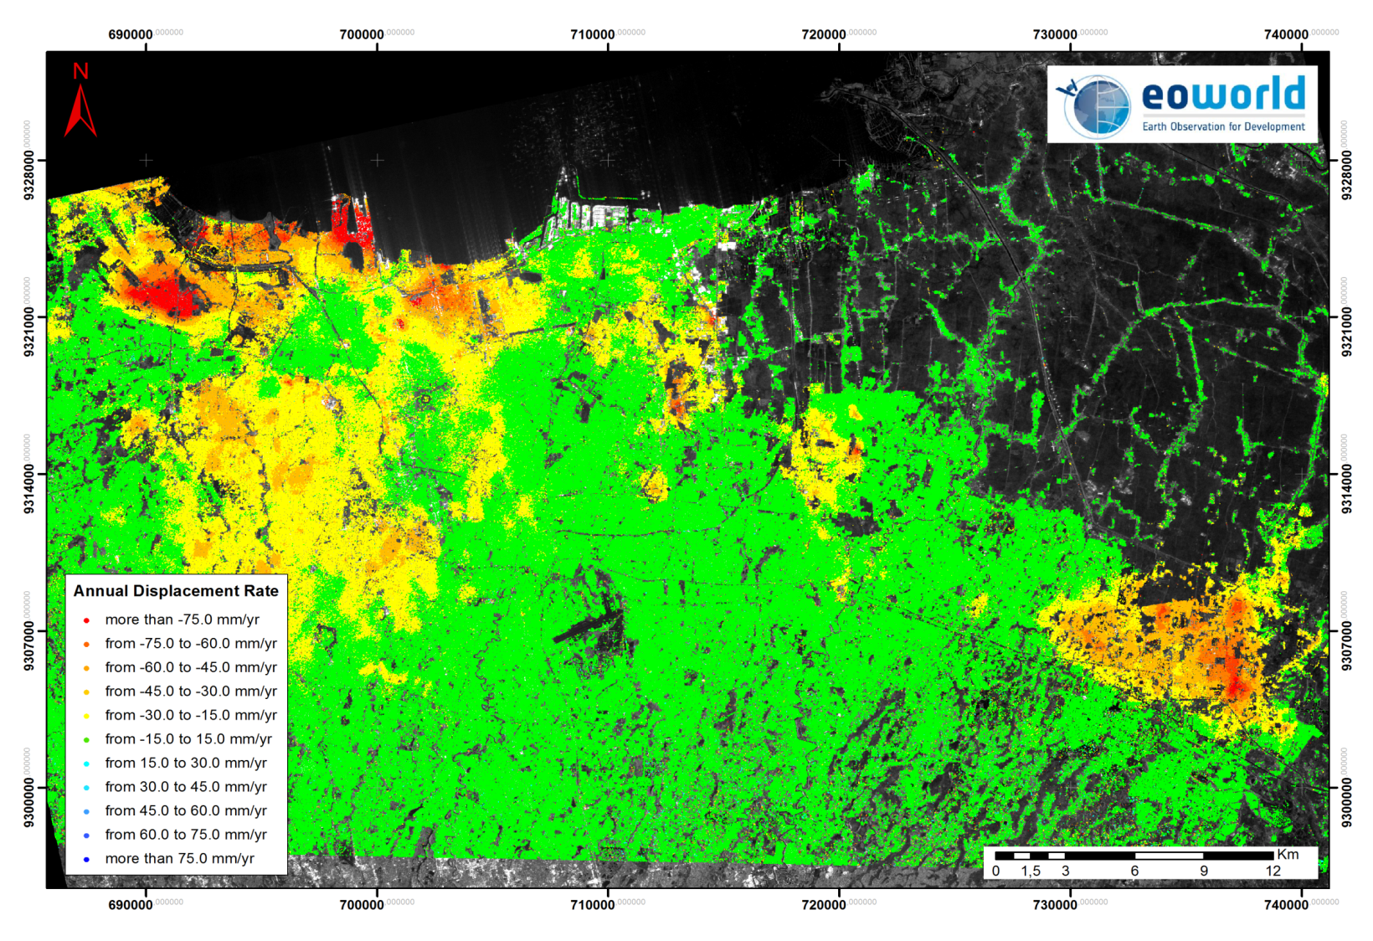
Jakarta (Indonesia)
30 m resolution
Notes:
Indonesia capital city with about 9 million people
inhabiting an area of about 660 Km².
Most prominent impact of land subsidence is due to intensive deep groundwater abstraction.
Areas in the North of Jakarta subsidence in the range 15-25 cm/year is occurring → sink to 4 to 5 meters below sea level by 2025.
Subsidence measured from the 80’s with in-situ techniques

Slide 13
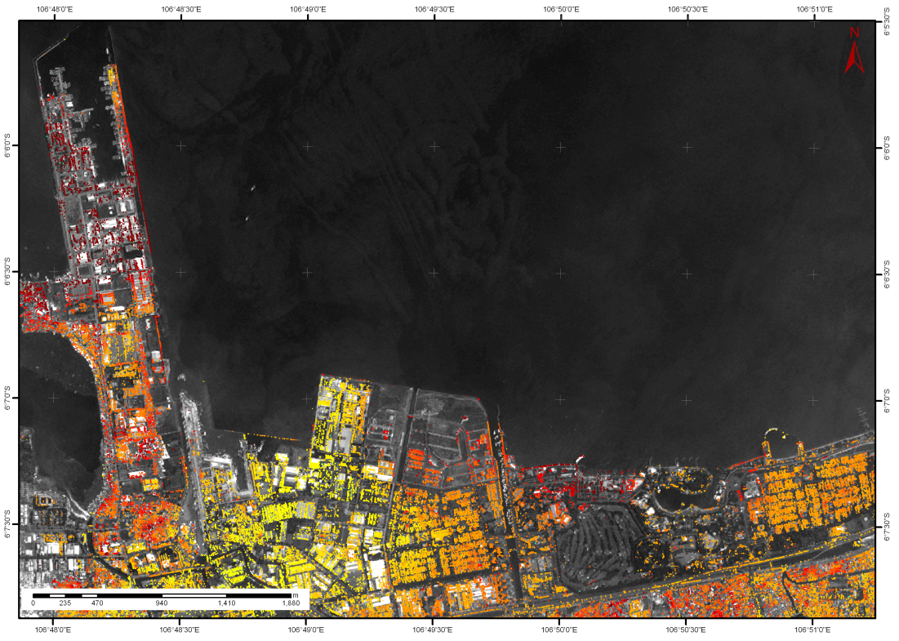

Jakarta (Indonesia)
3 m resolution
Mean Displacement rate (mm/year)
- 75
75

Slide 14
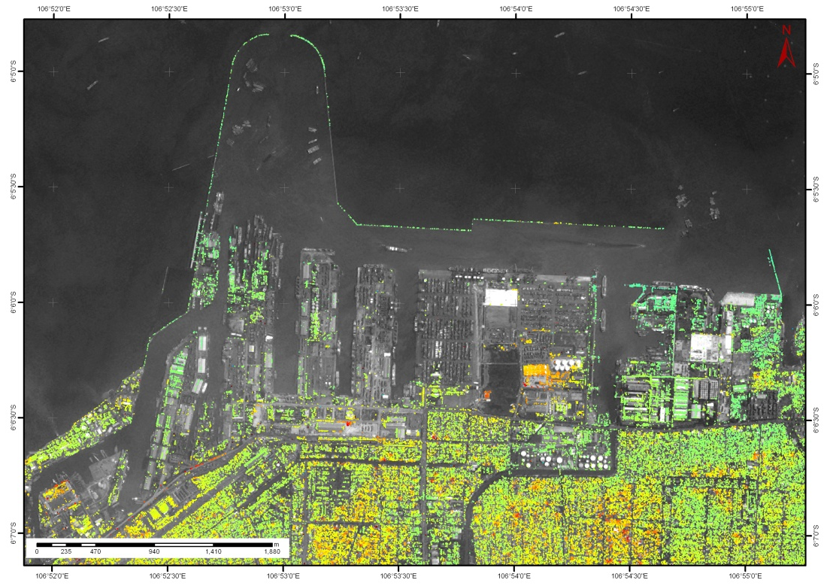
Jakarta (Indonesia)
3 m resolution
Mean Displacement rate (mm/year)
- 75
75

Slide 15
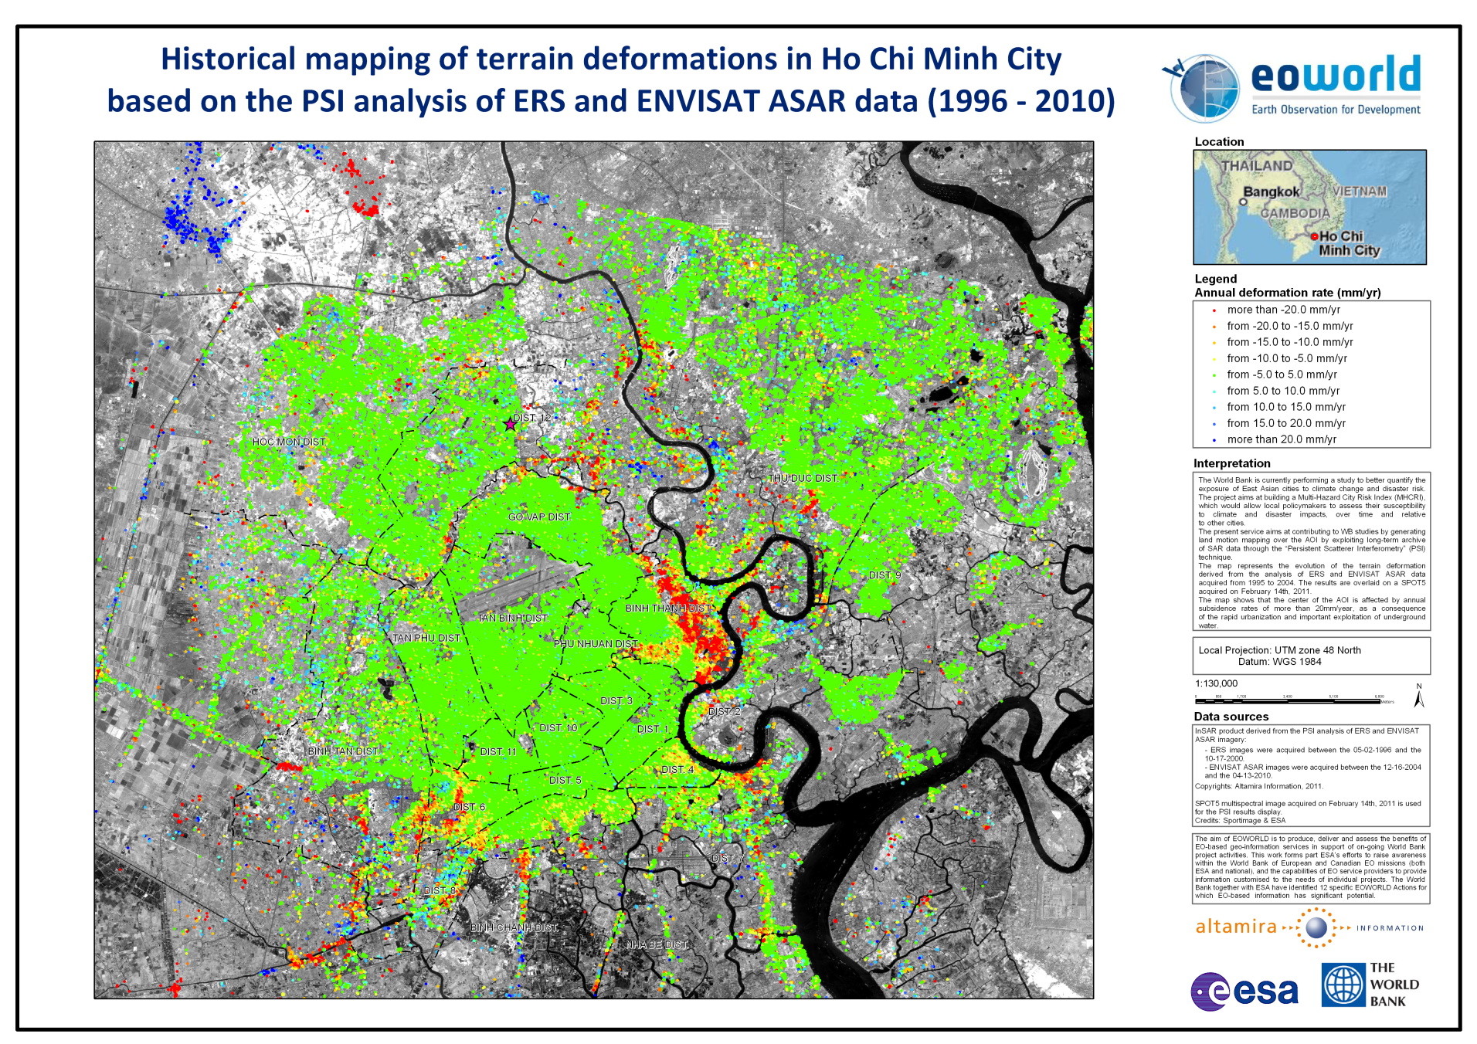
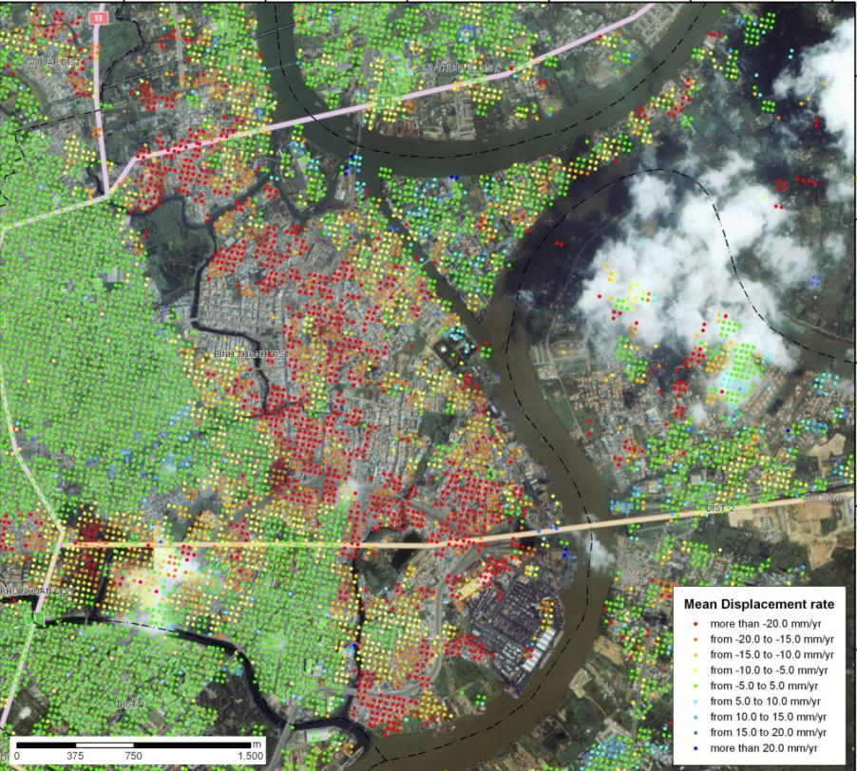

Ground motion due to ground water extraction
Land motion measurement in Ho Chi Minh City
Binh Tanh District
Deformations up to -20mm/year triggered by rapid urban development
Notes:
The countries of East Asia and the Pacific (EAP)
are among the most vulnerable in the world to
the physical, social, and economic impacts of disasters.
The frequency of natural disasters x 4 in the
past two decades mainly due to global climate change.
Urbanization in the region is continuing at unprecedented rates → reduction of natural streams/channels, lakes, wetlands that causes problems of water drainage and thus increase of flood impact

Slide 16
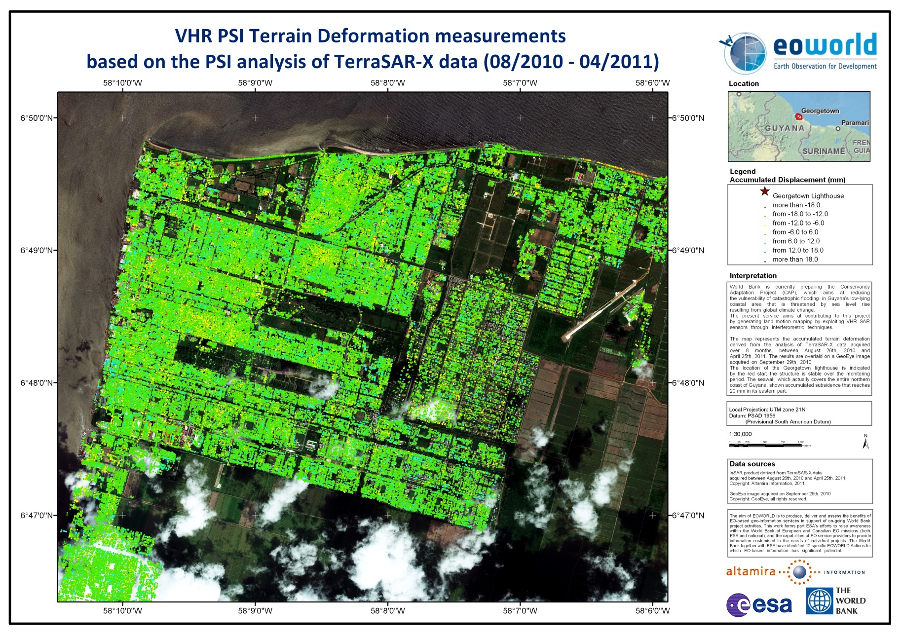
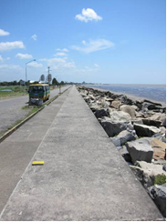
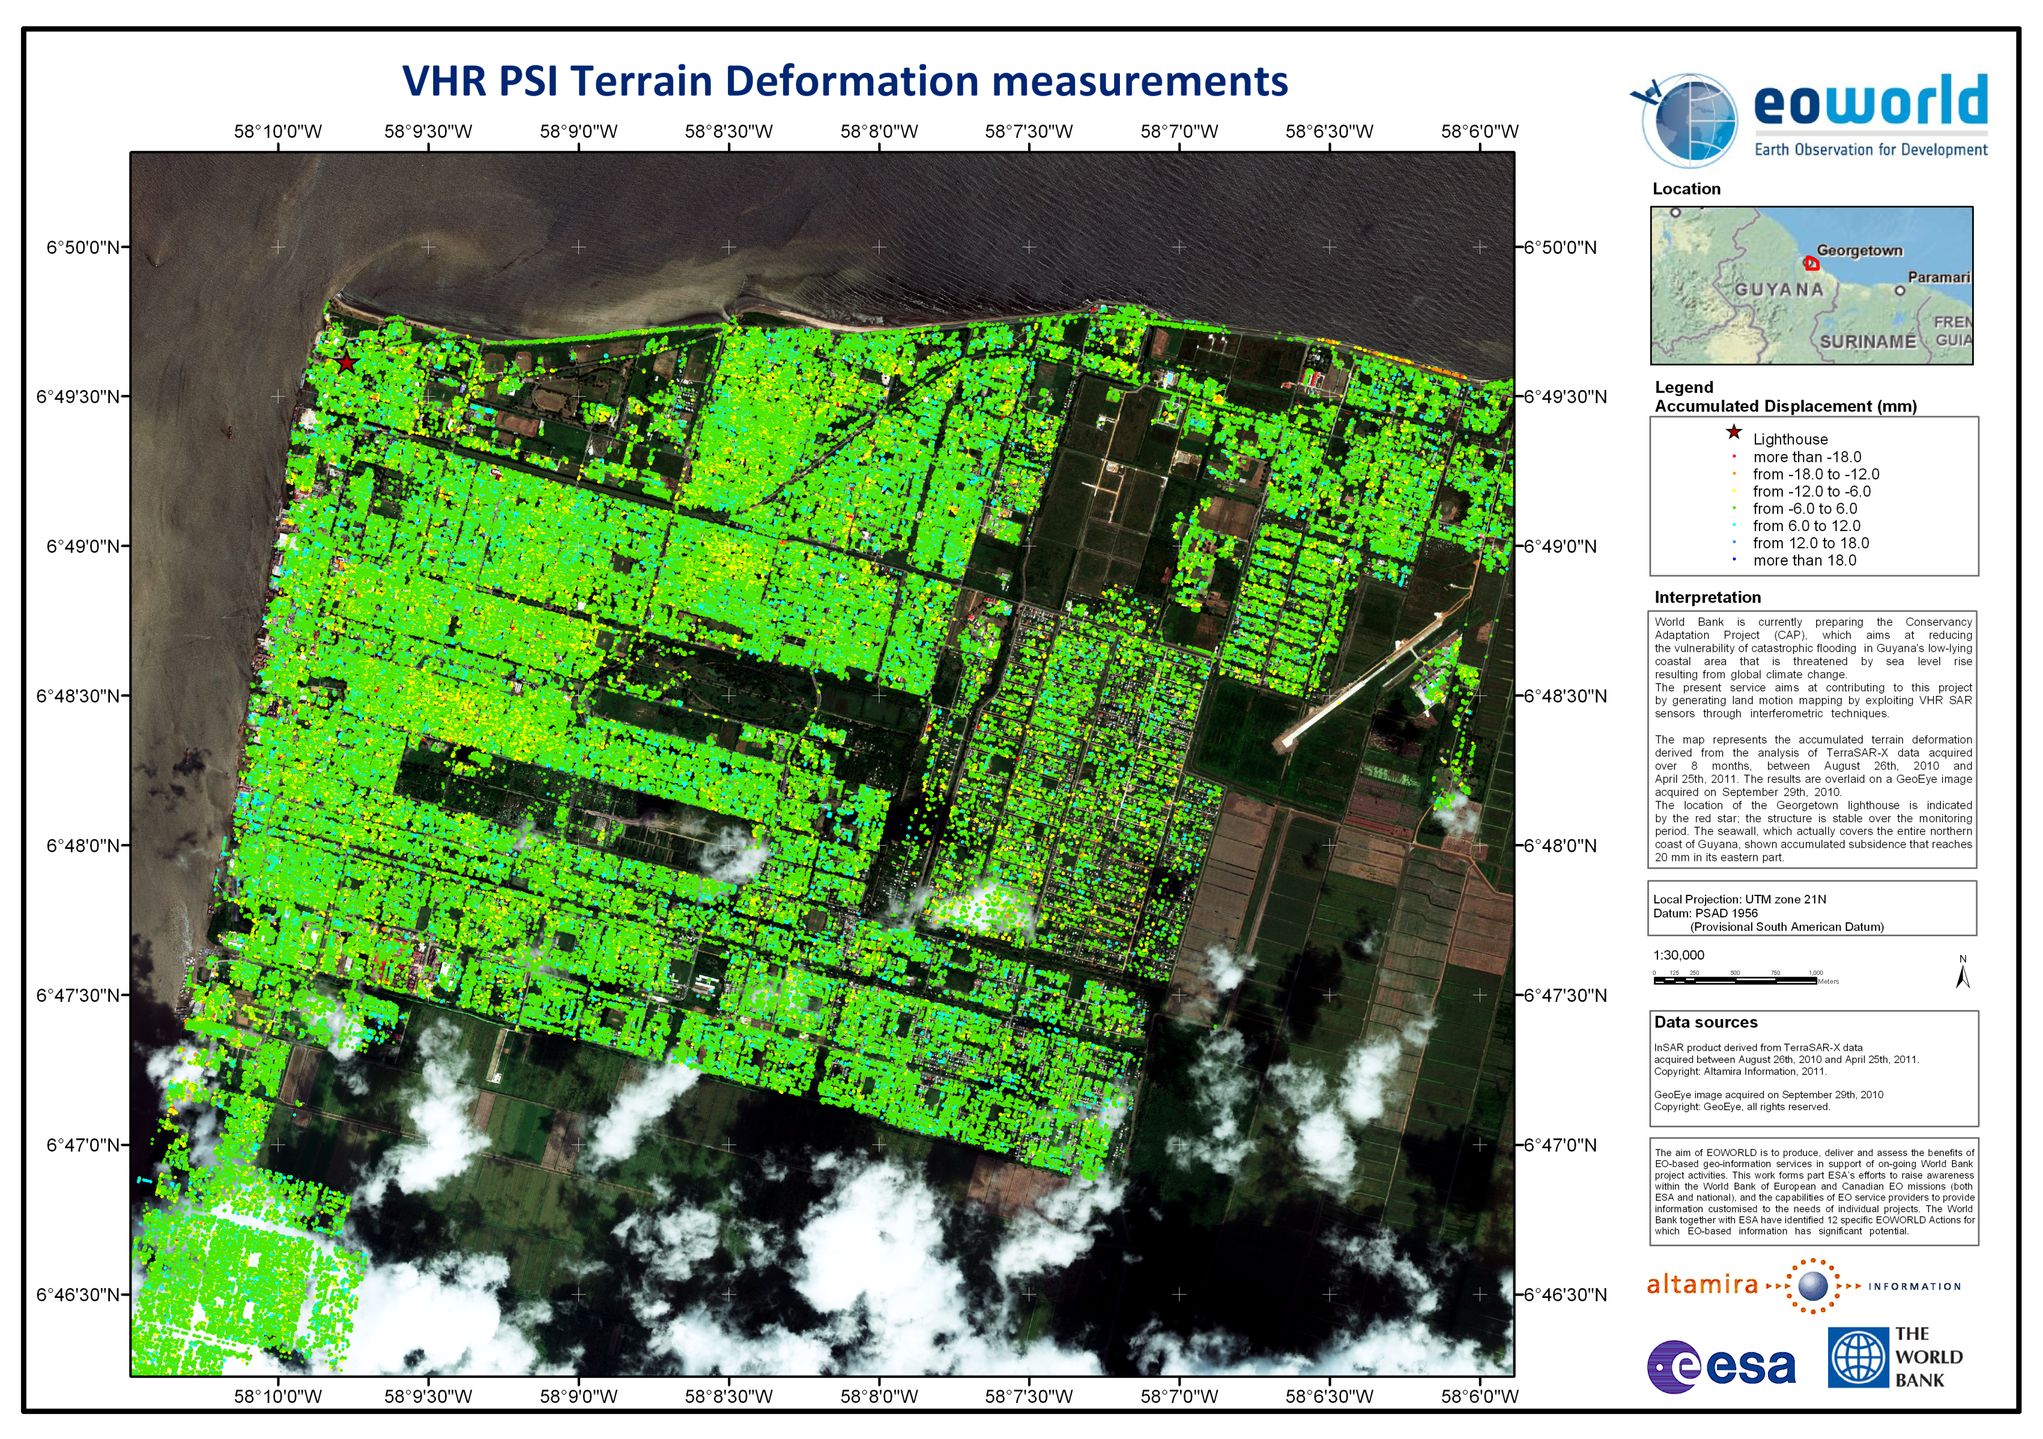
Flood defence system stability
Case of the Georgetown (Guyana) seawall
1.2M of measurement points.
Possibility of evaluating the stability of flood defence structure as the seawall
Accumulated displacement in mm
Notes:
Approximately 90% of Guyana
population lives on the coastal plain,
which lies about 1.4 meters below mean
high tide.
Georgetown is protected from flooding by a sea defence system, consisting of dikes, drainage canals, seawalls, sluices, etc., requiring continuous maintenance and reinforcement.

Slide 17
Flood defence system stability
Case of the Georgetown (Guyana) seawall
High number of measurement point detected along the seawall.
Instability at the Ogle Kocker used to control the flow of water in the drainage canals (trenches) in the city.
Higher subsidence reaches 2 cm in 8 months.
Notes:
Instability known locally, work has recently been conducted on this part. Together with Urban Mapping, the results provide information on the subsidence over the town. High resolution to study flood defense system. Possibility of extending monitoring period discussed.

Slide 18
Conclusion
Ground motion measurement in DDR
Risk Analysis or Risk Assessment
Disaster Prevention and Mitigation
(Natural) Disaster Reduction/ Disaster Risk Management
Disaster Preparedness

Slide 19

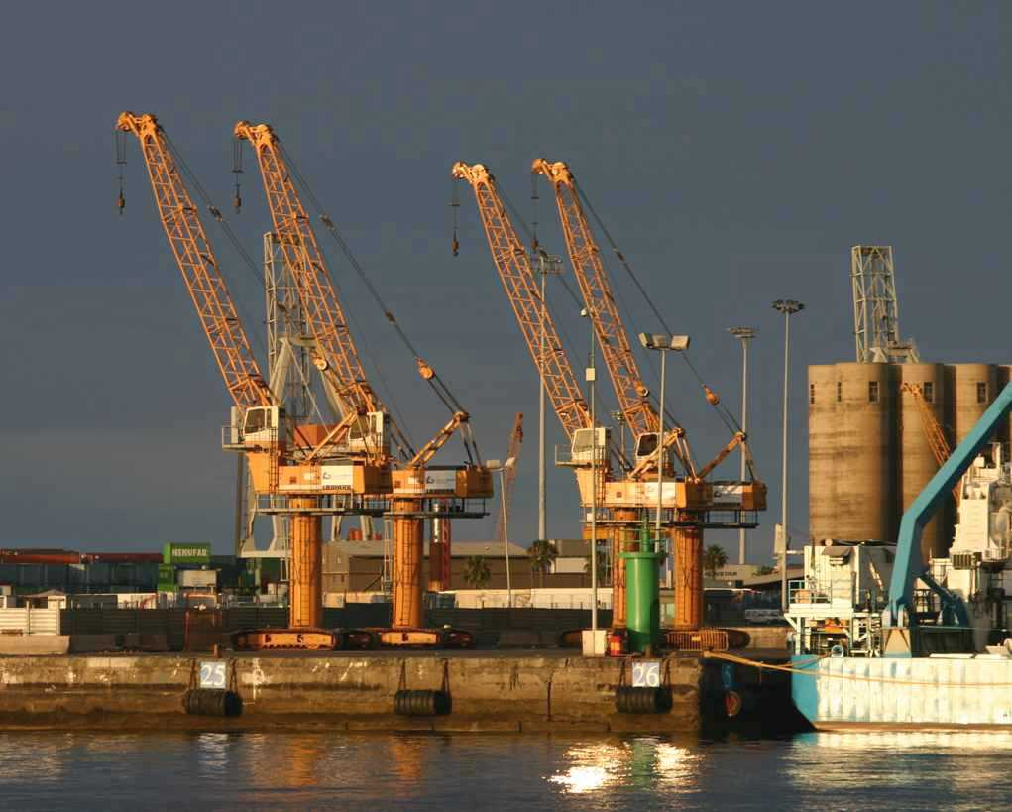
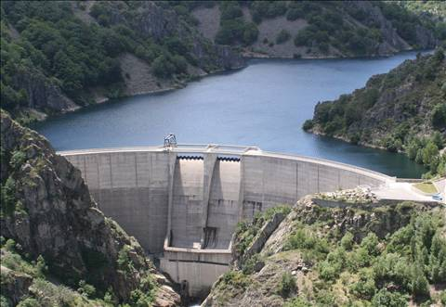


THANK YOU FOR YOUR ATTENTION
Alain Arnaud
Alain.Arnaud@altamira-information.com
ALTAMIRA INFORMATION
C/Còrsega 381-387
08037 Barcelona
Tel: + 34 93 183 57 50 – Fax: +34 93 183 57 59

