Slide 1


IGNITE STAGE
Indonesia Safe Schools:
Perspectives from the local level

Slide 2
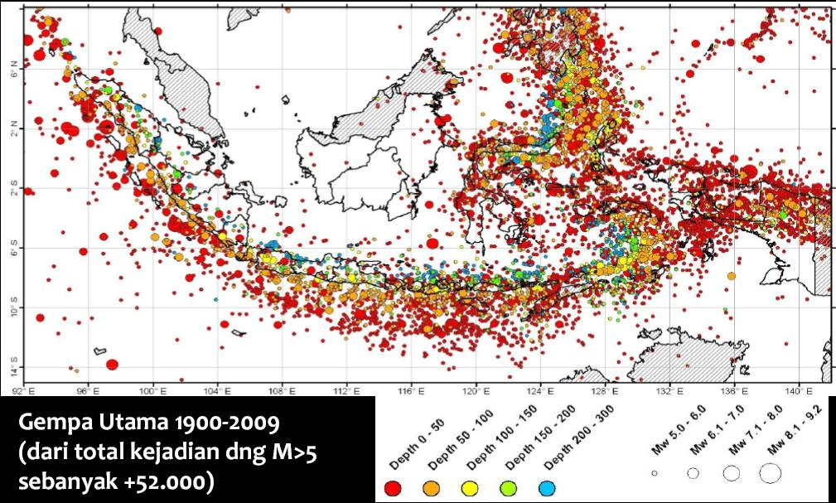
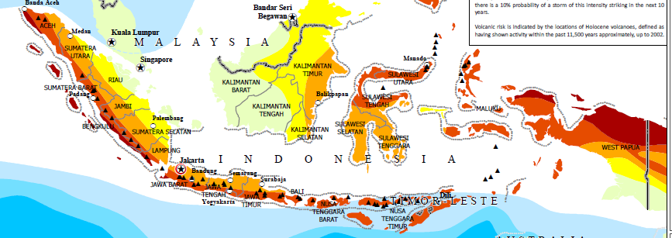
Main Earhquakes 1900-2009 (from all +52,000 occurences with M>5)
Increased risk from floods, landslides, and strong winds

Slide 3
Drivers of success
DM Law and National Action Plan for DRR
NDMA issued Regulation on Implementation Guideline for Safe Schools
Policy and legal framework
1
MoEC issued circular letter for integration of DRR into education curriculum
Education Cluster,
Consortium for Disaster Education
National Secretariat for Safe Schools
2
Coordination and networks
MoEC allocate Special Allocation Fund around 1 billion USD that can be used for Safe School Rehabilitation
3
Resources Allocation
Capacity building initiatives with more than 50 agencies are working on Safe Schools
4
Technical Expertise

Slide 4






















PARTNERSHIP and COLLABORATION
... And many other agencies (local, national, and international)

Slide 5
Topics of discussion
Sharing of experiences DRR in schools from children perspective.
What are the children’s view on Safe Schools, particularly the most vulnerable children?
What are the driving factors for local government to replicate and implement Safe Schools? And where are the gaps?
What can the children do to promote Safe Schools?

Slide 6
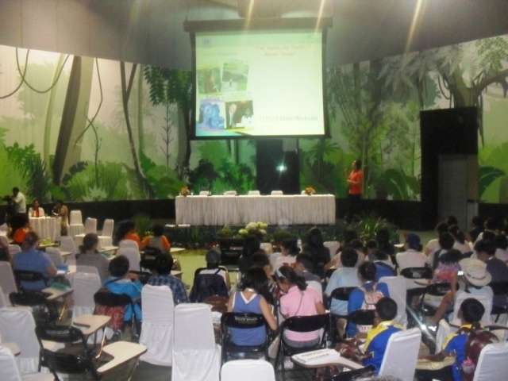
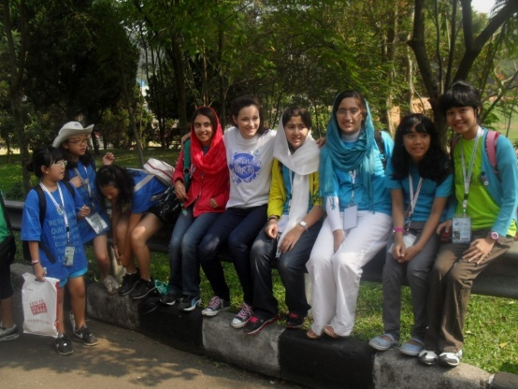

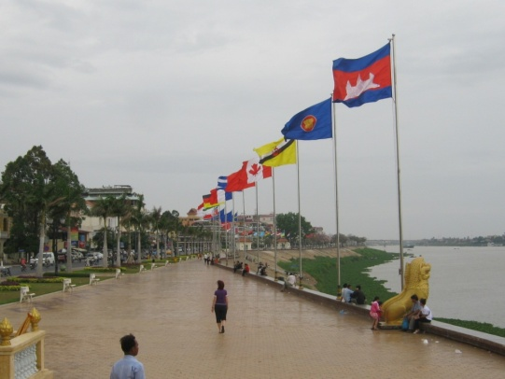
“SchoolaTourRahmi”
Network of Safer School Clubs
Project Approach:
encourage schools to have “Safer School Club”
do a cross-visit tour among clubs
Anggi
  Grade 11, Student of SMAN 98 Jakarta, Indonesia
  Regional Ambassador for Indonesia, Eco-Generation UNEP-Tunza
  Chairperson of FOSCA Young Scientist Club, Jabodetabek,, Indonesia
  Ambassador of “SPEAK” Magazine, The Jakarta Post, Indonesia

Slide 7
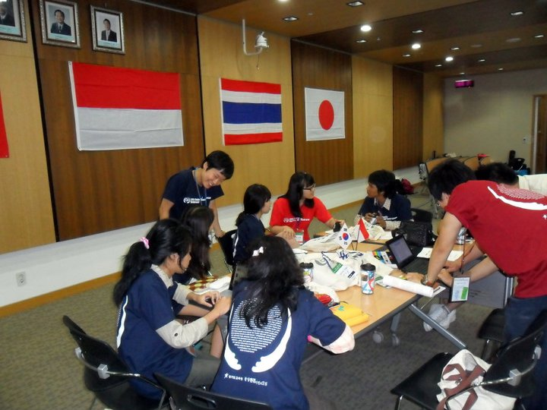
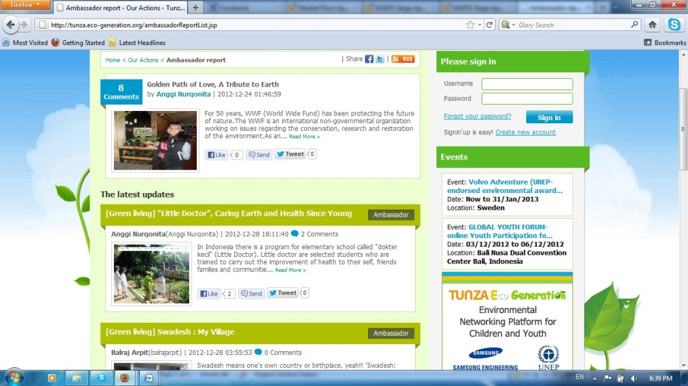



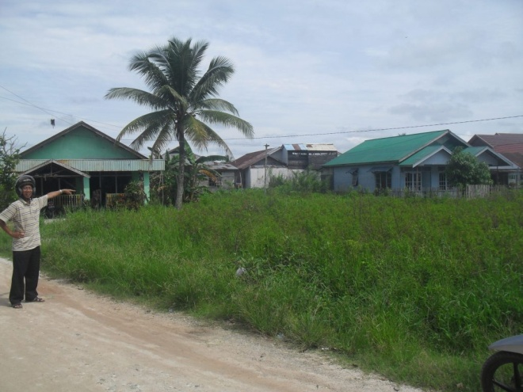
“SchoolaTourRahmi”
Challenges
the continuity and improvement of “SchoolaTourRahmi” project
the insertion of DRR column in “Speak” Magz and its distribution to wider audiences
the proliferation of “Safer School Clubs”

