Slide 1
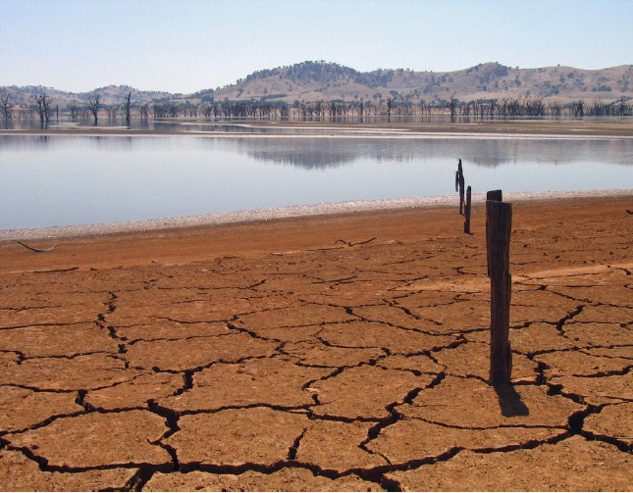
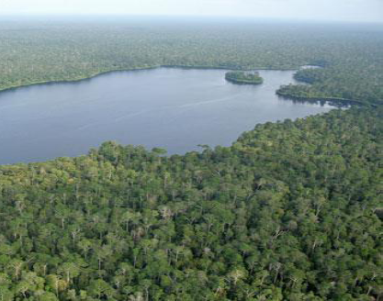
CLIMATE SUPPORT FACILITY
Presentation
"Project funded by European Union"

Slide 2
The Global Climate Change Alliance (GCCA): A platform for (1) dialogue and (2) technical and financial support

Slide 3
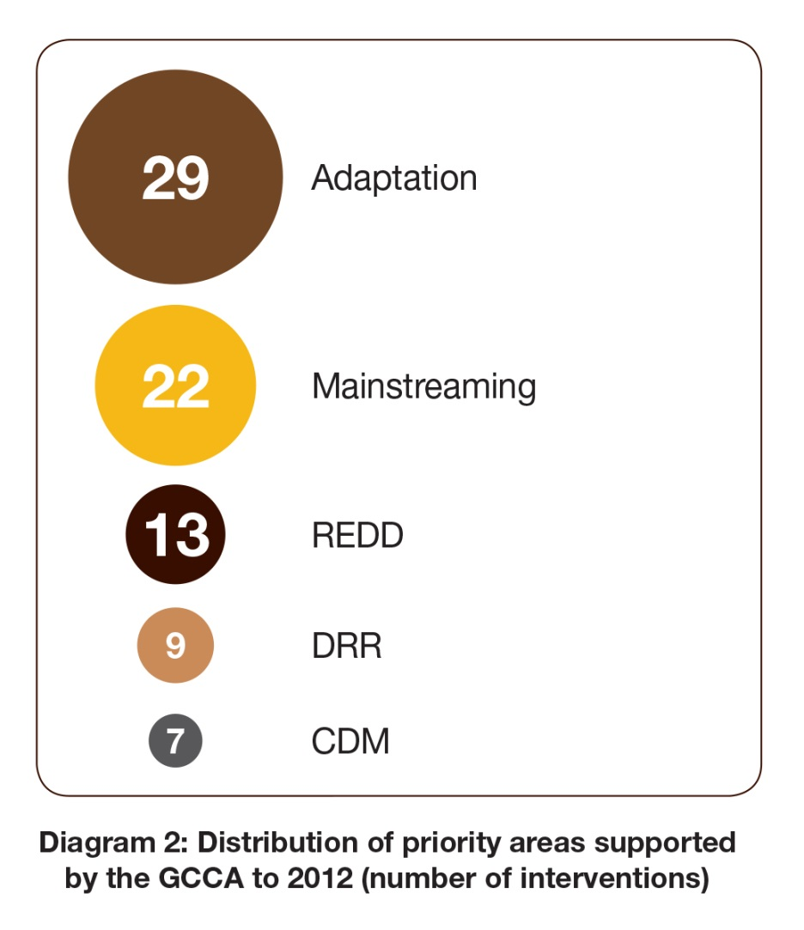
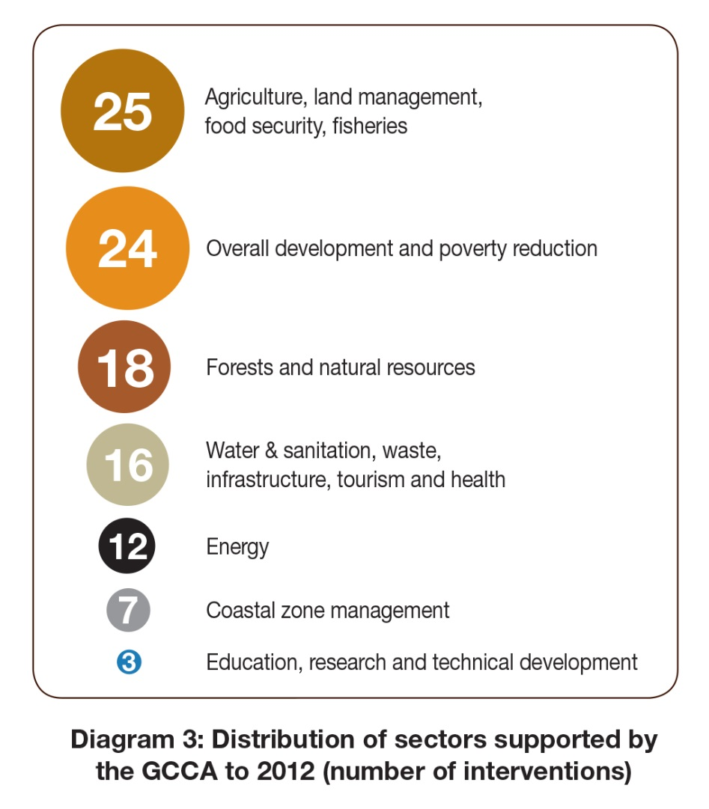
GCCA Priority Areas and Sectors

Slide 4
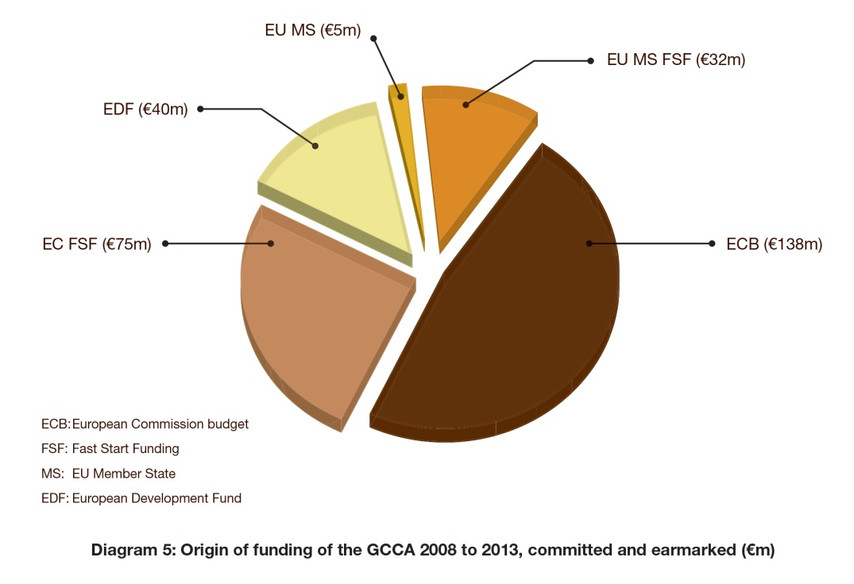
GCCA funding sources
Total : €290m

Slide 5
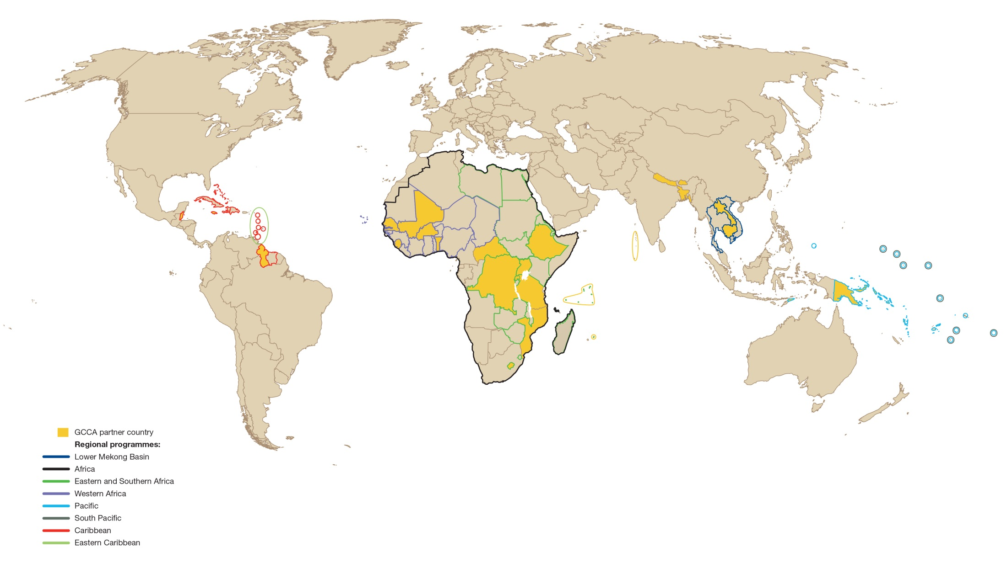
GCCA Geographical Coverage Overview

Slide 6
GCCA Intra-ACP Programme
2009 : Joint ACP/EU declaration on CC
EDF intra-ACP Financial Framework : 6 components
Pan-African « ClimDev Africa - FAFA »
South and East Africa « COMESA »
West Africa « ECOWAS -CILSS »
Caribbean « CCCCC »
Pacific « University of South Pacific »
Support
Coordination
Institutional Support
Technical assistance « Climate Support Facility »

Slide 7
Criterion to benefit from CSF
Based in an ACP country
Contribution OMD
GCCA priority
Part of a larger project/programme
Beneficiary has resources to follow-up
Short-term (~1 month)

Slide 8
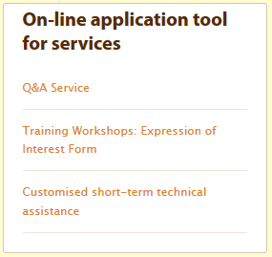
How to Apply
GCCA website : « Apply for Technical Assistance »
Or contact ACP Secretariat :
Dr. Pendo Maro
pendo@acp.int
+32 495 281 494

Slide 9
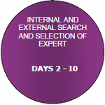
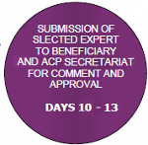
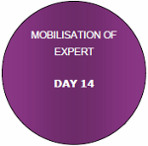
Implementation schedule
Preparation of a Work Order in collaboration with ACP Secretariat (?? days)
Approbation of the Work Order by steering sub-committee (4 days)
Experts mobilisation by CSF (10 days)
Approbation of the experts proposed by ACP Secretariat and Beneficiary (4 days)

Slide 10
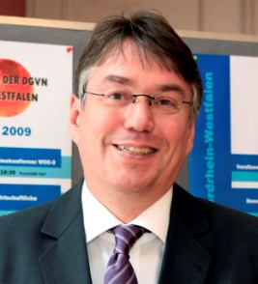
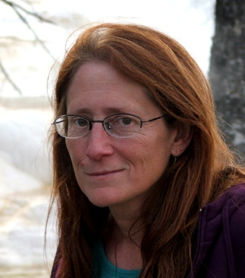
CSF Team
Manu Harchies – Administrator
Hans-Peter Winkelmann – Climate Change
(300 working days)
Joy Hecht – Environmental Economics
(300 working days)
Isabelle Mamaty – Training and Institutional Support
(250 working days)
+ POOL OF EXPERTS (1650 working days)

Slide 11
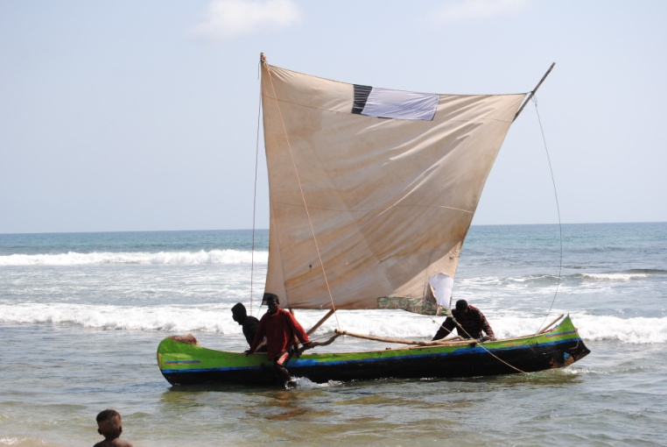
Achievements: Examples of past missions
Work Order 2 – Madagascar 22 days – 2 workshops
Mainstreaming Climate Change in the Fishery Sector in the Androy Region, southern Madagascar
Work Order 3 – Togo – 40 days
Mobilizing Climate Change funds for project proposals in the technical areas of renewable energy and clean technology

Slide 12
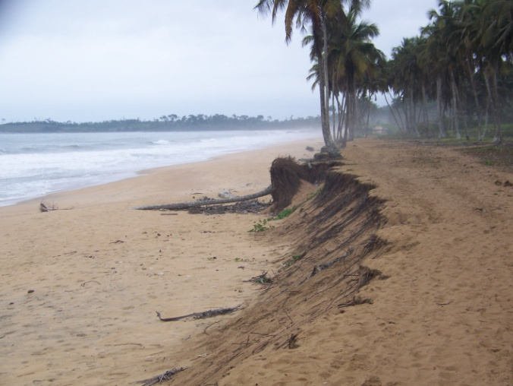
Work Order 4 – Togo – 42 days
Building capacity in conducting feasibility & impact assessment studies and in developing communication strategies to promote energy efficiency and renewable energy
Work Order 6 – Côte d’Ivoire
53 days – 1 workshop
Development of a climate change
adaptation strategy and programme
for the coastal area of Côte d'Ivoire

Slide 13
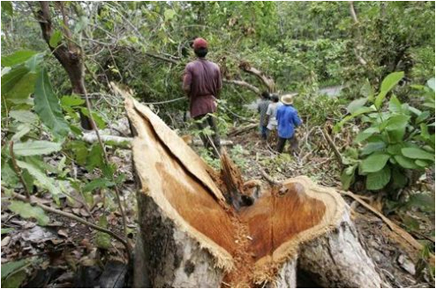
Work Order 7 – Côte d’Ivoire 53 days – 1 workshop
Starting-up a REDD+ Programme in Côte d’Ivoire: capacity strengthening and roadmap development
Work Order 8 – Côte d’Ivoire – 27 days – 1 workshop
Capacity building in conducting greenhouse gas (GHG) inventories and vulnerability assessments

Slide 14
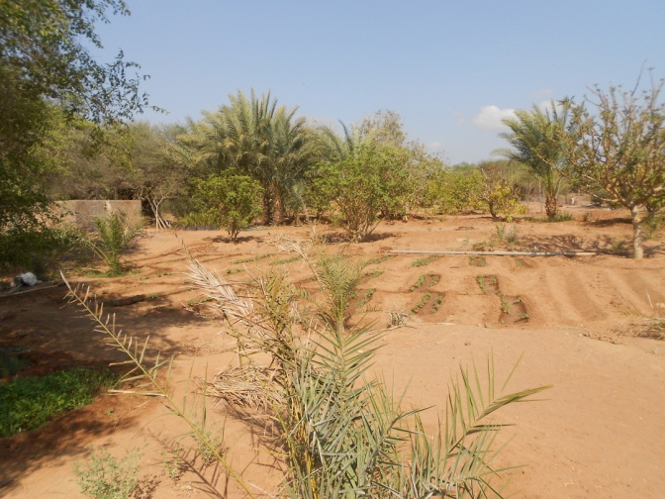
Work Order 9 – Guinea – 30 days – 1 workshop
Matching priority needs for Climate Change action in Guinea and funding opportunities
Work Order 10 – Djibouti – 14 days – 1 workshop
Calculation of the Emission Factor for the Electricity System (2011)
Work Order 11 – Djibouti – 24 days
Mapping and prioritising needs for additional water supply in Douda

Slide 15
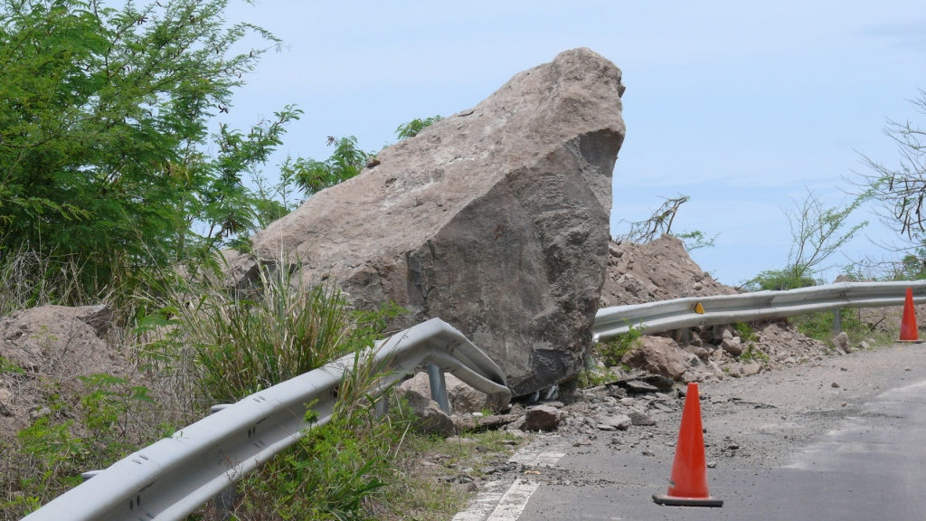
Work Order 13
Dominica - 55 days
1 workshop
Integrating CC aspects
in land use policy and
physical development
Planning
Work Order 20 – Burkina Faso - 31 days – 1 workshop
Formation des formateurs sur l’intégration du CC dans les stratégies et politiques
Work Order 17 – Kenya – 48 days – 2 workshops
CC Adaptation in Lake Victoria Basin

Slide 16
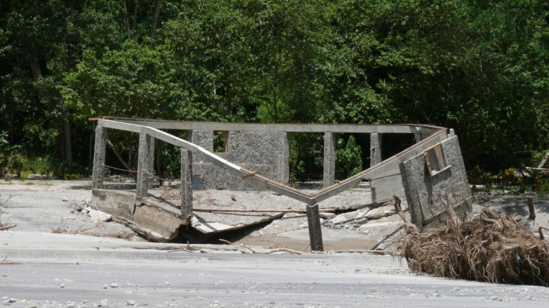
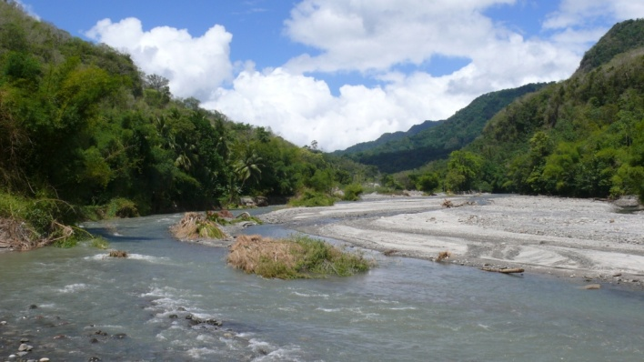
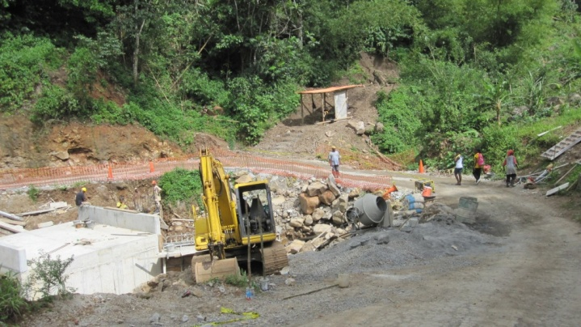
Dominica Vulnerability assessment and Mainstreaming
Caribbean Small Island Developing States (SIDS)
Mountainous + heavy rainfall → Vulnerable to CC effects
Vulnerable sectors :
Coastal ecosystems
Natural Resources
Forestry
Water resources
Infrastructure
Agriculture
Fisheries
Tourism

Slide 17
Dominica Vulnerability assessment and Mainstreaming
Changes and risks observed:
Extended winter swell
Loss of beaches
Sea grass coverage decrease by 90%
Land slippage from increase in rainfall and floodings
Rainfall distribution change
Longer periods of droughts
Pests, diseases and invasive species more frequents
Crop depravation by wildlife
CSF provided technical assistance to the Government in the effort to prepare a new National Land Use Policy (NLUP) as well as a National Physical Development Plan (NPDP).

Slide 18
Thank you for your attention

