Slide 1


The One Health Approach in the post HFA process
CONTACT INFORMATION
Global Risk Forum GRF Davos
Promenade 35
CH-7270 Davos
Phone: +41 (0) 81 414 1600
Fax: +41 (0) 81 414 1610
info@grforum.org
www.grforum.org
Marc Stal
Project Officer
marc.stal@grforum.org
www.grforum.org

Slide 2
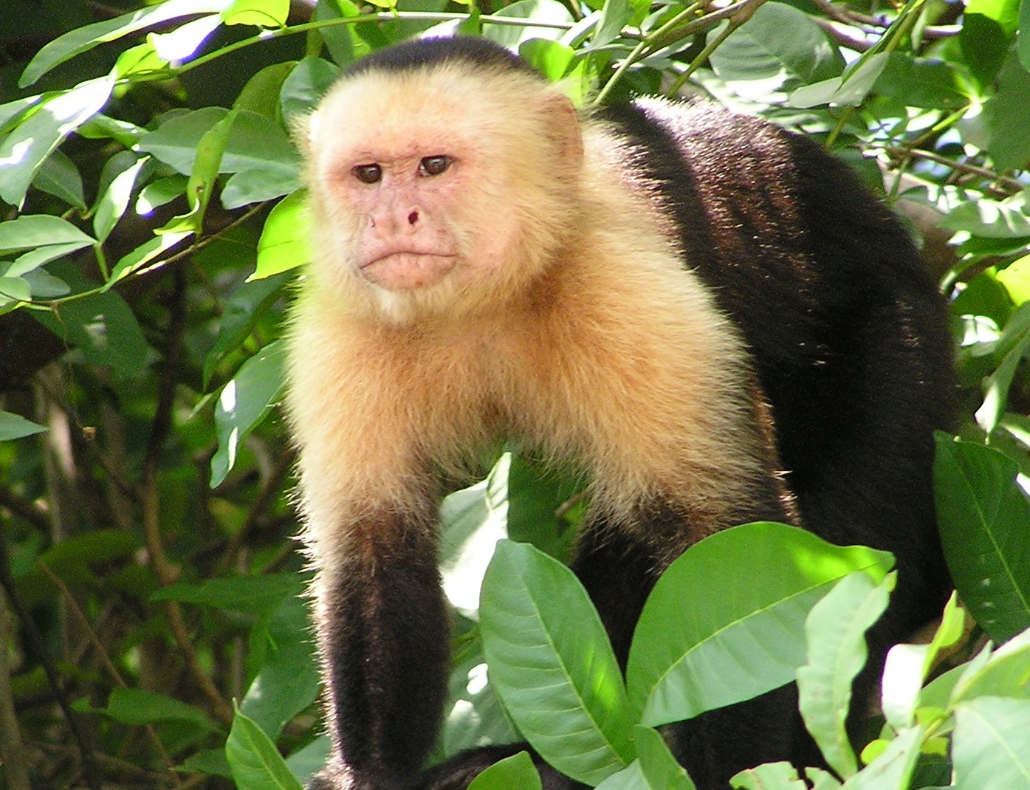

Slide 3
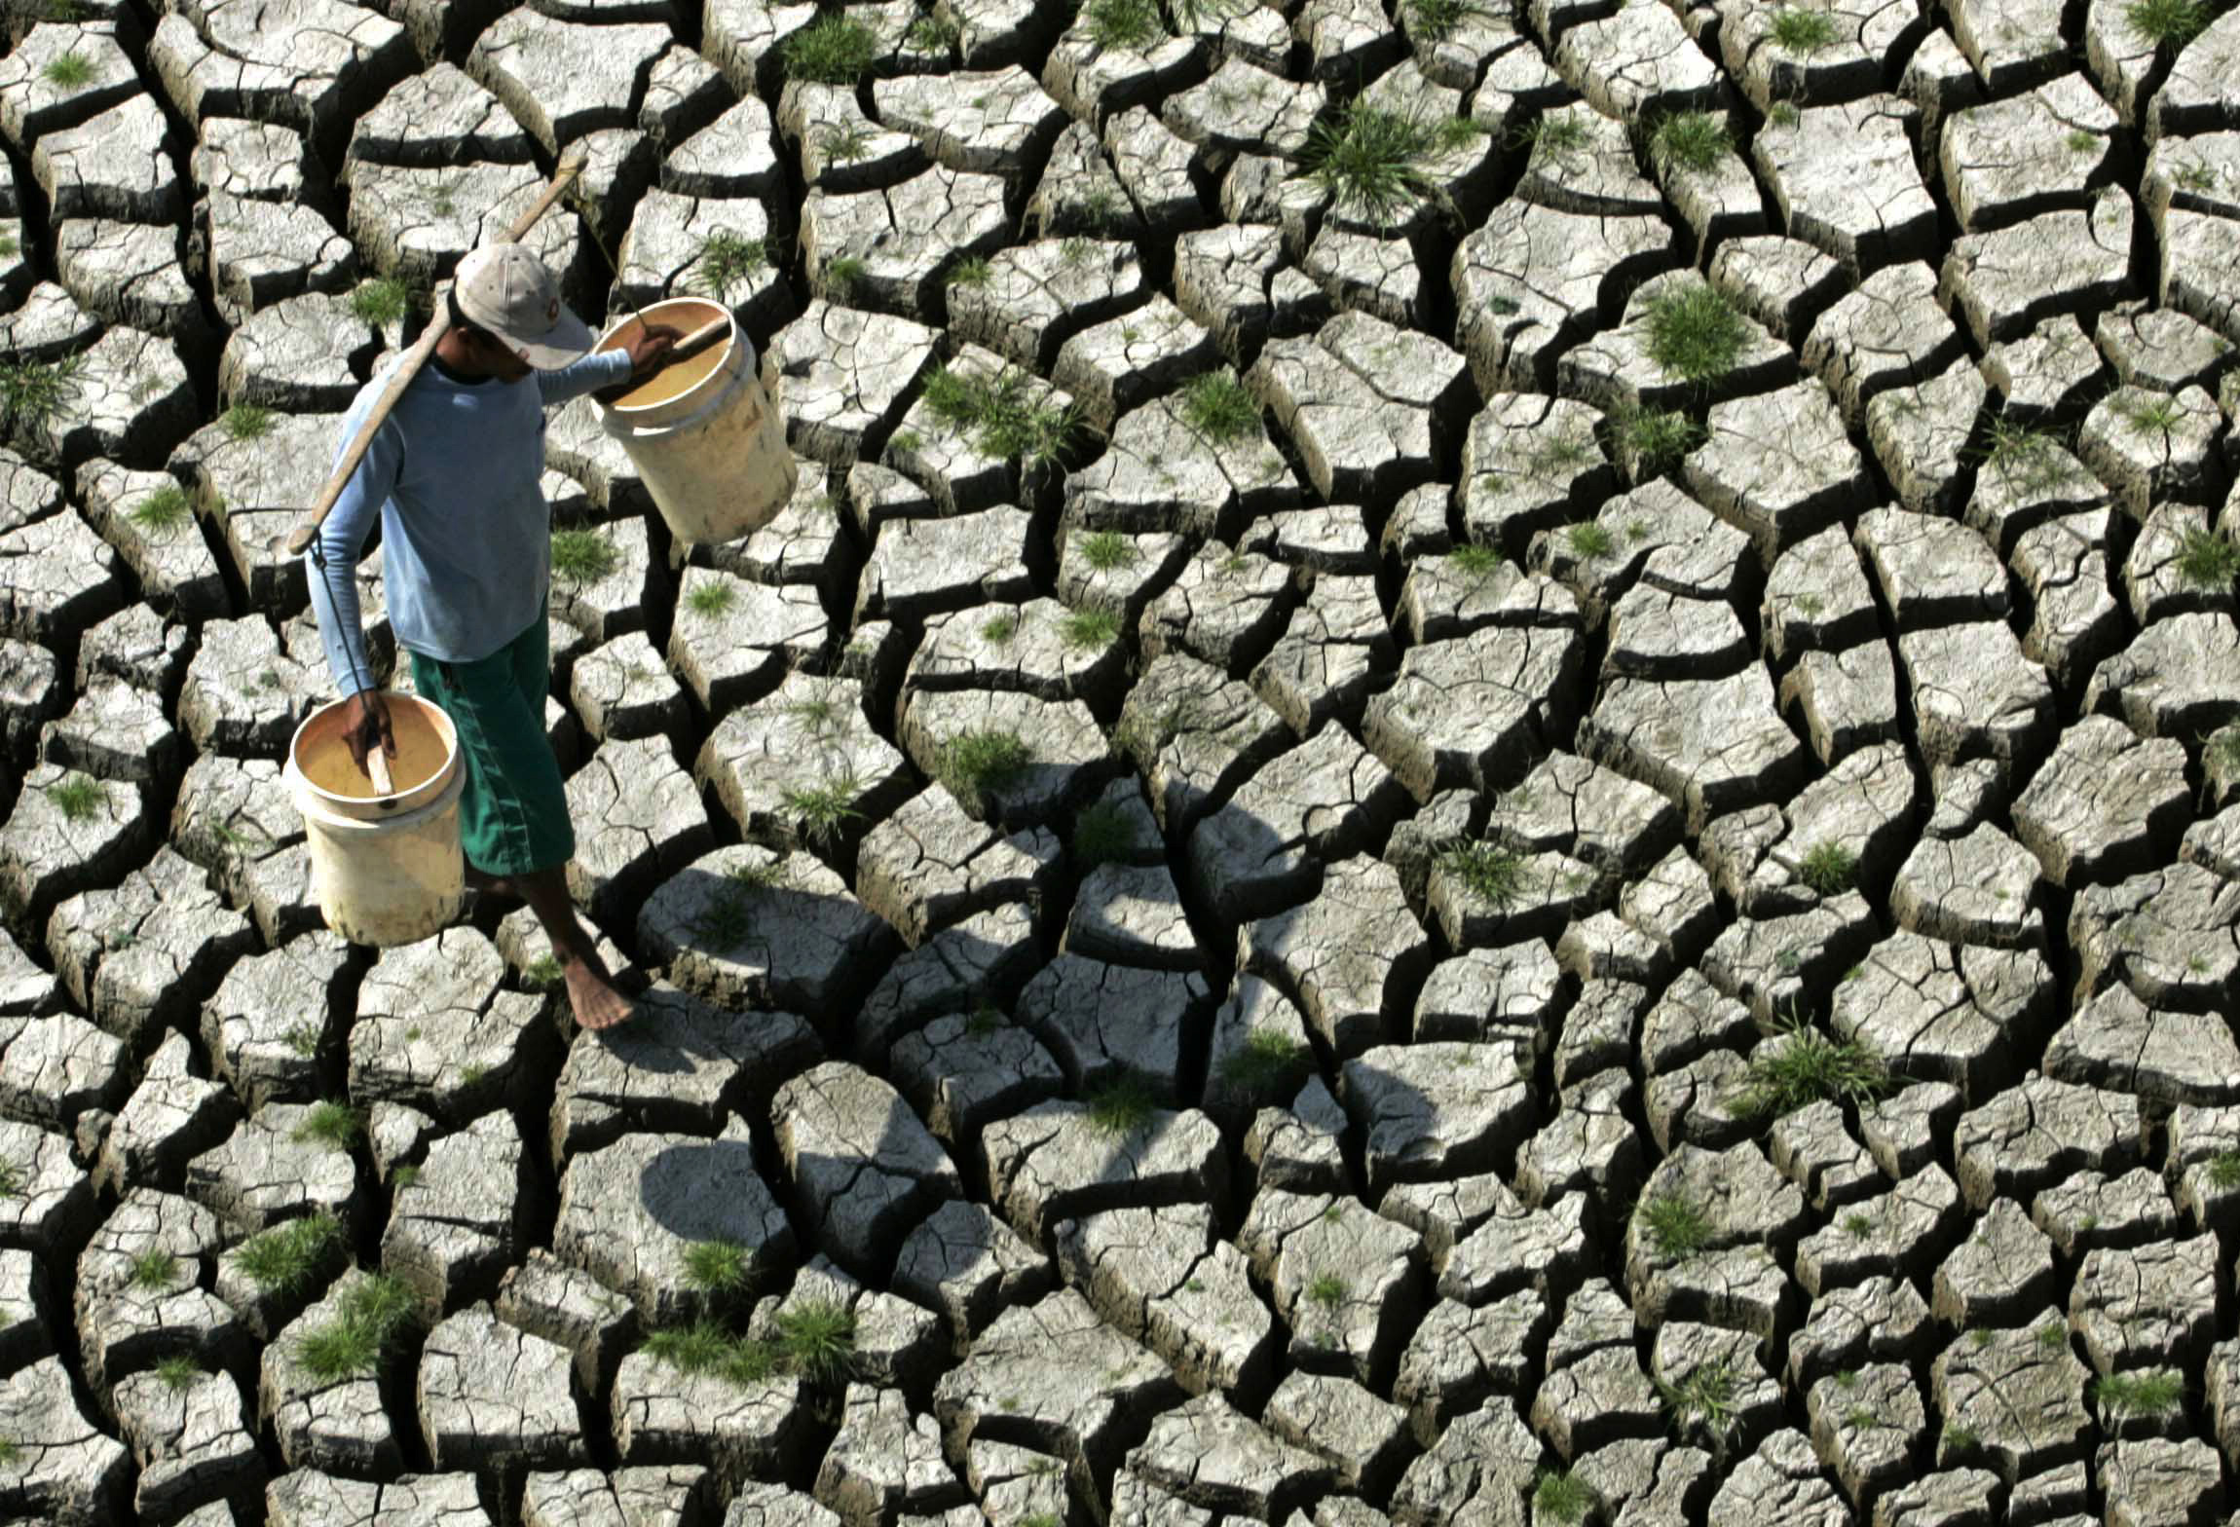

Slide 4


Slide 5
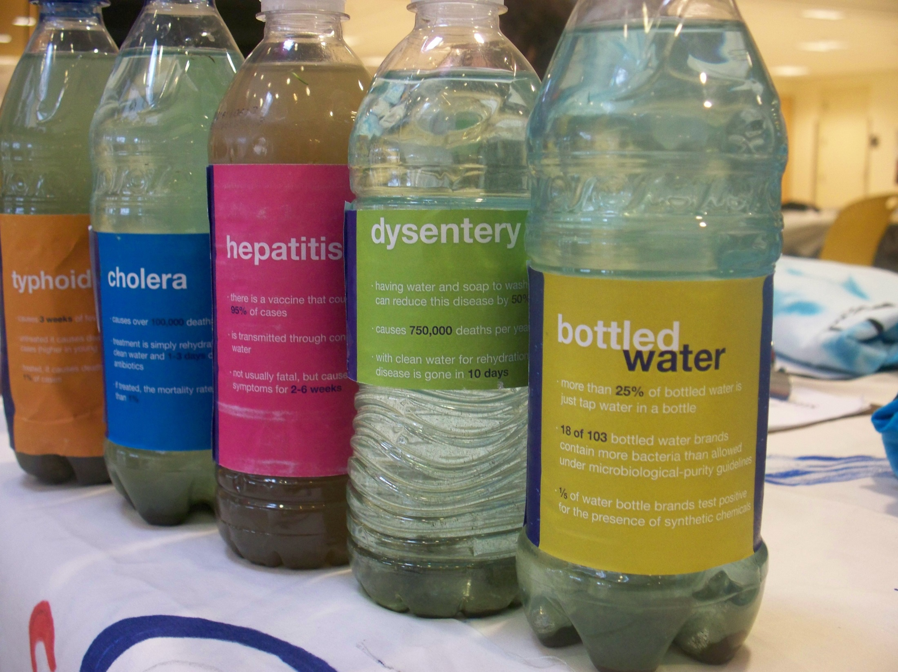

Slide 6
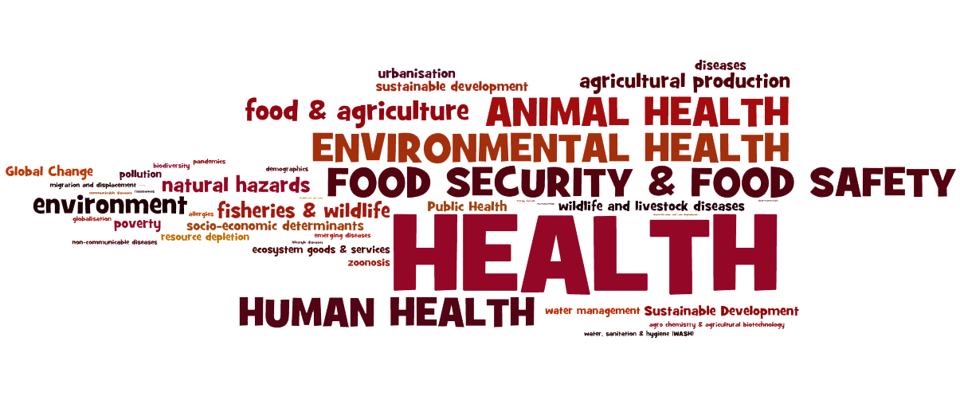
Notes:
Human Health, Environmental Health, Animal Health, Food security & food safety are all interconnected
HEALTH is a complex-socio-ecological-system with many interconnected determinants
urbanisation, food, agriculture, zoonotic disease, diseases, poverty, resource depletion, or wildlife diseases
HEALTH IS A CORE COMPONENT OF ALL LIVE
Human Health, Environmental Health, Animal Health, Food security & food safety are all interconnected with each other. I think it is safe to argue that HEALTH is a complex-socio-ecological-system with many interconnected determinants. Determinants such as urbanisation, food, agriculture, zoonotic disease, diseases, poverty, resource depletion, or wildlife diseases to only name a few. HEALTH is a core component of all live.

Slide 7
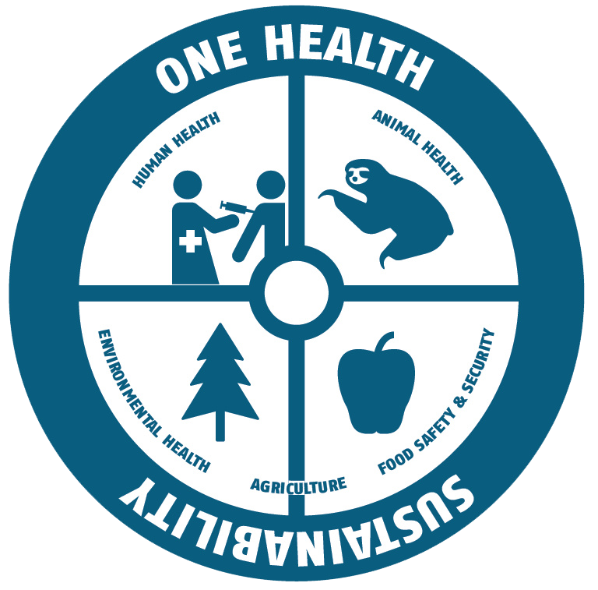

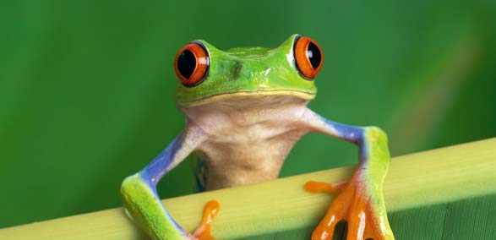
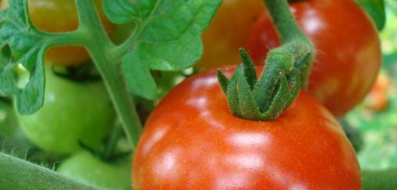
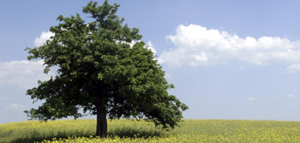
Notes:
One Health concept promotes an integrative approach to public health, reflecting the interconnectedness of a larger ecological system.
a worldwide strategy for expanding interdisciplinary collaborations and communications in all aspects of healthcare for humans, animals and the environment.
Integrative components of One Health are Human, Animal & Environmental Health, Food Safety & Security and Agriculture.
The importance of this interconnectedness is basically what the One Health approach is trying to describe and highlight.
The One Health concept promotes an integrative approach to public health, reflecting the interconnectedness of a larger ecological system. It is a worldwide strategy for expanding interdisciplinary collaborations and communications in all aspects of healthcare for humans, animals and the environment.
Integrative components of One Health are Human Health, Animal Health, Environmental Health, Food Safety & Security and Agriculture.

Slide 8
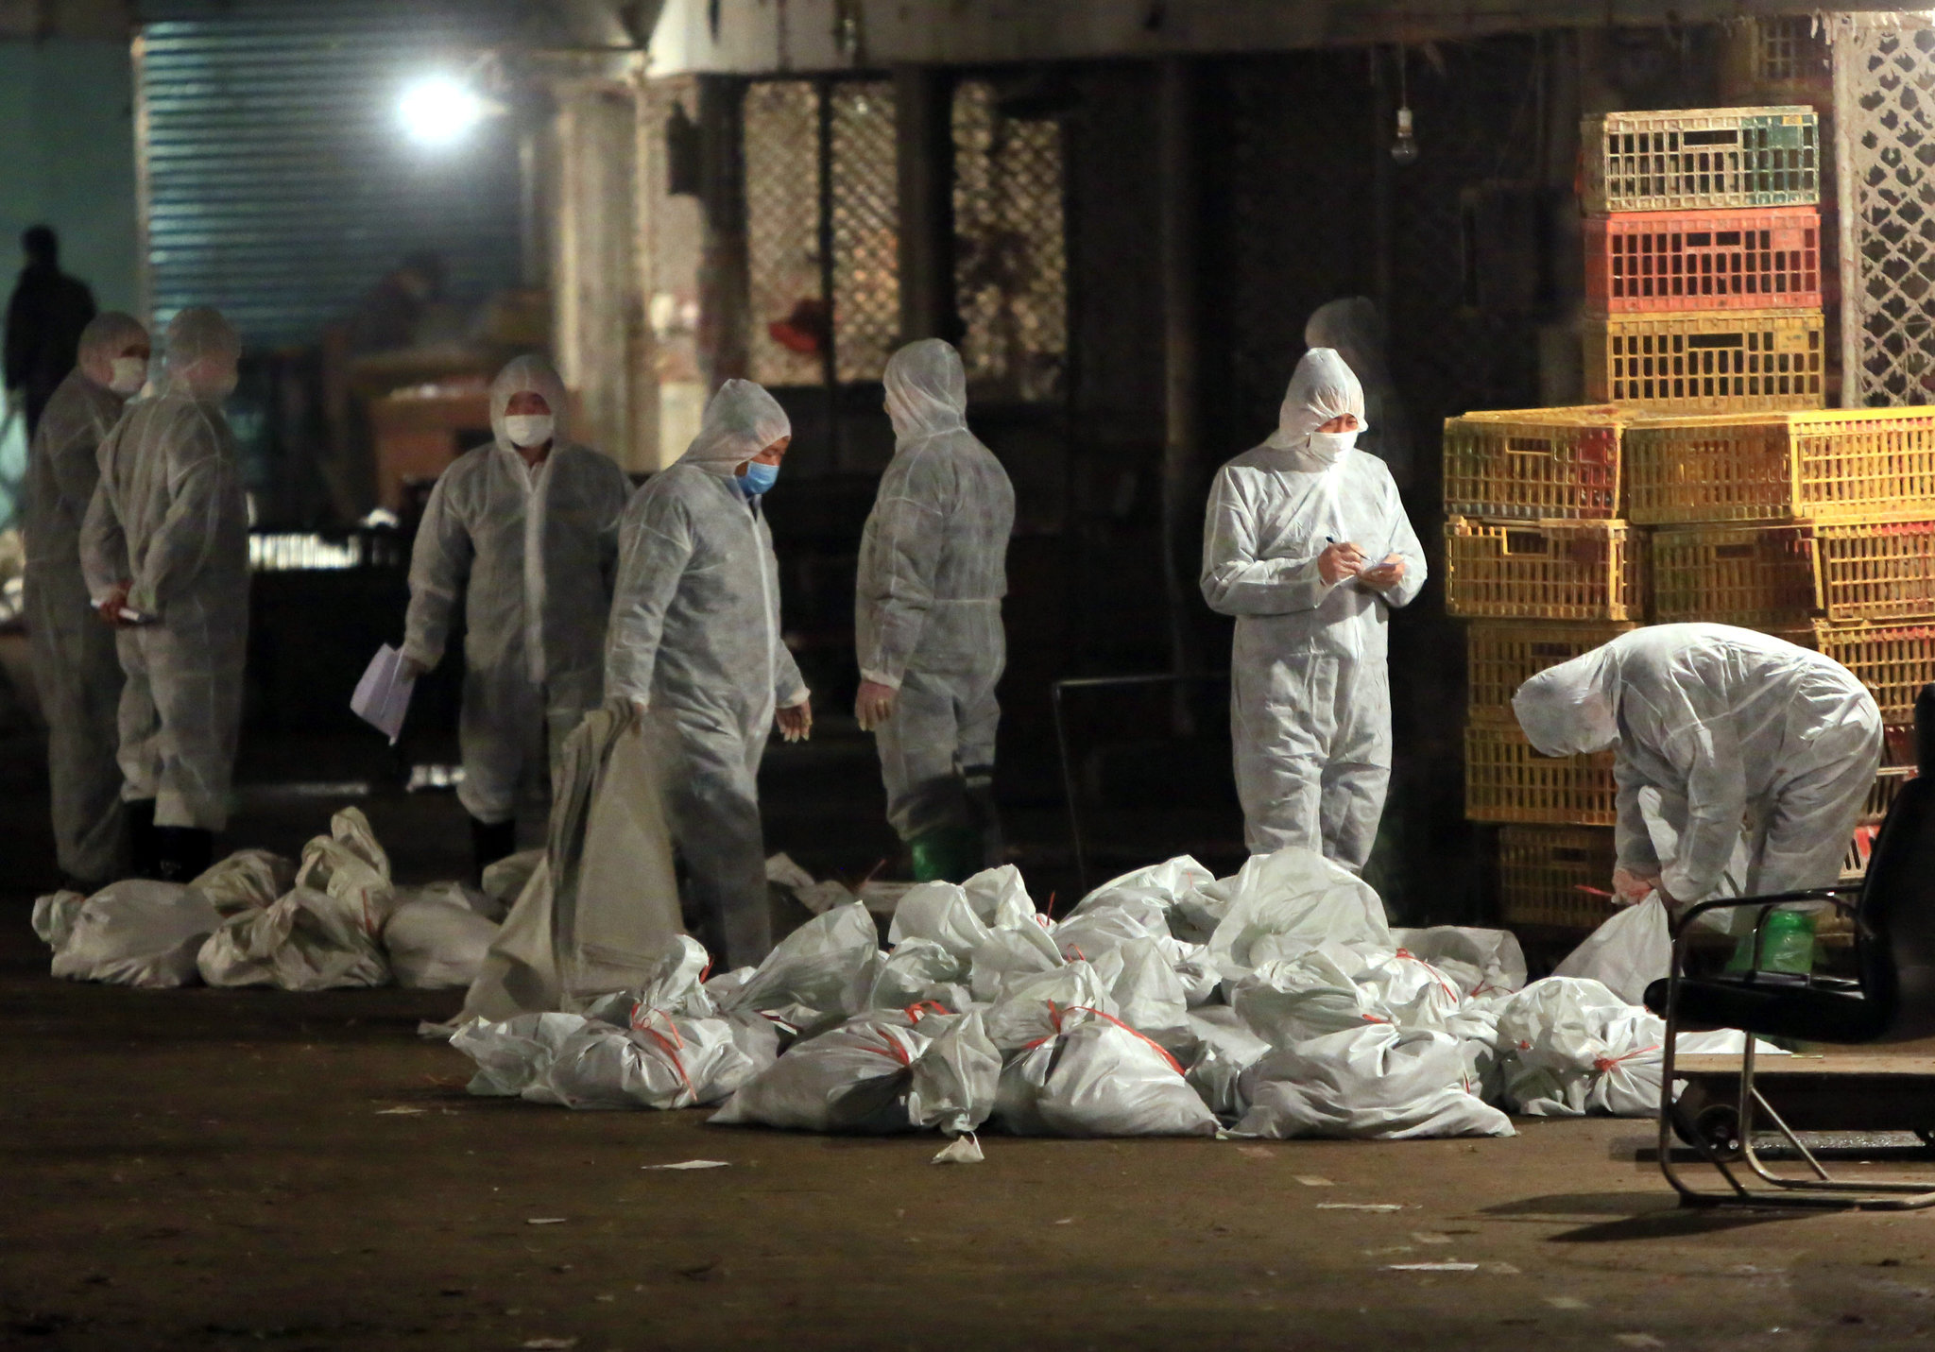
Agence France-Presse — Getty Images
Notes:
Diseases at the interface between humans and animals
H5N1 – bird flu causing significant effects on the human society with social, political and financial impacts worldwide
SARS – 2002 - 8000 cases and 775 deaths (WHO)
Emerging zoonoses demonstrate pathogen interferences with complex and interdependent feedbacks between human beings, livestock and wildlife
One Health for example deals with the diseases that emerge on the interface between humans and animals and there are many examples such as H5N1, also known as the avian influenza or the ”bird flu” which can cause illness in humans and many other animal species. The avian influenza had a significant effect on human society, with social, political and financial impacts worldwide. Another example is the he SARS outbreak in Southern China with over 8ooo cases and 775 deaths worldwide, according to the World Health Organization. Emerging zoonoses demonstrate pathogen interferences along with complex and interdependent feedbacks between human beings, livestock and wildlife.

Slide 9
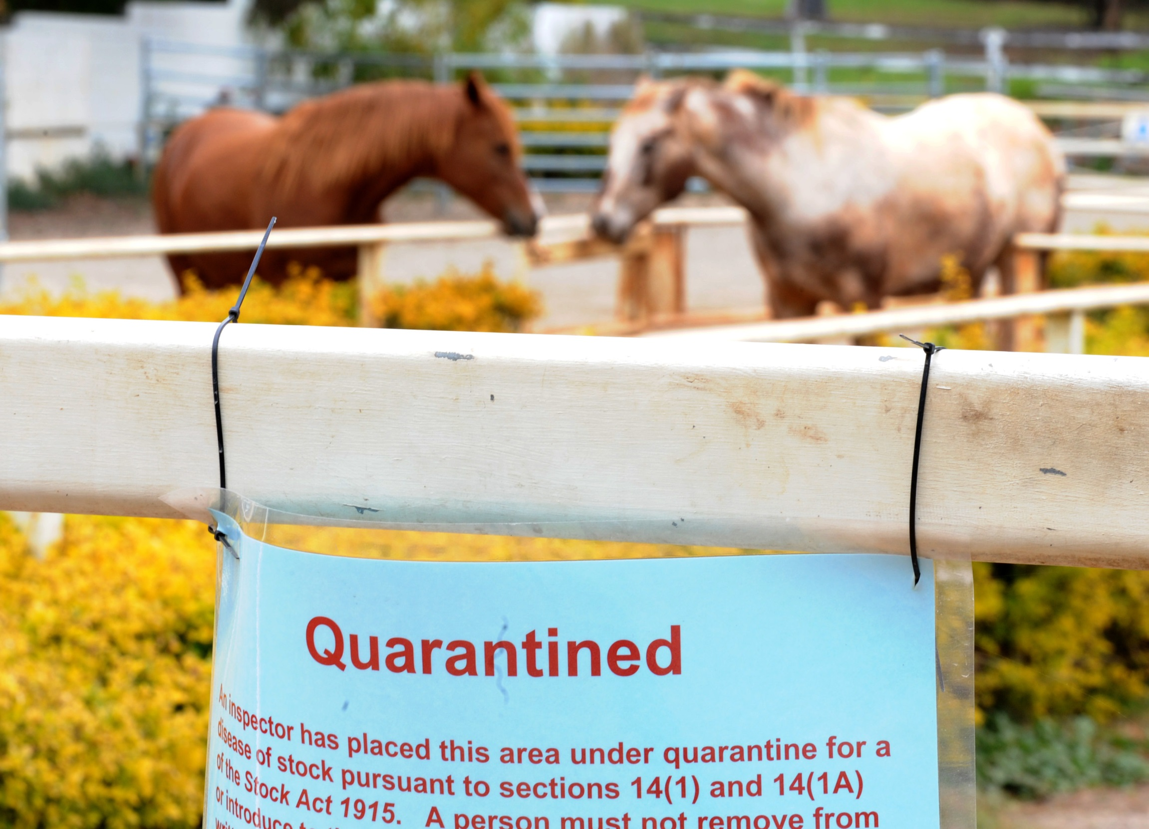

Slide 10
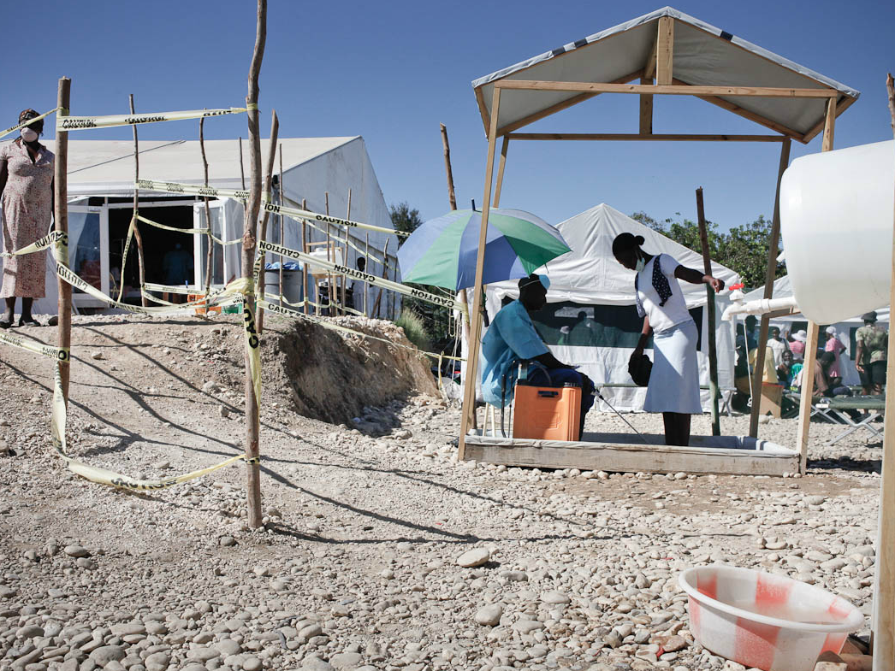
copyright jean-cluade coutausse

Slide 11
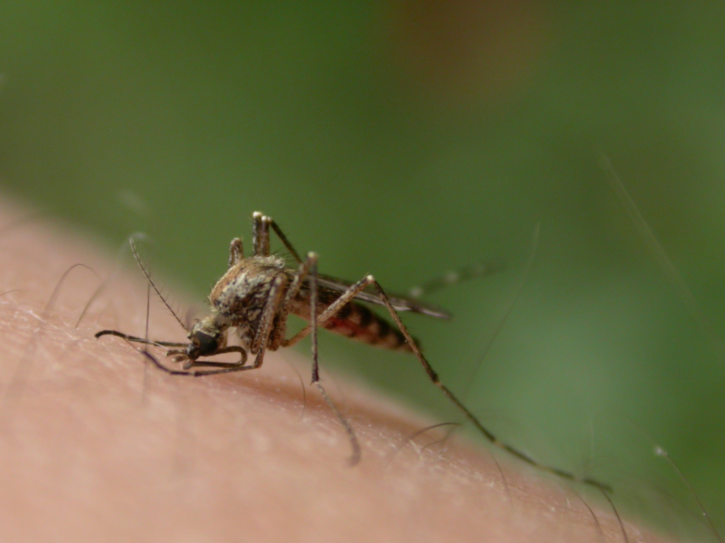
CliMate Change
Notes:
Moreover, climate change will further influence and catalyze zoonoses as well as vector-borne diseases as it creates favorable conditions for the emergence and establishment of disease vectors and affecting parasite cycles. Or, the use of wheats, sugarcane, or maize for increased meat and biofuel production increases the price for staple food, and may lead to new food insecurities, malnutrition and hunger, and even to political instabilities in resource limited countries. All of these examples showcase the potential severity of new threats to health, livelihoods, prosperity and social welfare, particularly those emanating at the human-animal-environment interface. It is therefore of utmost importance to address these threats, potential losses and damages from an integrative risk management perspective and in a One Health context.

Slide 12
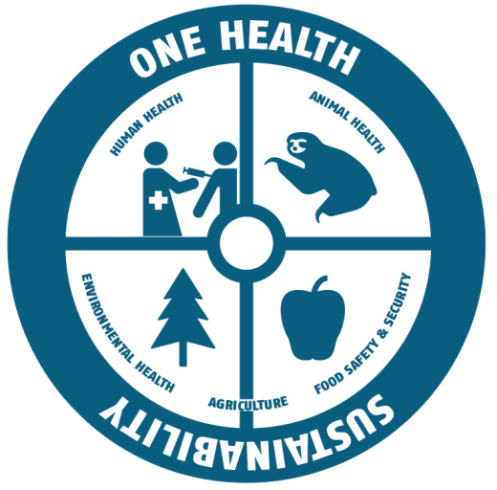
Risk based One Health Approach
How safe is safe enough?
WHAT
can
happen?
WHAT
is acceptable
to happen?
WHAT
has to
be done?
RISK ANALYSIS
RISK ASSESSMENT
MEASURES
to be taken
Notes:
A Risk based One Health Approach includes the health of humans, animals and the environment as a central role of health outcomes for people at risk.
There are multiple benefits of following this approach. It is crucial for improving sustainable agriculture and sustainable urban development, crucial for food safety & security, for clean water availability and to preserve ecosystems. It helps to organise the monitoring of the interfaces between human-animal-ecosystems for improved disease surveillance and installing early warning systems, thus not only reducing zoonotic disease emergencies but also increasing resilience and reducing vulnerabilities.
How safe is safe enough?
What Can happen
What is acceptable to happen
What has to be done?

Slide 13



One Health - Tripartheit
Notes:
The One Health Approach has evolved to a paradigm that addresses the complex interactions between human-animals and ecosystems. With international organisations supporting it, such as the so called tripartheit of the WHO, the OIE and the FAO, it also gains momentum and moved beyond the state of a mere concept to a movement at the interface of science, society, policy and practice.
Nevertheless, there are still many challenges. It remains important on how the work of governments, international organisations, the private sector and other actors is being organised to have a strong platform with a good network behind. An investment framework is yet missing on how best to invest in One Health, as well as a stronger country level support. There is the need for useful guidance mechanisms to avoid duplication and conflict and science is yet to come up with a clear message on evidence based science for international health regulations.
Of course these challenges also provide opportunities for research, for business and for civil societies and other groups to participate and enrich the dialogue to become and grow as a movement to impact the local level.

Slide 14

HFA - The Global Agenda in DRR
The Hyogo Framework for Action 2005-2015: Building the resilience of nations and communities to disasters (HFA)
1. Build institutional capacity
2. Know your risks
3. Build understanding and awareness
4. Reduce risk
5. Be prepared and ready to act

Slide 15
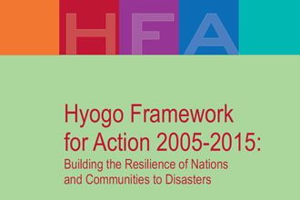
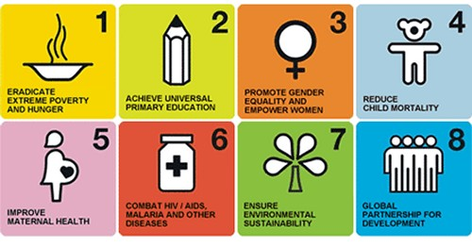

POST 2015

Slide 16

GRF One Health Summit 2013
One Health – One Planet – One Future
Risks and Opportunities
International Conference
17 - 20 November 2013
Davos, Switzerland
www.grforum.org

