Slide 1
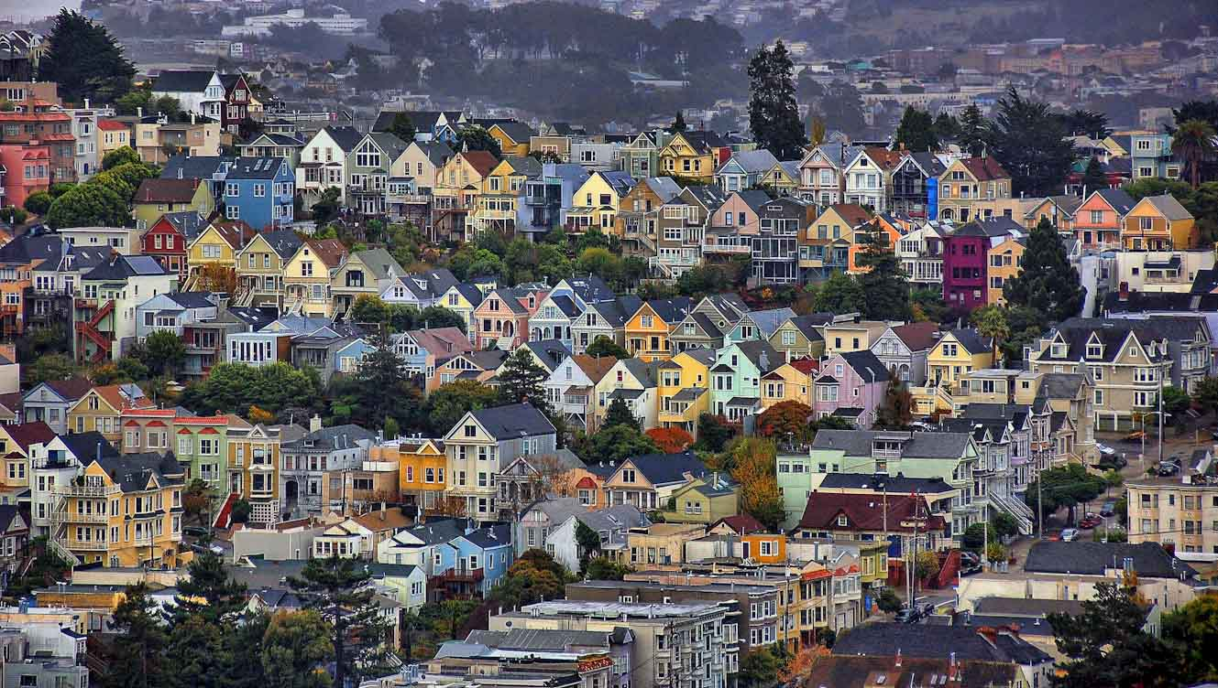
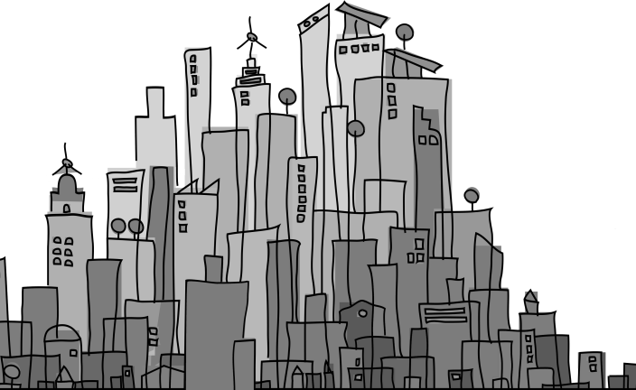
San Francisco - Investing in Resilience
May 21, 2013 Presentation to UNISDR Global Platform for Disaster Risk Reduction
Linda Yeung, Deputy City Administrator and Dale Sands, AECOM Technology
UNISDR Making Cities Resilient Campaign

Slide 2
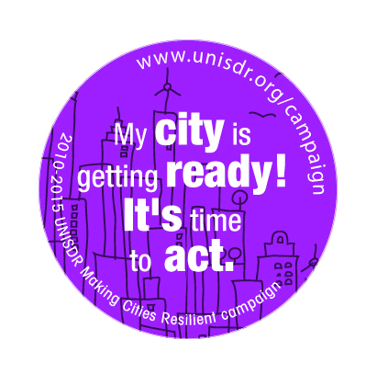
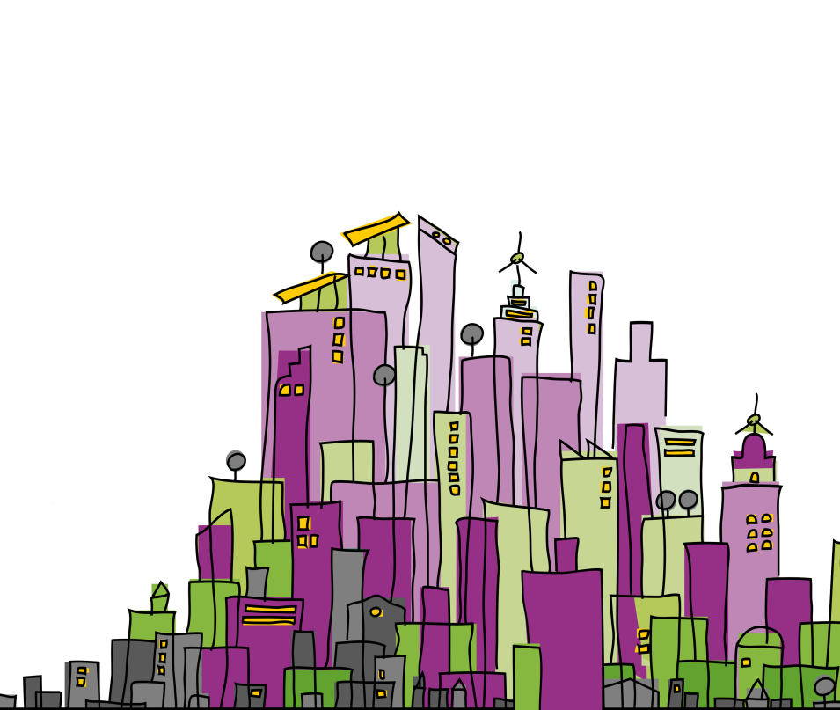
Making Cities Resilient Campaign
UNISDR Initiative
Over 1,400 cities signed up globally since campaign’s launch in May 2010
San Francisco’s involvement
1st major US city to join UNISDR’s campaign under Mayor Edwin M. Lee’s leadership - June 2012
Identified as a “Model City” for engaging citizens in building resilience at the neighborhood level
Demonstrates leadership through its ‘Advancing Resilience Through the Whole Community Approach’

Slide 3
San Francisco: Key Facts
49 square miles
City + County governance structure
376,942 housing units + 805,235 residents
96,000 registered businesses + 593,932 employees
16.5 million visitors in 2012
Source: 2010 Census, Bureau of Labor Statistics, San Francisco Travel Association

Slide 4
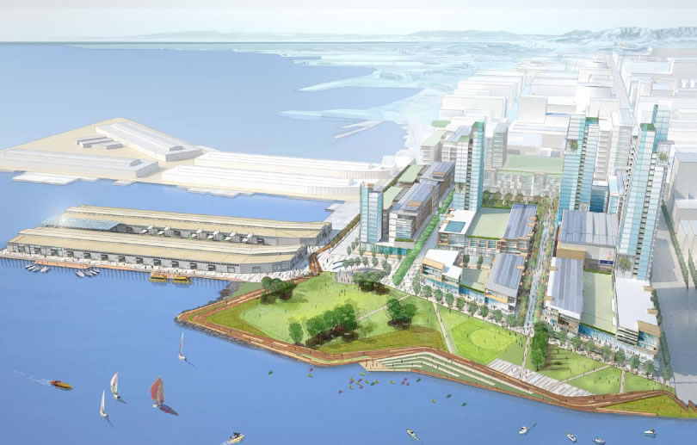
San Francisco: Sustainable Development Goals
Future growth: 100,000 new housing units + 90,000 new jobs by 2040
Waste: zero waste by 2020
Energy: Carbon free electricity citywide by 2020
Water: Reduce per capita use 20% by 2020

Slide 5
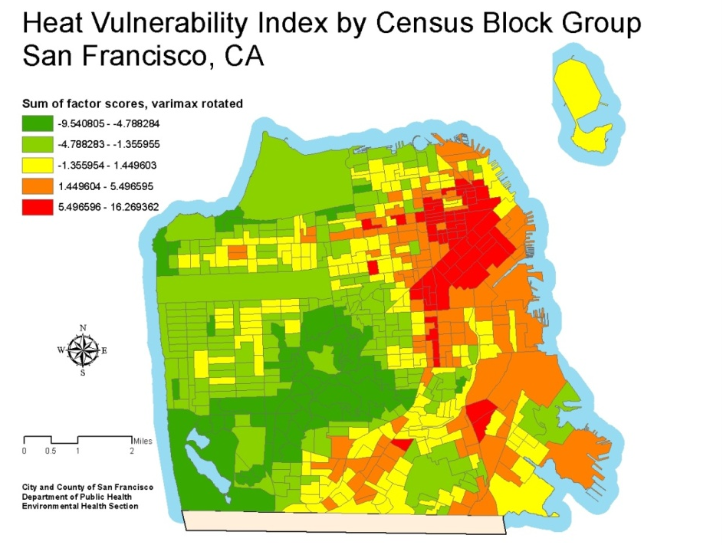
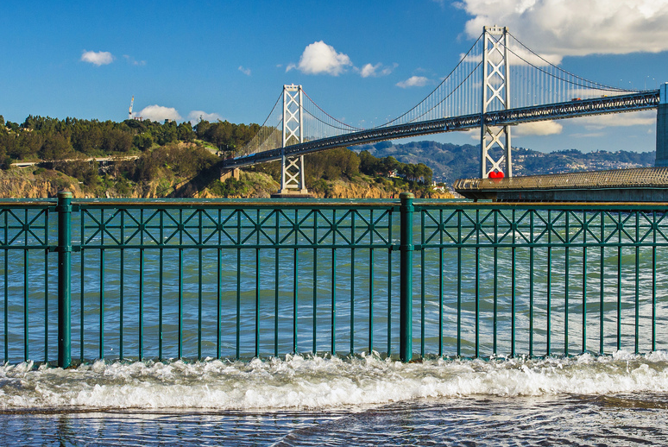
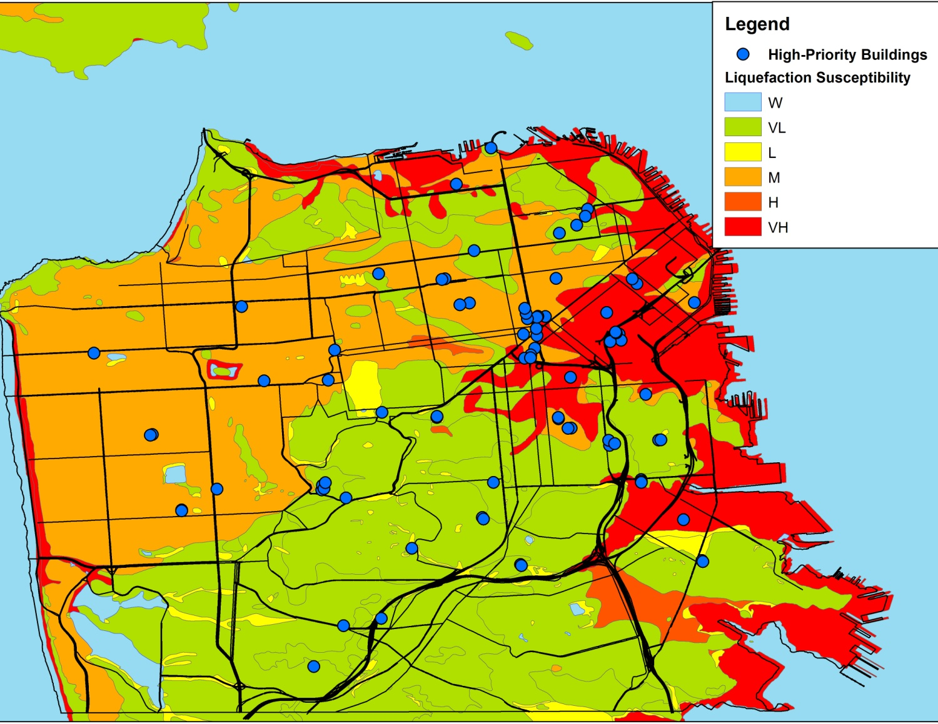
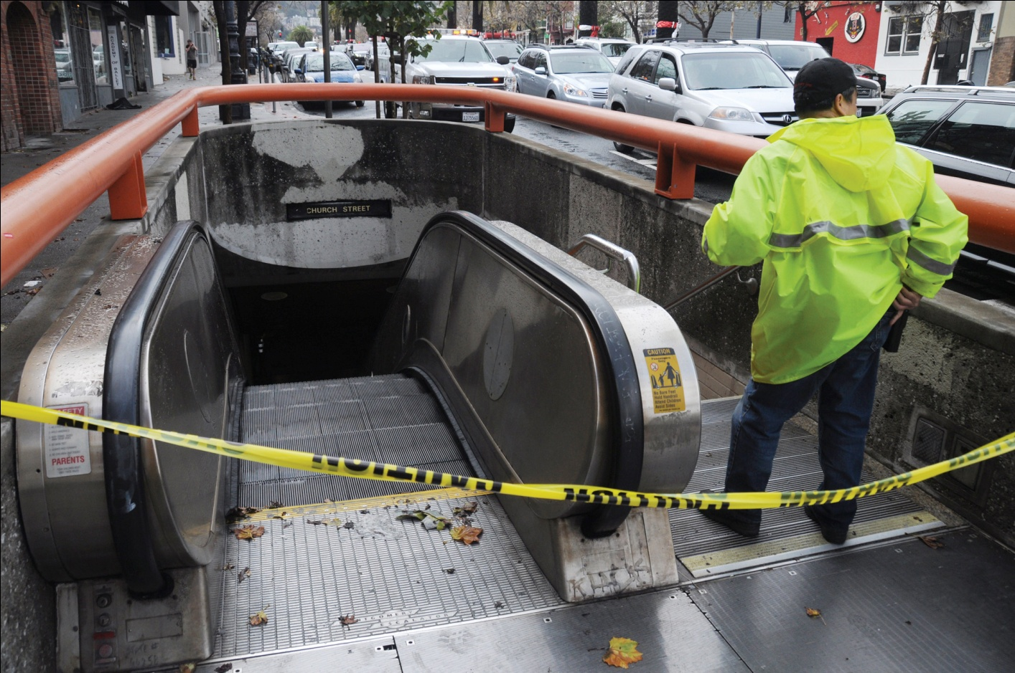
Current Threats: Earthquakes, Severe Storms, Sea Level Rise, Heat Waves
Severe Storms
From 1948 to 2011:
35% increase in frequency of severe storms
100-year storm to become 10-year storm by 2050
Heat Waves
Number of extreme heat days to increase from baseline of 4 days
Sensitive populations at risk from lack of cooling infrastructure
Increased grid stress from greater peak demand
Sea Level Rise
Current state projections for 36” (91 cm) by 2050 and 55” (140 cm) by 2100
$4B in infrastructure at risk, including existing + planned investments along the Bay waterfront + downtown
Earthquakes
63% chance of one or more earthquake M6.7+ by 2036
Majority of waterfront built on reclaimed land, subject to liquefaction
Sea level rise to exacerbate liquefaction
Sources: ABAG and City and County of San Francisco

Slide 6
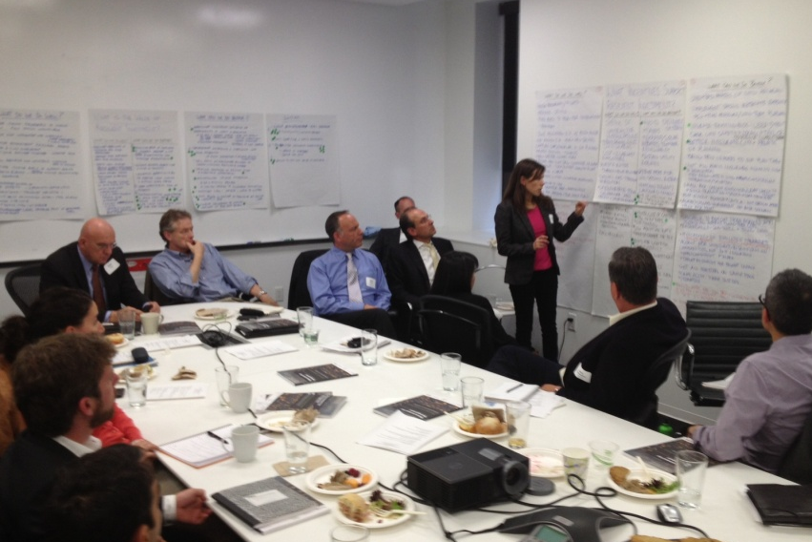
Private-Public Working Group
Overview
2012: UNISDR Private Sector Advisory Group (PSAG) made Resilient Investment a high priority initiative
PSAG members identified cities from UN’s Making Cities Resilient Campaign (MCRC) to initiate a Private-Public Dialogue on Resilient Investment
San Francisco
January 2013: Mayor Edwin M. Lee agrees to participate with PSAG
April 9th 2013: City officials + PSAG convened a kick-off workshop with 30 participants from private + public sectors

Slide 7
San Francisco Resilient Investment Workshop
30 public + private sector leaders
Local agencies: City Administrator’s Office, city planning, risk management, emergency preparedness, environment
Utility + service providers: energy, water, waste, information systems
Construction industry
Energy developers
Insurance + reinsurance
Tax / accounting
Biotech

Slide 8
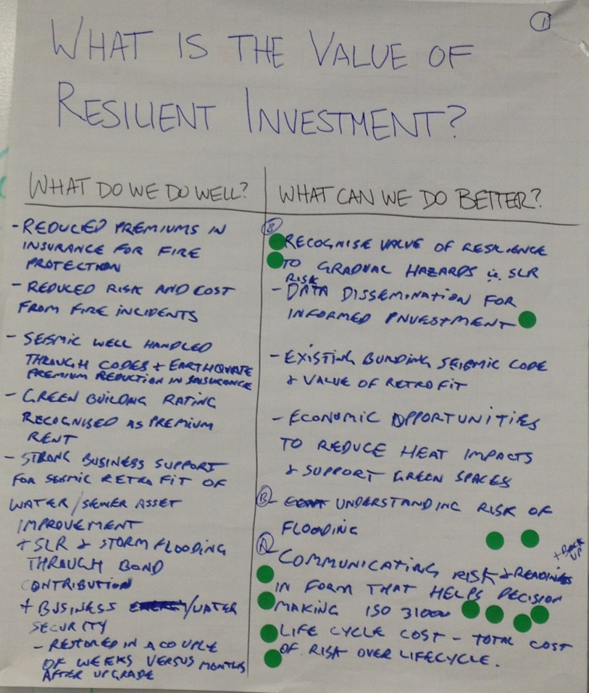
Workshop Goals
Explore “Resilient Investment”: how do we define it?
Highlight current successes: policies, programs, practices + initiatives that already encourage Resilient Investment
Identify future needs: potential new policies, programs, practices and initiatives to further stimulate Resilient Investment (strengthen existing and introduce new)

Slide 9
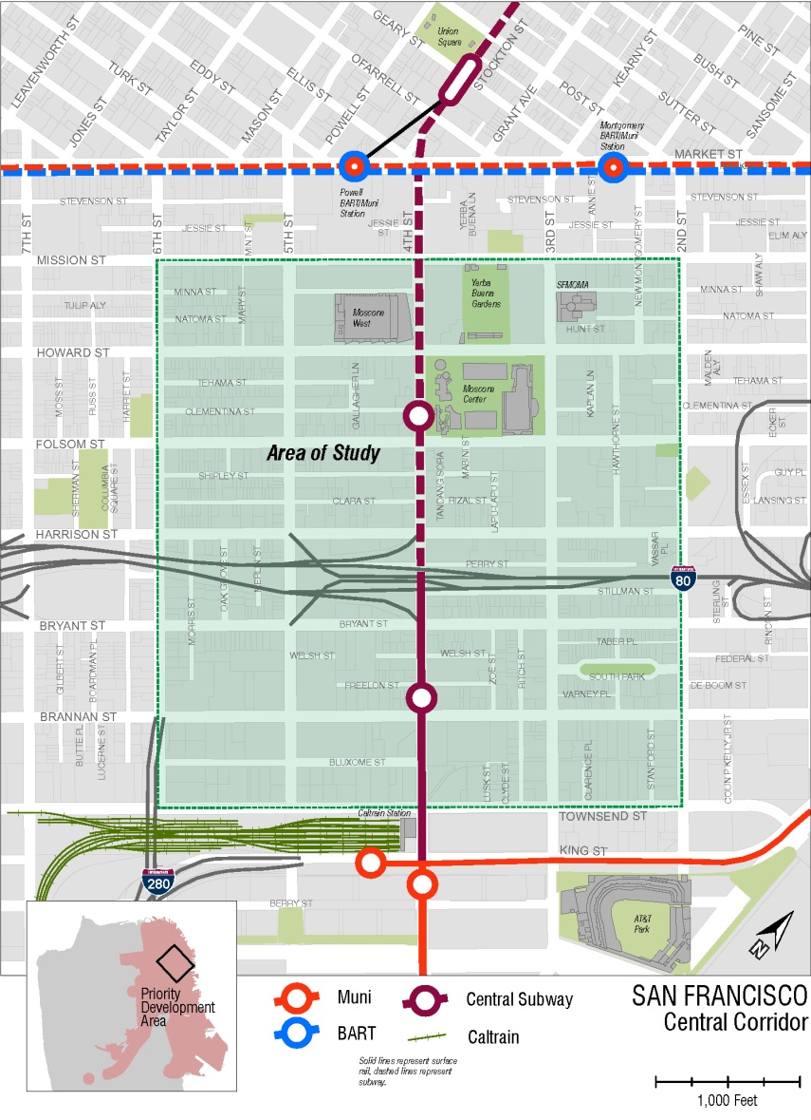
San Francisco’s Eco Districts
Leveraging a Best Practice – Central Corridor
TYPE 2: The “Patchwork Quilt” - A neighborhood of mixed land uses and is comprised of undeveloped, underdeveloped, and developed land owned by different property owners.
Project Goals:
Support transit-oriented growth, particularly workplace growth, in the central corridor area.
Shape the area’s urban form recognizing both city and neighborhood contexts.
Maintain the area’s vibrant economic and physical diversity.
Support growth with improved streets, additional open space, and other elements of “complete communities”.
Create a model of sustainable growth.

Slide 10
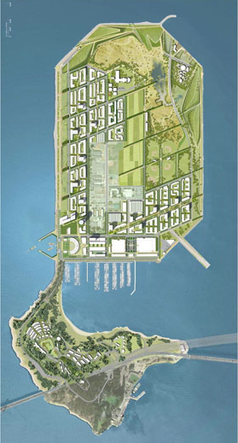
Supporting Resilient Investment: Future Needs
Greater Knowledge of Resilience
Improved Communication
Increased Coordination
Creative Financing
Incentives for investments
Regulations and Standards for Resiliency at neighborhood, city and regional level

Slide 11
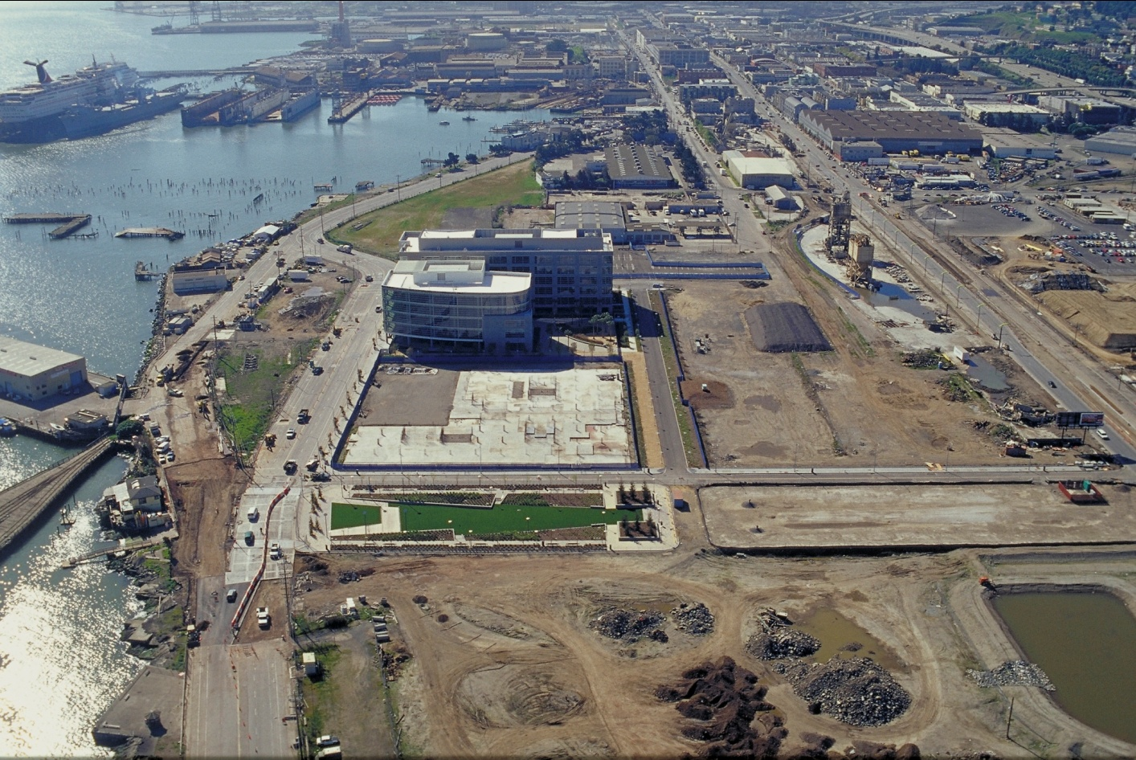
Next Steps for San Francisco
Form a Resilient Investment focus group: public + private sector leaders
Apply UNISDR’s 10 essentials
Incorporate resilience into Central Corridor Eco-District planning
Create a roadmap to resilience

