Slide 1


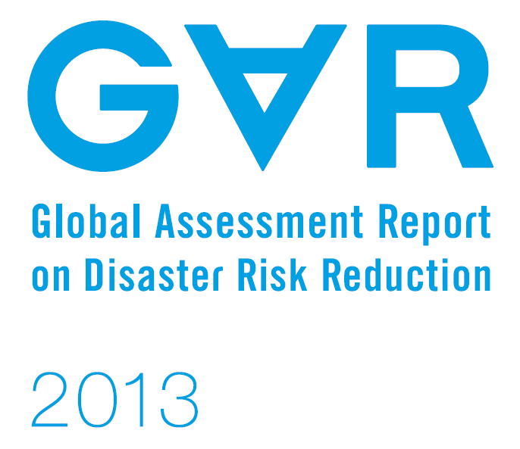


READY-TO-USE DATA
New sources of open risk information

Slide 2
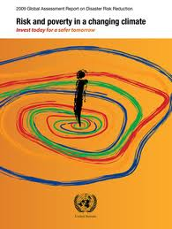
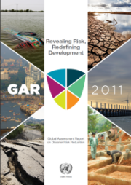
Global Assessment Report
Notes:
The Global Assessment Report has, since 2009, produced information on countries’ risk. This assessment has been carried out through the development of scientifically robust models and methods that use the most up-to-date techniques for risk assessment.

Slide 3


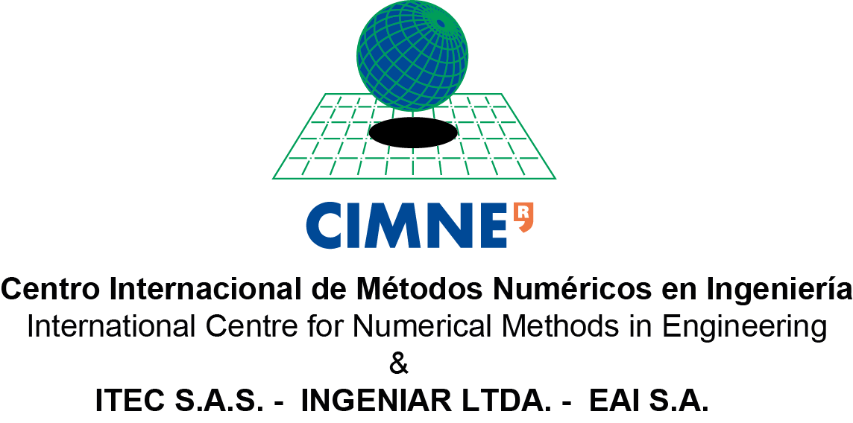





Global Risk Assessment
Notes:
The GAR global risk assessment has been developed in collaboration with a number of partners, whose representatives have just been introduced to you
This presentation wants to provide an overview the data have been produced for the GAR 2013, aiming to promote the use of such data and to gather feedback on the specific data needs. I will have no time to go through the details of the data and the methodologies used to produce them, but please feel free to discuss with the panelists after the event. You can also find these information in the GAR website.
It is important to remark that all the data produced by the GAR global risk assessment are open, freely available and downloadable

Slide 4

What is “risk”?
    Risk is the probability of an adverse outcome (Graham and Weiner, 1995)
    Risk is a measure of the probability and severity of adverse effects (Lowrance, 1976)
    Risk is the combination of probability of an event and its consequences (UNISDR, 2007)
RISK
events
consequences
severity
probability
uncertainty
Notes:
Several definitions of “risk “ exist (some examples here), which are all based on the concepts of probability, specifically in terms of probability of events' occurrence and probability of consequences caused by such events

Slide 5
What is “risk”?
    Risk assessment thus analyse what could happen in a near future following hazardous events (e.g. floods, cyclones, earthquakes)
    Further than “what could happen”, the risk assessment also provide information on “how likely this is to happen”
    Once the decision makers know how likely and how severe the events (and their consequences) are, they can act upon them
RISK
events
consequences
severity
probability
uncertainty
Notes:
Therefore the risk assessment not only gives us information on which events could happen (such as floods, cyclones, earthquakes etc.) and what consequences they can cause, but also how likely they are to happen.

Slide 6
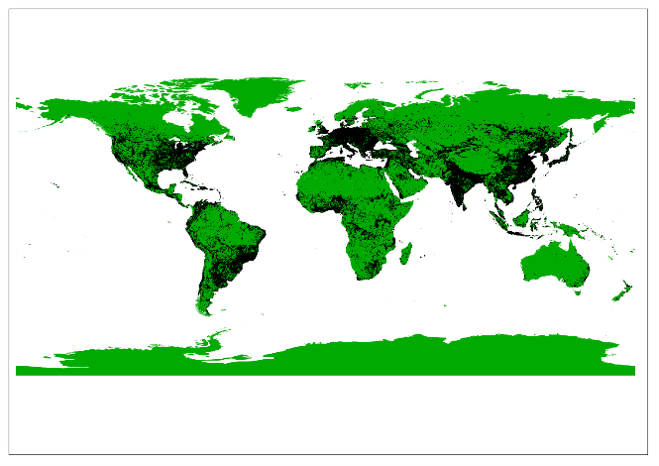
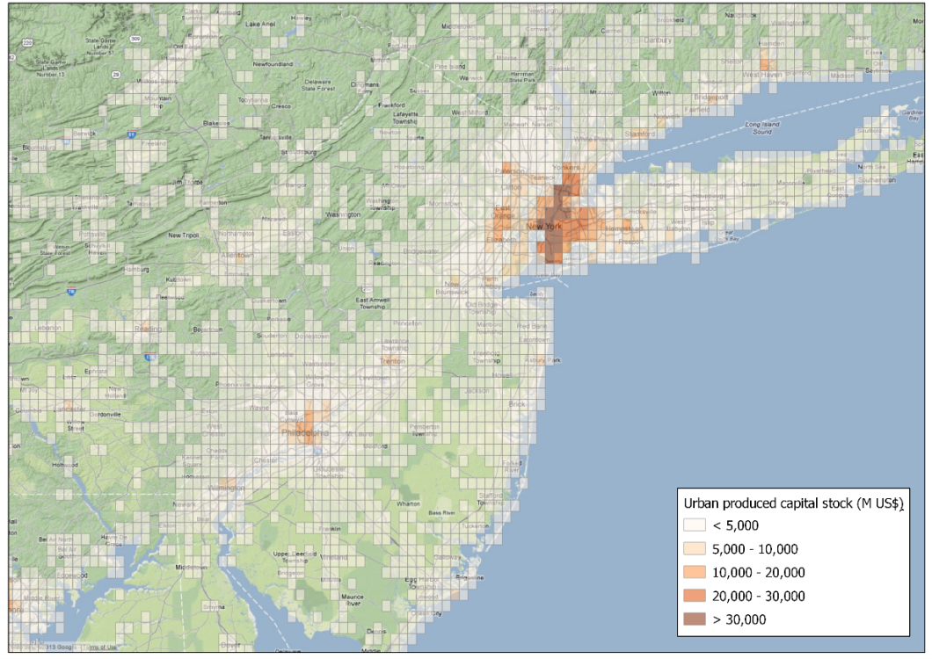
Global Exposure Database
The Global Exposure Database provides the distribution of the value of the urban built environment around the world in a 5Km x 5 Km grid
Notes:
To calculate the expected consequences on the built environment (in our case, in the form of economic losses) from any hazard, the first thing that is needed to know is “what’s on the ground”, thus the value and the structural characteristics of the exposed assets
For this, a “Global Exposure Database” was developed by UNEP-GRID in collaboration with CIMNE and Associates. This database contains the value of the urban buildings in a 5Kmx5Km grid

Slide 7
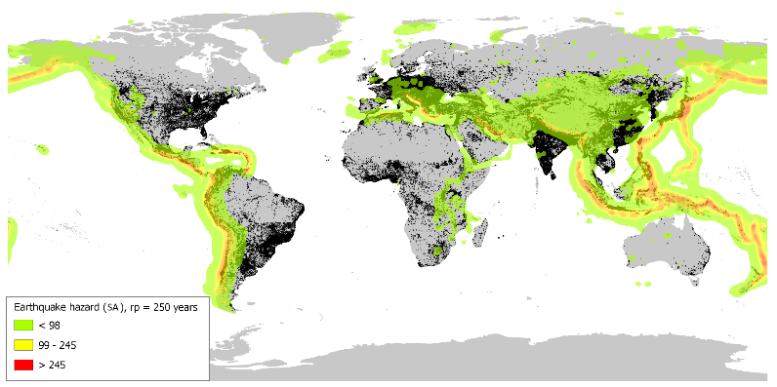
Global hazard assessment
  Earthquake Hazard for different return periods, developed using the open source program CRISIS2012 (www.ecapra.org)
Notes:
Regarding the “hazardous events” that we mentioned earlier, they were determined for different types of hazard and different probability of occurrence.
Earthquake hazard was calculated in terms of spectral acceleration for 250, 475, 1000, 1500, 2500 years return periods. This work was carried out by CIMNE and Associates, in collaboration with the Global Earthquake Model, through the open source program CRISIS2012

Slide 8
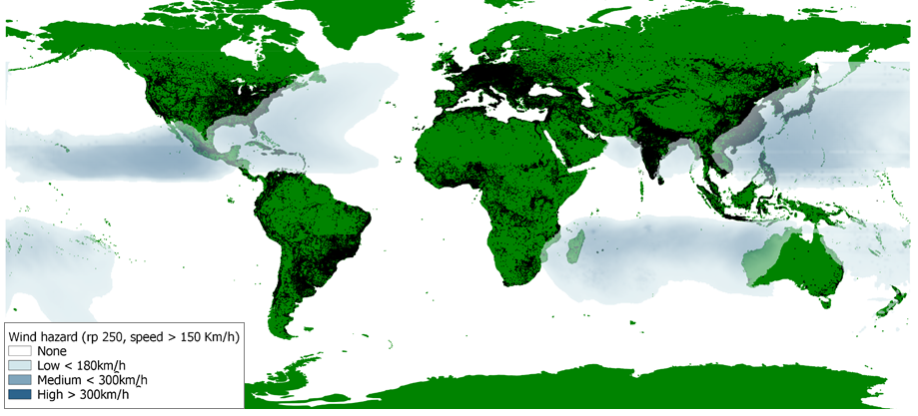
Global hazard assessment
  Cyclonic wind hazard for different return periods, developed using the open source program ERN-Hurricane (www.ecapra.org)
Notes:
The hazard from cyclonic wind, in terms of wind speed, was calculated for 50, 100, 250, 500 and 100 years return periods. This hazard was also calculated by CIMNE and Associates through the open source program ERN-Hurricane

Slide 9
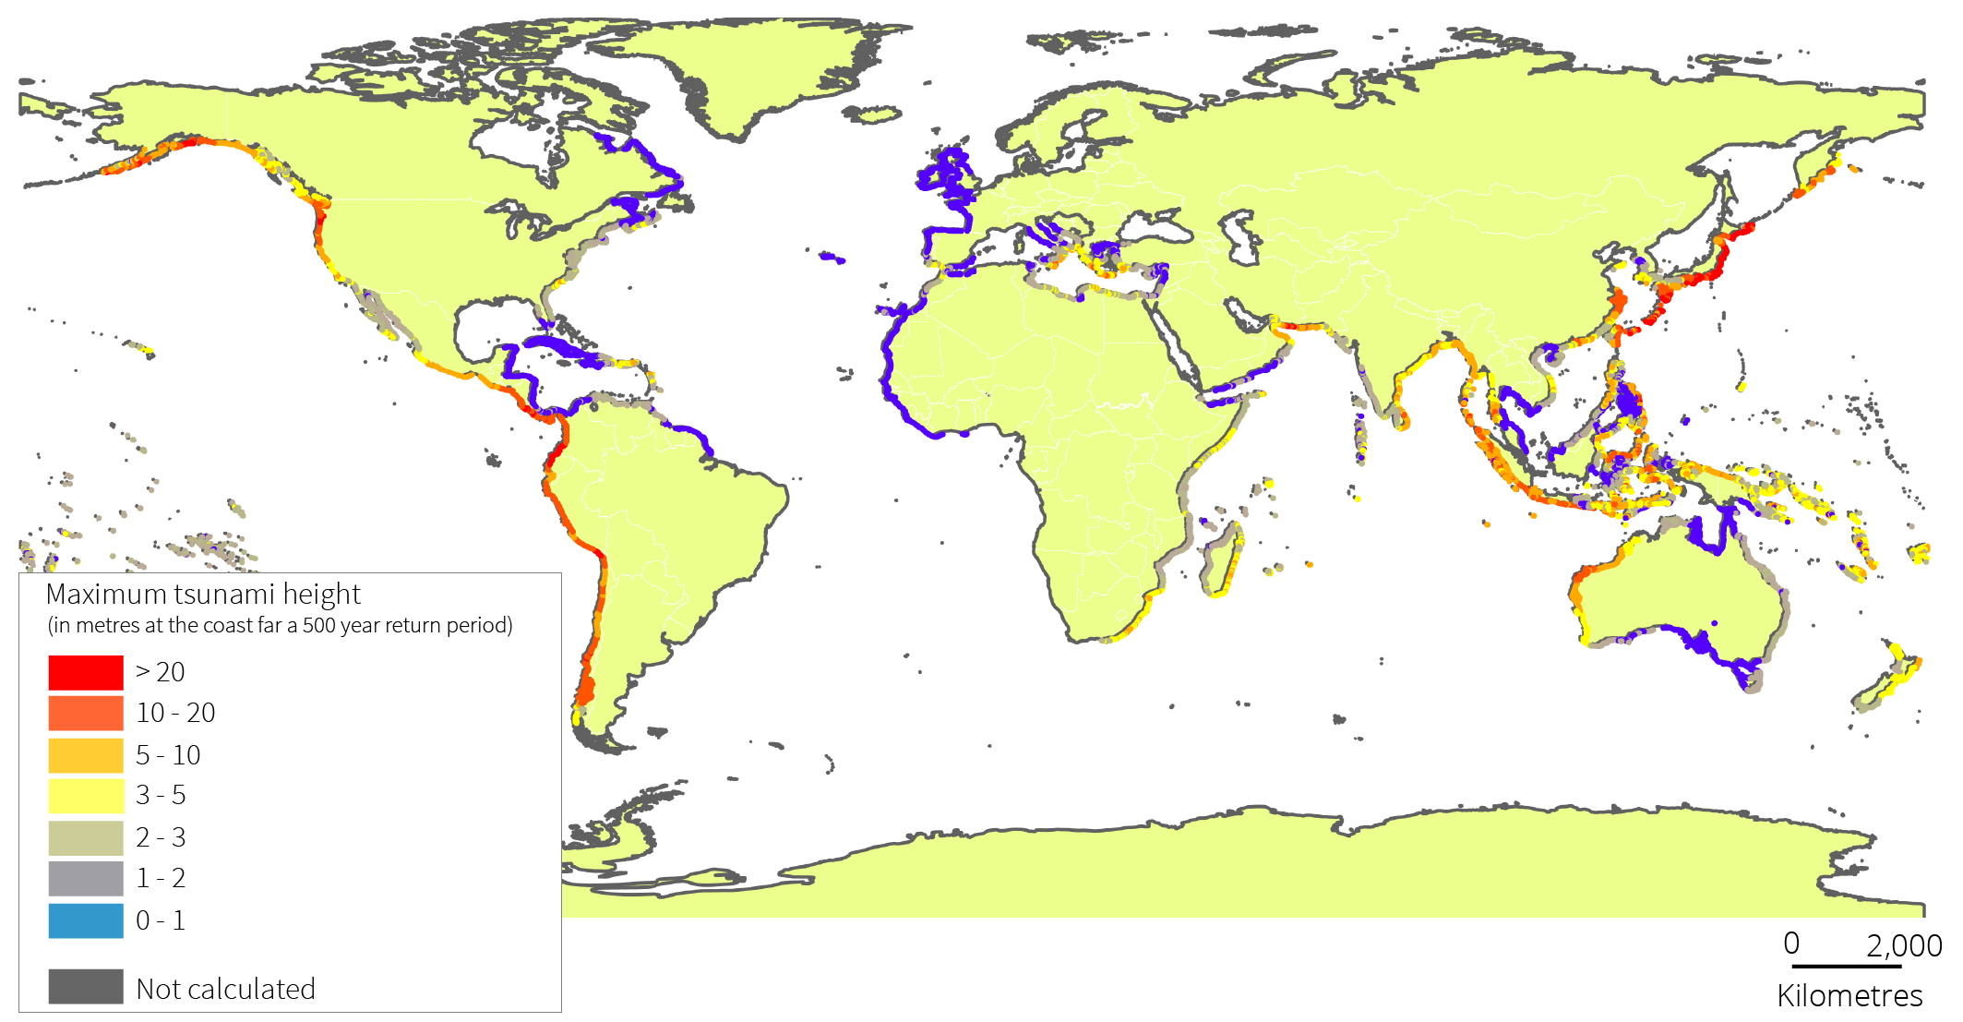
Global hazard assessment
  Tsunami hazard for ~1 in 500 years return period
Notes:
The tsunami hazard was calculated by NGI, in collaboration with Geoscience Australia, for one return period in terms of run-up height and water depth

Slide 10
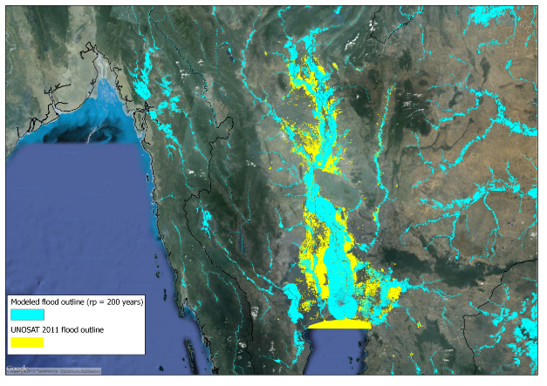
Global hazard assessment
  Global Flood Model, pilot study for Thailand
Notes:
The global flood model it’s under development by CIMA and UNEP-GRID and will be ready in 2015. For 2013, results in terms of flood depth for 25, 50, 100, 200, 500, 1000 years return periods are available for Thailand

Slide 11




Global Risk Assessment
CAPRA
COMPREHENSIVE APPROACH TO PROBABILISTIC RISK ASSESSMENT
www.ecapra.org
Notes:
The risk calculation was carried out for earthquake and cyclonic wind hazard. This work was developed by CIMNE and Associates using the open source software CAPRA, developed by the World Bank GFDRR, IDB and UNISDR

Slide 12
Global Risk Assessment
Annual Average Losses (AAL)
  Estimated average loss per year, over a long time period and considering the range of loss scenarios with different occurrence probabilities
Probable Maximum Losses (AAL)
  Maximum loss that could be experienced in the occurrence of a disaster with a particular return period
Notes:
In terms of risk, the main output for GAR13 were the Annual Average Losses and the Probable Maximum Losses at country level, for earthquake and cyclonic wind. The Annual Average Losses are the expected losses in every given year (averaged over a long period of time). The Probable Maximum Losses are the losses to be expected from an infrequent event (in this case, 250 years return period was used).
The losses are expressed as monetary value, in terms of replacement cost of urban buildings. Thus these results provide a picture of the extent of monetary losses the countries are likely to face, on average, in one year; as well as provide an estimate of the possible extent of losses that a country could face should a “big” event occur

Slide 13
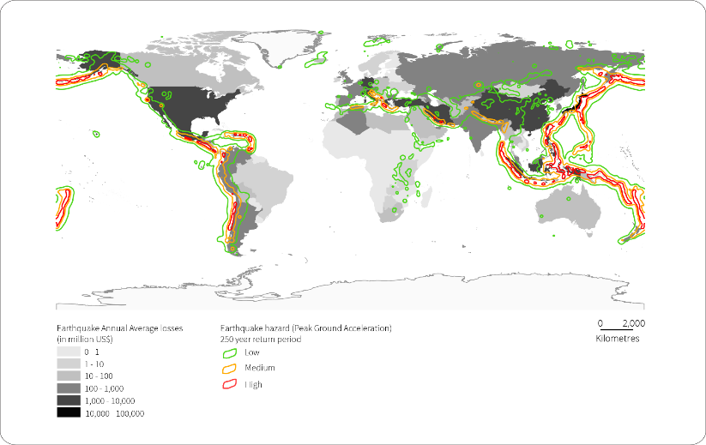
Global Risk Assessment
Notes:
The Annual Average Losses and Probable Maximum Losses for 250 years return period are available for earthquakes and tropical cyclones for every country in the world . Here we can see the distribution of Annual Average Losses due to earthquakes

Slide 14
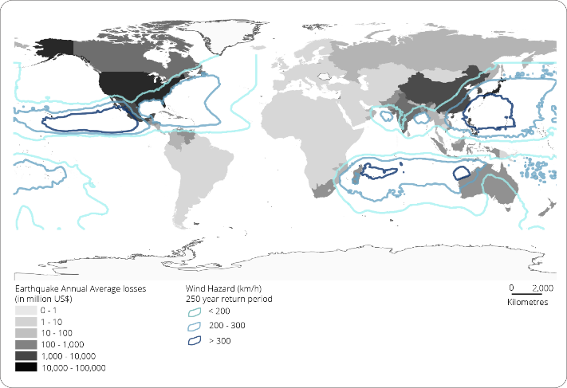
Global Risk Assessment
Notes:
And this figure shows the distribution of Annual Average Losses due to cyclonic wind

Slide 15
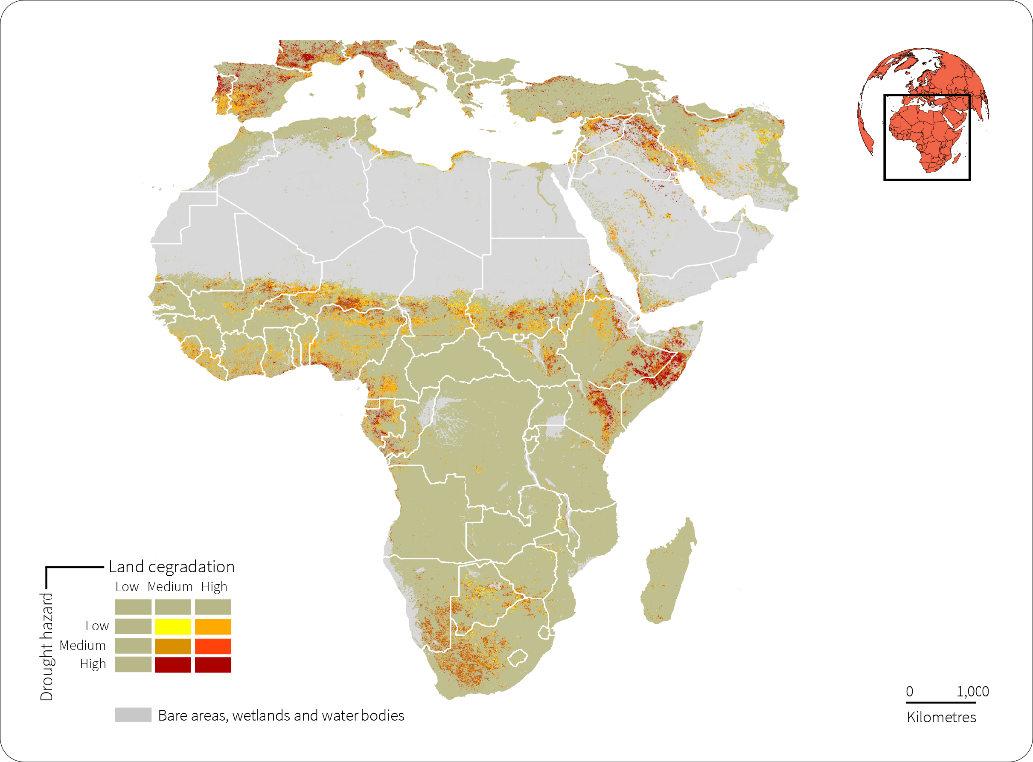
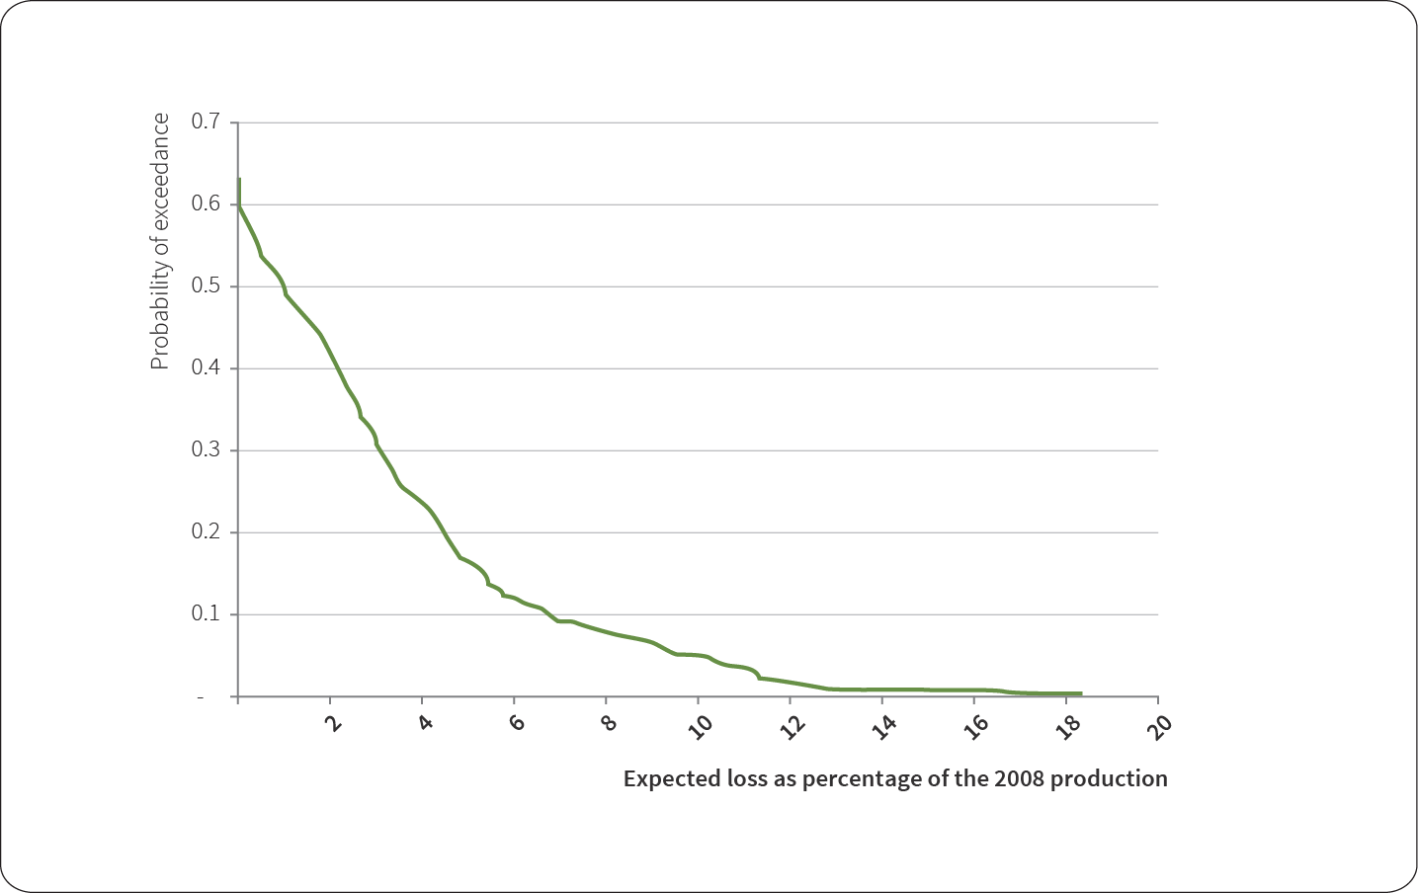
Drought Hazard and Risk
  Agricultural drought hazard for Africa and the Mediterranean Regions between 2000 and 2010
  Assessment of likelihood of crop losses for Mali, Niger, Mozambique and Kenya
Notes:
We are also working to assess agricultural drought hazard and risk:
ACSAD collected and elaborated data from 2000 to 2010 to produce the maps of past agricultural drought and land degradation for Africa and the Mediterranean Regions.
FEWS-NET has developed a model for calculating annual average losses of crops in four African countries (Mali, Niger, Mozambique and Kenya)

Slide 16
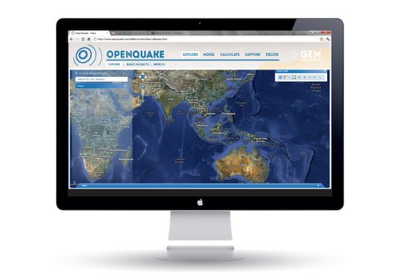
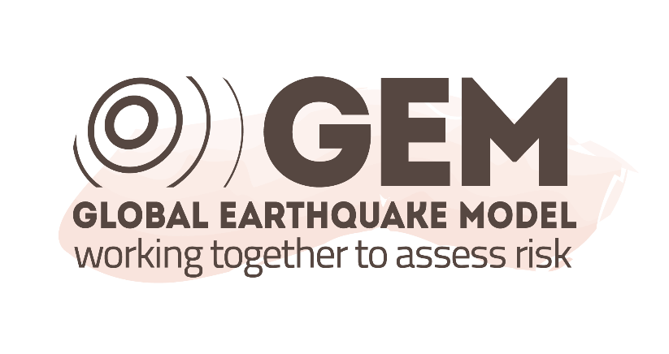
OPEN QUAKE
… Looking forward
  Developed by the Global Earthquake Model
  Web-based risk assessment platform, an integrated environment for modelling, viewing, exploring, and managing earthquake risk
Notes:
Further datasets that will be used in 2015, and that will be available from 2014, include those produced by the Global Earthquake Model. GEM is a global collaborative effort to develop tools and resources to assess and understand earthquake risk
OpenQuake include all the tools, data and models developed by GEM.
The core of OpenQuake is a web-based risk assessment platform, an integrated environment for modeling, viewing, exploring, and managing earthquake risk

Slide 17

















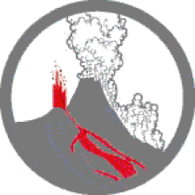



Global Volcano Model
A sustainable, accessible platform for information on volcanic hazard and risk
… Looking forward
  Global assessment of relative threat for each volcano at a national scale
  Regional stochastic models of volcanic ashfall and risk case studies
GNS
New Zealand
CEV
WOVO
V_{HUB}
UNAM
Notes:
In 2015, we will also feature volcano hazard and risk through the work of the Global Volcano Model. This is a growing international network assessing global volcanic hazard and risk
For GAR15, the GVM will work on:
Global assessment of relative threat for each volcano at a national scale
Regional stochastic models of volcanic ashfall and risk case studies

Slide 18
All the GAR13 (and more) data available from: www.preventionweb/gar
Further information on data uses, methods and tools in the
Global Assessment Report 2013 Annex 1
Notes:
Once more, I would like to stress that all the data are available and downloadable form the GAR website.
If you want to read more on the data typologies and the methodologies used to produce them, please refer to the Annex 1 of the GAR13 and all the background papers referenced in this Annex, also available on the GAR website

Slide 19
Thank you
www.preventionweb.net/gar

