Slide 1


WHAT TO DO
IN THE EVENT OF AN EMERGENCY
Orientation module
for migrant workers
Place
Date
Notes:
Update the slide with place and date of the training

Slide 2
INTRODUCTION
The goal of this module is to help you be understand the main types of emergencies that may happen in xxxx, and to know about basic measures you can take in anticipation or in the event of an emergency in order to be prepared

Slide 3
KEY IDEAS
Emergencies discussed in this training module are possible but it doesn’t mean they are going to happen
Being prepared help you cope with emergency if it happens
The goal of this module is to help you be prepared

Slide 4
ORGANISATION OF THE MODULE
Session 1: Introduction and Why Prepare for Emergency
Session 2: Being Prepared for Emergency
Session 3: Emergency Contacts
Session 4: Practical Exercise and Conclusions

Slide 5
QUESTIONS AND COMMENTS
? ? ?

Slide 6
SESSION 1
Preparing for an Emergency: Why?

Slide 7

LEARNING OBJECTIVE
By the end of the session, you will be able to describe why it is important to be prepared for emergencies such as natural disaster, epidemics, political turmoil or conflicts, and economic crises.

Slide 8
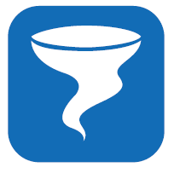
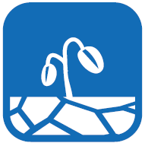
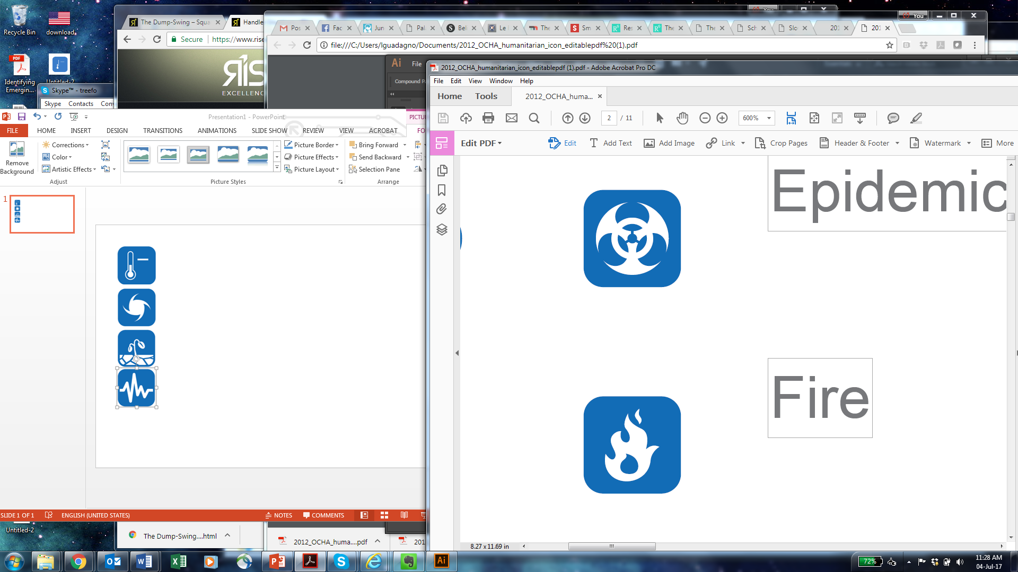
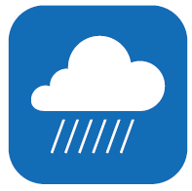
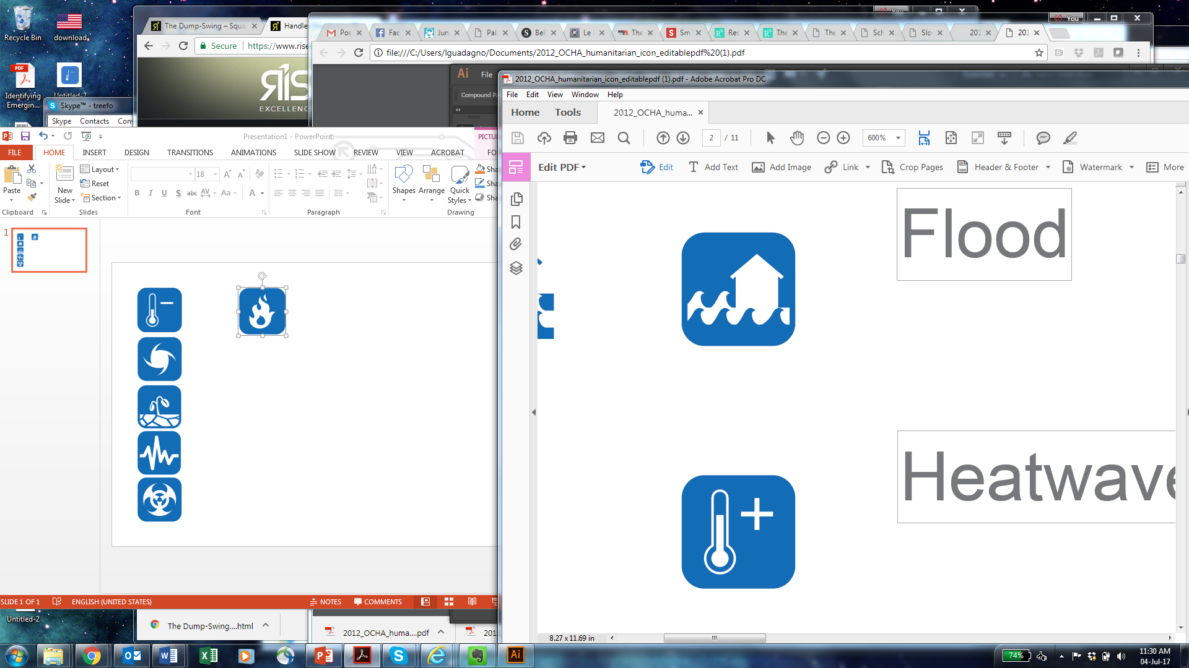
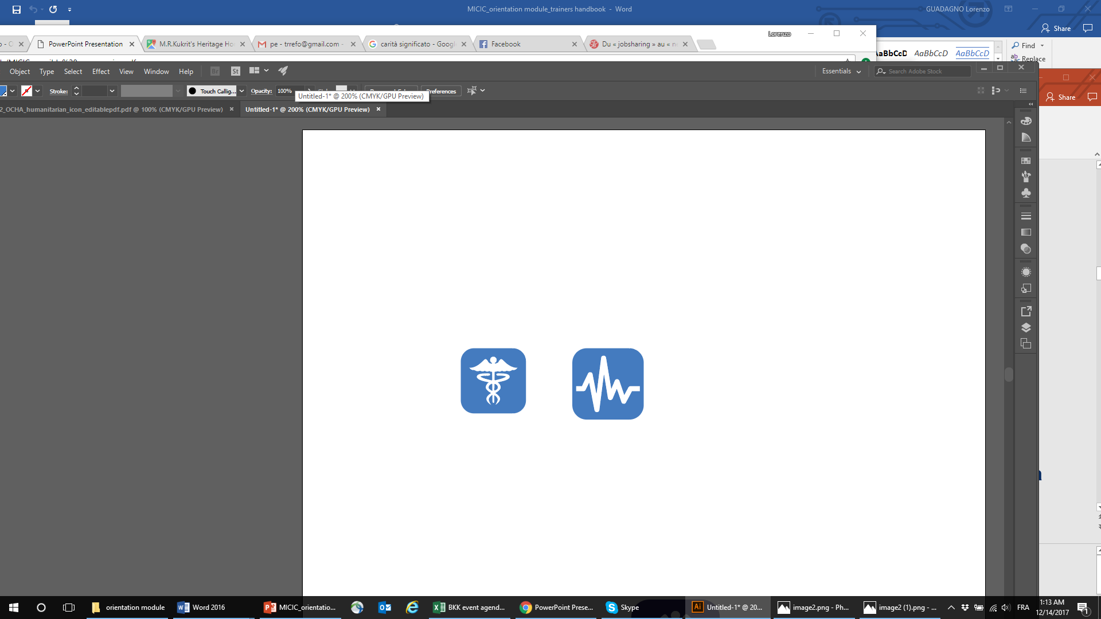
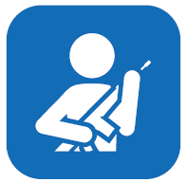
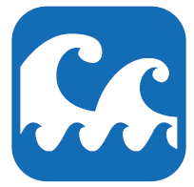
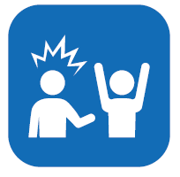
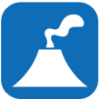
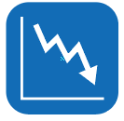
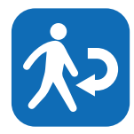
POTENTIAL EMERGENCIES
Storms
Droughts
Industrial
accidents
Heavy rains
Extreme
temperatures
Epidemics
Floods
Earthquakes
Conflict
Fires
Tsunamis
Violence and
xenophobia
Volcanic
eruptions
Economic
Crises
Crackdown
on migrants
Notes:
Adapt the list according to the country of destination and only keep the emergencies that may affect that country.
Information is available from:
http://www.inform-index.org/ (all crises, global level)
http://emdat.be/ (just for disaster + epidemics, global level)
http://www.desinventar.net/index_www.html (country specific, not everywhere, only disasters)
http://www.preventionweb.net/english/maps/index.php?cid=79 (only disasters, very specific, difficult to use)
https://www.irinnews.org/maps-and-graphics/2017/04/04/updated-mapped-world-war IRIN’s conflict map (only active, no potential crises)
https://www.cfr.org/global/global-conflict-tracker/p32137#!/ (same as above, but very US centric)$
https://www.icc-ccs.org/piracy-reporting-centre/live-piracy-map piracy and robbery map
https://www.start.umd.edu/gtd/ global terrorism database, with a map of last 45 years or recorded entries
Insist that the likelihood that these emergencies may occur is limited but that it is important to know about them

Slide 9

BEING PREPARED
Know what to expect
Know how to react
Know which information to look for and where find it
Saves time and reduces stress
Get better access to assistance
Notes:
Explain that being prepared for crisis will help them cope with the crisis should they happen and that this is what you will discuss during the following session.

Slide 10
QUESTIONS AND COMMENTS
? ? ?

Slide 11
SESSION 2
Being Prepared For Emergencies

Slide 12
LEARNING OBJECTIVE
By the end of the session, you will be able to list the preparedness measures that can help you be organised in the event of an emergency
Notes:
Upate slide in country of destination

Slide 13
PRIORITIES FOR PREPAREDNESS
Register with your embassy or consulate
Make copies of your documents
Identify useful contacts both at home and at work
Prepare an emergency bag
Learn safety and security rules from your place of residence and work
Prepare a family emergency plan and make sure everybody knows what to do in an emergency
Notes:
For each of these most important measures, ask participants what they should do to implement them

Slide 14
OTHER USEFUL ACTIONS
Learn about potential local emergencies
Know your neighbourhood and neighbours
Participate in local preparedness drills and exercises
Identify evacuation sites, routes and options
Know your rights
Subscribe to an insurance policy
Notes:
Present and discuss each measure briefly, making sure to involve participants into the discussion.
Explain you will discuss again preparation measures during the practical exercise

Slide 15
DURING AN EMERGENCY
Stay tuned
Provide updates on your situation to your emergency contacts and consulate
Notes:
Present and discuss each measure briefly, making sure to involve participants into the discussion.
Explain you will discuss again preparation measures during the practical exercise

Slide 16
QUESTIONS AND COMMENTS
? ? ?

Slide 17
SESSION 4
Practical Exercise

Slide 18
LEARNING OBJECTIVE
By the end of the session, you will be able to put into practice the most important actions that would help you be prepared in the event of an emergency.

Slide 19

INSTRUCTIONS
You have just arrived in xxx
Select the 12 key items to include in your emergency bag.
Decide on the 3 most important actions you should take in the coming weeks.
15 min

Slide 20
EMERGENCY BAG
Items you must take with you:
Water
Cash with some extra coins
Identity papers: passport, residence card, work permit, bank account details, copy of contract, etc.
Emergency contacts
Prescribed medication and glasses

Slide 21
EMERGENCY BAG
Items that it is important to take with you:
Mobile phone charger
Blanket
Non-perishable food such as openable canned food, chocolate, biscuits, candies and others

Slide 22
EMERGENCY BAG
Items that you should take if you can:
Knife/can opener
Portable radio
Hand sanitizer
Water purifying tablets
Mask (gas or dust)
Whistle
Towel
Lighter or matches
Plastic bags
Umbrella & raincoat
Flashlight
Emergency medical kit
Toiletries
Local map

Slide 23
QUESTIONS AND COMMENTS
? ? ?

Slide 24
SESSION 5
Debriefing and assessment

Slide 25
LEARNING OBJECTIVE
By the end of the session, participants have a reinforced understanding of why preparing for emergencies is important, and have an idea of options for and benefits of doing so in their destination.

Slide 26
ENGAGING: WHY?
Engaging in emergency preparedness activities can be useful for your day-to-day integration and well-being in your destination:
Get in touch with migrants and locals;
Get to know your area and your institutions;
Learn skills that can be useful or can help you get a job;
Help protect your community (migrants and host);
Change perceptions of host communities on migrants.

Slide 27
THANK YOU
Contact: micicsecretariat@iom.it / http://micicinitiative.iom.int

