Slide 1
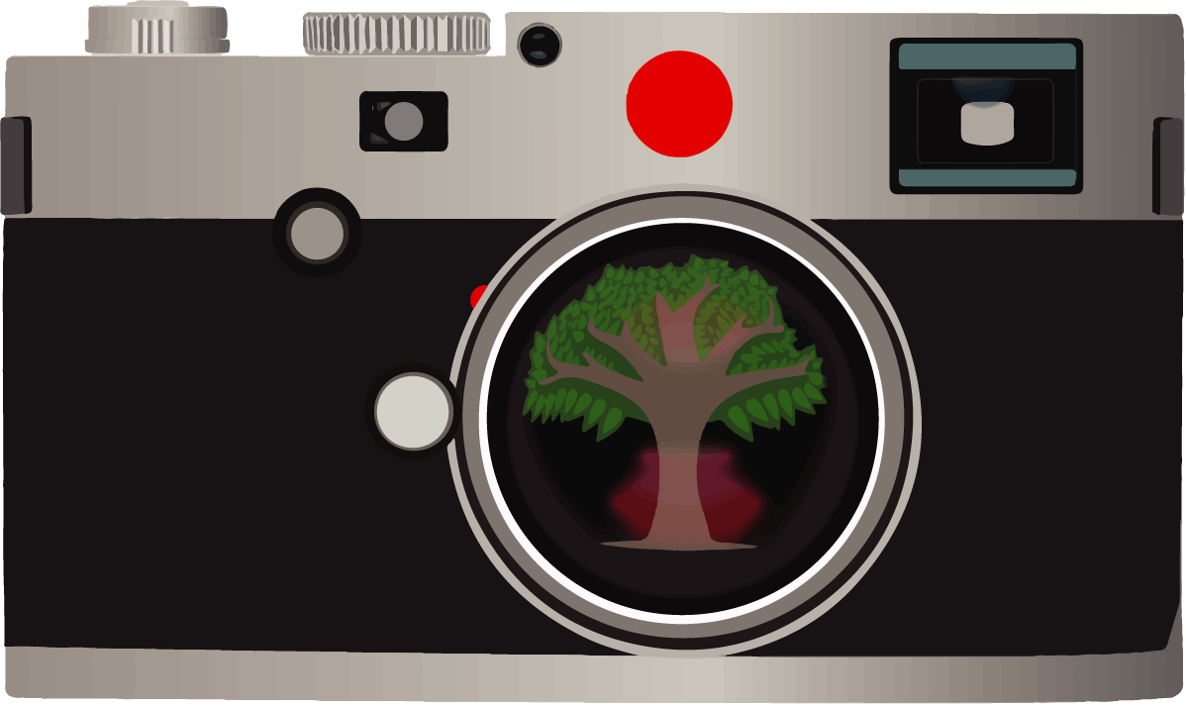
Picturing Resilience Intervention:
Using Photovoice for Youth Resilience

Slide 2
PRI Examples:
Youth Challenges
Untitled
Here we see a house without windows. You see this every day. Maybe the people that live here cannot afford new windows. We can help the poor by donating money.

Slide 3
PRI Examples:
Youth Challenges
“More Graffiti”
Here we see a photograph of graffiti. It represents a lot of other bad things and bad creations that other people are a part of. I see a lot of graffiti. This photo can tell people to stop it.

Slide 4
PRI Examples:
Youth Challenges
Untitled
This is a photograph of a tobacco pack on the ground. This happens because people smoke and people litter. It would be nice if we could make people stop.

Slide 5
PRI Examples:
Youth Challenges
“Attention to Signs”
This is a warning sign telling you to go slow and not to do any crimes. The problem is, that people barely pay attention to signs and don’t care about our community. Signs are important because they help people to be good by telling us what to do and not to do.

Slide 6
PRI Examples:
Youth Challenges
“Why You Should Keep Neighborhoods Clean”
This is a picture of broken glass, socks, and junk on the sidewalk. It is not safe to walk here, especially for kids. Kids need to be protected, because people are forgetful and not always respectful. This picture tells people to clean up their neighborhood and will hopefully make them think twice before littering.

Slide 7
PRI Examples:
Youth Challenges
“The Imperfect World”
This glass window was shot at with a gun. There is a lot of shooting happening in the world and it is imperfect and people do wrong things. We need to watch out for others and do the right thing.
*All example photos courtesy of former PRI participants.

