Slide 1
OCTOBER 9 - 13, 2017 ⎪ SAINT KITTS AND NEVIS
Session 4
The Assessment Tool

Slide 2
MSSP Assessment Tools
Early Childhood / Primary Schools / Secondary Schools / Tertiary Schools
Table 1 – Vital Information for the Management of Safety
Table 2 – School Safety Compliance Assessment
Table 3 - Building Condition Assessment
Table 4 – Green Assessment
146 Questions
19 Systems to be assessed
128 Questions

Slide 3
MSSP Assessment Tools
Table 1 – Vital Information for the Management of Safety
Table 2 – School Safety Compliance Assessment
Table 3 - Building Condition Assessment
Table 4 – Green Assessment
Critical
Standards
Critical
Standards
99 Q Early Childhood
112 Q Primary Schools
140 Q Secondary Schools
140 Q Tertiary Schools
112 Q Early Childhood
115 Q Primary Schools
128 Q Secondary Schools
128 Q Tertiary Schools

Slide 4
MSSP Assessment Tools
+
=
Table 2 – School Safety Compliance Assessment
All
CS
met
80%
Certification
possible
=
Table 3 - Building Condition Assessment
80%
Certification
possible
+
=
Table 4 – Green Assessment
All
CS
met
Certification
possible
80%

Slide 9
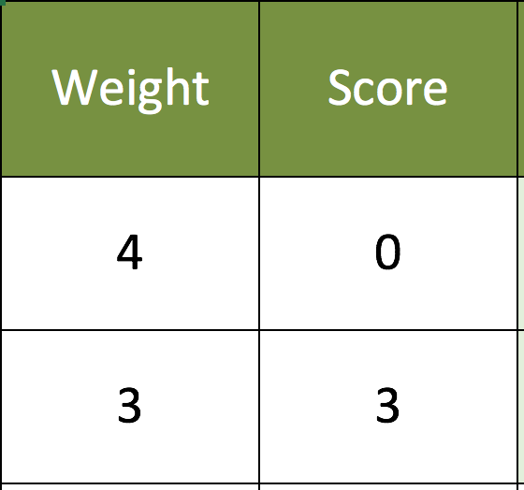

Slide 10
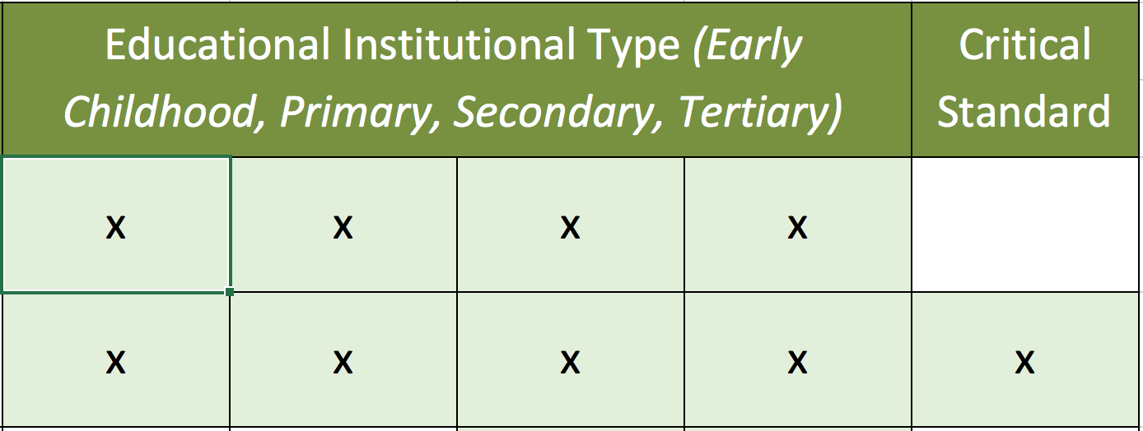

Slide 13
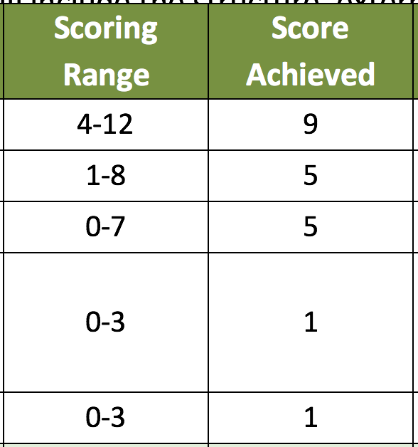

Slide 14
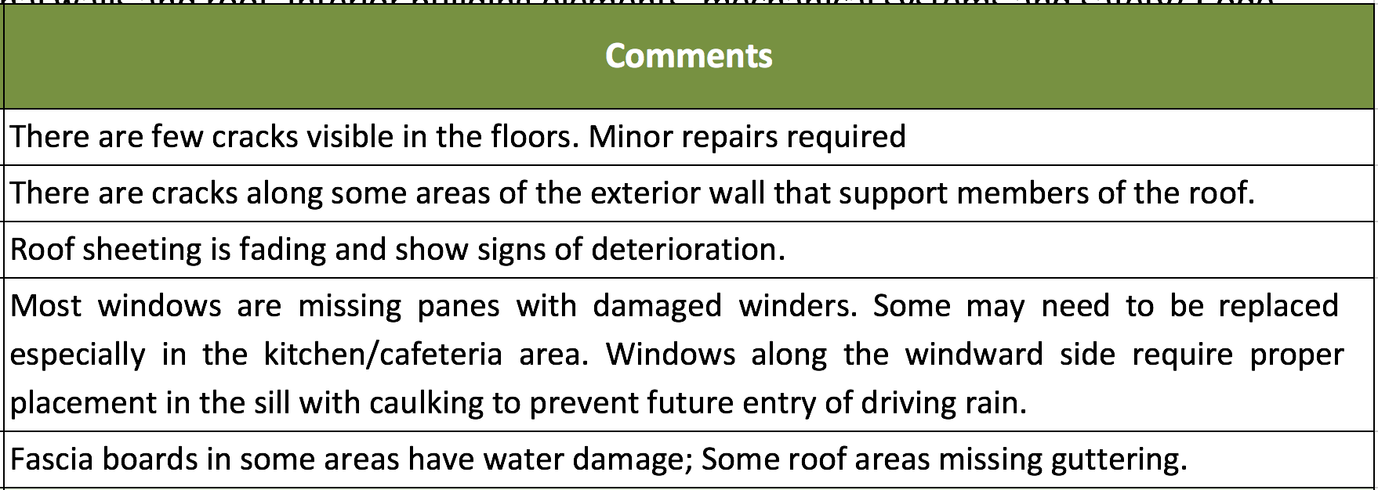

Slide 15
Session 4 – Activity 3: Question Scenarios
Exercise description: The questions below are taken from the Safety Assessment and the Green Assessment. For each question, an example context is provided, which shall be used to evaluate each. As a group, answer each question with a corresponding Yes/No answer. Take note of your reasoning of each answer.

Slide 16
School Assessment
 | Group 1 Cecele | Group 2 Tyrell | Group 3 Tucker
Tucker Clarke Primary School | Safety A. | Building Condition A. | Green A.
Cecele Browne Integrated School (CBIS) | Green A. | Safety A. | Building Condition A.
Tyrell Williams Primary School | Building Condition A. | Green A. | Safety A.

Slide 17
School information sheet | 1 representative from group that is undertaken the Building Conditions Assessment
School Safety Compliance Assessment | Interview with Principle / Deputy Principle | Interview teachers | Interview care takers / grounds man | Interview Canteen
 | 1 representative + 1 note taker Questions: 1-22, 28-30, 32-46, 61-70, 93-106, 115-142 | At least 1 representative Questions: 23-27, 31, 47-53 | At least 1 representative: Questions: 70-92, 107-115 | At least 1 representative: Questions: 54-60
Building Conditions Assessment (see also School information sheet) | Exterior Building Elements | Interior Building Elements | Mechanical Systems | Safety Code Compliance
 | At least 1 Person | At least 1 Person (together with Mechanical Systems) | At least 1 Person (together with Interior Building Elements) | At least 1 Person
 | Mainly observers - Ask teachers or care taker whenever appropriate
Green Assessment | Interview with Principle / Deputy Principle | Sustainability Management & Natural Resources | Indoor Environment & Hazardous Chemicals and Materials | Facility and Grounds Management & Food Service
 | 1 representative + 1 note taker Questions: 1-18, 28, 30, 38-40, 42-46, 49-60, 64-66, 72, 82, 89, 91-92, 98, 102-103, 105, 107, 110-117, 120, 126, 128 | At least 1 Person Care taker/ Observer Questions: 19-27, 29, 31-37, 41, 47-48 | At least 1 Person Care taker/ Observer Questions: 61-63, 67-71-78, 88, 90-91, 93-94 | At least 1 Person Care taker/ Observer Questions: 95-97, 99-100, 104, 106, 108-109, 118-119, 121-122, 127

