Slide 1
Implementing the Sendai Framework at the local level
Disaster Loss Accounting at the Local Level

Slide 2
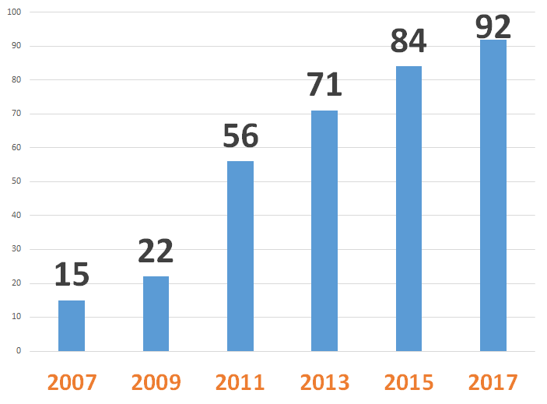
Disaster Loss Tracking
No. of Countries with Disaster Loss Databases Globally
Sustainable arrangement within an institution for the systematic collection, documentation and analysis of data about losses caused by disasters

Slide 3
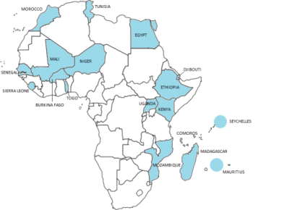
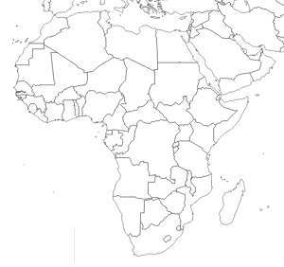
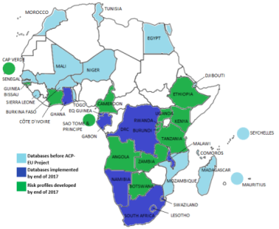
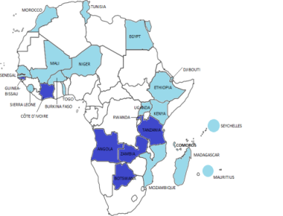
Disaster Loss Tracking
2008
2012
2016
By 2016

