Slide 1
Benefits of multimedia messages in Public Warning for persons with disabilities
Peter Sanders – Product Manager and Standards Director
peter.sanders@one2many.eu

Slide 2
Agenda
Introduction
Timing
EU-Alert for people with disabilities
Next generation PWS
Deploying PWS
Notes:
Introduction on one2many
Overview = Explanation of what CB is
Environment = Explanation how CBS interfaces to its environment
Platform = Hardware
Roadmap = Future development of Acision’s CBS
Service Concepts = Examples of services that include CB
1) Product overview on CBC - HW, SW, capacity and functionality
2) Dimensioning on CBC
3) Use cases
4) Reference, especially on 3G (WCDMA), as we understand there is limited implemented on 3G network.

Slide 3
Introduction
Emergency Services
Citizen calls Emergency Services to report an incident (112)
Citizen receives Public Warning Message from Emergency Services (EU-Alert)
EU-Alert is based on text messages today
Next generation EU-Alert is based on multimedia messages
EU-Alert is specified in ETSI TS 102 900

Slide 4
Timing
112 services legally created by the EU Council in 1991
Operational in 1995/96
Every country in the EU provides a 112 service
PWS triggered by 2004 Indian Ocean earthquake and tsunami
250,000 people died
Japan came to 3GPP to specify ETWS in 2008
Area Mail Service in Japan went live end of 2007
US came to 3GPP to specify CMAS (now WEA) in 2009
WEA went live in 2012
ETSI specified EU-Alert in 2010
NL-Alert went live in the Netherlands in 2012
Mass Alert went live in Lithuania in 2013

Slide 5
EU-Alert for people with disabilities
EU-Alert is text based broadcast
Nation-wide service
SMS is text based
No nation-wide service in the EU today
People with disabilities:
Text may be read
Text can be converted to speech (possibly with an external device)
Text can be sent in multiple languages

Slide 6
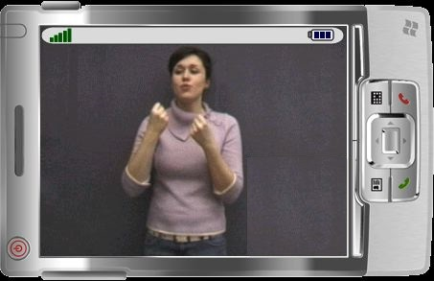
Ongoing work for emergency alerts
ETSI
Alerting Libraries TR 103 273; defines an abstract language to transmit alert messages and related alert properties to end users, including those with disabilities
Based on output of Alert4All (EU-funded project SEC-2010)
National Center for Accessible Media (2009)
Access to Emergency Alerts for People with Disabilities (http://ncam.wgbh.org/invent_build/analog/alerts)
General conclusions from referred documents for PWS for disabled people:
Send messages in as many formats as possible
Text
Audio
Video (e.g. with sign language)
Broadcast of audio and video requires next gen PWS

Slide 7
Next generation PWS
Multimedia messages
Based on MBMS (Multimedia Broadcast Multicast Service)
Available on 4G (also on 2G and 3G, but that was never commercially successful)
Allows broadcasting of
Text
Audio
Pictures, diagrams or maps
Video
Should allow the citizen to select the appropriate media
Today there are technology trials, general availability of MBMS will be in 2016/17.
3GPP has published TR 22.815 on Multimedia Broadcast Supplement for PWS
MBMS can be used as a supplement to the current PWS with Cell Broadcast
Requires no modification to MBMS on the network side
Requires (standardized) support on mobile devices
You may ask what the next step is……

Slide 8
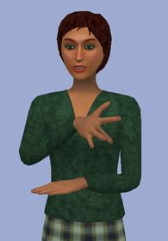
Deploying PWS
Introduction of PWS as a national service benefits from a mandate
Costs for public awareness are bigger than technology costs
Often PWS is a cost for operators and mobile device manufacturers
Government funding or legislation will convince operators
EU-Alert compatible devices are available (for Android, Windows, iOS)
MBMS is likely to be used for commercial services
Introduction of PWS is to a large extent a communications project
Get all parties on board
Responsibility of PWS often lies locally rather than at the federal level
Public awareness
Multimedia messages should be accessible by the disabled
Which combination of media is best suited?
Possible subject for research funding?
Notes:
CSRIC is a federal advisory committee which provides recommendations on best practices and actions the Commission may take to ensure optimal communications systems. WG2 was tasked to examine next generation alerting.

Slide 9
End
Thanks for your attention!

