Slide 1
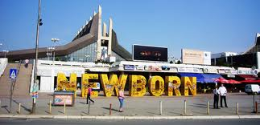
G L O B A L P L A T F O R M FOR D I S A S T E R R I S K R E D U C T I O N
19-23 May, Geneva, Switzerland
Presented by:
Prof. Dr. Isa Mustafa
Mayor of Municipality of Prishtina

Slide 2
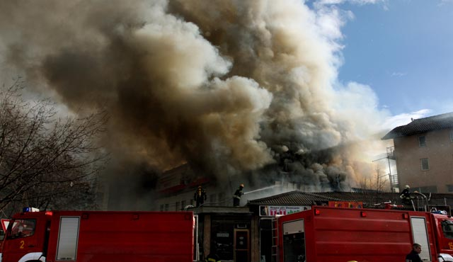
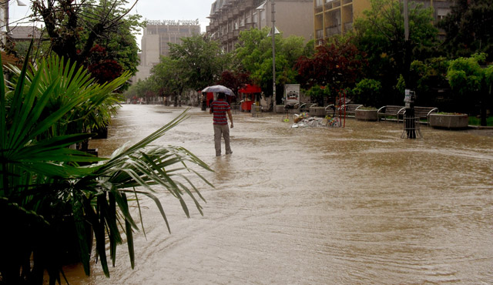
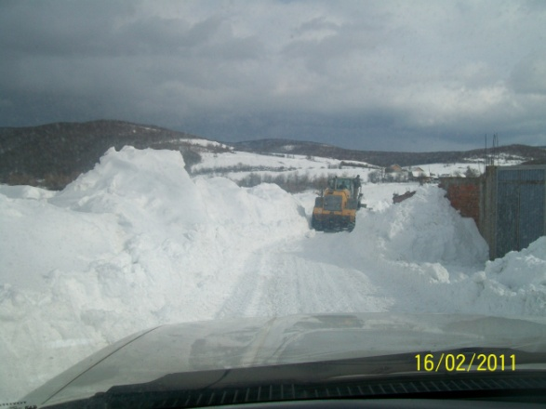
Disaster profile:
Fires / Floods / Heavy snowfall / Earthquakes / Landslides
Municipality legal framework:
Disaster Risk Assessment for Municipality of Prishtina
Operative Plan for Action for Municipality of Prishtina
Fire protection Plan for Municipality of Prishtina
Regulation for Fire Protection for Municipality of Prishtina
Evacuation Plan for Personnel and other equipments from M. of Prishtina premises
Plan Against Bird Diseases
Prevention Measures:
Fire monitoring and alarming system
Construction of barriers against fires
Construction and Maintenance of river beds, sewage system through out the Municipality
Public awareness for disasters which threaten the Municipality
Municipality of Prishtina – Disaster profile Platform for Disaster Risk Reduction, 19-23 May 2013, Geneva, Switzerland

Slide 3
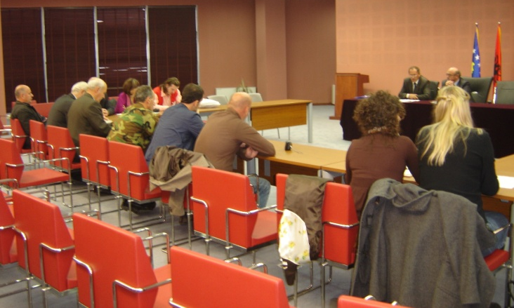
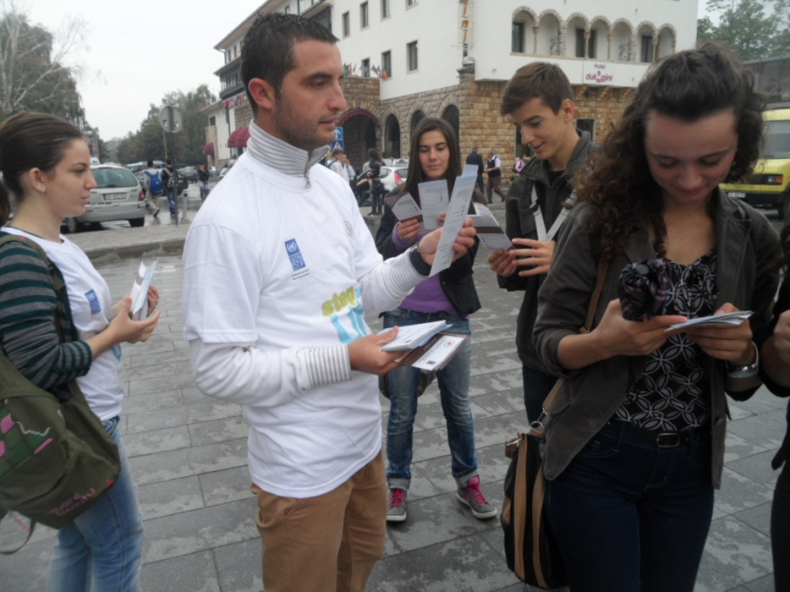
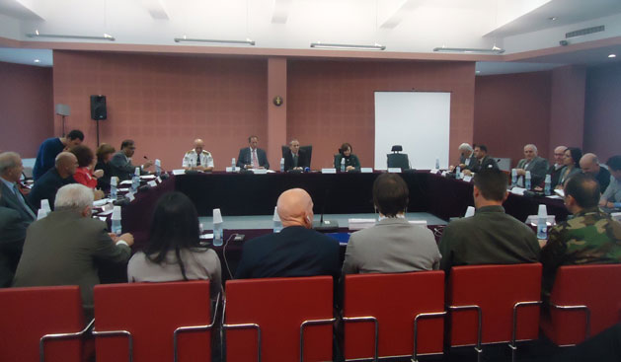
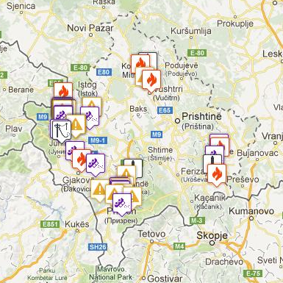

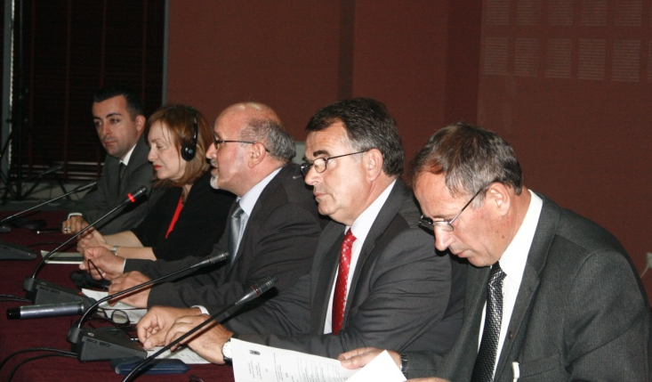
13 October 2010
13 October 2011
13 October 2012
Kosovo Emergency Management Application - KEMA
13 October, International Day for Disaster Risk Reduction Platform for Disaster Risk Reduction, 19-23 May 2013, Geneva, Switzerland
Notes:
13 Tetori, Dita Ndërkombëtare për Zvogëlimin e Rrezikut nga Fatkeqësitë, ka filluar të shënohet ne Kosovë, respektivisht në Prishtinë që nga viti 2010. Komuna e Prishtinës ishte njëra ndër anëtaret e para të UNISDR (United Nations International Strategy for Disaster Reduction) Kampanjës “Making Cities Resilient” që nga Maji 2010. Komuna e Prishtinës në bashkëpunim me Kryqin e Kuq të Kosovës dhe UNDP-në cdo vit ka organizuar tryezë të rrumbullakët me të gjithë akterët relevant nga niveli qendror, local, organizatat e kombeve të bashkuara dhe shoqërinë civile. Gjatë ditës së njejtë vullnetarët e Kryqit te Kuq të Kosovës kanë shpërndarë broshura vetëdijësuese për vetëmbrojte gjatë fatkeqësive të ndryshme natyrore (tërmetit, zjarrit, vërshimeve dhe ortekut) si dhe Broshuren e Hyogo Framework for Action te perkthyer ne shqip.

Slide 4
MIA Operation Center
Monitors threats & potential incidents
President
Declares State of Emergency
Incident
Interagency Incident Management Group
Frames operational courses of action
Local First Responders
Arrive first at scene
Alerts
Requests aid from
May convene
Recommends
Mayor
Activates Local EOC
EMA Regional Coordinator
Activates Regional EOC - 112
MIA Operation Center
Evaluates Situation
Minister
Reviews situation, assesses need for state of emergency declaration & activation of NRP elements
NRP Resources
May deploy in advance of imminent danger
Preliminary Damage Assessment & requests Presidential declaration
Reports to
Activates
Central Assistance
Activates
MIA and others
Implement National Response Plan
Delivers
Activates
Emergency Response Team or other elements
Deployed as necessary
Joint Field Office
Provides coordination of central resources
Overview of Initial Central Government Involvement according to National Response Plan Platform for Disaster Risk Reduction, 19-23 May 2013, Geneva, Switzerland
Notes:
MIA – Ministry of Internal Affairs
EOC – Emergency Operating Center
EMA – Emergency Management Agency

