Slide 1

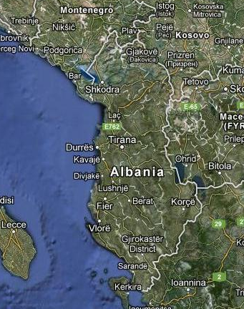
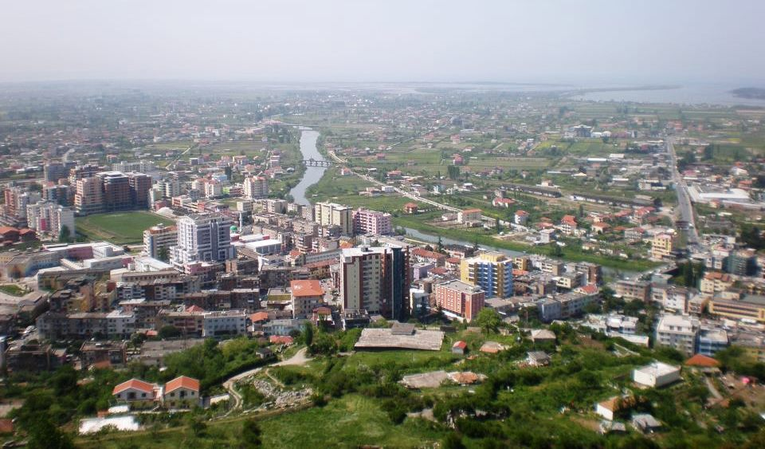

Municipality of Lezhe
Lezhe
Area: 6.2 km2
Number of citizens in the municipality: 29 780
Climate: Mediterranean type
Road Network: Today the city remains a transportation node as it connects major national highways, railways and the port of Shengjin. Lezha has good connections with Montenegro, Macedonia and Kosovo.
Mayor Viktor TUSHAJ

Slide 2
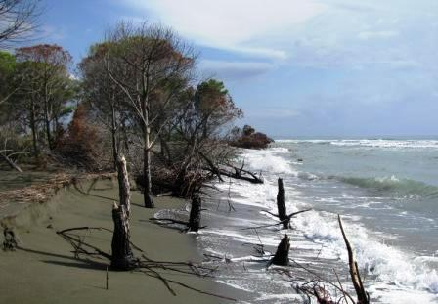
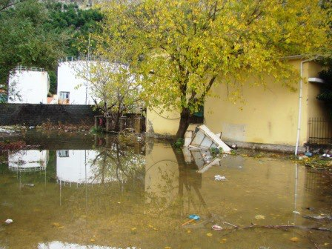
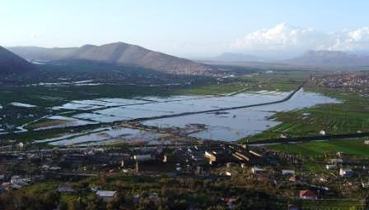
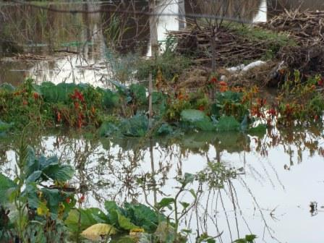
Main disaster risks faced in the Municipality of Lezha
Increase of the number of extreme weather events as marine and land storms, sea ​​level rise, leading to flooding, seacoast erosion, acerbating of environmental situation in general as a result of climate change impact
This climate changes lead into different consequences to water resources, electricity power, tourism, ecosystems, city infrastructure and agriculture.
Mayor Viktor TUSHAJ

Slide 3
The prevention and risk reduction measures adopted by the Municipality of Lezha
We design each year a Civil Emergency Plan under the National Law no.8756 (26/03/2001 For Civil Emergencies);
The municipality worked on disciplining the surface waters and the Drin River waters;
A permanent working group for the maintenance of infrastructure damaged especially by
floods;
Improving waste management and sewerage to face extreme events;
The temporary and permanent evading the affected families;
Economic assistance to families affected by disaster;
Allocation of funds for emergency cases;
Prohibition of construction in vulnerable areas;
Taking into account the risk areas in the process of Territory Urban Planning;
Mayor Viktor TUSHAJ

Slide 4
The main challenges and the lessons the Municipality of Lezha has learnt
Building adoptive institutional capacities to climate change impacts;
Territory planning;
Tourism Planning;
Coast and lowland protection;
Encouragement and promotion of the use of solar energy
Improvement of drinking water supply and waste management system;
Interventions of City infrastructure;
Changing building codes;
Increasing of green surfaces per inhabitant
Resistant varieties in agriculture;
According Climate Change Scenarios regarding Lezha in the framework of the project "Identification and Implementation of Response Measures in Drini-Mati River Deltas” are identified figers and data on:
Increase of annual average temperatures, reduction of average rainfall amount etc.( ccalb.com)
Mayor Viktor TUSHAJ

