Slide 1
HFA Update and Post HFA Consultation at Disaster Management Platform
On Feb 17, 2013
Government of Nepal
Ministry of Home Affairs

Slide 2
Disaster Management Platform
Loose network
Wider participation
Sharing and dissemination
Replication and lesson learned
Cooperation and support
Common Understanding on DRR
Registered as NGO
Is it needed to registered ?
MOHA – Lead and Secretariat
At least twice a year

Slide 3
Hyogo Framework of Action 2005-2015
Priority I:
Make Disaster Risk Reduction a Priority
Priority II:
Know the Risk and Take Action
Priority III:
Build Understanding and Awareness
Priority IV:
Reducing Underlying Risk Factors
Priority V:
Be Prepared and Ready to Act

Slide 4
Hyogo Framework of Action 2005-2015
National DRR Platform initiated
Key Achievements
Priority I:
Make Disaster Risk Reduction a Priority
Mainstreaming DRR into development
National DRM Strategy functional
New DRM Act proposed; Concept of DRM division initiated
Capacity assessment of several ministries and organisations
DRR focal points established in Ministries/DRR-CCA Focal Points

Slide 5
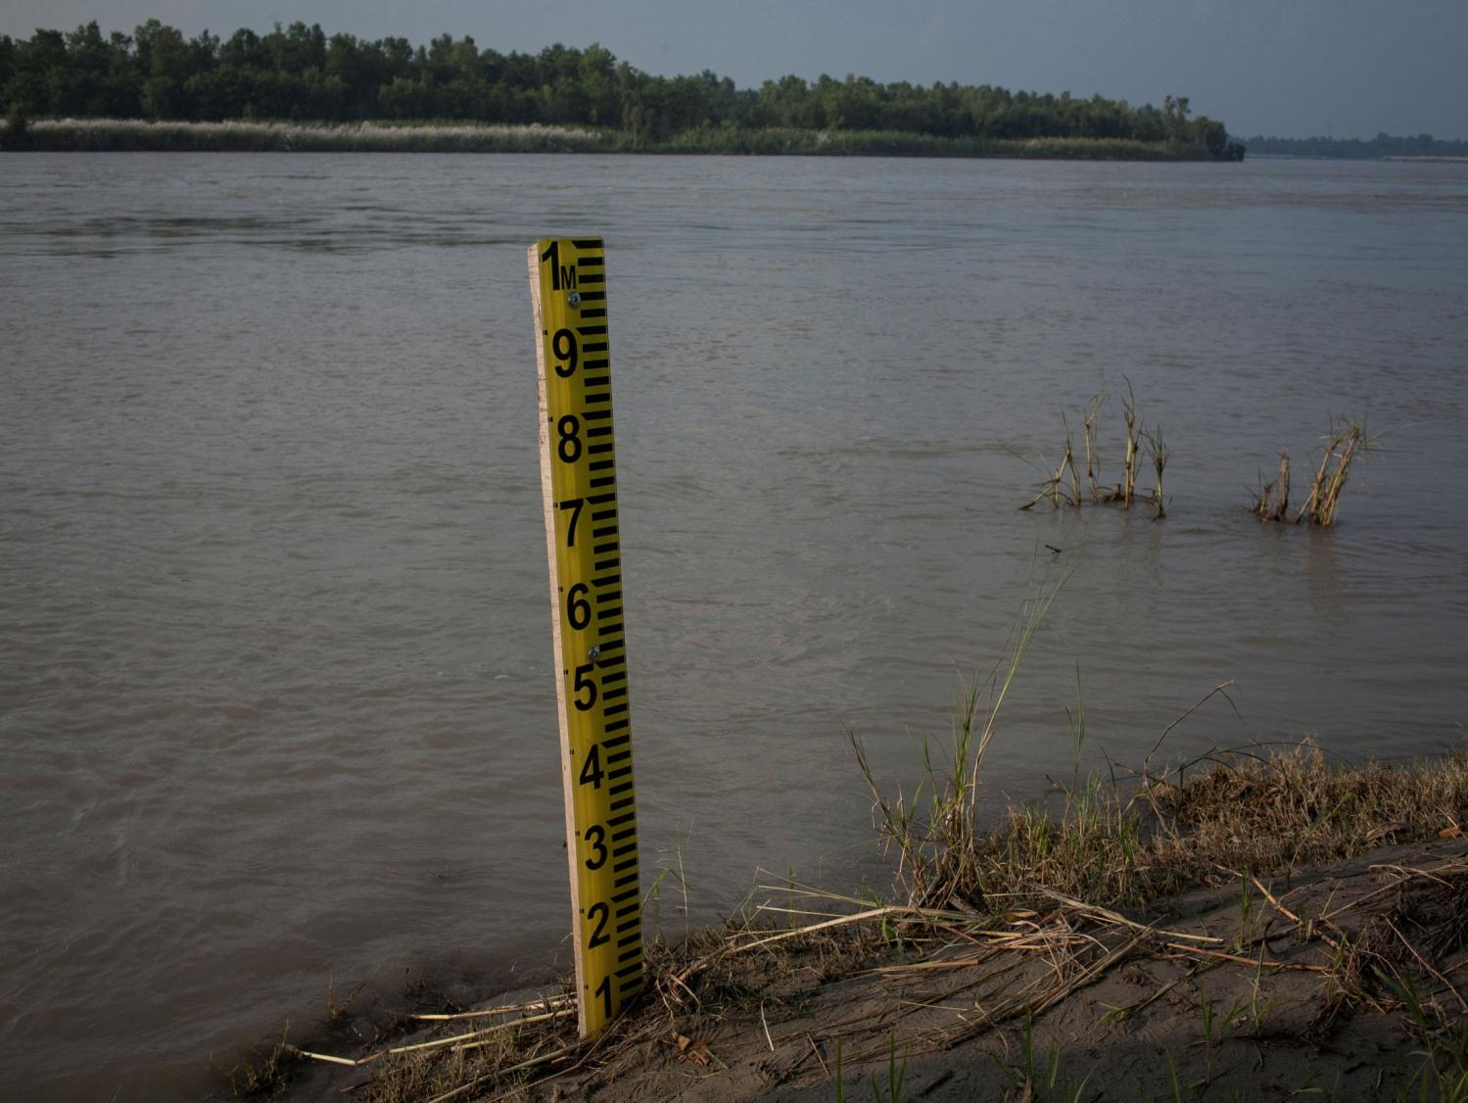
Hyogo Framework of Action 2005-2015
Risk/vulnerability/hazard assessment initiated by several organisations
Key Achievements
Priority II:
Know the Risk and Take Action
DesInventar data of disasters over last 37 years
SAHANA/DRR Portal initiated
Several community level early warning systems established
Regional level dialogue and information sharing
Risk assessment and DPR plans completed in 72 districts

Slide 6

Hyogo Framework of Action 2005-2015
NRRC Communications Group with BBC Media Action as technical lead
Key Achievements
Priority III:
Build Understanding and Awareness
DRR included in school curricula and disaster management degrees initiated
Public awareness activities at several levels
Large scale training activities activated by government and NGOs

Slide 7
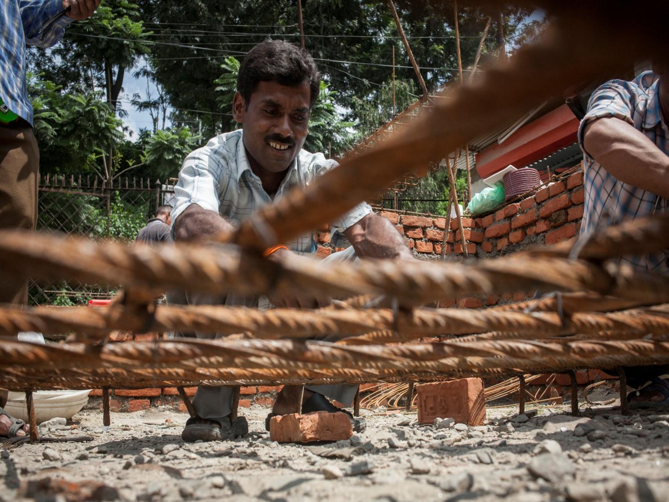
Hyogo Framework of Action 2005-2015
School and hospital safety initiatives (Flagship 1)
Key Achievements
Priority IV:
Reduce Underlying Risk Factors
Government and NGO initiated linkages between DRM and CRM
Risk sensitive land use planning initiated in Kathmandu Valley and other districts
Early recovery activities initiated in flood and earthquake affected areas
TIA retrofitting initiatives

Slide 8
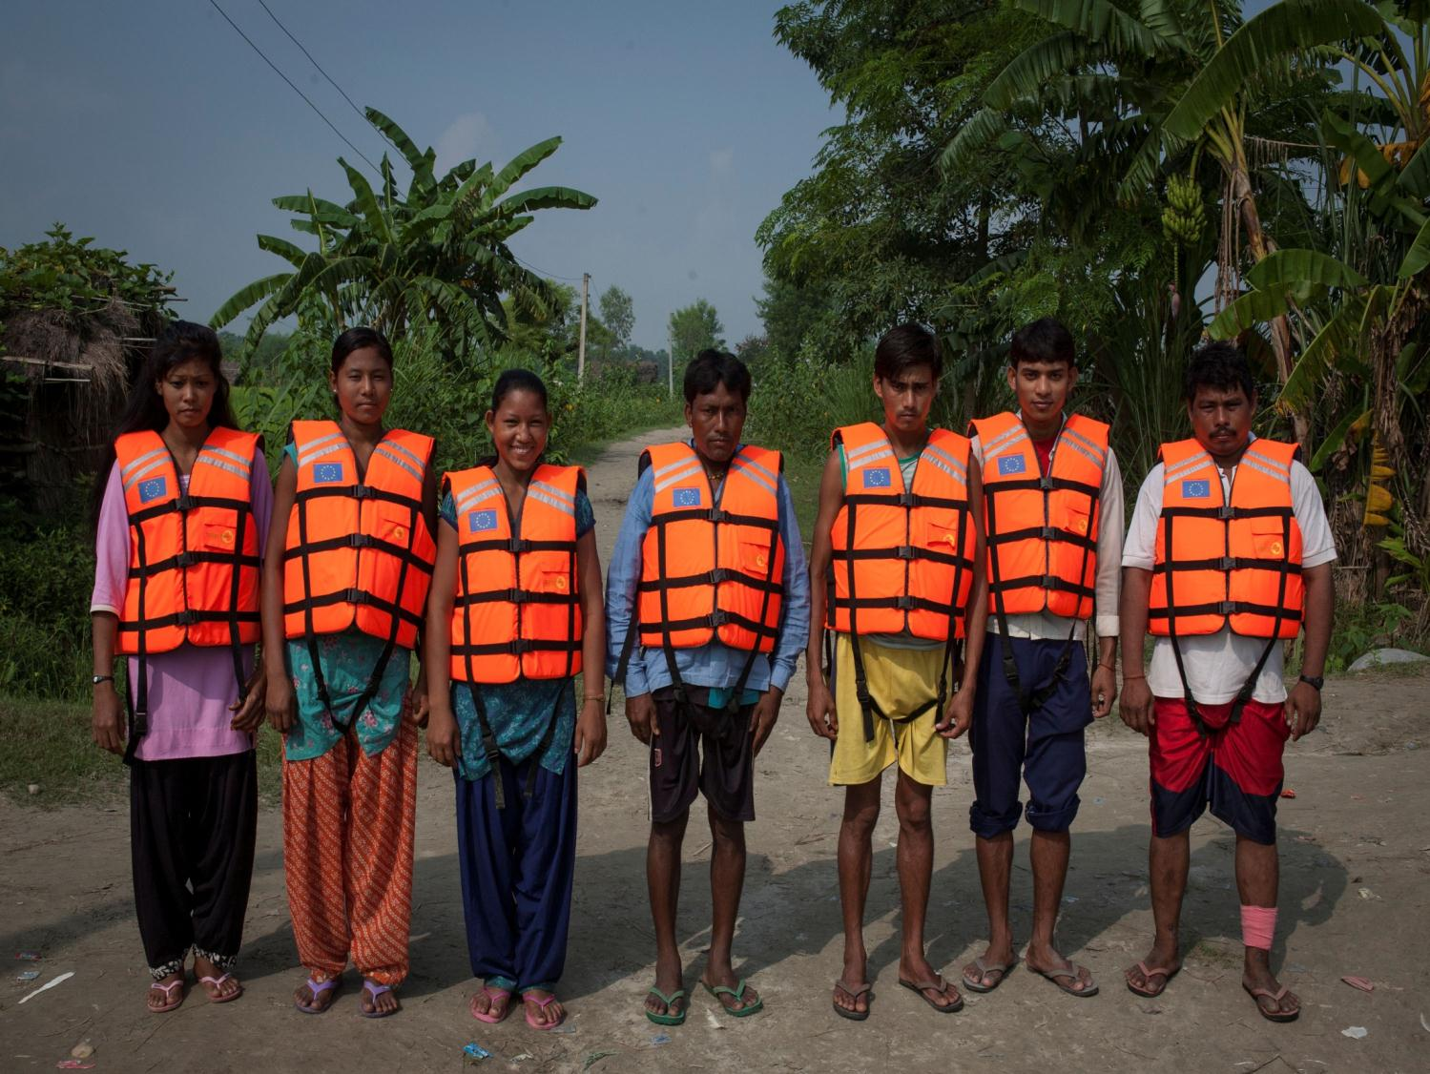
Hyogo Framework of Action 2005-2015
Provision of emergency funds
Key Achievements
Priority V:
Be Prepared and Ready to Act
DM capacity assessed and capacity development plan activities initiated by many agencies
Regular interactions amongst practitioners regarding DRM/CRM mainstreaming
Volunteers trained in First Aid and Search and Rescue at the national and local level
USAR Capacity Development
Establishment of national, regional and district EOCs
NDRF approved at MOHA and need endorsed by CNDRC

Slide 9
Post-Hyogo Framework
Objectives
  Engage wide range of stakeholders in the preparatory process in developing a Post HFA - 2015 Framework on DRR
  Review success and lessons learnt, identify challenges and opportunities on risk reduction, especially at national and local levels
  Deepen understanding and knowledge of issues imperative to making development initiatives resilient to the impact of natural disasters

Slide 10
Post -2015 framework on DRR
What are the major achievements/ successes ?
What three challenges in the implementation of the current HFA at national level ? Why ?
What are the DRR priorities that you wish to be addressed in the post -2015 framework on DRR at national and local levels ?

Slide 11
Post -2015 framework on DRR
What are the major achievements/ successes ?
What three challenges in the implementation of the current HFA at national level ? Why ?
What are the DRR priorities that you wish to be addressed in the post -2015 framework on DRR at national and local levels ?

Slide 12
Post HFA Plan
Effectively implement NSDRM
Update policies related to C/DRM and focus on capacity building
Strengthen institutional mechanisms and relations with private sector
Include C/DRM in school curricula, academic an training institutions
Strengthen coordination and information sharing
Strengthen Early Warning Systems

Slide 13
Post HFA Plan
Promote large scale media involvement
National level multi-hazard risk assessment
Mainstream C/DRM in planning, implementation and M&E
Strengthen post disaster response and recovery
Promote wider coverage of CBDRM/LDRM

Slide 14
Post HFA
Continuation of NRRC
Flagship 3 - Flood Management only in spite of KFM
Registration at DM Section of Member of Platform
Early Warning Automatic do exist - 23 rivers, 9 rivers to community level
LDRMP and LAPA - some confusion
More workout on Post HFA - More opinion has come
National Platform - need more wider
Post HFA Progress - Cross-cutting issue focus ? Gender, Environment
Resilience community and DRR Community - platform need more wider
Disaster Management - Annual Report need incorporate in progress
Need to care on Spare Standard in Priority one - 65 school retrofit completed
Global Platform - complementary report link with poverty, social inclusion, gender issue incorporation
Land use planning - various data available, need to consolidate in one portal, probably with GIS Database
NPDDR - those who has paid for registration ? Corporate Sector involvement ? Local level consultation link with FG4, CBDMC consultation,
Plans LDRMP/DDRMP Guideline - Need to transmit the National level data and initiation to local level - DRR Portal operationalize -
Include in FG5 - TTX, INSARAG, FTX and DPRP need to operationalize,
According to NSDRM - Reporting from concern Ministries - Coordination reporting from NPC as well.

Slide 15
Thank You

