Slide 1
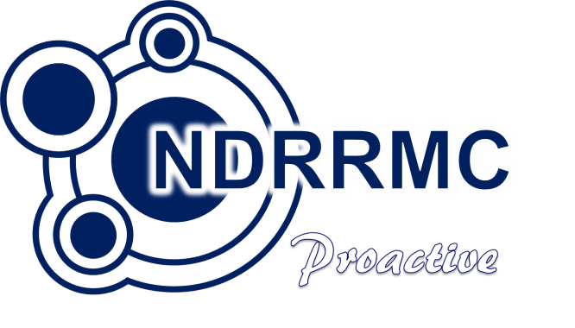
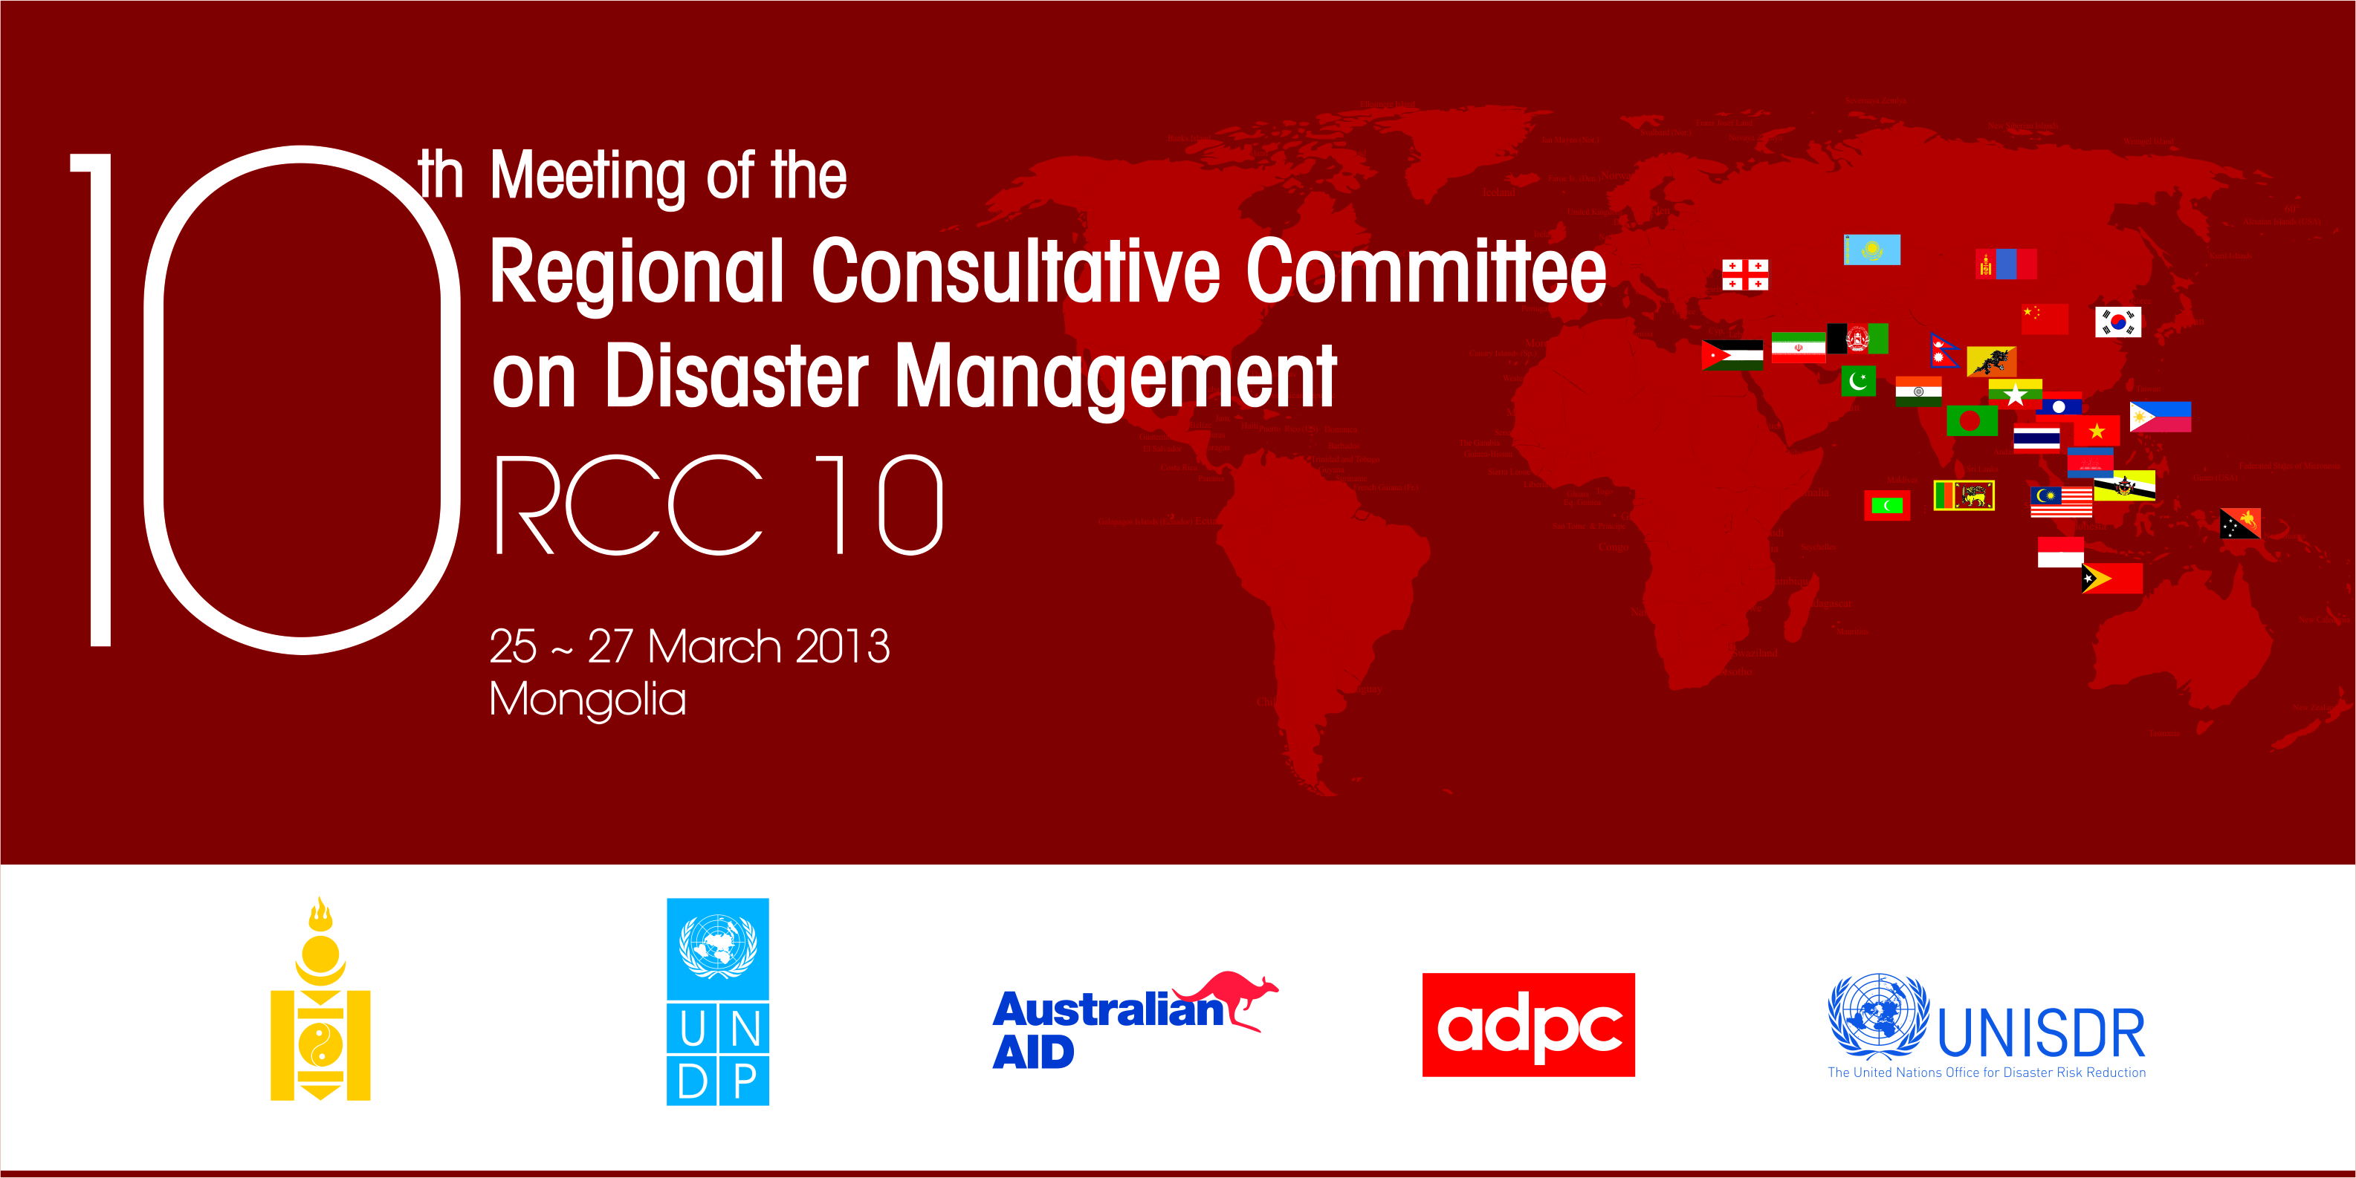
_______ ___ ________
___ _________
__ _________ ______
USec Eduardo D Del Rosario
Executive Director, NDRRMC
Philippines

Slide 2
____ __ ___________
_________
_______ __
_______ _____ ___ _
_________
Notes:
THIS PRESENTATION WILL COVER THE FF:
FIRST – AN OVERVIEW OF OUR SITUATION IN THE PAST TWO YEARS;
SECOND – A REVISITING OF THE LEGAL BASIS OF OUR POLICIES;
THIRD – A BRIEF DISCUSSION ON CURRENT DRRM EFFORTS; AND
FOURTH – THE CHALLENGES THAT WE MUST CONFRONT.

Slide 3
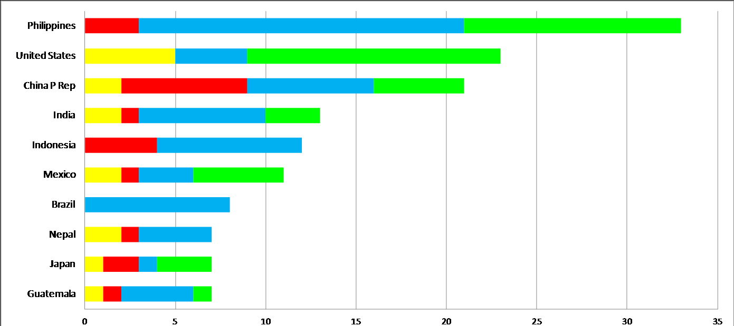
_ __ ______ __ ________ ______ __
PHILIPPINES
33
USA
23
CHINA
21
INDIA
13
INDONESIA
12
MEXICO
11
BRAZIL
8
NEPAL
7
JAPAN
7
GUATEMALA
7
Climatological
Geophysical
Hydrological
Meteorological
Annual Disaster Statistical Review 2011 (USAID/OFDA http://reliefweb.int/sites/reliefweb.int/files.pdf)
Notes:
THE PHILIPPINES RANKED NO. 1 IN THE TOP 10 COUNTRIES BY NUMBER OF REPORTED EVENTS IN 2011 ACCORDING TO THE USAID OFFICE FOR FOREIGN DISASTER ASSISTANCE. DURING THAT YEAR, THE COUNTRY WAS DOMINANTLY HIT BY HYDROLOGICAL AND METEOROLOGICAL HAZARDS, THE MOST NOTABLE OF WHICH WAS THE DEVASTATING TYPHOON SENDONG, HIGHLIGHTING OUR CONTINUING VULNERABILITY TO DISASTERS GIVEN OUR LOCATION IN THE PACIFIC RING OF FIRE AND BEING ALONG THE TYPHOON BELT.

Slide 4
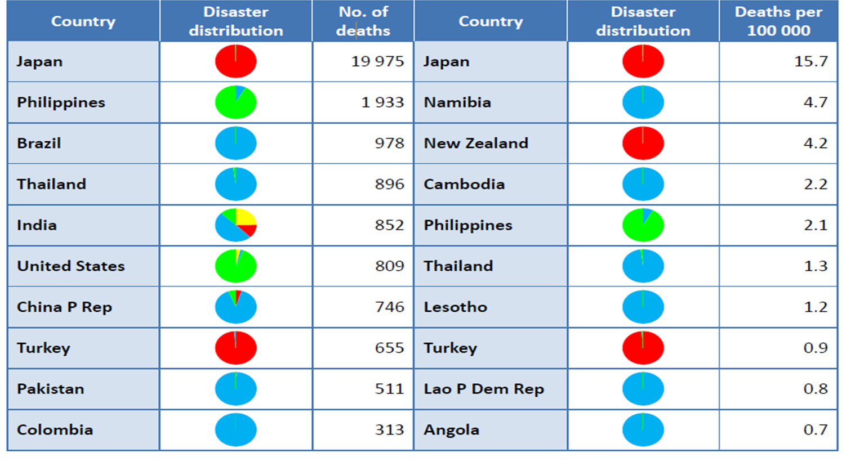
_ __ _____ __ ________ _________ __
Annual Disaster Statistical Review 2011 (USAID/OFDA http://reliefweb.int/sites/reliefweb.int/files.pdf)
Notes:
WE WERE ALSO NO. 2 IN TERMS OF DISASTER MORTALITY IN 2011, SECOND ONLY TO JAPAN WHICH LOST MORE CITIZENS DUE TO THE MARCH 11, 2011 EARTHQUAKE AND TSUNAMI THAT CLAIMED ALMOST TWENTY THOUSAND LIVES. HOWEVER, OUR MORTALITY RATE IS ONLY 5TH IN TERMS OF POPULATION DENSITY AT 2.1 DEATHS PER 100,000 POPULATION.

Slide 5
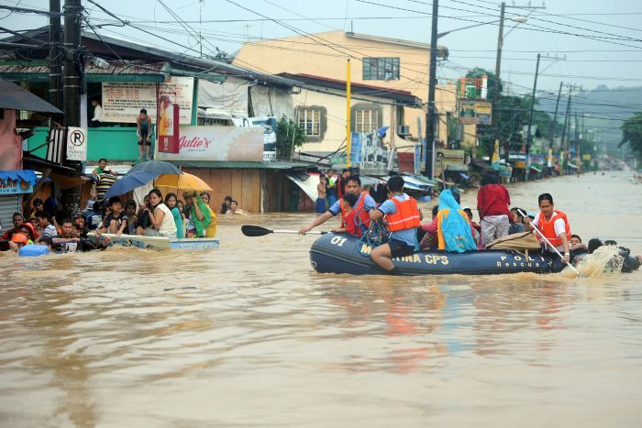
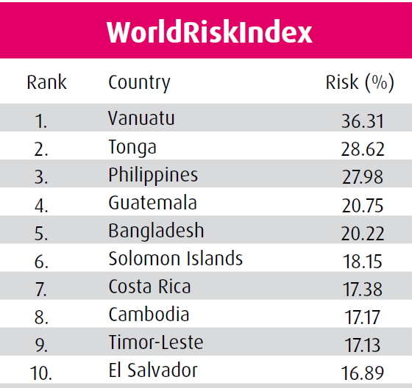
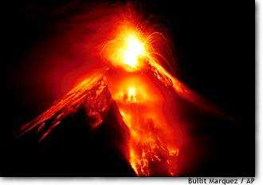
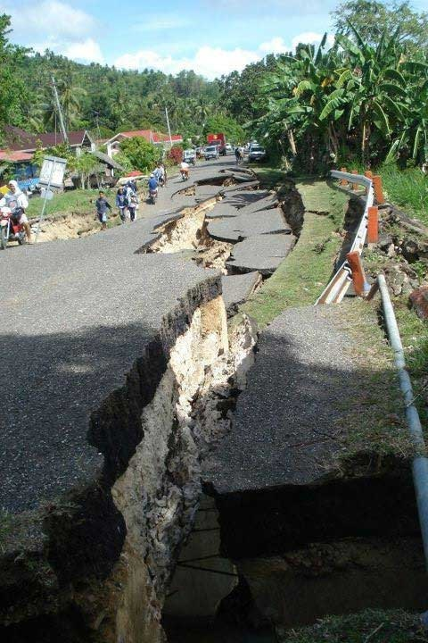
_ __ _____ __ ________ __ _______
World Risk Report 2012 (http://www.ehs.unu.edu/file/get/10487.pdf)

Slide 6
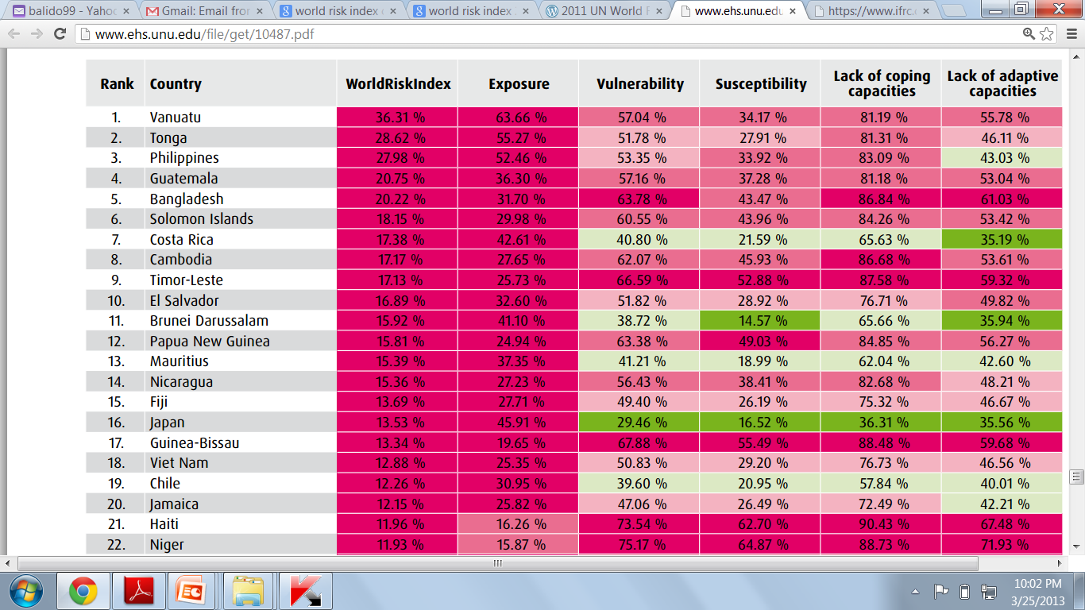
_ __ _____ __ ________ __ _______
World Risk Report 2012 (http://www.ehs.unu.edu/file/get/10487.pdf)

Slide 7
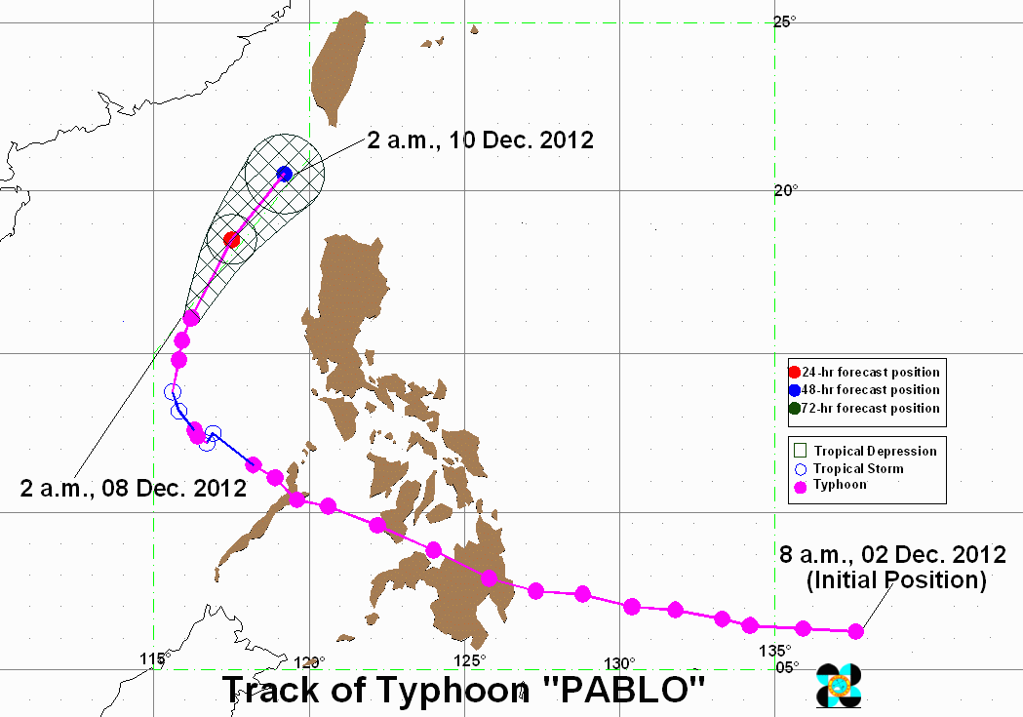
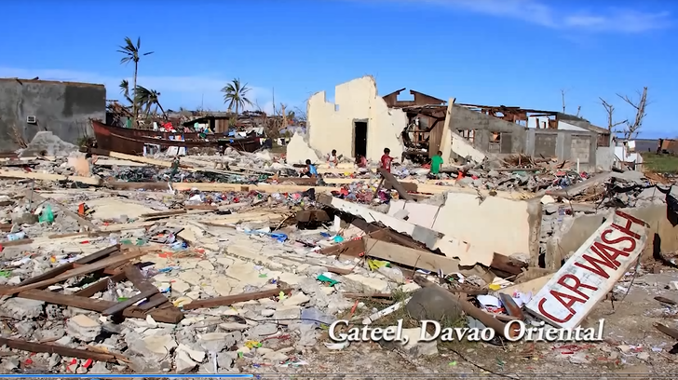
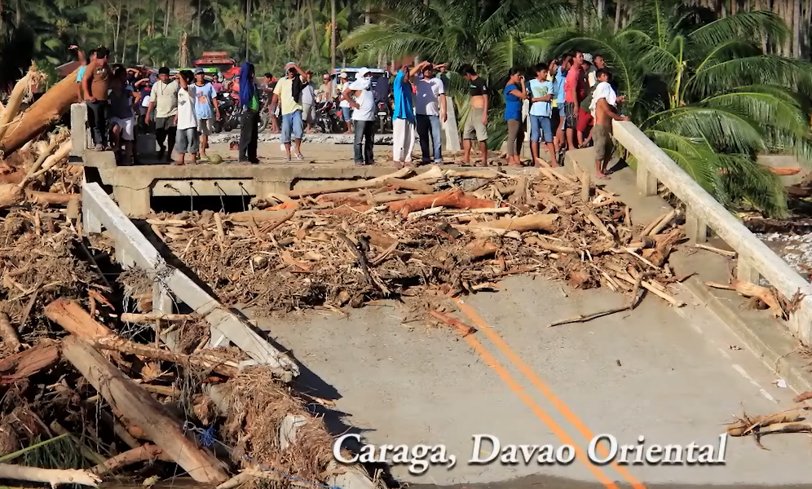
______ ____ _______
Effects
Casualties
Dead | 1,067
Injured | 2,668
Missing | 834
Damaged Houses | 216,817
Total Cost of Damages | $ 1B
Notes:
IN 2012, WE WERE HIT BY TYPHOON PABLO AND THIS SHATTERED ASSUMPTIONS ABOUT DISASTER IMPACTS ON AREAS THAT ARE NOT FREQUENTLY VISITED BY TYPHOONS PARTICULARLY IN MINDANAO.
WITH CASUALTIES REACHING MORE THAN 1000 DEAD, 834 STILL MISSING, TYPHOON PABLO ALSO CAUSED AN ESTIMATED FORTY P40B TOTAL DAMAGES. THIS INCIDENT TRIGGERED THE CHAIRPERSON OF THE NATIONAL COUNCIL TO CALL ALL OF US TO GATHER TODAY IN ORDER TO REVISIT DRRM IN THE LIGHT OF THE HARD LESSONS FROM THE CATASTROPHIC IMPACTS OF PABLO, ESPECIALLY, TO THE HARDEST HIT COMMUNITIES IN REGION XI.

Slide 8
_______ __
  “An Act Strengthening the Philippine Disaster Risk Reduction and Management System, Providing for the National Disaster Risk Reduction and Management Framework and Institutionalizing the National Disaster Risk Reduction and Management Plan, Appropriating Funds Therefor and for other Purposes”
Notes:
CONTEMPORARY EFFORTS IN DRRM EVOLVED FROM PRESIDENTIAL DECREE 1566 OF JUNE 1978 WHICH AIMED TO STRENGTHEN THE PHILIPPINE DISASTER CONTROL CAPABILITY AND ESTABLISH THE NATIONAL PROGRAM ON COMMUNITY DISASTER PREPAREDNESS.
OVER THE YEARS, THE BASIC PROVISIONS OF PD 1566 PROVED INSUFFICIENT, THUS LEADING TO THE PASSAGE OF REPUBLIC ACT 10121 IN MAY 2010.
RA 10121 IS NOW FOCUSED ON STRENGTHENING THE PHILIPPINE DISASTER RISK REDUCTION AND MANAGEMENT SYSTEM. IT LIKEWISE PROVIDES FOR THE ADOPTION OF A NATIONAL DISASTER RISK REDUCTION AND MANAGEMENT FRAMEWORK AND PLAN, AS WELL AS PROVIDING APPROPRIATION OF FUNDS.
8
Present Policies and Procedures for Disaster Risk Reduction in the Philippines

Slide 9
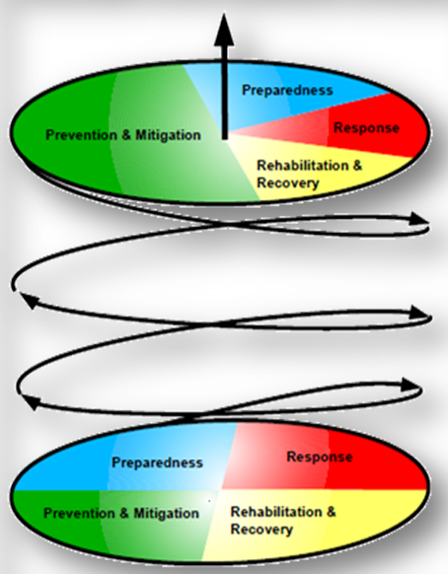
________
Safer, adaptive and resilient Filipino
communities toward sustainable development
RISK FACTORS
Hazards
Exposures
Vulnerabilities
Capacities
DRR and CCA in
Planning &
Implementation
Prevention &
Mitigation
Preparedness
Response
Rehabilitation &
Recovery
Notes:
IN COMPLIANCE TO RA 10121, THE COUNCIL ADOPTED ON JUNE 2011, THE NATIONAL DRRM FRAMEWORK, WITH THE VISION OF ATTAINING A “SAFER, ADAPTIVE AND DISASTER-RESILIENT FILIPINO COMMUNITIES TOWARDS SUSTAINABLE DEVELOPMENT”.
THE FRAMEWORK SHOWS THAT MITIGATING THE POTENTIAL IMPACTS OF RISKS, PREVENTING HAZARDS AND BEING PREPARED FOR DISASTERS WILL SUBSTANTIALLY REDUCE LOSS OF LIFE AND DAMAGES TO SOCIAL, ECONOMIC AND ENVIRONMENTAL SECTORS.
THE UPWARD MOTION INDICATED A BOTTOM-UP PARTICIPATORY PROCESS THAT THROUGH TIME, WILL ENHANCE OUR LEVEL OF AWARENESS, STRENGTHEN MULTI-STAKEHOLDER PARTNERSHIPS, AND ENCOURAGE POOLING OF RESOURCES.
THESE POSITIVE CHANGES WILL BE COMPLEMENTED BY MAINSTREAMING DRR AND CCA MEASURES INTO OUR NATIONAL AND LOCAL PLANS AS A MAJOR STEP TO REFOCUS OUR EFFORTS TOWARDS ACHIEVING OUR DEVELOPMENT GOALS.

Slide 10
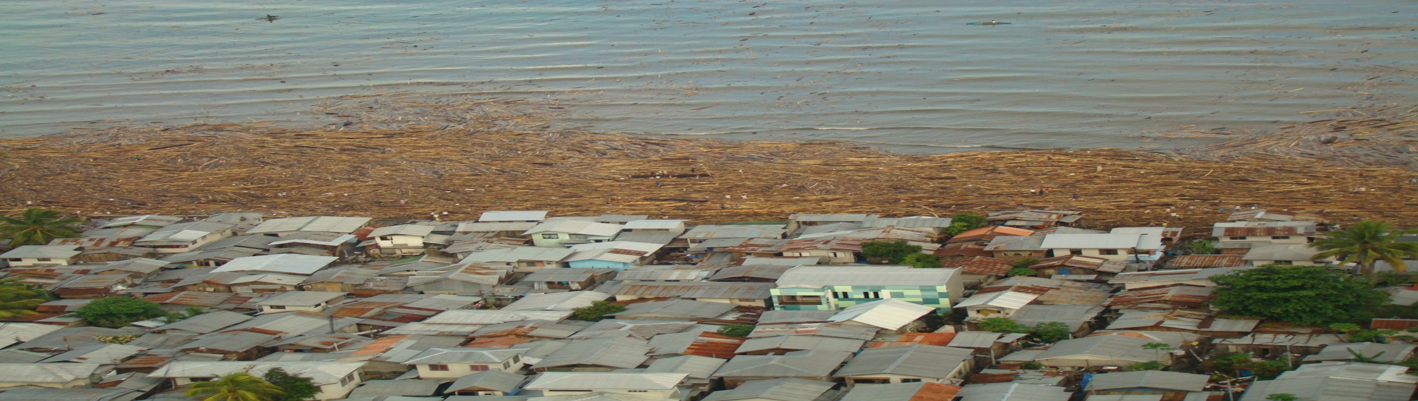
___
safer, adaptive & resilient
sustainable development
Prevention & Mitigation
Preparedness
Response
Rehabilitation & Recovery
Notes:
10
THE NDRRMC FURTHER CRAFTED THE NATIONAL DRRM PLAN COVERING THE PERIOD 2011 TO 2028 TO COINCIDE WITH THE IMPLEMENTING HORIZON OF THE NATIONAL CLIMATE CHANGE ACTION PLAN OF THE PHILIPPINES.
THE LONG TERM GOALS OF THE PLAN CORRESPOND TO THE 4 THEMATIC AREAS OF: PREVENTION AND MITIGATION; PREPAREDNESS; RESPONSE AND REHABILITATION AND RECOVERY EFFORTS.
10

Slide 11
______ _______
National Disaster Risk Reduction and Management Council
17 Regional Disaster Risk Reduction and Management Councils
81 Provincial Disaster Risk Reduction and Management Councils
122 City Disaster Risk Reduction and Management Councils
1, 511 Municipal Disaster Risk Reduction and Management Councils
42,026 Barangay Disaster Risk Reduction and Management Committees
Notes:
RA 10121 is implemented by the NDRRMC through its support network as shown...
The structure of the national council is replicated in all regions, whereby the Regional DRRMCs are now chaired by the Regional Director of OCD, except for two Regional DRRMCs, ARMM and NCR. ARMM is chaired by its Governor and NCR is chaired by the MMDA Chairman
From the regional level, local DRRMCs – provincial, city, municipal levels – have their own councils formed and chaired by their respective local chief executives.
At the barangay level, the BDRRM committee is assumed by the existing Barangay Development Council.

Slide 12
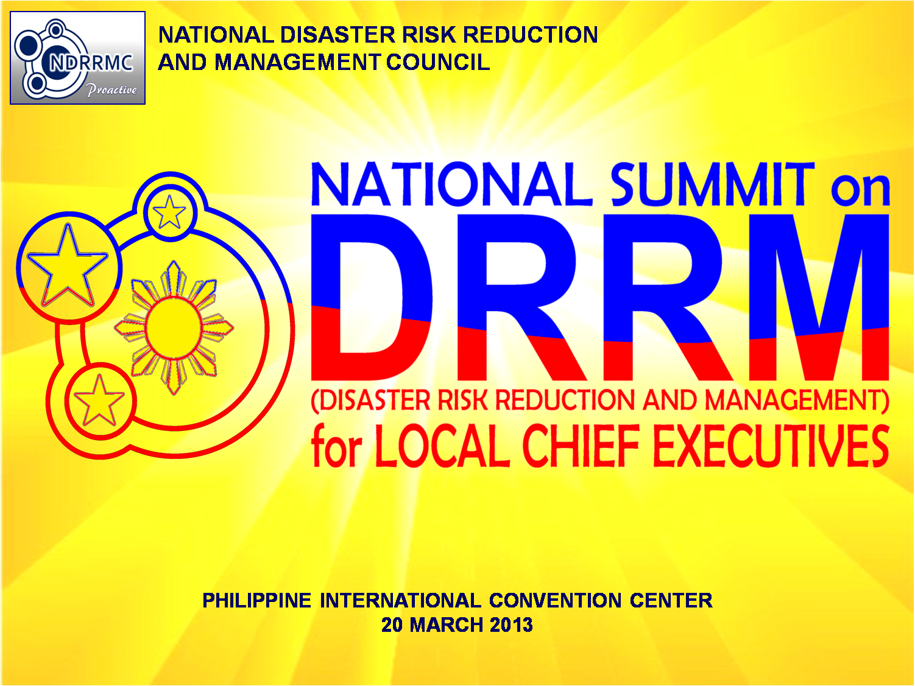

Slide 13
National Summit on DRRM Output
  Significant LCE roles & responsibilities in DRRM
  DRRM tools to be integrated into the Local DRRM Plans
  DRRM Learning Experiences
Joint Memo Circular on the Allocation & Utilization of the Local DRRM Fund
LCE Declaration of Commitment to DRRM Action
Notes:
IN RESPONSE TO ACTUAL CALAMITIES AND DISASTERS, WE IMMEDIATELY MOBILIZE SEARCH, RESCUE AND HEALTH SERVICES.
FOR AFFECTED CITIZENS, WE PROVIDE TEMPORARY SHELTER, WATER, SANITATION AND HYGIENE. FINANCIAL ASSISTANCE IS ALSO GIVEN TO CALAMITY VICTIMS WHILE EFFICIENT MANAGEMENT OF EVACUATION CENTERS IS ALWAYS ASPIRED IN ORDER TO MINIMIZE DISRUPTION TO THE WAY OF LIFE OF AFFECTED COMMUNITIES.

Slide 14
__________ ____
_______________
  Integration of DRR & CCA into the Comprehensive Land Use & Development Plan
  Capacitating communities down to the barangay level
  Establishment of DRRM offices & facilities
  Involve all CSOs & other stakeholders in DRRM
Notes:
IN RESPONSE TO ACTUAL CALAMITIES AND DISASTERS, WE IMMEDIATELY MOBILIZE SEARCH, RESCUE AND HEALTH SERVICES.
FOR AFFECTED CITIZENS, WE PROVIDE TEMPORARY SHELTER, WATER, SANITATION AND HYGIENE. FINANCIAL ASSISTANCE IS ALSO GIVEN TO CALAMITY VICTIMS WHILE EFFICIENT MANAGEMENT OF EVACUATION CENTERS IS ALWAYS ASPIRED IN ORDER TO MINIMIZE DISRUPTION TO THE WAY OF LIFE OF AFFECTED COMMUNITIES.

Slide 15
____
  Identified important DRRM tools to be integrated into the Local DRRM Plans
    Hydro-Met Hazard Maps
    Geo-Hazard Maps
    Early Warning System
    Incident Command System
    Rapid Needs Assessment
    Post Disaster Needs Assessment
    Cluster Approach in Response Mgt
Notes:
IN RESPONSE TO ACTUAL CALAMITIES AND DISASTERS, WE IMMEDIATELY MOBILIZE SEARCH, RESCUE AND HEALTH SERVICES.
FOR AFFECTED CITIZENS, WE PROVIDE TEMPORARY SHELTER, WATER, SANITATION AND HYGIENE. FINANCIAL ASSISTANCE IS ALSO GIVEN TO CALAMITY VICTIMS WHILE EFFICIENT MANAGEMENT OF EVACUATION CENTERS IS ALWAYS ASPIRED IN ORDER TO MINIMIZE DISRUPTION TO THE WAY OF LIFE OF AFFECTED COMMUNITIES.

Slide 16
___ __ _ ______
  Risk Assessment is a MUST
  Rehabilitation must be undertaken even before a potential disaster may happen
  Build capacities down to the grassroots level
  Involve all stakeholders in DRRM
  Establish and rehearse localized early warning systems
  Work 24-7 especially during RESPONSE operations
  Establish proven and tested DRRM protocols
Notes:
IN RESPONSE TO ACTUAL CALAMITIES AND DISASTERS, WE IMMEDIATELY MOBILIZE SEARCH, RESCUE AND HEALTH SERVICES.
FOR AFFECTED CITIZENS, WE PROVIDE TEMPORARY SHELTER, WATER, SANITATION AND HYGIENE. FINANCIAL ASSISTANCE IS ALSO GIVEN TO CALAMITY VICTIMS WHILE EFFICIENT MANAGEMENT OF EVACUATION CENTERS IS ALWAYS ASPIRED IN ORDER TO MINIMIZE DISRUPTION TO THE WAY OF LIFE OF AFFECTED COMMUNITIES.

Slide 17
____ ___ _______ __ ___ _________
__________ __ ___
  To serve as a guide to LGUs in the allocation & use of the LDRRM Fund
  To enhance transparency & accountability in the use of LDRRM Fund.
Notes:
IN RESPONSE TO ACTUAL CALAMITIES AND DISASTERS, WE IMMEDIATELY MOBILIZE SEARCH, RESCUE AND HEALTH SERVICES.
FOR AFFECTED CITIZENS, WE PROVIDE TEMPORARY SHELTER, WATER, SANITATION AND HYGIENE. FINANCIAL ASSISTANCE IS ALSO GIVEN TO CALAMITY VICTIMS WHILE EFFICIENT MANAGEMENT OF EVACUATION CENTERS IS ALWAYS ASPIRED IN ORDER TO MINIMIZE DISRUPTION TO THE WAY OF LIFE OF AFFECTED COMMUNITIES.

Slide 18
DECLARATION OF COMMITMENT BY LOCAL CHIEF EXECUTIVES to DRRM Action
“We, the Local Chief Executives of the Philippines, as the lead actors of Disaster Risk Reduction and Management in our own localities, do hereby declare our commitment to work with the National Government and other stakeholders in:
Preventing and mitigating the adverse impacts of hazards and related disasters affecting our communities;
Preparing and building the capacities of our communities to effectively anticipate, respond to, and recover from the impacts of likely, imminent or current hazard events or conditions;
Responding to disasters and ensuring the preservation of the lives and properties of the communities;
Restoring our communities’ livelihood and improving our local facilities and infrastructures in the aftermath of a disaster;
Maximizing the application of all tools in DRRM;
Notes:
This commitment highlights the LCEs’ dedication to work with the National Government to put DRRM as among, from disaster. I would like everyone to read together this draft commitment to DRRM action, which THE lceS will ALL officially address during the National Summit on March 20 2012 before His Excellency, President Aquino.
“We, the Local Chief Executives of the Philippines, as the lead actors of Disaster Risk Reduction and Management in our own localities, do hereby declare our commitment to work with the National Government and other stakeholders in:
preparing and building the capacities of our communities to effectively anticipate, respond to, and recover from the impacts of likely, imminent or current hazard events or conditions;
preventing and mitigating the adverse impacts of hazards and related disasters affecting our communities;
restoring our communities’ livelihood and improving our local facilities and infrastructures in the aftermath of a disaster; and
responding to disasters and ensuring the preservation of the lives and properties of the communities

Slide 19
6. Strengthening partnerships with CSOs and humanitarian organizations in DRRM efforts.
Mainstreaming DRRM and Climate Change Adaptation in all local development plans;
Incorporating DRRM in the normal delivery of services by the local government;
9. Serving our people with utmost unity, cooperation and mutual assistance regardless of political and religious affiliation;
10. Securing and safeguarding our citizens and environment against natural and human induced calamities as a moral obligation.
To ensure the fulfillment of the foregoing commitments, we further commit the formulation of DRRM and CCA Plans in consultation with all stakeholders.
Adopted by consensus this 20th day of March 2013 in Manila, Philippines.
Notes:
This commitment highlights the LCEs’ dedication to work with the National Government to put DRRM as among, from disaster. I would like everyone to read together this draft commitment to DRRM action, which THE lceS will ALL officially address during the National Summit on March 20 2012 before His Excellency, President Aquino.
“We, the Local Chief Executives of the Philippines, as the lead actors of Disaster Risk Reduction and Management in our own localities, do hereby declare our commitment to work with the National Government and other stakeholders in:
preparing and building the capacities of our communities to effectively anticipate, respond to, and recover from the impacts of likely, imminent or current hazard events or conditions;
preventing and mitigating the adverse impacts of hazards and related disasters affecting our communities;
restoring our communities’ livelihood and improving our local facilities and infrastructures in the aftermath of a disaster; and
responding to disasters and ensuring the preservation of the lives and properties of the communities

Slide 20
_________
  Governance
  Accountability
  Responsibility
Notes:
IN RESPONSE TO ACTUAL CALAMITIES AND DISASTERS, WE IMMEDIATELY MOBILIZE SEARCH, RESCUE AND HEALTH SERVICES.
FOR AFFECTED CITIZENS, WE PROVIDE TEMPORARY SHELTER, WATER, SANITATION AND HYGIENE. FINANCIAL ASSISTANCE IS ALSO GIVEN TO CALAMITY VICTIMS WHILE EFFICIENT MANAGEMENT OF EVACUATION CENTERS IS ALWAYS ASPIRED IN ORDER TO MINIMIZE DISRUPTION TO THE WAY OF LIFE OF AFFECTED COMMUNITIES.

Slide 21


Thank you & Mabuhay!!!

