Slide 1
Contributions of the UN Country Team to DRR and CCA in Maldives
Consultative Leadership Workshop for the Development of the Strategic National Action Plan for Disaster Risk Reduction and Climate Change Adaptation,
19 -20 August 2009
Mohamed Inaz,
UNDP

Slide 2
DRR & CCA – UN Support
The 2004 tsunami heightened the need for urgency in mainstreaming and integrating environmental protection and risk-management measures in regular development programmes and addressing longstanding environmental issues.
Environment Management and Disaster Risk Reduction is one of the three key areas of cooperation contained within the UNDAF in the Maldives for the period 2008-2010.
UN-supported programmes aim
to improve access to environmental services and strengthen national capacities, including local communities in environmental management and disaster risk reduction and
to enable communities enjoy improved access to environmental services and are more capable of protecting the environment and reducing vulnerability and disaster risks with enhanced disaster management capacity

Slide 3
DRR & CCA – UN Support
The UN system has been a partner of the Maldives in environment management, disaster risk reduction, including climate change adaptation.
The UN-supported programmes have been towards creating the necessary enabling policy environment, mainstreaming climate change and DRR into national priorities, policies and plans, and building capacities of the nation.

Slide 4
UN Agencies Support
UNDP Maldives has been assisting the formulation of plans to address vulnerability, mitigation and adaptation to climate change, and by enhancing related capacities.
This is in addition to the UNDP assistance to the GoM in addressing other environmental issues such as conservation of biological diversity and support to disaster preparedness and risk reduction efforts from the national down to the community level.

Slide 5
UNDP
Some of the key achievements of GoM-UNDP partnership in past five years (specifically on environment) are:
Development of the National Adaptation Programme of Action (NAPA)
The formulation of National Solid Waste Management Policy
The formulation of National Energy Policy
Piloting a renewable energy system on an island
Undertook the first initiative of its kind project on Renewable Energy Technology Development and Application
National Capacity Self Assessment

Slide 6
UNDP
Mainstreaming of biodiversity conservation into national and sectoral policies
Increased systemic, institutional and individual capacities to better address environmental issues
Awareness building on environmental issues through all the projects
Development of a National Strategy and Action Plan drafted for Mangroves for the Future
On-going thriving works such as the pilot project of Atoll Ecosystem-based Conservation of Biodiversity in Baa Atoll.
Developing a project on Integrating Climate Change in to Resilient Island Planning

Slide 7
UNDP
Main objective of UNDP’s DRM project in the Maldives is capacity building and institutional strengthening for DRR.
Some of the past Key Achievements:
Support to establishment & capacity building of NDMC
Community based disaster preparedness plans developed in 39 Islands across 7 Atolls; conducted simulation exercises in 2 Atolls
Publication of Disaster Risk Profile in Maldives covering 1,039 islands
19 island communities sensitized to basic climate change & DM issues, and vulnerabilities were assessed.
DRR gradually being integrated in development planning and key policies as a result of risks assessments and capacity development activities.
Climate change integrated into the CBDP process
Enhanced capacities of National Meteorological Centre for prediction, analysis, and dissemination of meteorological phenomena
Ongoing work on DRR integration into the school sector (including curriculum & school DM planning) – creating greater awareness and commitment from education sector on DRR mainstreaming

Slide 8
UNICEF
UNICEF will continue to promote the expansion of environmental education activities and ensure the full integration of an Environmental Toolkit into the national Environmental Studies curriculum. The aim is to heighten awareness of environmental issues country wide, particularly amongst young people, instilling stewardship of environment at an early age and creating a generation of active advocates on environmental issues.
UNICEF will also focus on ensuring sustainable management of water supplies in the new country programme cycle. This means enabling communities to effectively operate and maintain the sewerage systems, promoting community ownership of the systems and developing individual opportunity through employment.

Slide 9
UNICEF
Some Key Achievements
Rainwater harvesting kits to households & Communities
RO Plants for the islands
Developing Water Quality Standards
Installation of vaccuum sanitation systems
Environmental education
primary schools across the country provided with Environmental Education resources and toolkits
E-Learning course on Environmental Education developed for primary teachers
Training package developed for trainers and teachers on Environmental Education
Training manual on school sanitation and hygiene for school health assistants and teachers developed

Slide 10
WHO
On environment management:
Technical support for development of rainwater harvesting guidelines;
Technical support to determine the quality of drinking water and training on testing materials
Support for Procurement of drinking water testing materials
Technical support to prepare profile on Occupational health
Support for training workshop for proper handling and safe management of chemicals in garages at Male‘
Technical support for the development of Water Master Plan
Technical support for the development of Water Act
Support for field training to sector professionals from 6 islands (north and south) on various aspects of water, sanitation and health
Technical support to finalize Guidelines for School Water, Sanitation and Hygiene.

Slide 11
WHO
On Disaster Risk Reduction:
Training programmes for disaster preparedness in schools
Training Course on Disaster Management in Maldives (conducted by ADPC)
Fire and rescue services and evacuation protocols training in six provinces and Male;
Community-based first aid training course in two provinces; and
Trainings on “Safe Hospitals, During Emergencies” in two Atoll Hospitals.

Slide 12
Non-resident UN Agencies
UNEP has also been active in assisting the GoM develop environmental policies and plans such as the recent National Environment Action Plan IV.
OHCHR, together with resident UN agencies, have supported the international and national advocacy on the human rights dimension of climate change.
There is collaboration with the UNISDR in addressing disaster risk management in Maldives.

Slide 13
DRR & CCA – UN Support
The UN system has been a partner of the Maldives in environment management, disaster risk reduction, including climate change adaptation.
The UN-supported programmes have been towards creating the necessary enabling policy environment, mainstreaming climate change and DRR into national priorities, policies and plans, and building capacities of the nation.

Slide 14
Thank you

Slide 15
Climate Change status in Maldives
Threats:
Sea level rise
Precipitation
Temperature
Extreme events

Slide 16
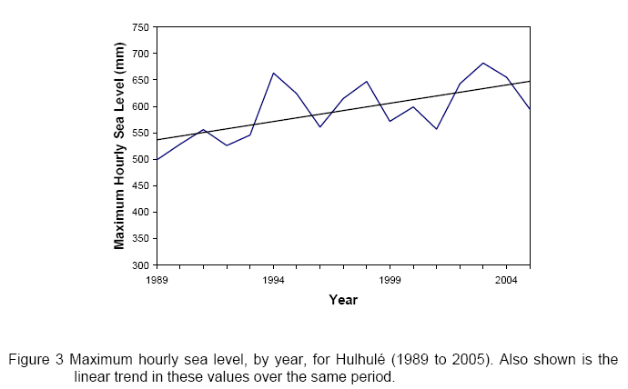
Climate Change status in Maldives
Sea Level Rise
Notes:
The global mean sea level rose 10 to 20cm during the 20th century at the rate of 1to 2mm/year.
Future sea level is projected to rise within the range of 9 to 88cm between 1990 and 2100. (under all SRES)
The projected average rate of increase is 5mm/year, with a range of 2 to 9mm/year (IPCC 2001)
For Maldives, the observed long term trend in relative sea level for Hulhulé is 1.7mm/year
The maximum hourly sea level is increasing by approximately 7mm/year, a rate far in excess of the observed local and global trends in mean sea level.
For Hulhulé an hourly sea level of 70cm above mean sea level (MSL) is currently a 100-year event. It will likely be at least an annual event by 2050.
16

Slide 17
Climate Change status in Maldives
Vulnerabilities:
Land, beach and human settlements
Critical infrastructure
Tourism
Fisheries
Human health
Water resources
Agriculture and food security
Coral reef biodiversity
Notes:
17

Slide 18
Projects
Sea Level Rise
1 | Integration of Future Climate Change Scenarios in the Safer Island Strategy to Adapt Sea Level Rise and Extreme Weather Risks Associated with Climate Change
2 | Coastal Protection of Safer Islands to Reduce the Risk from Sea Induced Flooding and Predicted Sea Level Rise
3 | Coastal Protection of Male' International Airport to Reduce the Risk from Sea Induced Flooding and Predicted Sea Level Rise
4 | Enhance adaptive capacity to manage climate change related risks to fresh water availability by appropriate technologies and improved storage facilities
5 | Enhance adaptive capacity to manage climate change related risks to fresh water availability by appropriate wastewater treatment technologies
6 | Increase the resilience of local food production through enhancing the capacity of farmers, local communities to address food security issues caused by climate change and climate variability
Notes:
18

Slide 19
7 | Improve the health status of the population by the prevention and management of vector-borne diseases caused by changes in temperature and flooding due to extreme rainfall.
8 | Improve resilience of Island communities to climate change and variability through sustainable building designs
9 | Investigating alternative live bait management, catch, culture and holding techniques in the Maldives to reduce vulnerability of the tuna fishery sector to the predicted climate change and variability.
10 | Improve the design and construction of access infrastructure in Maldives to increase the resilience of access infrastructure and island beaches to climate change.
11 | Increase resilience of coral reefs to reduce the vulnerability of islands, communities and reef dependant economic activities to predicted climate change.

