Slide 1
The Sasakawa Award
Supporting Documents

Slide 2
15-20% of the world’s population are persons with disabilities.
World Report on Disability, 2011

Slide 3
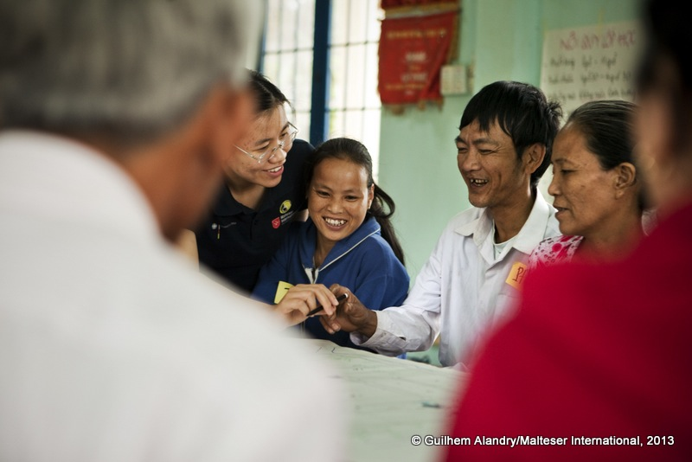
Mr Phuc contributes to flood risk mapping in his village in Vietnam

Slide 4
‘States Parties shall take […] all necessary measures to ensure the protection and safety of persons with disabilities in situations of risk, including […] the occurrence of natural disasters.’
UN Convention on the Rights of Persons with Disabilities, Article 11.

Slide 5
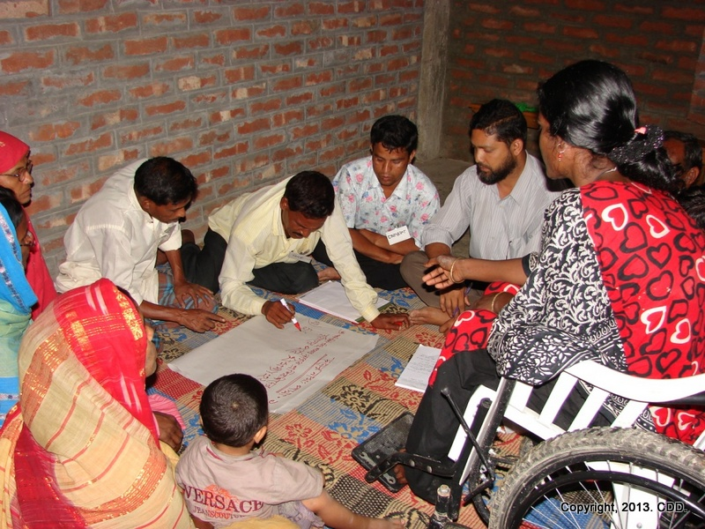
Ms Kajol Rekha facilitating community risk mapping in her village, Bangladesh.

Slide 6
‘The impact on persons with disabilities and the extent to which disasters contribute to disability is an area that needs to be studied further.’
Disability at a Glance, 2011

Slide 7
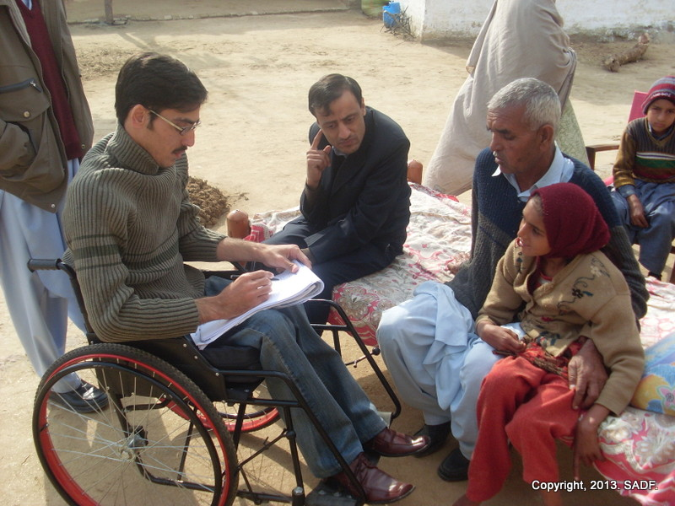
Collecting data on persons with disabilities after the Pakistan earthquake.

Slide 8
58% of persons with disabilities have never been involved in any DRR activities in their community.
Household survey on disability and disasters, Indonesia. ASB & University of Sydney, 2014

Slide 9
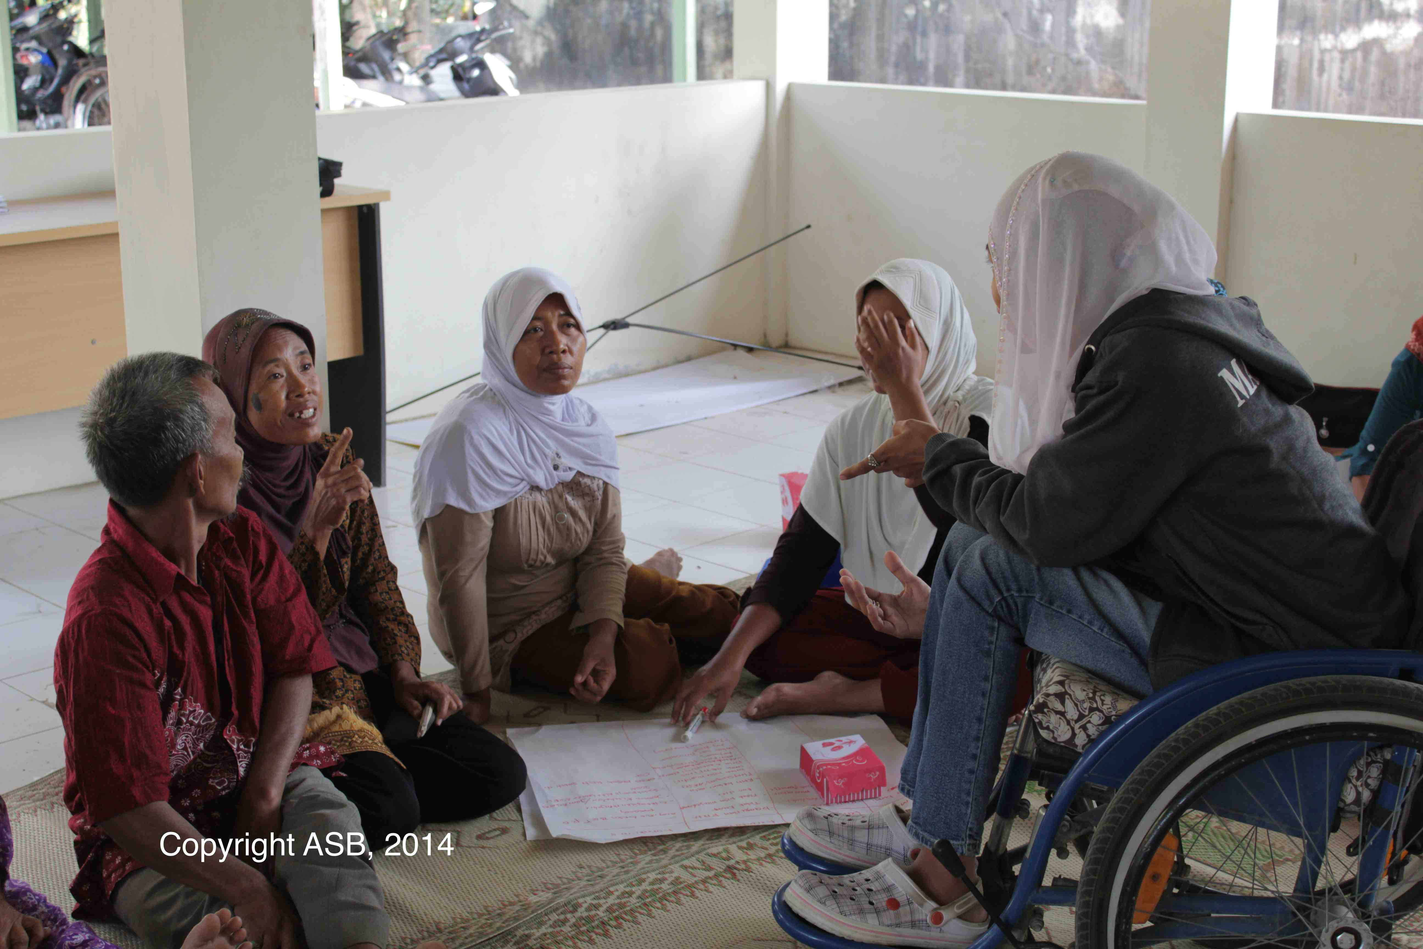
Hazard, vulnerability and capacity assessment led by person with disabilities, Indonesia.

Slide 10
63% of persons with disabilities reported needing assistance evacuating.
Household survey on disability and disasters, Indonesia. ASB & University of Sydney, 2014

Slide 11
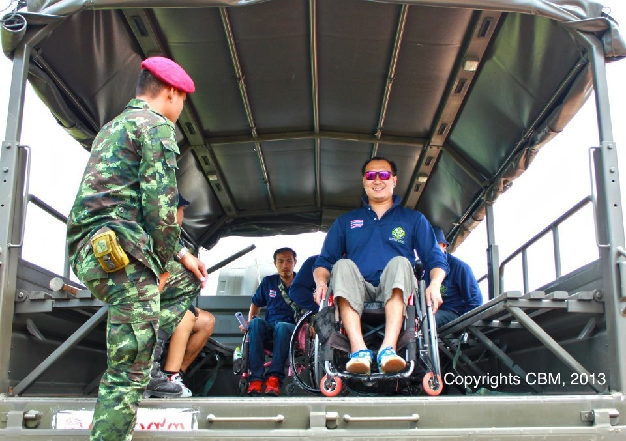
Persons with disabilities join as volunteers in disaster simulation exercise, Thailand.

Slide 12
‘I hope people with disability can be active in DRR and that there are regulations ensuring our access and participation.’
Ms Krisnawati, women with hearing impairment, Indonesia.

Slide 13
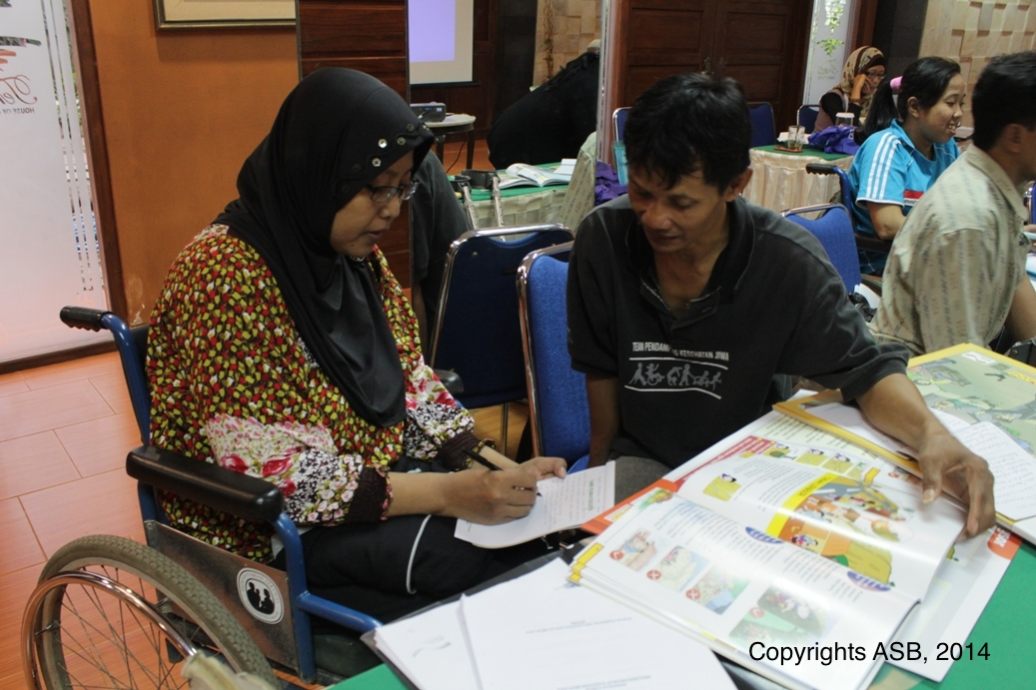
Disabled People’s Organisation representatives in DRR facilitation capacity building workshop, Indonesia.

Slide 14
‘In Pakistan we have seen the success of disability-inclusive CBDRM with 150 persons with disabilities evacuated by community members during the
recent floods.’
South Asian Disability Forum, 2014.

Slide 15
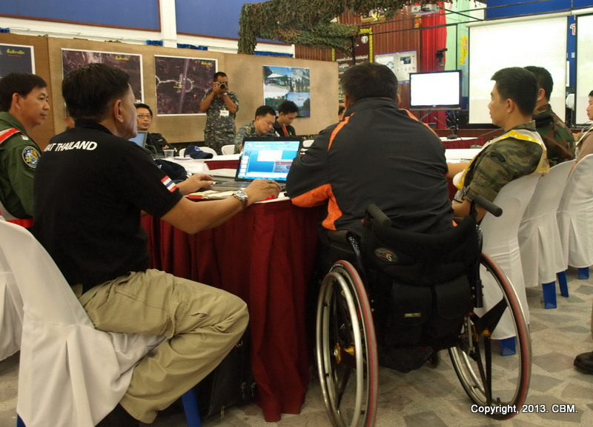
Mr. Bhuparat, Director of the Thai Council of Persons with Disabilities, providing inputs to the evacuation Command Unit, Thailand.

Slide 16
‘Previously the local elected representative did not give any importance to our opinions.
They did not even consider that we should be
consulted.
But after being active as a self-help group and
becoming members of Ward Disaster Management
Committees, we are now valued and our opinions
sought. As a group we have stronger voice’.
Person with disability and self-help group member, Pakistan.

Slide 17
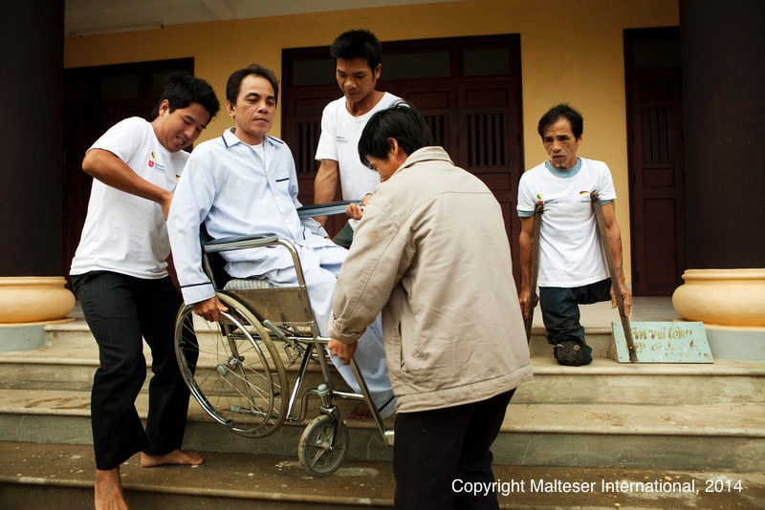
Mr Nhung Dao looking on his brother Dao is evacuated by a rescue team during a simulation, Vietnam.

Slide 18
57% of persons with disabilities reported difficulties in accessing DRR information.
Household survey on disability and disasters, Indonesia. ASB & University of Sydney, 2014

Slide 19
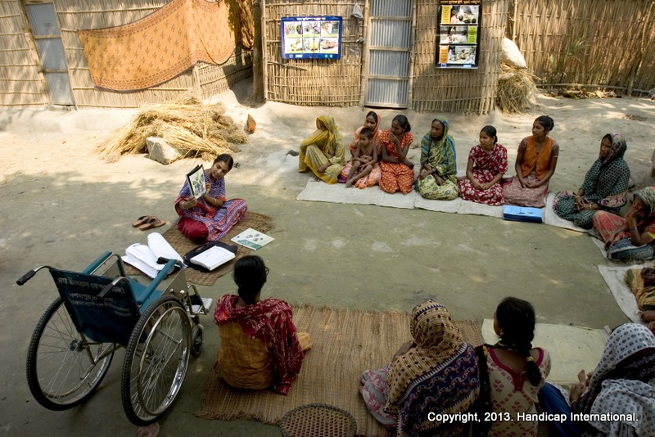
Disability-inclusive DRR community-based learning with women in Nepal.

Slide 20
HFA2 engagement and participation

Slide 21
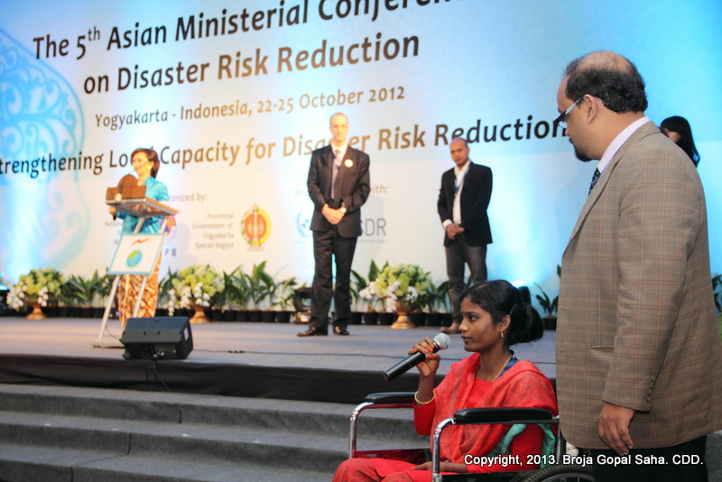
Ms Kajol Rekha , 5th AMCDRR, Indonesia.

Slide 22
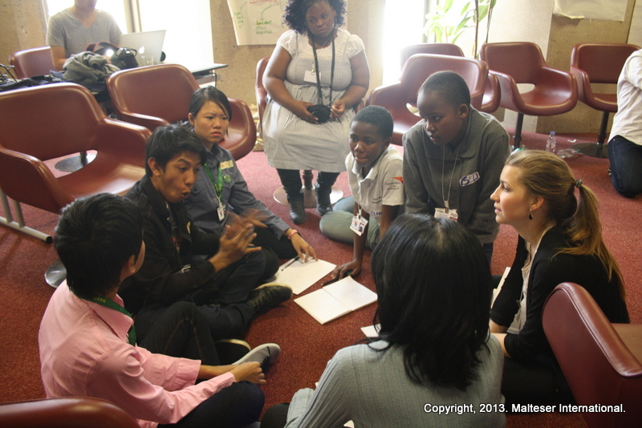
Deaf youth from Indonesia facilitating preparatory session with children preparing for the Children’s featured event at the Global Platform, 2013.

Slide 23
Pacific humanitarian workshop to strengthen disaster response, Suva.

Slide 24
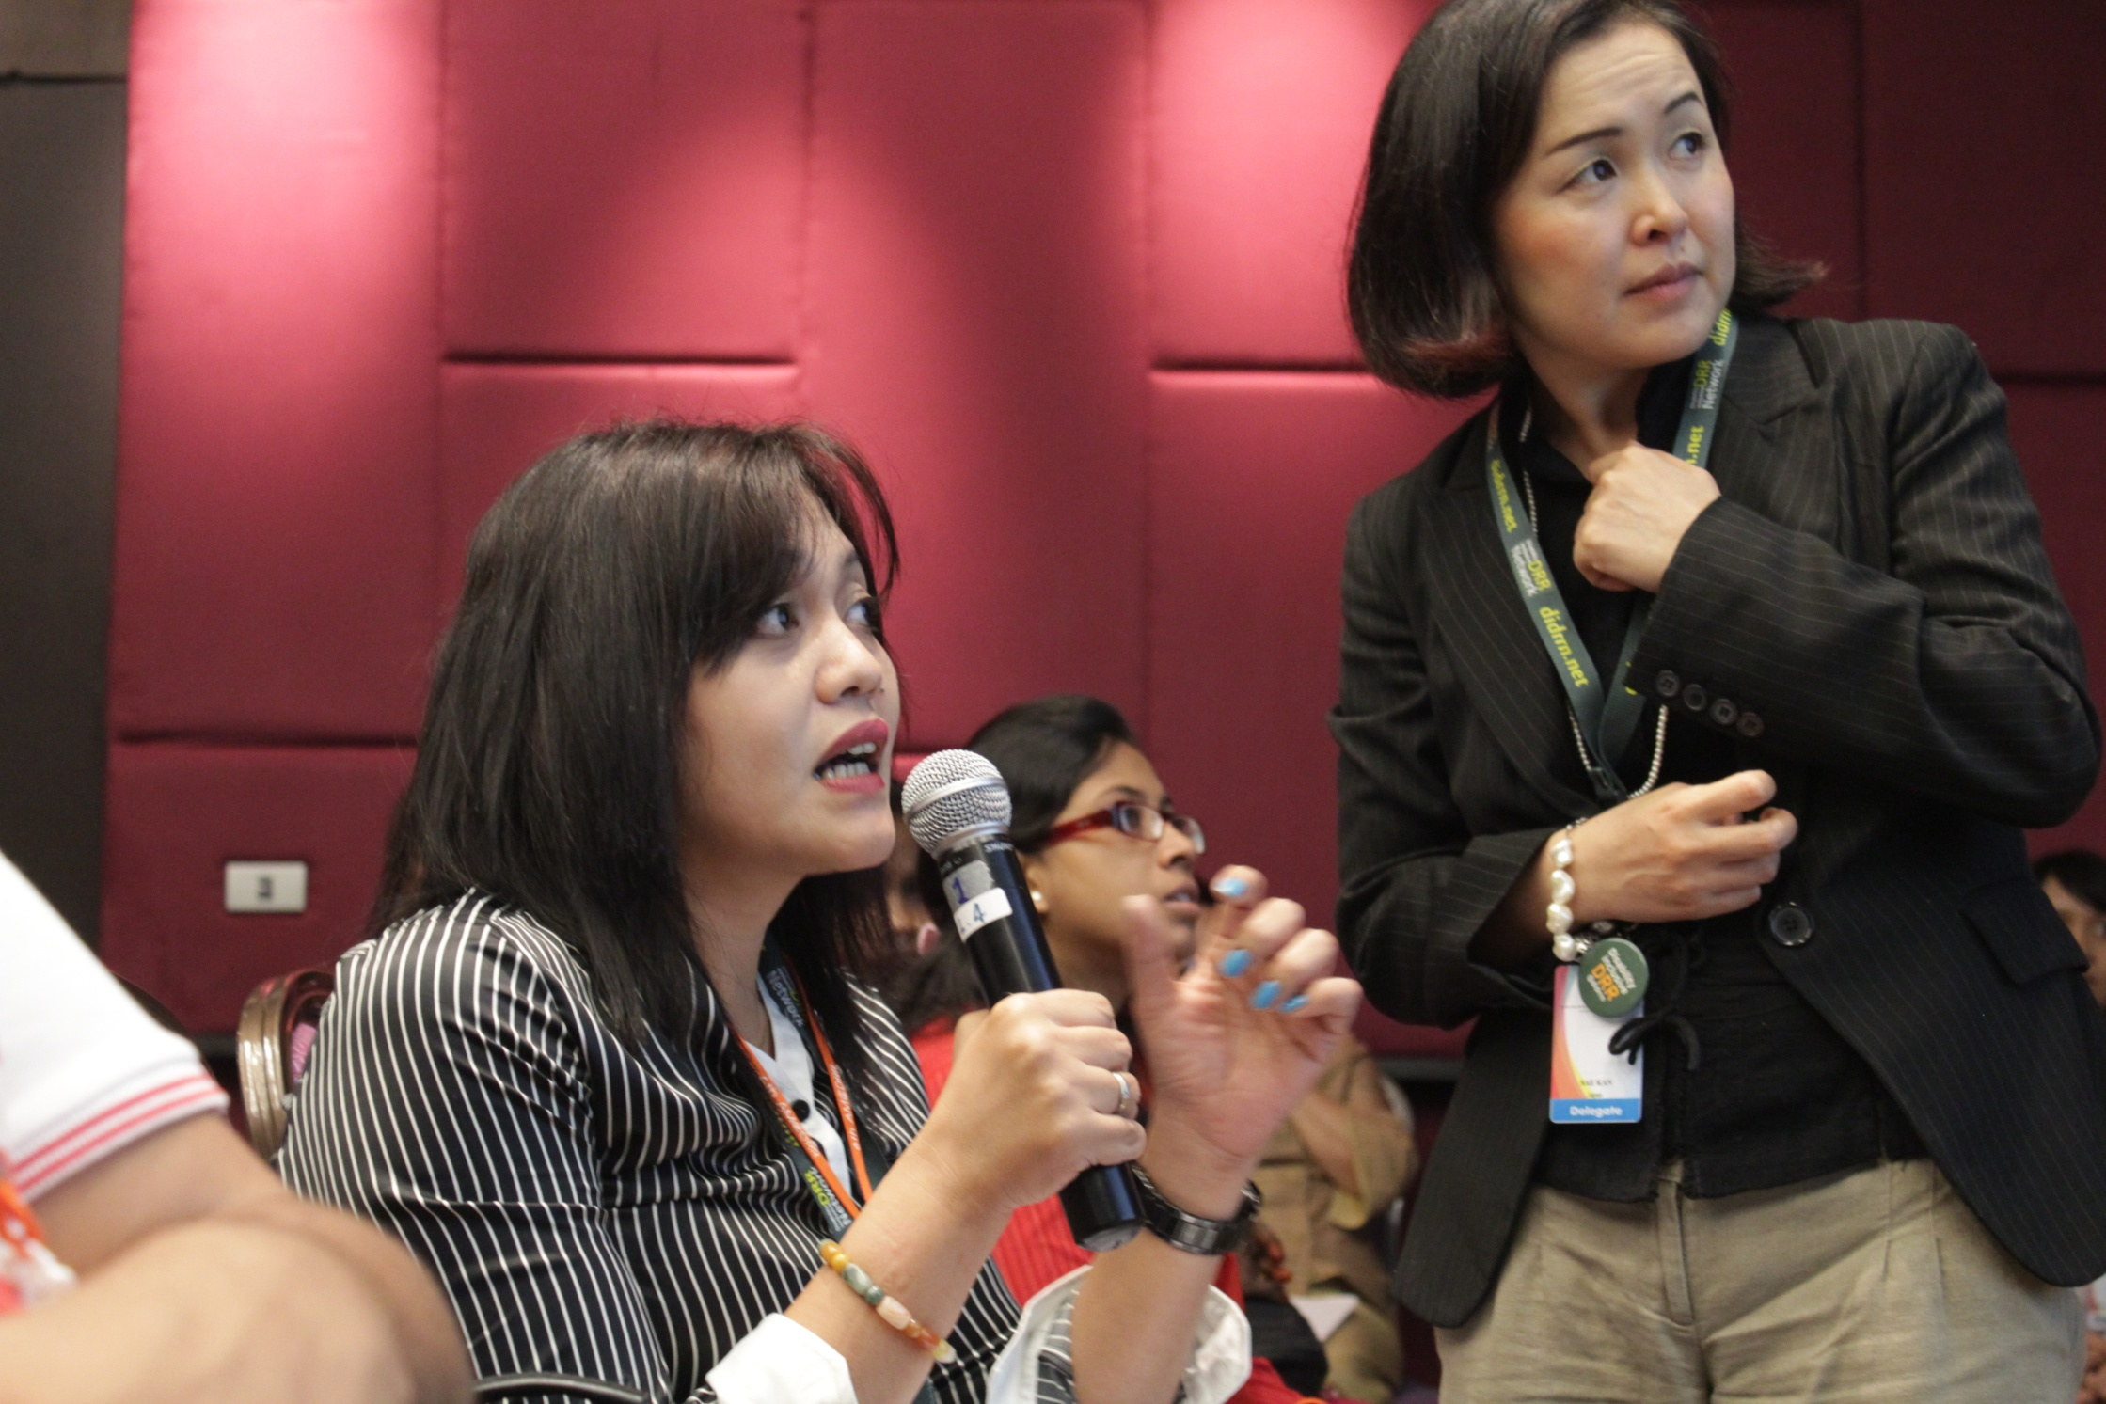
Copyrights ASB, 2014
Ms Yustisia, a woman with disability, 6th AMCDRR, Bangkok

Slide 25
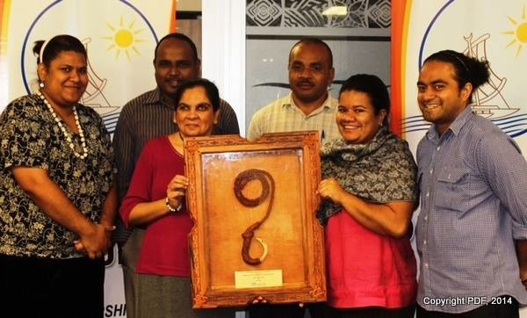
Pacific Disability Forum recipients of the Inaugural Pacific Award for Disaster Innovation and Leadership for Resilience (PILAR)

Slide 26
Videos

Slide 27
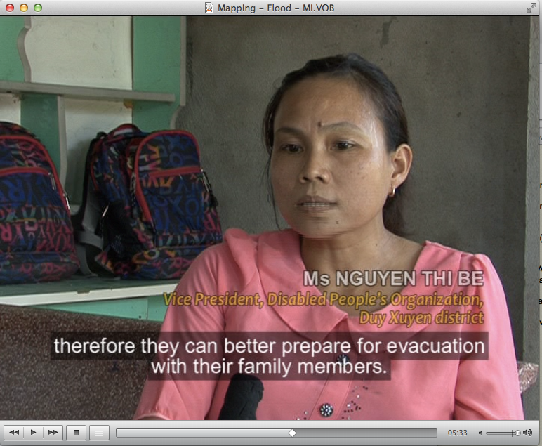
Short video on disability-inclusive community-based disaster risk management in Vietnam.
Video can be found here

Slide 28
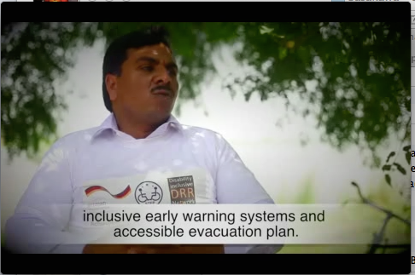
Short video on inclusive and resilient communities, Pakistan
Video can be found here

Slide 29
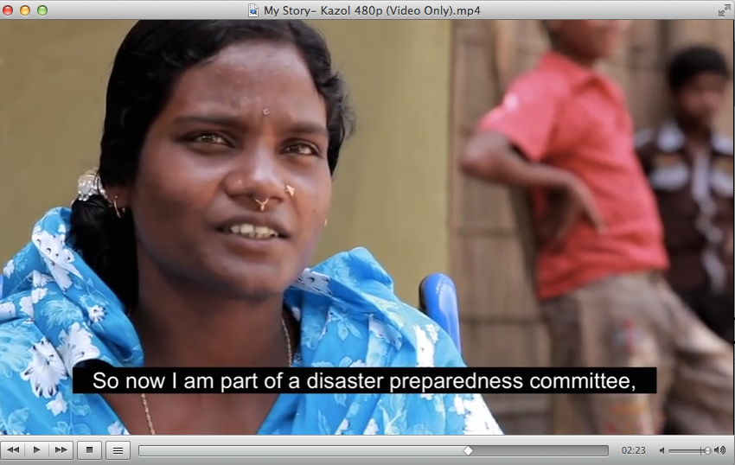
Short video with Ms Kajol Rekha on contributing to DRR in her village in Bangladesh
Video can be found here

Slide 30
Short video from Thailand on ASEAN Day for Disaster Prevention and Mitigation.
Video can be found here

Slide 31
Documents

Slide 32
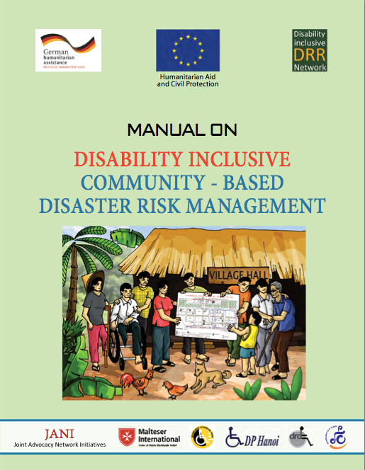
Practical manual on how to include people with disabilities in CBDRM, Malteser International/DiDRRN.
Document can be found here

Slide 33
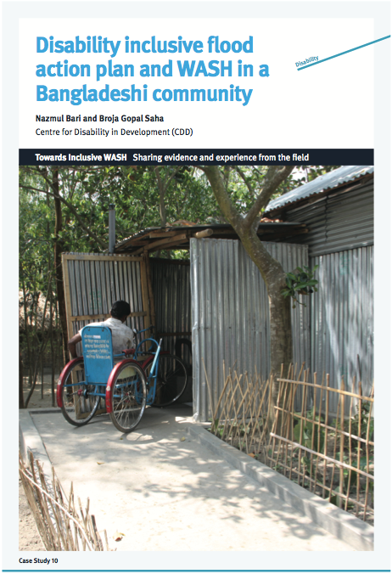
Evidence and experiences from inclusive disaster preparedness and improved water and sanitation access for persons with disabilities, Centre for Disability in Development/DiDRRN.
Document can be found here

Slide 34
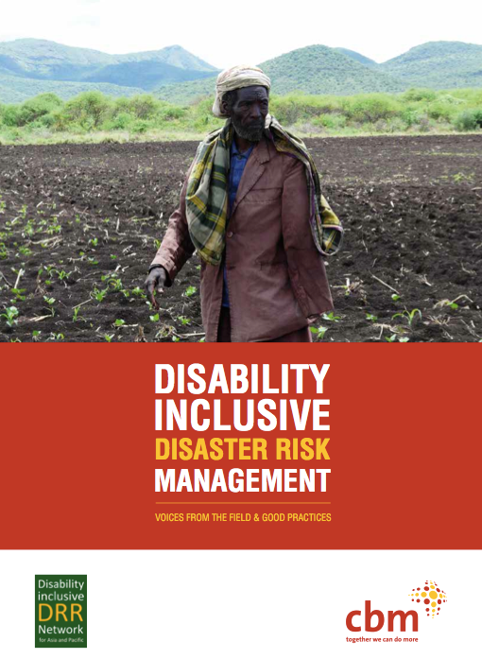
Collection of good practices from the Disability-inclusive DRR Network (DiDRRN), CBM/DiDRRN.
Document can be found here

Slide 35
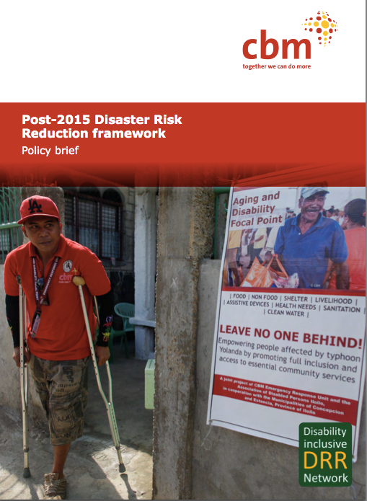
Policy brief on recommendations for the post-2015 framework for Disaster Risk Reduction (DRR) to ensure the inclusion of persons with disabilities, CBM/DiDRRN.
Document can be found here

Slide 36
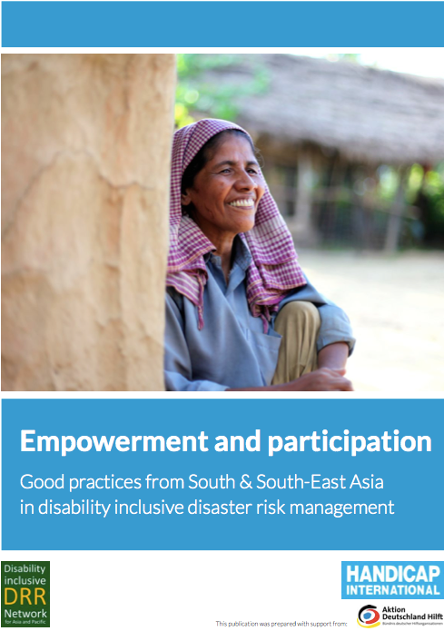
Collection of good practices from Asia on disability-inclusive disaster risk management, HI/DiDRRN
Document can be found here

Slide 37
Collection of “Most Significant Change” stories from persons with disability involved in CBDRM, Malteser International/DiDRRN.
Document can be found here

Slide 38
www.didrrn.net
DiDRRN
@didrrn

