Slide 1
Resilient Cities: Disaster Risk Reduction in an Urbanizing World
ECOSOC Humanitarian Affair Segment Side Event.
The City of Tijuana Experience
Presented by:
Antonio Rosquillas
CIVIL PROTECTION OFFICE DIRECTOR
CITY OF TIJUANA, MAJOR OFFICE.

Slide 2
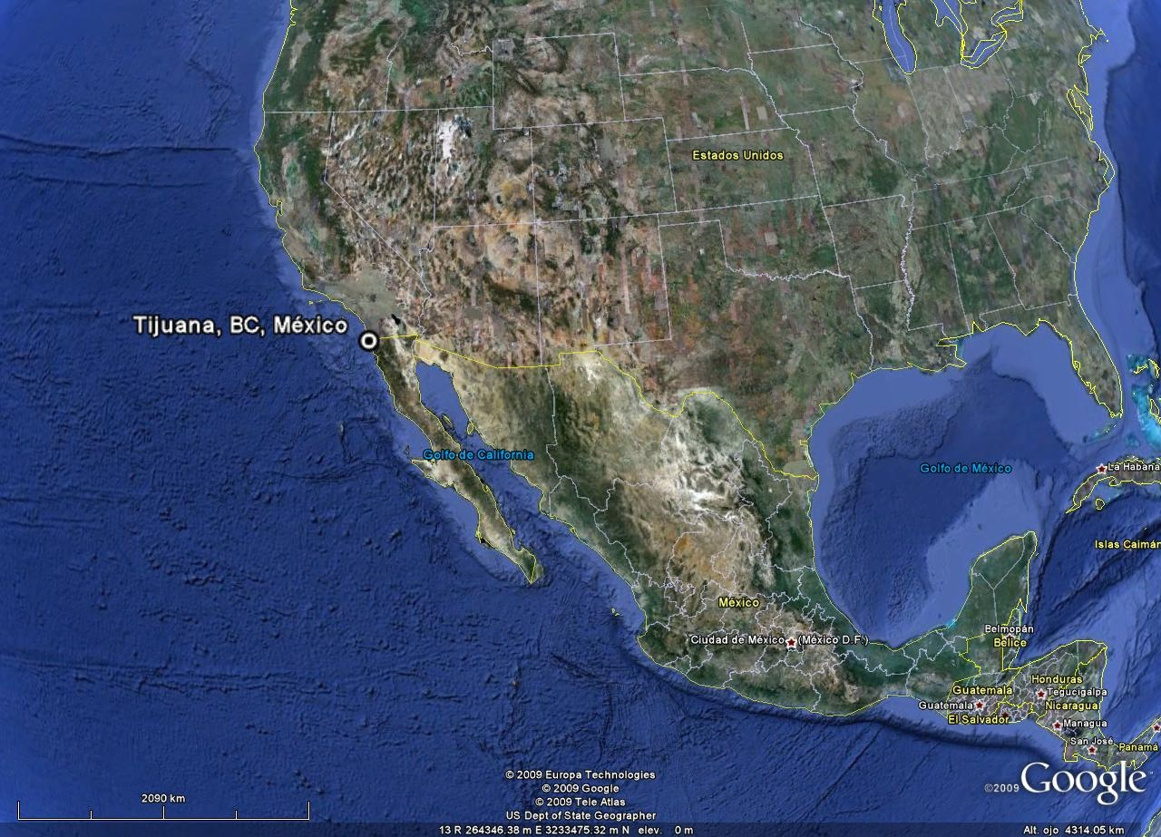
Location of City of Tijuana

Slide 3
Tijuana Urban Scenario
A 120 plus year old City.
Today, 1.8 million population…and growing.
Fast Urban Growth (5.5%) without considering the Earthquake phenomenon.
Mostly Soft Soils (unstable slopes).
Surrounded by earthquake faults.
No experience as a City, in earthquakes.
Semidesertic climate.
Sporadic periods of Torrential Rains.

Slide 4
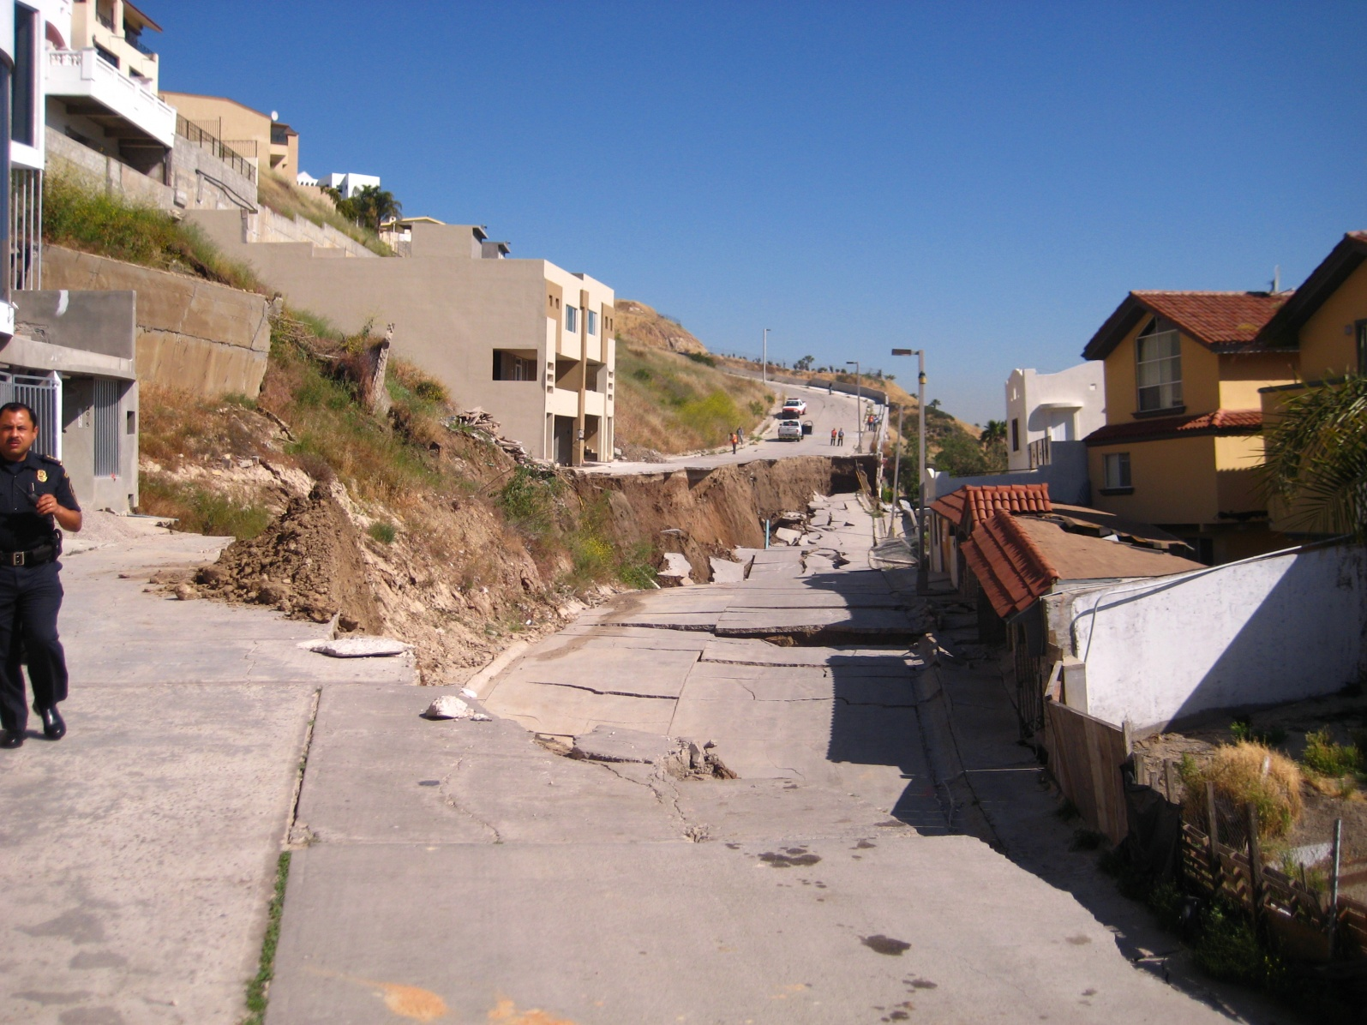
The last Land Slide occurred in may 2010

Slide 5
Earthquake activity since 1850’s

Slide 6
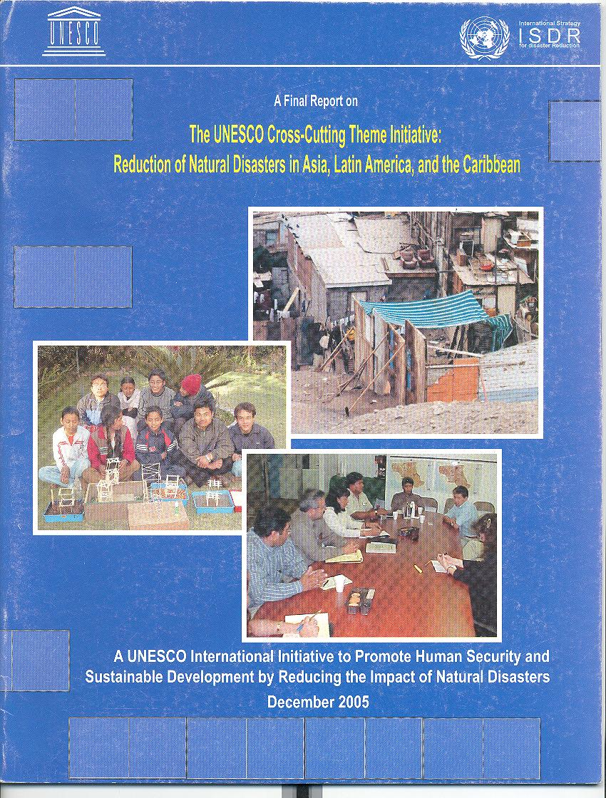
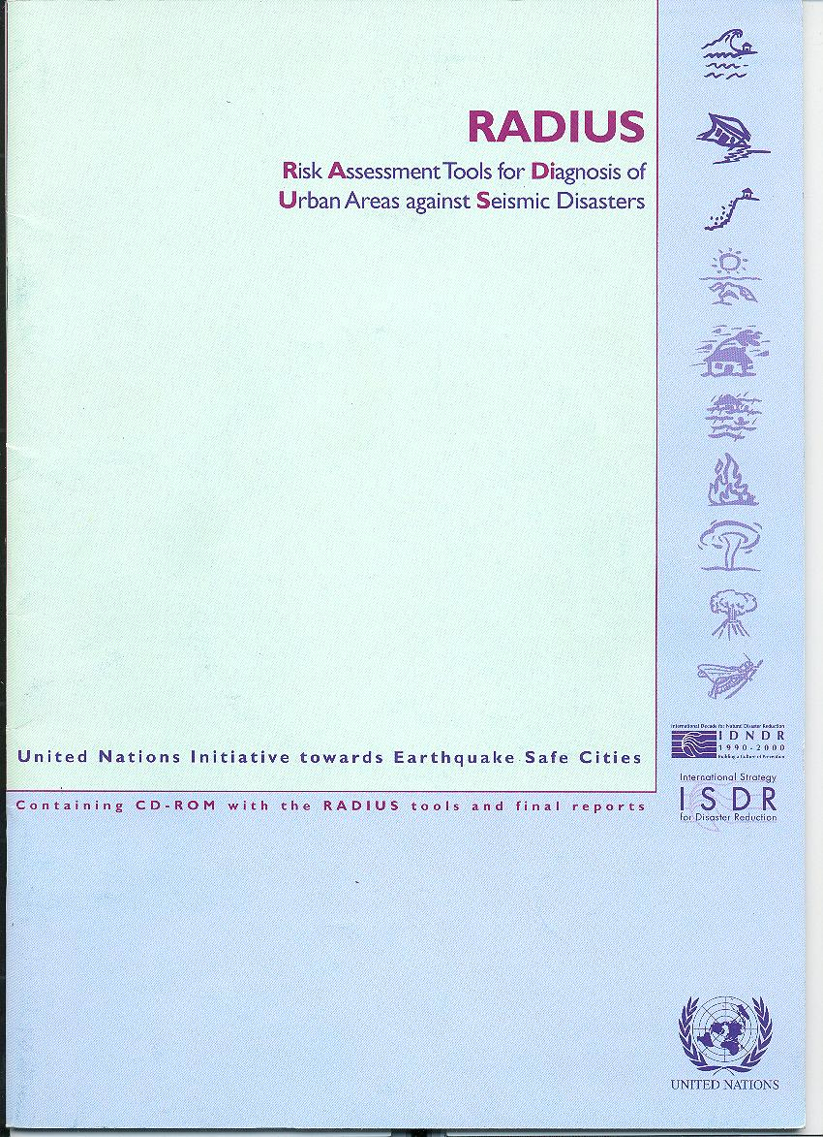

Slide 7
City Level Earthquake Preparedness Activities
1998-1999 IDNDR RADIUS Project.
2000 Founding of the Tijuana RADIUS Group.
2000-2001 GESI Project (Global Earthquake Safety Initiative) with GeoHazards International and the UNCRD.
2004 UNESCO Project (Cross Cutting Theme Initiative, Reduction of Natural Disasters in Asia, Latin America and the Caribbean.
2008 Finish of the City of Tijuana Seismic Microzonation Study.
2008-2009 “Strategic Plan for Emergency Shelters in Tijuana”: UNHabitat, IFRCC, UNDP, and GRIP Project.
Next Tuesday the 115th Tijuana Radius meeting.

