Slide 1
Climate change adaptation from the NPs and HFA focal points perspective
Dag Olav Høgvold
Directorate for Civil Protection and Emergency Planning, Norway
HFA focal point / Norwegian Climate Adaptation Programme

Slide 2
Past, present and future climate
  A very brief introduction
Notes:
Climate change has already started processes that will continue for a long time.

Slide 3
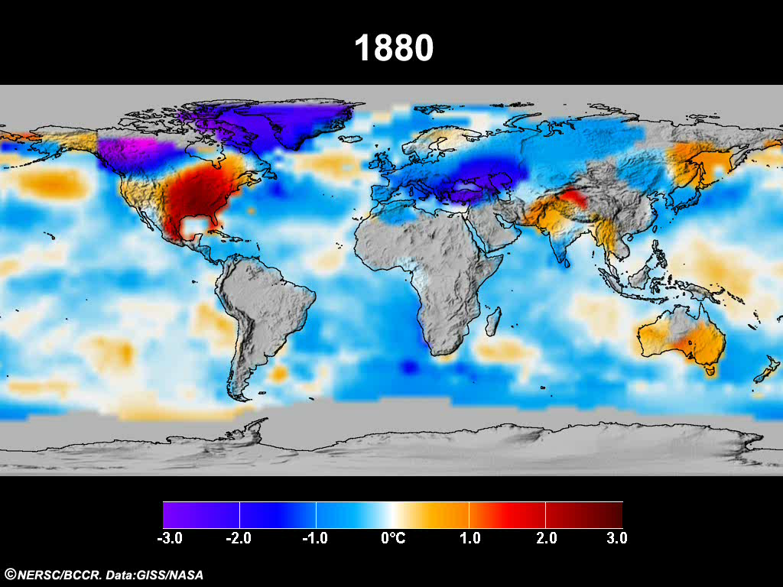
Notes:
3
Animation can be found at http://www.bjerknes.uib.no/
Shows observed changes in annual mean temperature 1881-2008, compared with present ’normal’ (1960-1990). Blue/purple colours indicate temperatures below normal, yellow/red indicate temperatures above normal. (-3 to + 3 degrees celsius)

Slide 4
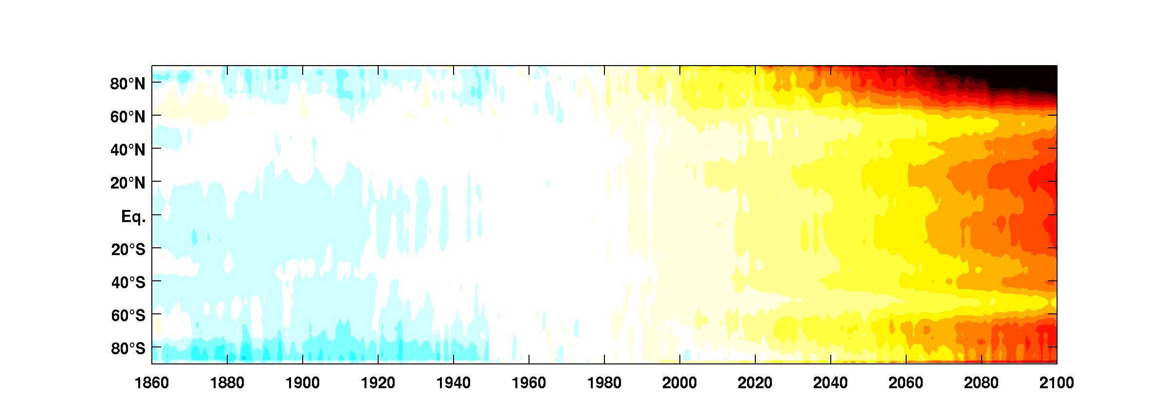
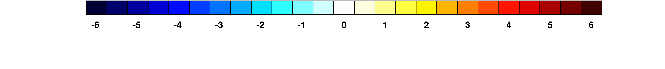
Today
(Ensemble Mean IPCC 4AR, Scenario A2)
Notes:
Illustration showing a static picture of the animation. Equator in the middle, north and south pole at the top/bottom. Observed temperatures.

Slide 5
Today
3.2 mill years
(Ensemble Mean IPCC 4AR, Scenario A2)
Notes:
Projected temperature change by the year 2100, if we do not reduce climate gas emissions.
Within 2100: Warmest climate in 3.2 million years. Most rapid climate change in mankind.

Slide 6
Some challenges from a Norwegian/Northern European perspective
Notes:
Climate change has already started processes that will continue for a long time.

Slide 7
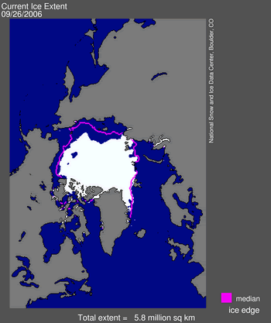
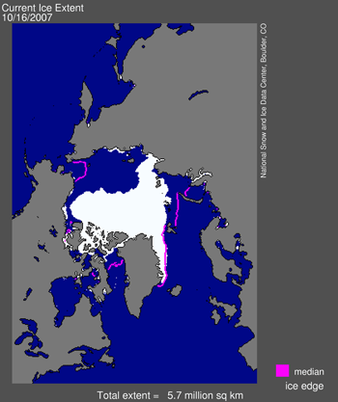
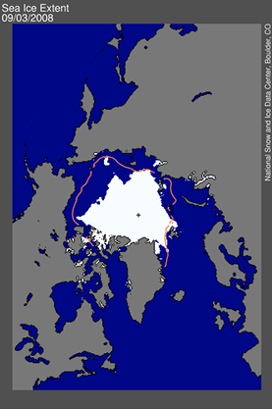
Melting of the Arctic ice
Serious damage to the Arctic ecosystem
Opens up for utilization of natural resources
New shipping routes
2006-min
2007-min
2008 pr. 3/9
Notes:
Arctic summer ice extent was at the lowest in 2007, three most extreme years in 2007, 2008, 2009.
Also: The thickness of the ice reduced by 60 per cent since 1970s.
Represents a serios threat to the ecosystems, as well as possible loss of livelihoods.
Other changes in the Arctic: Melting permafrost, causing unstable ground.
According to EU, the Arcic is one of the areas most vulnerable to climate change in Europe.

Slide 8
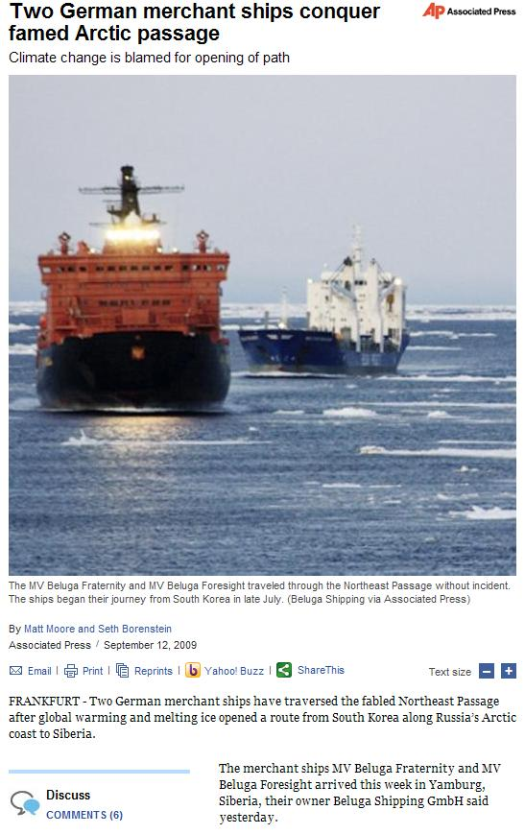
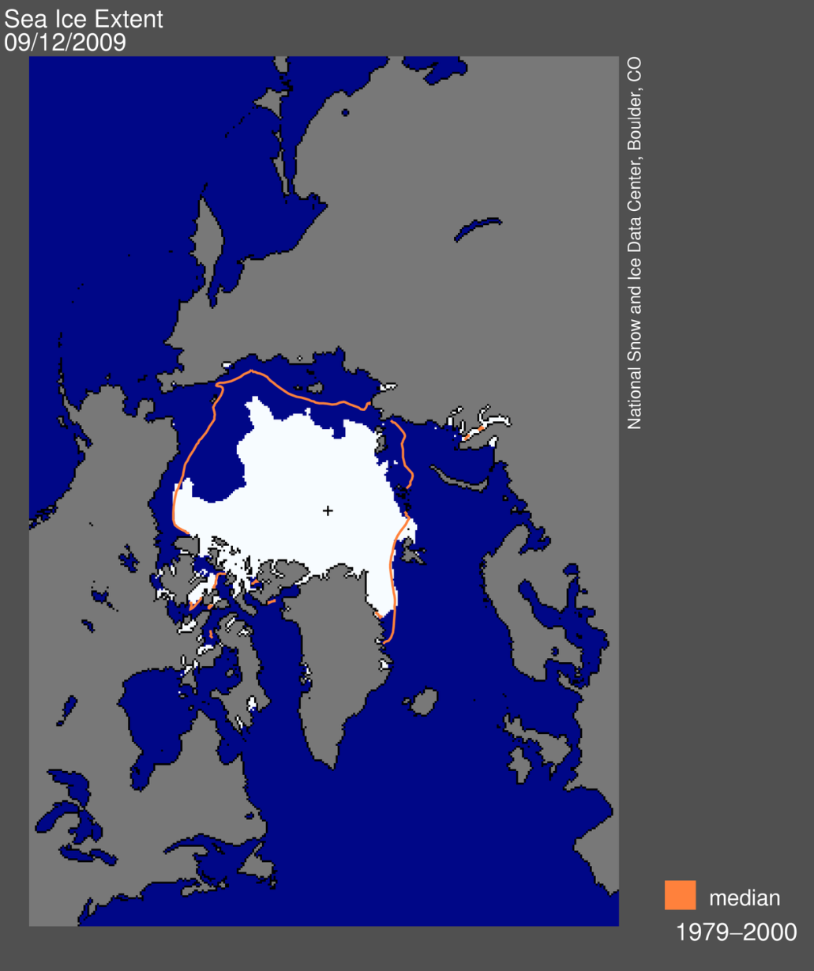
Notes:
Northeast passage was open summer 2009. Companies have started planning for regular ship traffic Europe-Asia from 2012.
Increased risk for accidents in a very vulnerable area.

Slide 9
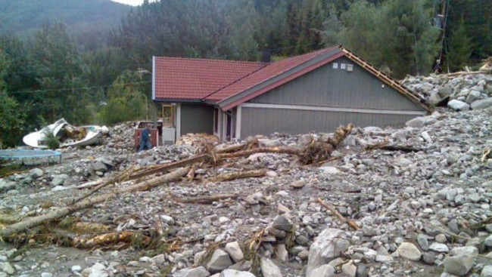
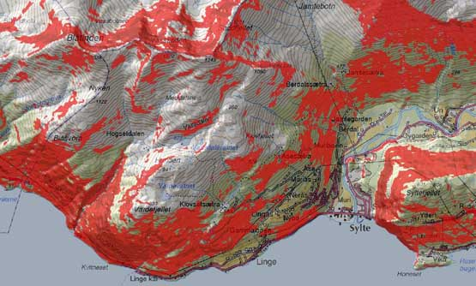
More frequent and heavier precipitation - consequences
Higher frequency of landslides and floods
New areas exposed
More unpredictible
Urban floods and insufficient drainage
Heavier rain will cause damage to buildings
Notes:
Hazard map from Western Norway: Red = more than 30 per cent incline.

Slide 10
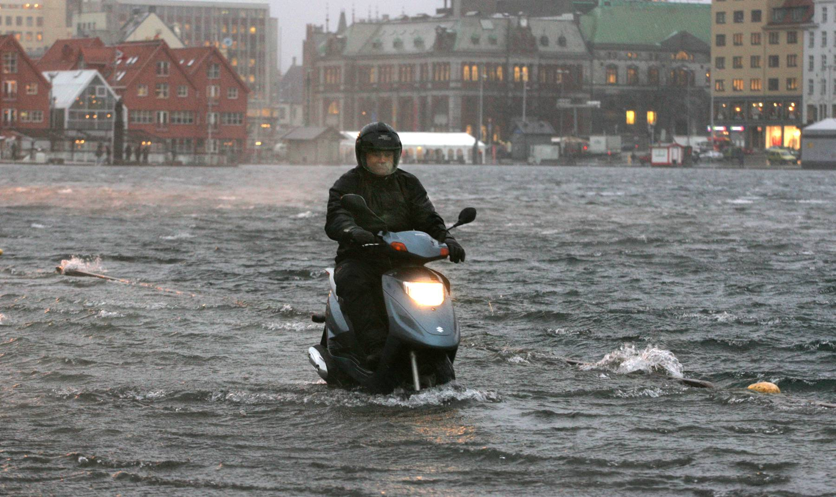
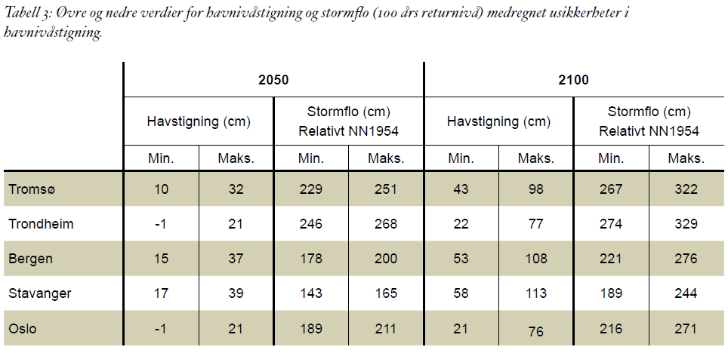
Rising sea level
Report first published October 2008
Shows expected sea levels 2050 and 2100 for all municipalities along the coast
Expected sea level varies according to land rise, ocean currents, and ocean temperature
Main challenge: How to use this knowledge?
Notes:
Table shows expected sea level rise (havstigning) by 2050 and 2100 as well as storm surge level (stormflo).
Numbers for storm surge include sea level rise.

Slide 11
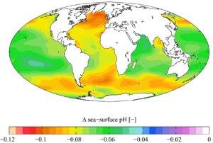
Ocean acidification
The ocean absorbs approximately one-fourth of the CO2 added to the atmosphere from human activities
Decreases the ability of many marine organisms to build their shells and skeletal structure
We don’t yet know the full impact for fisheries and coastal sector
Change in sea surface pH caused by anthropogenic CO₂ between the 1700s and the 1990s (Wikipedia)
Notes:
Ocean acidification may represent a larger threat to Europe than sea level rise.
Scientists have argued that ”Ocean acidification is to Europe what sea level rise is to the Pacific.”

Slide 12
Planning for the unknown – how to deal with the uncertainties?
  Planning can not be based on past experiences
  Climate projections are uncertain
Notes:
Climate change represents nothing new – but more of what we already have experienced.
Main challenge: Uncertainties.
Our best tool is climate projections, but they are uncertain and become more uncertain the more we downscale them to local level.

Slide 13
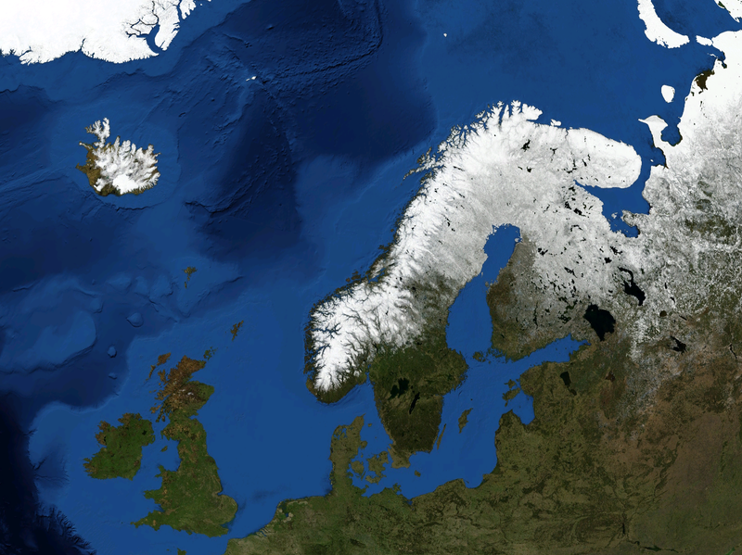
Dominant wind direction today
Tomorrow?
Notes:
Dominant wind direction in Northern Europe: From southwest.
In southern Norway: Mountain range lifts the humid air up to higher altitudes, this falls as rain in Western Norway. With only a small change in dominant wind direction: This mechanism will no longer be there, will give new precipitation patterns in Southern Norway.

Slide 14

Norwegian Climate Adaptation Programme
Established 2007
Interministerial committee
  Headed by Ministry of the Environment
  Secretariat: Directorate for Civil Protection and Emergency Planning (links DRR and CCA)
No changes in responsbilities – municipality/county levels
Provide knowledge, exchange of experiences, competence building
Notes:
To meet the challenges: Established Norw. Climate Adapt. Programme 2007.

Slide 15
Activities
Developed course in climate change adaptation for development/ emergency planners & decision-makers at local level
Research (funding / steering groups)
’Future Cities’ project – 13 largest municipalities (covers 50 per cent of total population)
Website launched March 2009
Handbook/planning tools to be developed by summer 2010
Official Norwegian Report (2009-2010)
Notes:
The secretariat develops various initiatives to serve local planners and decision-makers.
Also strong focus on national level: All ministries must present plans for CCA in the National Budget.

Slide 16
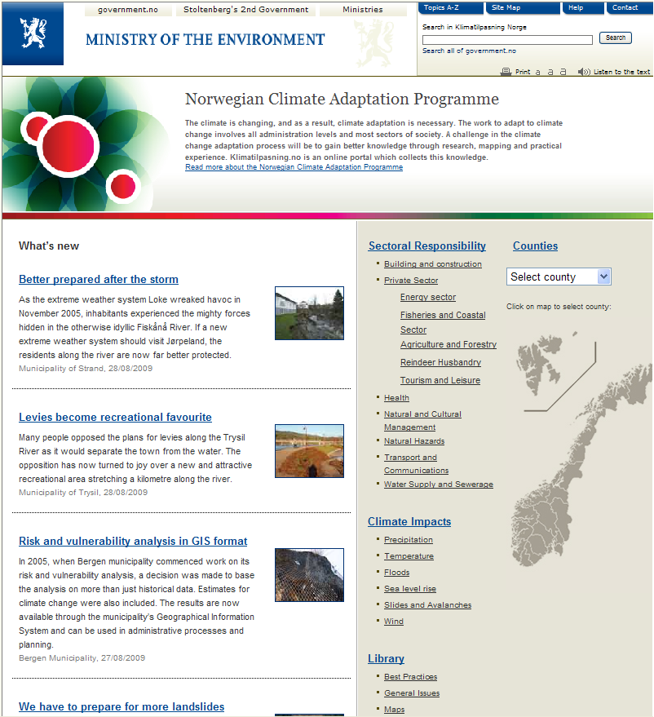
Website – klimatilpasning.no
Information sharing
Experiences
Best practices
Research
Specific issues
Target groups:
Local planners
Decision-makers
Municipality level
County level
Notes:
Website developed in cooperation with local planners.
Possible to find information according to geography, sectoral responsibility, climate impacts, as well as general information.
Cooperation with research community: Agreements with research institutions and other public institutions.
Web ’portal’ directing the user to the relevant information at other websites.

Slide 17
DRR in a changing climate
Climate projections: Knowledge – not answers
Must be combined with local knowledge
Awareness, culture
Responsibilities at local level, with support from national level
Long-term effects
Climate related hazards
Other hazards
Climate Change Adapt.
Disaster
Risk
Reduc-
tion
Integration into local development planning
Notes:
Both DRR and CCA rely heavily on research, but research must be supplemented with local knowledge.
Possible to take steps for DRR and CCA without knowing exactly what the future holds.
Make use of existing data, knowledge and experiences, instead of waiting for more projections.

Slide 18
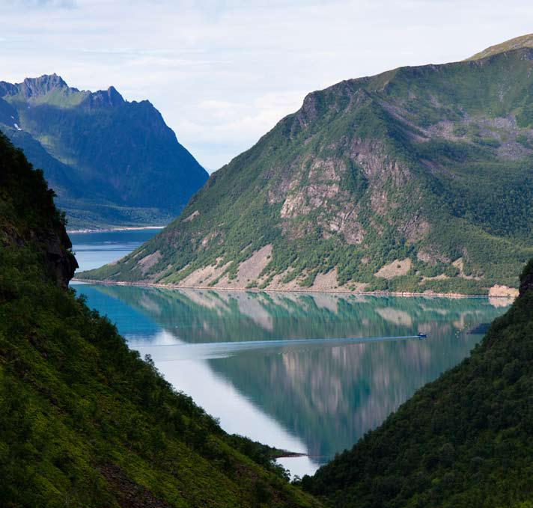
Thank you!

